Slide 1
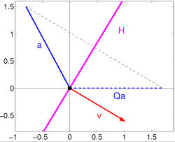
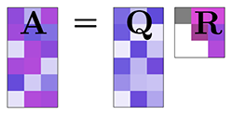
QR DECOMPOSITION
Group 20

Slide 2
What is QR Decomposition ?
QR decomposition is method to solve a set of simultaneous linear equations.
Also called a QR factorization
QR decomposition of a matrix is a decomposition of a matrix A into a product of an orthogonal matrix Q and an upper triangular matrix R
(A = QR)
[A] [X]= [C]
[Q] [R] [X]=[C]

Slide 3
What is an orthogonal matrix ?
A matrix Q is orthogonal if its transpose is equal to its inverse:
Q^{T}=Q⁻¹
which entails
Q^{T}Q = QQ^{T} = I
where I is the identity matrix.

Slide 4
Deriving the orthogonal matrix
Mainly There are 2 methods for calculate Q(orthogonal matrix)
1. Gram–Schmidt process
2. Householder reflections Method

Slide 5
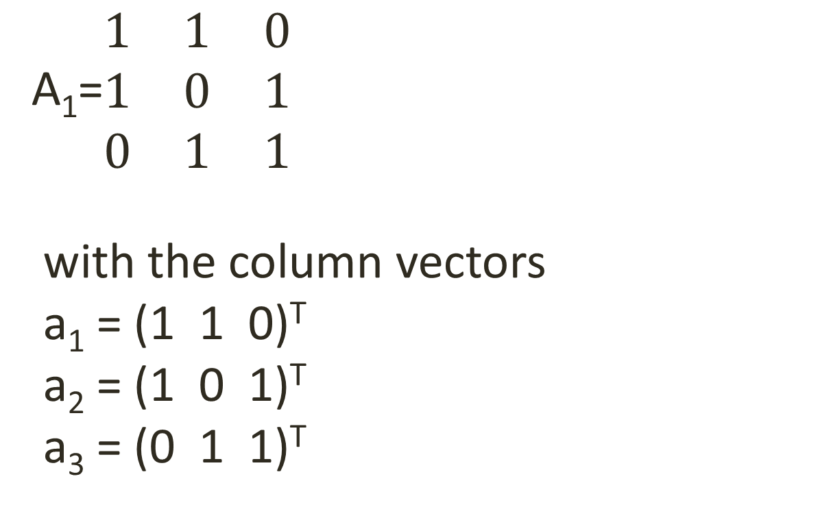
Gram–Schmidt process
A₁=$\begin{matrix}1 & 1 & 0 \\ 1 & 0 & 1 \\ 0 & 1 & 1\end{matrix}$
with the column vectors
a₁ = (1 1 0)^{T}
a₂ = (1 0 1)^{T}
a₃ = (0 1 1)^{T}

Slide 6
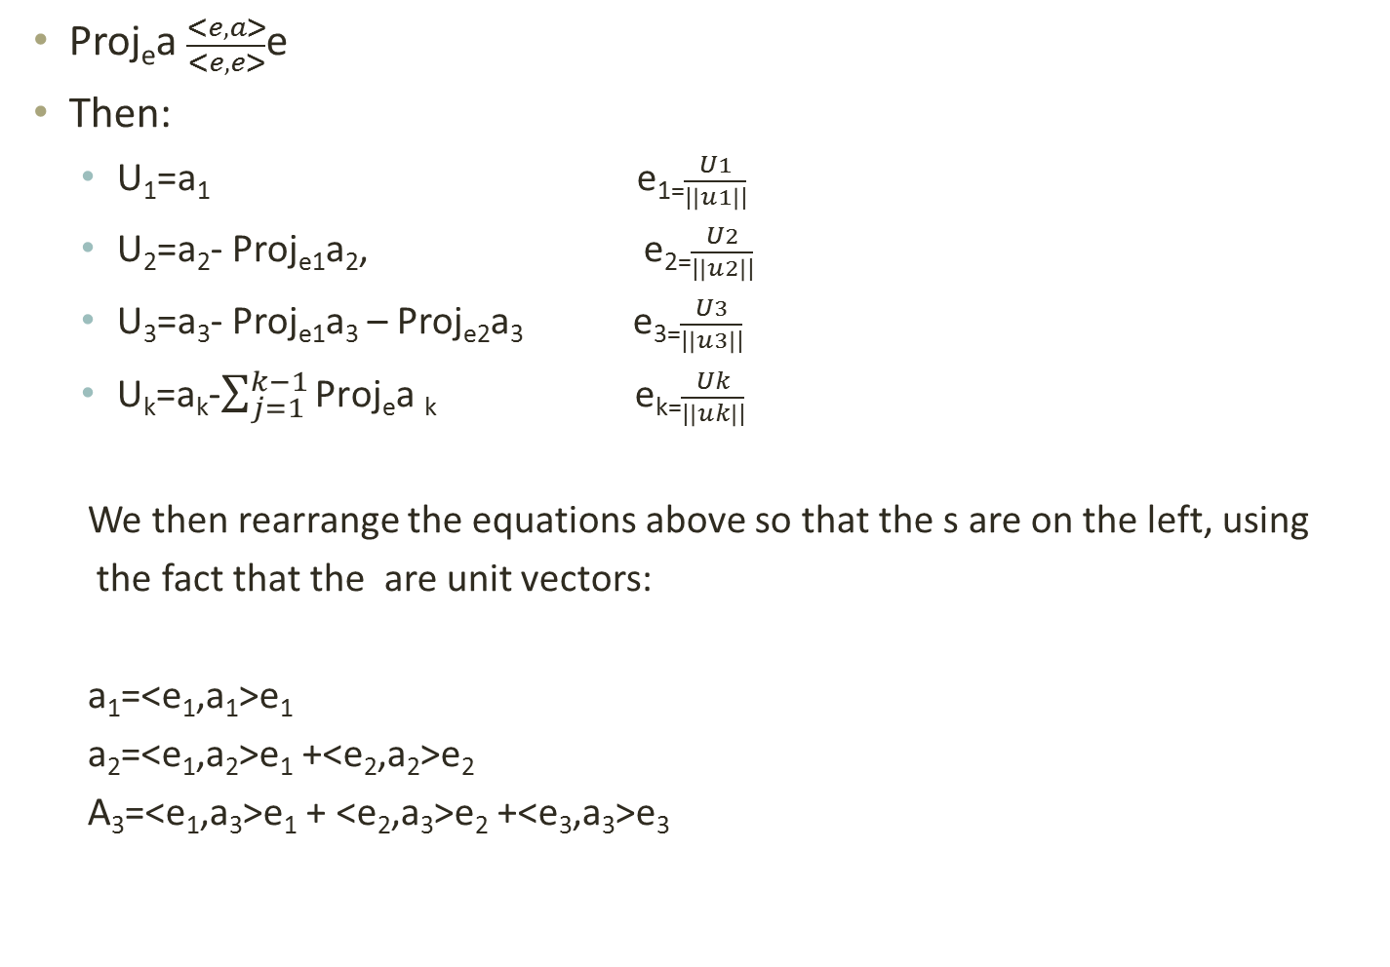
Proj_{e}a $\frac{<e,a>}{<e,e>}$e
Then:
U₁=a₁ e₁₌$\frac{U1}{|\left|u1\right||}$
U₂=a₂- Proj_{e1}a₂, e₂₌$\frac{U2}{|\left|u2\right||}$
U₃=a₃- Proj_{e1}a₃ – Proj_{e2}a₃ e₃₌$\frac{U3}{|\left|u3\right||}$
U_{k}=a_{k}-$\sum_{j=1}^{k−1}{\text{Proj}\text{e}\text{a} \text{k} }$ e_{k=}$\frac{Uk}{|\left|uk\right||}$
We then rearrange the equations above so that the s are on the left, using
the fact that the are unit vectors:
a₁=<e₁,a₁>e₁
a₂=<e₁,a₂>e₁ +<e₂,a₂>e₂
A₃=<e₁,a₃>e₁ + <e₂,a₃>e₂ +<e₃,a₃>e₃

Slide 7
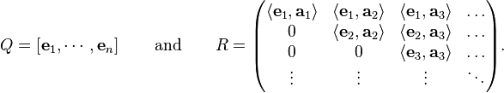
This can be written in matrix form:
A=QR
Where:

Slide 8
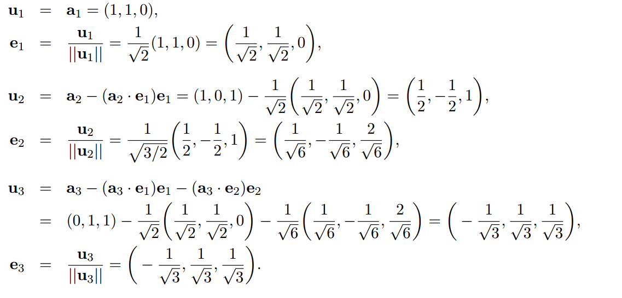

Slide 9
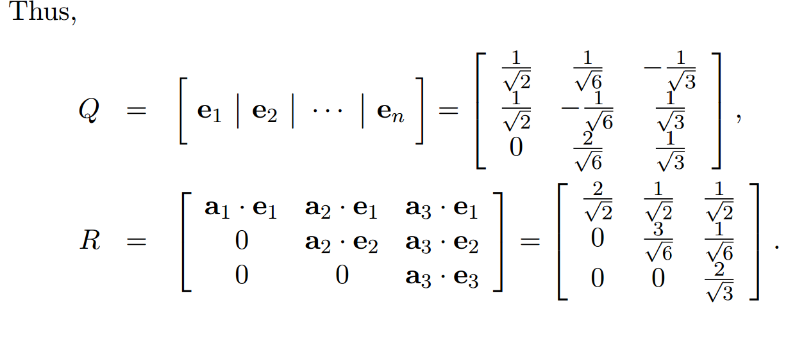

Slide 10
Procedure
If solving a set of linear equations [A][X] = [C]
If [A] = [Q][R] then [Q] [R] [X ] = [C]
Multiply by [Q]⁻¹ [Q]-1 [Q] [R] [X] =[C] [Q]-1
Which gives
[Q]-1 [Q] =I So, I [R] [X] =[C] [Q]-1
[R] [X] =[C] [Q]-1

Slide 11
Convergence of QR
Convergence theorem for basic QR iteration
Theorem 1
Let y € G L_{n}(R) such that the moduli of the eigenvalues
|λ₁|, | λ₂ |……|λ_{n}| (>0).
Let A=Y⁻¹ DY where
D:=diag(λ_{1,…….,}λ_{n}).
Suppose Y=LU, where L is unit lower triangular and U is upper triangular
The strictly lower triangular part of A^{(k)} converges to zero
The diagonal part of A^{(k)} converge to D in O(t^{k}),where,
t:max{|λ₂/λ₂|,…..|λ_{n}/λ_{n-1}|}<1

Slide 12
Convergence cont..
The upper triangular entries may fail to converge
Under the assumption of the above theorem , all eigenvalues are real.
So basic QR iteration inefficient because slow convergence in general

Slide 13
Accelerate the convergence of QR Iteration
Eigenvalues of A-μI are λ₁-μ,… λ_{n}-μ.
Introduce shift to accelerate the convergence:
A^{(k-1)} –μ^{(k)}I = Q^{(k)} R^{(k)}
A^{(k-)} = R^{(k)} Q^{(k)}+ μ^{(k)} I
A^{(k)} =(Q^{(k)})^{T} A^{k-1} Q^{K}=(Q^{(1)……..} Q^{(k)})^{T} A (Q⁽¹⁾………Q^{(k)} )

Slide 14
Accelerate the convergence of QR Iteration cont.…
Rayleigh quotient shift
μ^{(k)} = (q _{n} ^{(k)} )^{T} A q k _{n}^{(k)} /(q _{n}^{(k)})^{T} q _{n}^{(k)} =(q _{n}^{(k)} ) A q_{n}^{(k)}
where q _{n}^{(k)} is the last column of Q⁽¹⁾……….Q^{(k)} .
In fact
the (n ,n ) entry of A^{(k)}
The convergence of a _{n , n}^{(k)} → 0 is quadratic in sense
|a_{n,n-1,}^{(k+1)}| / || A ||₂ = O(η_{k}²)
where |a_{n,n-1}^{(k)}|/|| A ||₂ = η_{k} < 1 for some k.
In practice a_{n,n-1}^{(k)} is set to zero if
|a_{n,n-1}^{(k)}| <=ε(|a_{n,n-1}^{(k)}| + |a_{n , n}^{(k)}|), k>=0
For prescribed of the order of u.

Slide 15
Accelerate the convergence of QR Iteration cont.….
This can implement using MATLAB
QR iteration with single shift
toll=tolerance ε, itmax = max admissible number of iterations
function [T,iter]=qrshift(A,toll,itmax)
n=max(size(A));
iter=0;
[T,Q]=houshess(A);
for k=n:-1:2

Slide 16
Accelerate the convergence of QR Iteration cont.…..
I=eye(k);
while abs(T(k,k-1)) > toll*(abs(T(k,k))+abs(T(k-1,k-1)))
iter=iter+1;
if (iter > itmax),
return
end

Slide 17
Accelerate the convergence of QR Iteration cont.
mu=T(k,k);
[Q,R,c,s]=qrgivens(T(1:k,1:k)-mu*I);
T(1:k,1:k)=R*Q+mu*I;
end
(k,k-1)=0;
end
return

Slide 18
Accelerate the convergence of QR Iteration cont.…..
How ever shift complicate the convergence analysis
No one has been able to prove that the QR iterations with some specific evidently successful shifting strategy always converges

Slide 19
Special Cases of QR Decomposition
This is used in many terms of mathematics because this is numerically stable
This reduce hardware complexity
QR decomposition used to produce eigenvalue and eigenvector those are very important in engineering
This can be up- dated recursively with each new set of data
This performs lowest execution time

Slide 20
Possible real world Applications

Slide 21
Dimension Reduction in Data mining
The problem of dimension reduction has recently received broad attention in areas such as databases, data mining, machine learning, and information retrieval .
Efficient storage and retrieval of high-dimensional data is one of the central issues in database and data mining research

Slide 22
cont….
standard approach to overcome this problem is dimension reduction, which transforms the original high-dimensional data into a lower-dimensional space with limited loss of information.
Once the high-dimensional data is mapped into a low dimensional space, indexing techniques can be effectively applied to organize this low dimensional space and facilitate efficient retrieval of data .
A further advantage of such dimension reduction is that it can improve data quality through the removal of noise

Slide 23

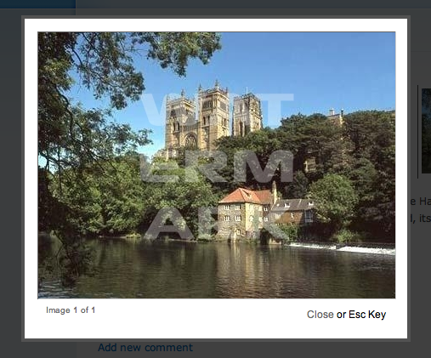


Slide 24
Blind Double Color Image Watermarking Algorithm
A blind double color image watermarking algorithm based on QR decomposition
Novel blind image watermarking scheme based on QR decomposition is proposed to embed
Color watermark image into color host image,
Embedding watermark
The 24-bits color host image with size of 512?×?512 is divided into non-overlapping 4×4 pixel blocks and
Each pixel block is decomposed by QR.

Slide 25
Scenario with a worked Example
Temperature Distribution

Slide 26
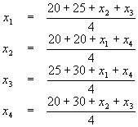
20
we have the following system of linear equations:
x1
x2
25
20
x3
x4
30

Slide 27


which after simplification gives:
The matrix form of the system is AX=b, where

Slide 28
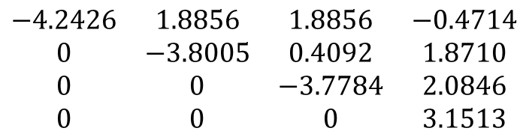
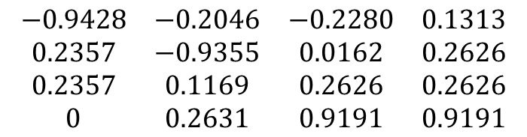
$$\begin{matrix}−0.9428 & −0.2046 & −0.2280 & 0.1313 \\ 0.2357 & −0.9355 & 0.0162 & 0.2626 \\ 0.2357 & 0.1169 & 0.2626 & 0.2626 \\ 0 & 0.2631 & 0.9191 & 0.9191\end{matrix}$$
Q =
$$\begin{matrix}−4.2426 & 1.8856 & 1.8856 & −0.4714 \\ 0 & −3.8005 & 0.4092 & 1.8710 \\ 0 & 0 & −3.7784 & 2.0846 \\ 0 & 0 & 0 & 3.1513\end{matrix}$$
R =
When the QR decomposition has been done Ax = b can be solved as follows:
Ax = b
QRx =b
First the system can be solved for z as follows:
Qz = b
Then the system can be solved for x as follows:
Rx = z

Slide 29

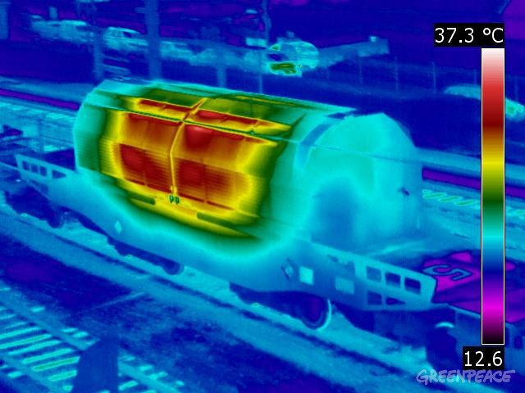
Answer …
X1 = 23.125
X2 = 21.875
X3 = 25.625
X4 = 24.375

Slide 30
Comparison of QR Algorithm with Other Algorithms

Slide 31
Mainly three algorithms
LU Decomposition
QR Decomposition
Singular value decomposition

Slide 32
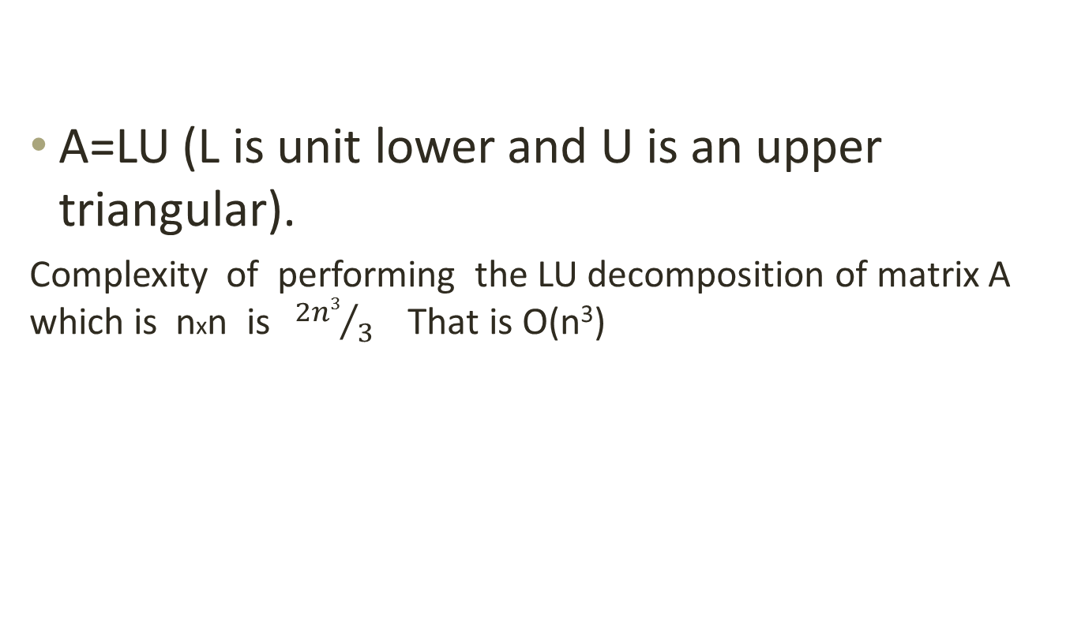
LU Decomposition
A=LU (L is unit lower and U is an upper triangular).
Complexity of performing the LU decomposition of matrix A which is nxn is ${2n3}/3$ That is O(n³)

Slide 33
QR Decomposition
Graham Schmidt method is more efficient than the other two methods.
Number of operations are in k^{th} step as followed
Multiplications = 2(n-k+1)²
Additions = (n-k+1)² +(n-k+1)(n-k+1)(n-k)+2
Divisions=1
Square root=1
Over n-1 steps , the complexity =O(n³)

Slide 34
Singular value decomposition(SVD)
In the first step matrix reduce for bi-diagonal matrix .It is about O(mn ²) (m>n).
In second step compute the SVD of bidiagonal matrix. This is O(n) order complexity

Slide 35
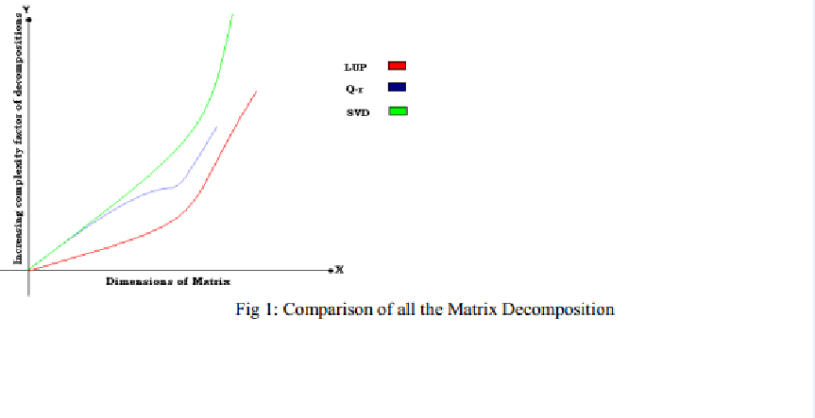
The graph below shows the comparison of three decompositions

Slide 36
Extra works
Software demo with a Special functions and scenario

Slide 37
Special scenario
Our software demo is mainly target practical scenario
“find the temperature distribution of a metal sphere“

Slide 38
Methodology
We keep some levels of spheres inside the main
Using basic physics of temperature distributions theorem, get a set of linear equations.
Set them into QR decomposition and get result.
Indicate result with a meaningful method

Slide 39
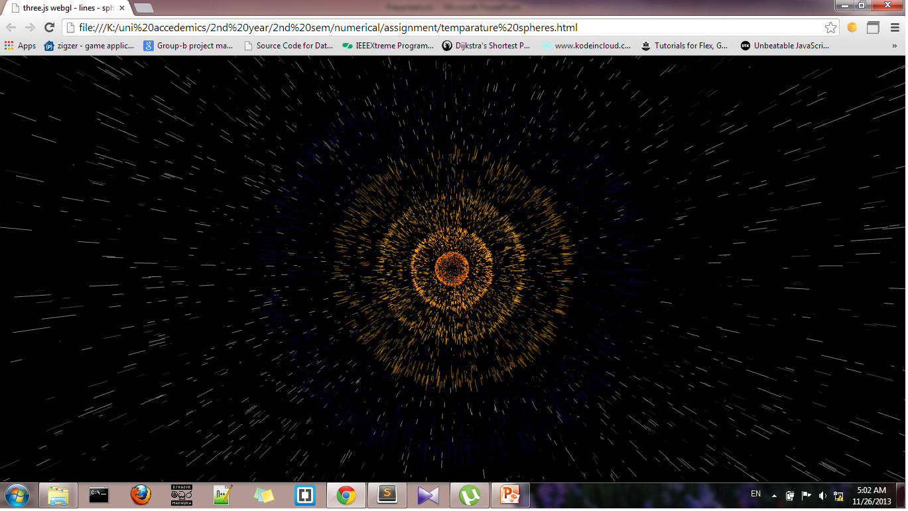
After implementation it may looks like..

Slide 40
Analyzing LU and QR decompositions
We set up some data set( smallest to highest )
Give all them separately to LU and QR decompositions and collect the running time of each one.
For representative purpose, create a graph including those data
It may be a good picture to show the best decomposition in runtime.

Slide 41
References for software demo
Use Web2py as main framework to create web project using python
Use Three.js as 3-D object creating framework
Use Highchart.js as graph creating library

Slide 42
References
Wikipedia / google /IEEE research papers
Research papers
Face recognition with QR decomposition http://www.cse.ust.hk/~csclchan/paper/dlda.pdf
http://www.math.ucla.edu/~yanovsky/Teaching/Math151B/handouts/GramSchmidt.pdf
https://inst.eecs.berkeley.edu/~ee127a/book/login/l_lineqs_solving.html

Slide 43








Slide 44


