Slide 1


Department of Computer Science and Engineering
AUTOMATED DEPRESSION PREDICTION USING NLP
Team Members Name / Register Number
ARCHANA K - 211419104016
SWETHA R - 211419104285
THARINI ABHINAYA S R - 211419104289
Guide Name & Designation
Dr.T.Tamilvizhi, M.E, Ph.D.
Associate Professor
Coordinator Name & Designation
Valarmathi K,M.E, Ph.D.
Associate Professor

Slide 2
Introduction
In the fast-paced modern world, psychological health issues like anxiety, depression and stress have become very common among the masses.The causes of depression can be complex, with contributing factors ranging from genetics to environment and psychology.
It is characterized by a persistent feeling of sadness, hopelessness, and low energy, often leading to a loss of interest in activities, difficulty sleeping, and changes in appetite.Machine learning Techniques are currently well suited for analysing the data and diagnosing the problem.
To address this problem, researchers have explored the use of machine learning algorithms to predict the likelihood of depression in individuals.
In this paper, predictions of depression was made using machine learning algorithms and NLP.

Slide 3
Objective of the Project
The objective of this project is to predict depression in individuals using Natural Language Processing (NLP) techniques.
NLP can be used to analyze various aspects of text, such as sentiment, tone, and word choice, to identify patterns that may indicate the presence of depression.
The project aims to develop a model that can accurately predict depression in individuals using their written text, such as social media posts or chat messages.
The model can be used to assist mental health professionals in identifying individuals who may be at risk of depression and provide them with appropriate care and support.

Slide 4
Literature Survey
TITLE | AURTHOR | YEAR | DESCRIPTION | ADVANTAGES | DISADVANTAGES
Single classifier vs. ensemble machine learning approaches for mental health prediction. | Jetli Chung and Jason Teo | 2023 | The survey consists of various questions regarding the respondents’ mental health and their opinion on mental health. The original raw data can be accessed on the OSMI website, and the data were covered by a Creative Commons Attribution License | Achieved the best performance in terms of accuracy. | Mandatory to have a medical practitioner
Designing a Tool to Address the Depression of Children During Online Education. | Asma Alwadei and Reem Alnanih | 2022 | Design thinking is a methodology that provides a solution-based approach to solving real problems. Through understanding the problem, defining and clarifying the problem, proposing the best idea to solve the problem, testing the prototype. | Helps the counselors discover students' mental health issues from the beginning stages. | The limited corporations to record videos from parents was one of an obstacle during this research.

Slide 5
TITLE | AURTHOR | YEAR | DESCRIPTION | ADVANTAGES | DISADVANTAGES
Journaling Data for Daily PHQ-2 Depression Prediction and Forecasting . | Alexander Kathan1, Andreas Triantafyllopoulos, Xiangheng He1, Manuel Milling and Tianhao Yan | 2022 | We experiment with four different regression models: a)XGBoost b)Support Vector Machines c) Random Forests, and d) Multilayer Perceptrons (MLPs).Each model comes with distinct associated hyper-parameters which is tuned using 3-fold nested-cross-validation on each train data set with non-disjoint subjects. | Actively-collected data can be promising to improve prediction models for PHQ scores in the future. | Minor fluctuations in results can be observed.
Mental Health: Detection & Diagnosis. | G. Parimala, R. Kayalvizhi and S. Nithiya | 2022 | Tested few Machine learning algorithms depending upon our parameters that we would be further using to test our model. Thereby, the algorithm giving the best accuracy has been used. | It is responsible for increasing decision tree accuracy by reducing overfitting. | It consumes a fairly large amount of computing power.

Slide 6
TITLE | AURTHOR | YEAR | DESCRIPTION | ADVANTAGES | DISADVANTAGES
The Impact of Mental Health due to Covid 19 – A Mental Health Detector Using Machine Learning. | B Anishfathim, B Sreenithi, S Trisha, J Swathi and M Sindhu Priya | 2022 | The following machine learning algorithms to predict the stress level during this quarantine. Modules: Acquisition of data. Pre-processing the data. 3. Splitting the Training and Testing Data. 4. Classification of data. 5. Analysis on the performance of the model. | Can find the level of stress using the collected dataset during this quarantine. | The limitations and issues of this method would be evident in case of raw data and more test cases.
Machine Learning Based Solutions for Real-Time Stress Monitoring. | Rajdeep Kumar Nath, Himanshu Thapliyal, Allison Caban-Holt and Saraju P. Mohanty | 2020 | They have used edge computing framework for real-time stress monitoring. The idea of edge computing is to migrate some of the computing capacity close to the end-point where data is collected also known as the edge. | Cost-efficient acute stress detection system. | Privacy issue is faced in this system.

Slide 7
Problem Statement
Depression is a mental health disorder that causes persistent feelings of sadness, hopelessness, and loss of interest in enjoyable activities.
The project aims to use NLP techniques to predict depression risk from textual data.
The model should be able to analyze the language used in text and identify patterns that are indicative of depression.
The ultimate goal is to create a tool that can be used by mental health professionals to quickly and accurately identify individuals who may require further evaluation and treatment for depression.

Slide 8
Existing System
In this study, an early detection framework based on ELECTROENCPHALOGRAM (EEG) data is developed for detecting common psychological issue leading to diseases such as depression, addiction, and heart attack.
In existing frameworks, signals are often segmented into smaller sections prior to being input to a deep neural network.
A multiclass classification framework termed MuLHiTA was developed for the early detection of mental stress.
This model effectively captured hierarchical temporal dependencies in intraslice and interslice regions of EEG signals using two complementary branches exhibiting attention mechanisms and BLSTM networks.

Slide 9
Proposed System
Proposed model is to build a machine learning model with NLP
The machine learning is generally build to tackle these type of complicated task. The machine learning can be used to classify the depression, by using the previous data and make them to understand the pattern and improve the accuracy of the model by adjusting parameters.
Different algorithms can be compared and the best model can be used for classification purpose.
Advantages
This system can be implemented in TELEMEDICINE.
Social Media Platforms – helps in analysing people’s mental health.
Deployed in a web browser, so that it retains the privacy of the patients.

Slide 10
Software / Hardware used
Software
Operating System
:Windows 10 or later
Tool
:Anaconda with
Jupyter Notebook
Hardware
Processor : Intel i3
Hard disk : minimum 80 GB
RAM : minimum 2 GB

Slide 11




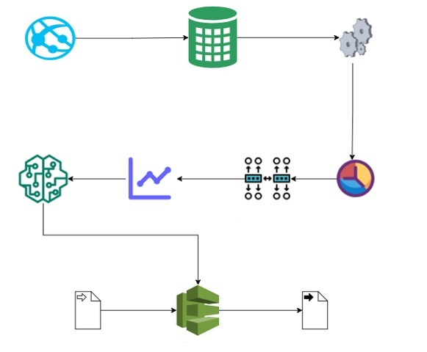


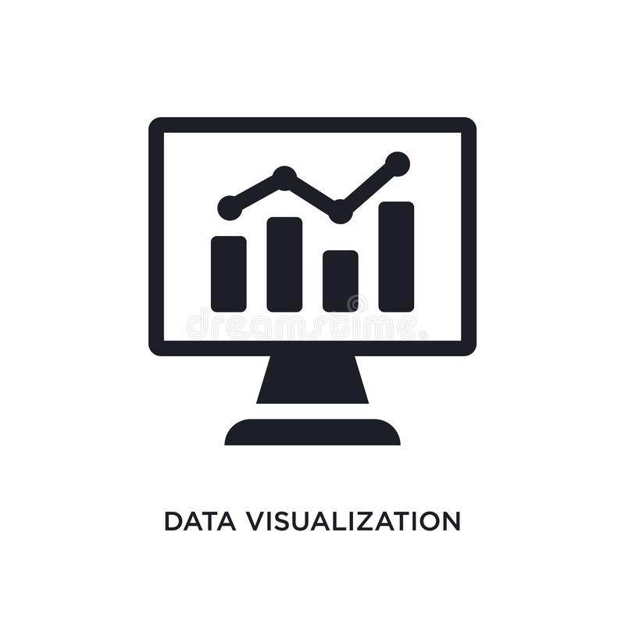



Architecture / Methodology used
Dataset
Preprocessing
Jupyter Notebook
Model
Accuracy
Algorithm
Implementation
Visualization
Deploy
Input
Output

Slide 12
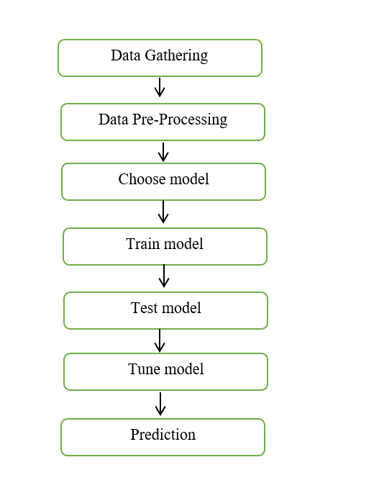
System Design - Flow Chart/DFD/ER
Dataflow Diagram

Slide 13
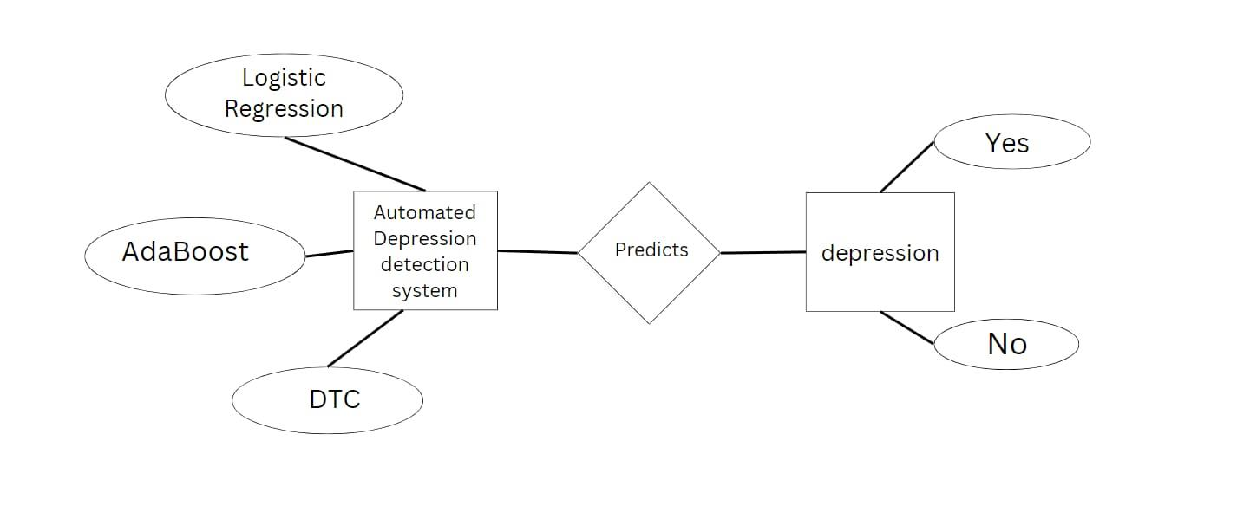
ER Diagram
System Design - Flow Chart/DFD/ER
Catboost classifier

Slide 14
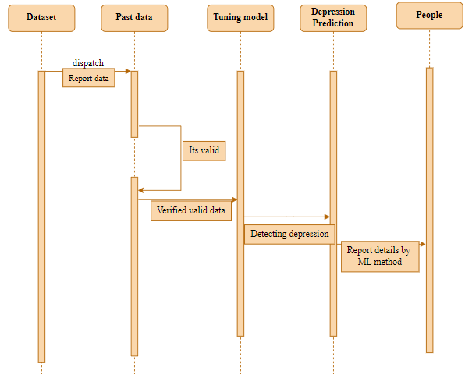
Sequence Diagram
System Design - Flow Chart/DFD/ER

Slide 15
Module Description
Data Pre-processing
Numpy and Pandas are commonly used Python libraries for data preparation and pre-processing. Numpy is used for mathematicaloperations and handling multi-dimensional arrays, while Pandas is used for data manipulation and analysis.
Together, they provide a powerful toolkit for cleaning, transforming, and restructuring data before it is used for machine learning or other data analysis tasks. It involves transforming the data into a format that can be easily understood and processed by the algorithm.

Slide 16
Module Description(Contd..)
Data Visualization
Data visualization is the presentation of data in a pictorial or graphical format.
It helps to identify trends, and relationships in the data. There are numerous libraries available in Python that enable the creation of visualizations.
There are various libraries available that offer an extensive collection of functions and tools to create diverse types of graphs, charts, and plots such as line plots, bar graphs, histograms, and heat maps.
These visualizations can be customized with different colors, labels, titles, and annotations to make them more informative and appealing to the audience.

Slide 17
Algorithm Implemented
Module Description(Contd..)
It is important to compare the performance of multiple different machine learning algorithms consistently and it will discover to create a test harness to compare multiple different machine learning algorithms in Python. The key to a fair comparison of machine learning algorithms is ensuring that each algorithm is evaluated in the same way on the same data and it can achieve this by forcing each algorithm to be evaluated on a consistent test harness.
PROPOSED ALGORITHMS
Logistic Regression
CatBoost Classifier
Decision Tree Classifier

Slide 18
Logistic Regression
Module Description(Contd..)
Logistic regression is a supervised learning classification algorithm used to predict the probability of a target variable. The nature of dependent variable is dichotomous, which means there would be only two possible classes. Its primary goal is to estimate the probability of a binary target variable, where the target variable represents either success/yes (denoted by 1) or a failure/no (denoted by 0).Logistic
the dependent variable is binary in nature having data coded as either 1 (stands for success/yes) or 0 (stands for failure/no).
Mathematically, a logistic regression model predicts P(Y=1) as a function of X.

Slide 19
Catboost Classifier
Module Description(Contd..)
CatBoost is a machine learning algorithm that uses gradient boosting to achieve high accuracy in predictions for numerical, categorical, and textual data.
It can be used for classification and regression tasks and is effective in handling noisy data.
CatBoost natively handles categorical variables, offers faster training times than other boosting algorithms, and includes advanced techniques like ordered boosting and model introspection for better performance and interpretability.

Slide 20
Module Description(Contd..)
Decision Tree Classifier
Decision Trees are a form of Supervised Machine Learning that involve splitting data based on certain parameters. This technique involves decision nodes and leaves as the two main entities that comprise a tree.
The decision tree classifier works by iteratively dividing the data into smaller subsets based on the most relevant features, until a specified stopping condition is met.
The algorithm selects the best feature to split the data at each node by maximizing the difference in impurity between the parent node and the child nodes.
It continues until the leaf nodes are pure or the maximum depth of the tree is reached.

Slide 21
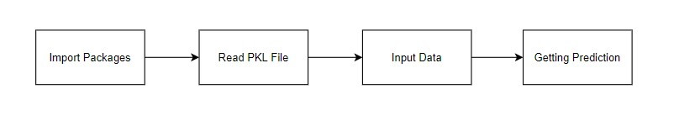
Deployment
Module Description(Contd..)
In this module the trained machine learning model is converted into pickle data format file (.pkl file) which is then deployed for providing better user interface and predicting the output of Depression Prediction.

Slide 22
Testing /Performance Evaluation / Results
Test Case Id | Test Case / Action To Be Performed | Expected Result | Actual Result | Pass/ Fail
1 | Display the Home page by clicking on the Website Link | Display the Information and Features of the website | Display the features of the website | Pass
2 | Enter the questionary and select the button predict. | Display the input text in questionary box | Display the input text in questionary box | Pass
3 | Select the predict button. | Display the predicted result. | Display the predicted result. | Pass

Slide 23
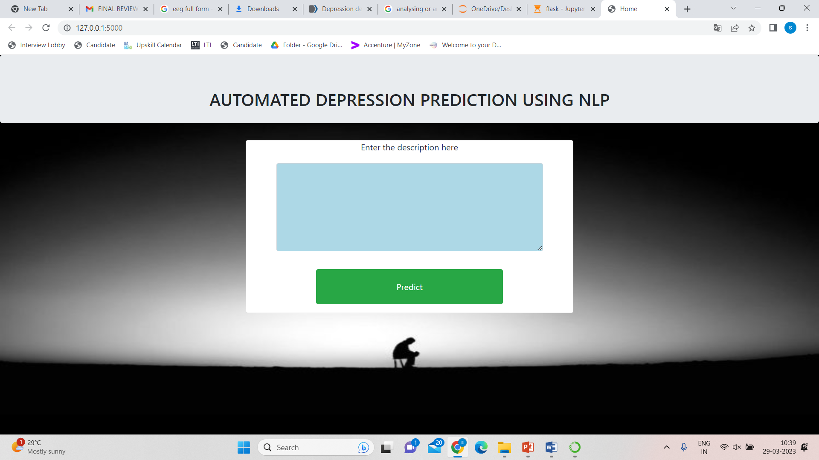
Input Design
Screen Shots

Slide 24
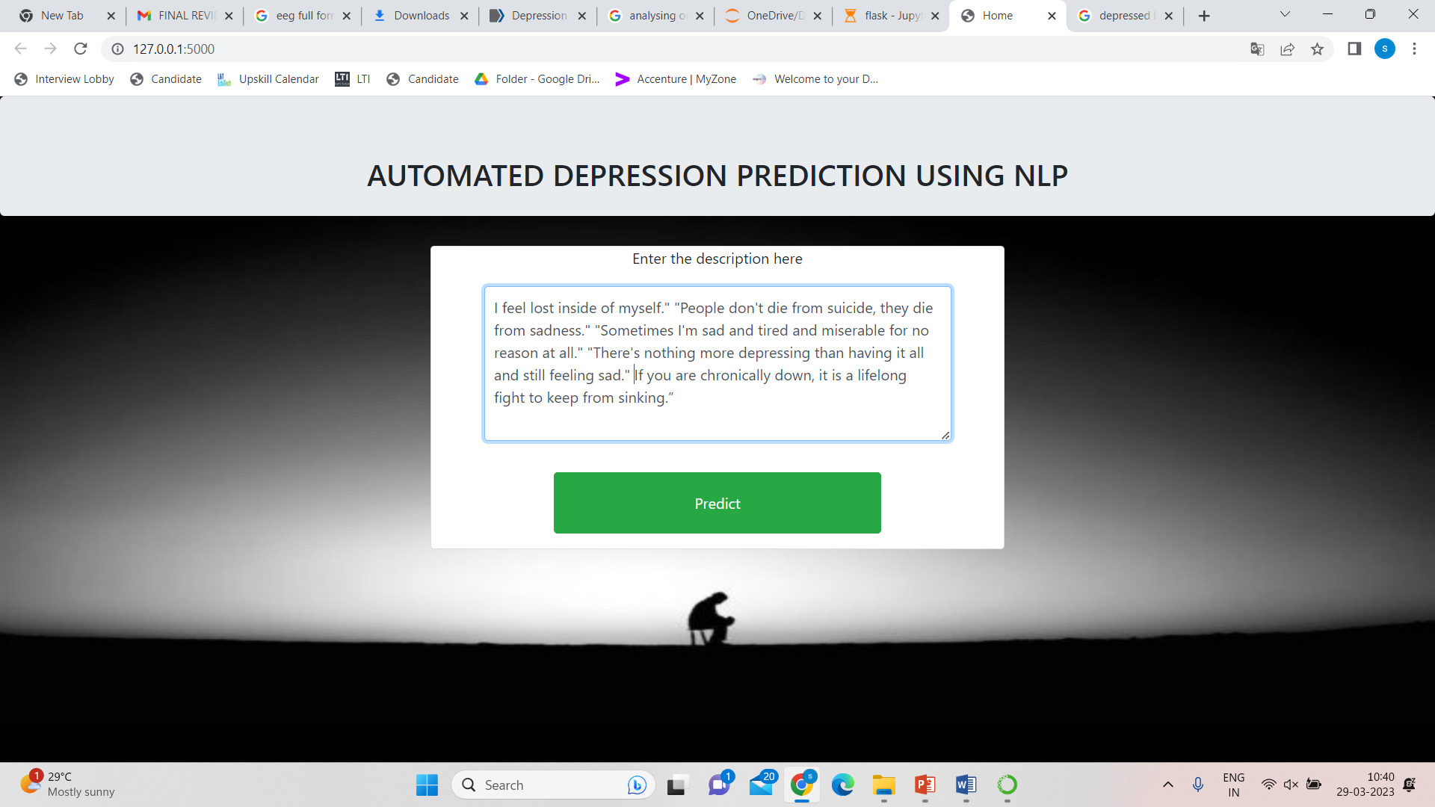
Input Design
Screen Shots

Slide 25
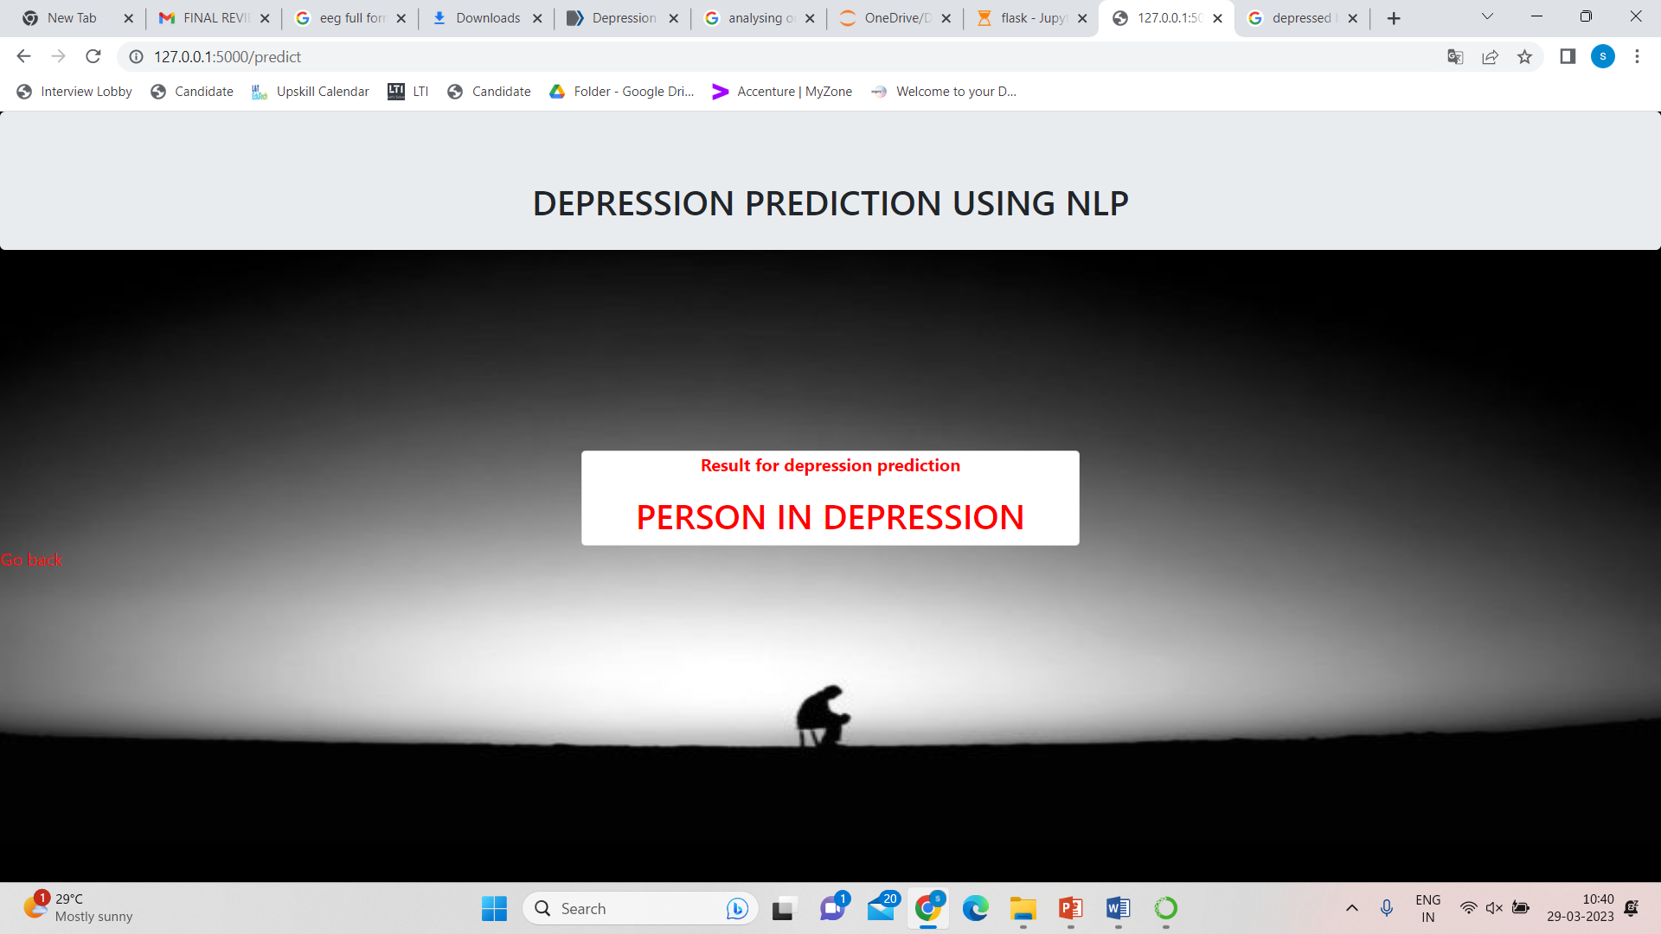
Output Design
Screen Shots

Slide 26
Conclusion/Feature Enhancement
In conclusion, the analytical process for this project involved several steps, including data cleaning and processing, missing value handling, exploratory analysis, and model building and evaluation. The highest accuracy was achieved on a public test set using a high-accuracy scoring algorithm, which was then used in the application to detect depression in individuals. To enhance this system, future work could involve implementing it in multiple programming languages, incorporating more data to improve accuracy, and adding voice input functionality. These enhancements can provide an even more robust and effective tool for detecting depression in individuals.

Slide 27
Reference Paper/ URL
[1] Likun Xia; Yuan Feng; Ziheng Guo “MuLHiTA: A Novel Multiclass Classification Framework With Multibranch LSTM and Hierarchical Temporal Attention for Early Detection of Mental Stress” 06,April,2022.
LINK
https://drive.google.com/file/d/1Vr9wNeoZUtrDyXAKZyqzhcSF_8ll9dGw/view?usp=sharing
[2] K V K Alekhya; K Yeshwanth; Praveen Tumuluru “Prediction of Public Mental Health by using Machine Learning Algorithms” 25, February,2022.
[3] Sandhya P, Mahek Kantesaria “Prediction of Mental Disorder for employees in IT Industry” , Volume-8 Issue-6S, April 2022.

Slide 28
Thank you

