Slide 1
AUTOMATED DEPRESSION PREDICTION USING NLP
Team Members
Guided By
ARCHANA.K (211419104016)
SWETHA.R (211419104285)
THARINI ABHINAYA S.R (211419104289)
Dr.T.TAMILVIZHI, M.E, Ph.D.,
DEPARTMENT OF CSE
PANIMALAR ENGINEERING COLLEGE

Slide 2
Abstract
In the fast-paced modern world, psychological health issues like anxiety, depression and stress have become very common among the masses. In this paper, predictions of depression was made using machine learning algorithms. With an increase in data sets with relevance for depression, and the advancement of machine learning, there is a potential to develop intelligent systems to detect symptoms of depression in written material.

Slide 3
Machine learning Techniques are currently well suited for analysing the data and diagnosing the problem. The accuracy over the full attribute set and selected attribute set on various machine learning algorithms have been compared.

Slide 4
Literature Survey
YEAR | AUTHOR NAME | PAPER DETAILS | METHODOLOGY | MERITS & DEMERITS | FUTURE SCOPE
2023 | Jetli Chung and Jason Teo | Title: Single classifier vs. ensemble machine learning approaches for mental health prediction. Issue date: 10 Jan 2023 Published In: Springer Open | The survey consists of various questions regarding the respondents’ mental health and their opinion on mental health. The original raw data can be accessed on the OSMI website, and the data were covered by a Creative Commons Attribution License which allows free adapting and sharing of the survey results. | Merits: Achieved the best performance in terms of accuracy. Demerits: Mandatory to have a medical practitioner | Future investigation to improve prediction performance is planned using Generalized Adversarial Networks (GANs) and transformer neural networks

Slide 5
YEAR | AUTHOR NAME | PAPER DETAILS | METHODOLOGY | MERITS & DEMERITS | FUTURE SCOPE
2022 | Asma Alwadei and Reem Alnanih | Title: Designing a Tool to Address the Depression of Children During Online Education. Issue date: 12 Aug 2022 Published In: Elsevier B.V | Design thinking is a methodology that provides a solution-based approach to solving real problems. It consists of five steps: 1) understanding the problem through empathy. 2) defining and clarifying the problem. 3) proposing the best idea to solve the problem. 4) proposing the prototype. 5) testing the prototype. | Merits: Helps the counselors discover students' mental health issues from the beginning stages. Demerits: The limited corporations to record videos from parents was one of an obstacle during this research. | To classify depression according to emotion type in future works and include a large sample size.

Slide 6
YEAR | AUTHOR NAME | PAPER DETAILS | METHODOLOGY | MERITS & DEMERITS | FUTURE SCOPE
2022 | Alexander Kathan1, Andreas Triantafyllopoulos, Xiangheng He1, Manuel Milling and Tianhao Yan | Title: Journaling Data for Daily PHQ-2 Depression Prediction and Forecasting Issue date: 15 Jul 2022 Published In: IEEE Access | We experiment with four different regression models: a)XGBoost b)Support Vector Machines c) Random Forests, and d) Multilayer Perceptrons (MLPs).Each model comes with distinct associated hyper-parameters which is tuned using 3-fold nested-cross- validation on each train data set with non-disjoint subjects. | Merits: Actively-collected data can be promising to improve prediction models for PHQ scores in the future. Demerits: Minor fluctuations in results can be observed. | Future work could be targeted at exploring these different possible multimodal combination to further improve performance as well as investigating more complex models.

Slide 7
YEAR | AUTHOR NAME | PAPER DETAILS | METHODOLOGY | MERITS & DEMERITS | FUTURE SCOPE
2022 | Ch.M.H. Saibaba, K V K Alekhya, K Yeshwanth and Praveen Tumuluru | Title: Prediction of Public Mental Health by using Machine Learning. Issue date: 25 Feb 2022 Published In: IEEE Access | Predicting with neural network for mental illness denoting all diagnosable mental disorders which are characterized by irregularities in reasoning, sentiments, or practices. | Merits: Psychological wellness experts be able to use machine Learning which can assist inside the detection, prognosis and treatment of mental health issues. Demerits: Exploration needs utilized information from the most recent six years of AHR report. | Improving the accuracy.

Slide 8
YEAR | AUTHOR NAME | PAPER DETAILS | METHODOLOGY | MERITS & DEMERITS | FUTURE SCOPE
2022 | B Anishfathim, B Sreenithi, S Trisha, J Swathi and M Sindhu Priya | Title: The Impact of Mental Health due to Covid 19 – A Mental Health Detector Using Machine Learning. Issue date: 25 Feb 2022 Published In: IEEE Access | The following machine learning algorithms to predict the stress level during this quarantine. Modules: 1. Acquisition of data. 2. Pre-processing the data. 3. Splitting the Training and Testing Data. 4. Classification of data. 5. Analysis on the performance of the model. | Merits: Can find the level of stress using the collected dataset during this quarantine. Demerits: The limitations and issues of this method would be evident in case of raw data and more test cases. | In future better results can be extracted from raw data and with more test cases.

Slide 9
YEAR | AUTHOR NAME | PAPER DETAILS | METHODOLOGY | MERITS & DEMERITS | FUTURE SCOPE
2022 | G. Parimala, R. Kayalvizhi and S. Nithiya | Title: Mental Health: Detection & Diagnosis. Issue date: 27 Jan 2022 Published In: IEEE Access | Tested few Machine learning algorithms depending upon our parameters that we would be further using to test our model. Thereby, the algorithm giving the best accuracy has been used. | Merits: It is responsible for increasing decision tree accuracy by reducing overfitting. Demerits: It consumes a fairly large amount of computing power. | Reducing computing power and time.

Slide 10
YEAR | AUTHOR NAME | PAPER DETAILS | METHODOLOGY | MERITS & DEMERITS | FUTURE SCOPE
2021 | Konda Vaishnavi, Nikhitha Kamath, Ashwath Rao and N V Subba Reddy | Title: Predicting Mental Health Illness using Machine Learning Algorithm. Issue date: 12 Jan 2022 Published In: Iopscience | This study identified five machine learning techniques and assessed their accuracy in identifying mental health issues using several accuracy criteria. The five machine learning techniques are Logistic Regression, K-NN Classifier, Decision Tree Classifier, Random Forest, and Stacking. | Merits: the classifiers were more accurate in predicting the condition of mental health than other classifiers because the ROC area of all classifiers used is between 0.8 and 0.9. Demerits: The data set used in the research is very minimal. | A large data set can be used and the research can be applied on the same for more accuracy.

Slide 11
YEAR | AUTHOR NAME | PAPER DETAILS | METHODOLOGY | MERITS & DEMERITS | FUTURE SCOPE
2021 | Usman Ahmed, Jerry Chun-Wei Lin, and Gautam Srivastava. | Title: Fuzzy Explainable Attention-based Deep Active Learning on Mental-Health Data. Issue date: 14 Jul 2021 Published In: IEEE Access | The standard PHQ-9 question-naire for authored text from patients. PHQ-9 is a standard procedure for measuring depression symptoms. The PHQ-9 method helps extract nine distinct behaviour types that incor-porate Diagnostic and Statistical Manual of Mental Disorders 5 (DSM-V)2. | Merits: It can handle the uncertainty and interpreted the embedding working. Demerits: The main issue is that rule construction requires a piece of prior knowledge and expertise in the system. | Improving the accuracy to detects the triggering rules and highlights the focused words that help psychiatrists make notes and diagnosis..

Slide 12
YEAR | AUTHOR NAME | PAPER DETAILS | METHODOLOGY | MERITS & DEMERITS | FUTURE SCOPE
2020 | MEERA SHARMA, SONOK MAHAPATRA , ADEETHYIA SHANKAR | Title: Predicting the Utilization of Mental Health Treatment with Various Machine Learning Algorithms. Issue date: 31 Dec 2020 Published In: IEEE Access | Decision Tree model is an information-mapping method with a tree-like structure commonly used for a variety of purposes in machine learning. There are multiple types of decision trees, but the one we used on our research is a Classification and Regression Tree, commonly abbreviated as CART, to conduct binary classification on our data | Merits: Fast way to predict a dataset Demerits: Cannot be implemented in any other languages. | Future research should seek to fill some of the shortcomings in the data by leveraging a larger, more recent sample across industries

Slide 13
YEAR | AUTHOR NAME | PAPER DETAILS | METHODOLOGY | MERITS & DEMERITS | FUTURE SCOPE
2019 | Theodoros Iliou, Georgia Konstantopoulou, Mandani Ntekouli And Christina Lymperopoulou | Title: ILIOU Machine Learning Preprocessing Method for Depression Type Prediction. Issue date: Mar 2019 Published In: Research Gate | There are 3 data preprocessing methods: PCA method, ILIOU preprocessing method and EVOLUTIONARY SEARCH method. Tested the initial dataset and the preprocessed datasets using 7 classification algorithms: the Nearest-neighbour classifier, J48, Random Forest, Multilayer Perceptron, Support Vector Machine, JRIP and FURIA. | Merits: ILIOU data preprocessing method have significantly improved the classification performance for each classifier than initial data classification performance. Demerits: If there is much irrelevant and redundant information present or noisy and unreliable data, then the training phase is more difficult. | ILIOU preprocessing method could be improved in order to achieve better classification performance or it could be ensemble in a classification algorithm.

Slide 14
YEAR | AUTHOR NAME | PAPER DETAILS | METHODOLOGY | MERITS & DEMERITS | FUTURE SCOPE
2020 | Rajdeep Kumar Nath, Himanshu Thapliyal, Allison Caban-Holt and Saraju P. Mohanty | Title: Machine Learning Based Solutions for Real-Time Stress Monitoring. Issue date: 11 May 2020 Published In: IEEE Access | They have used edge computing framework for real-time stress monitoring. The idea of edge computing is to migrate some of the computing capacity close to the end-point where data is collected also known as the edge. When computations are done at the edge, the response time from the system reduces considerably as the data does not need to transmit through a very long distance. | Merits: Cost-efficient acute stress detection system. Demerits: Privacy issue is faced in this system. | Real-time monitoring of stress can be integrated in a smart home environment to assist older adults and persons with dementia or cognitive impairment.

Slide 15
Existing System
Mental stress is an increasingly common psychological issue leading to diseases such as depression, addiction, and heart attack.
In this study, an early detection framework based on ELECTROENCPHALOGRAM (EEG) data is developed for reducing the risk of these diseases.
In existing frameworks, signals are often segmented into smaller sections prior to being input to a deep neural network.

Slide 16
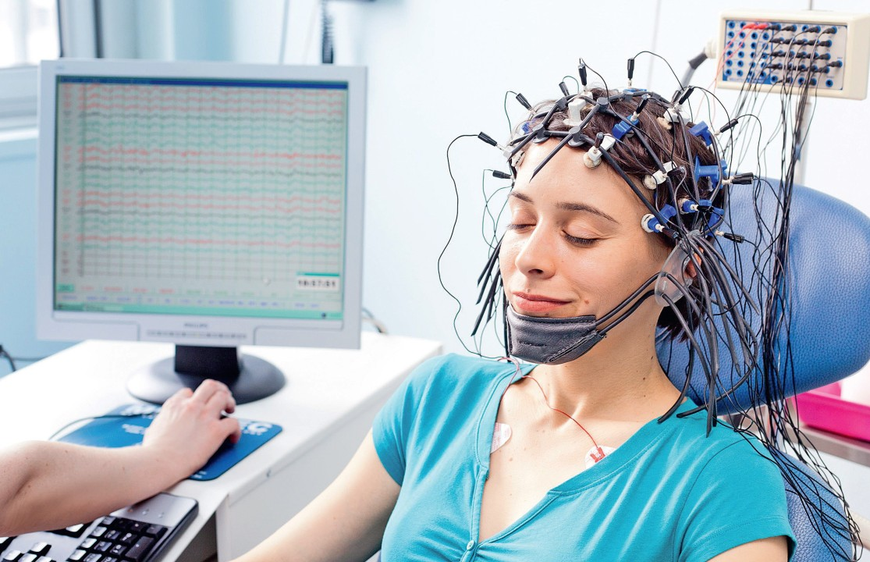
Existing System (contd..)
The model effectively captured hierarchical temporal dependencies in intraslice and interslice regions of EEG signals using two complementary branches exhibiting attention mechanisms and BLSTM networks.

Slide 17
Proposed System
The proposed model is to build a machine learning model with NLP that is capable of classifying whether the person is in depression or not.
The machine learning can be used to classify the depression, by using the previous data and make them to understand the pattern and improve the accuracy of the model by adjusting parameters.
Different algorithms can be compared and the best model can be used for classification purpose.

Slide 18
Advantages
This system can be implemented in TELEMEDICINE.
Social Media Platforms – helps in analysing people’s mental health.
Deployed in a web browser, so that it retains the privacy of the patients.
Brain signals are not required in this proposed system.

Slide 19
Modules
Data Pre-processing
Data Analysis of Visualization
Algorithm Implementation
Deployment

Slide 20
Module Descriptions
Data pre – processing
A number of different data cleaning tasks using Python’s Pandas library and specifically, it focus on probably the biggest data cleaning task, missing values and it able to more quickly clean data. It wants to spend less time cleaning data, and more time exploring and modeling.

Slide 21
Data visualization
Data visualization is an important skill in applied statistics and machine learning. Statistics does indeed focus on quantitative descriptions and estimations of data. Data visualization provides an important suite of tools for gaining a qualitative understanding. This can be helpful when exploring and getting to know a dataset and can help with identifying patterns, corrupt data, outliers, and much more. Data visualization and exploratory data analysis are whole fields themselves and it will recommend a deeper dive into some the books mentioned at the end.

Slide 22
Algorithm Implementation
It is important to compare the performance of multiple different machine learning algorithms consistently and it will discover to create a test harness to compare multiple different machine learning algorithms in Python. It can use this test harness as a template on your own machine learning problems and add more and different algorithms to compare. Each model will have different performance characteristics.

Slide 23
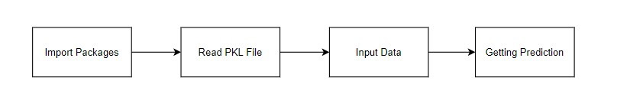
Deployment
In this module the trained machine learning model is converted into pickle data format file (.pkl file) which is then deployed for providing better user interface and predicting the output of Depression Prediction.

Slide 24
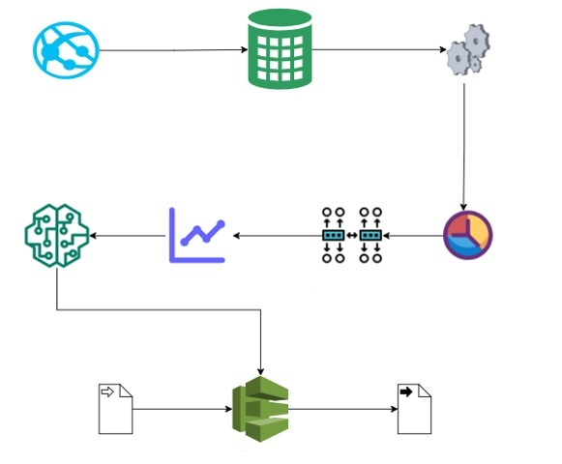
System Architecture
Website
Dataset
Preprocessing
Model
Accuracy
Visualization
Algorithm
Implementation
Input
Output
Deploy

Slide 25
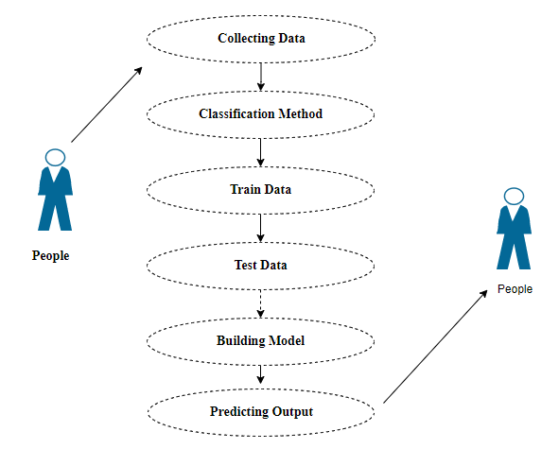
Use case Diagram

Slide 26
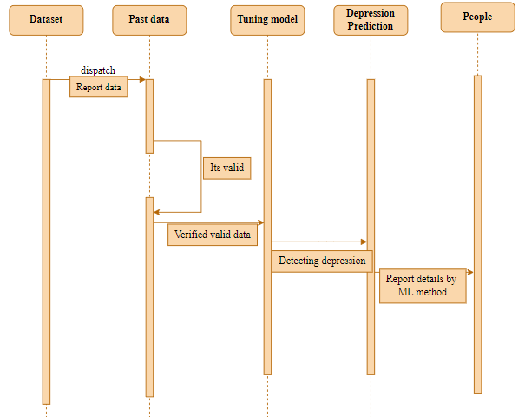
Sequence Diagram

Slide 27
System Requirements
1. Software Requirements:
Operating System : Windows 10 or later
Tool : Anaconda with Jupyter Notebook
2. Hardware requirements:
Processor : Intel i3
Hard disk : minimum 80 GB
RAM : minimum 2 GB

Slide 28
Proposed Algorithm
Logistic Regression
AdaBoost
Decision Tree Classifier

Slide 29
Algorithm Explanation
Logistic Regression
Logistic regression is a supervised learning classification algorithm used to predict the probability of a target variable. The nature of dependent variable is dichotomous, which means there would be only two possible classes.
the dependent variable is binary in nature having data coded as either 1 (stands for success/yes) or 0 (stands for failure/no).
Mathematically, a logistic regression model predicts P(Y=1) as a function of X.

Slide 30
Adaboost
The basic concept behind Adaboost is to set the weights of classifiers and training the data sample in each iteration such that it ensures the accurate predictions of unusual observations. Any machine learning algorithm can be used as base classifier if it accepts weights on the training set. Adaboost should meet two conditions:
The classifier should be trained interactively on various weighed training examples.
In each iteration, it tries to provide an excellent fit for these examples by minimizing training error.

Slide 31
Decision Tree Classifier
Decision Trees are a type of Supervised Machine Learning where the data is continuously split according to a certain parameter. The tree can be explained by two entities, namely decision nodes and leaves.
Decision Trees (DTs) are a non-parametric supervised learning method used for classification and regression. The goal is to create a model that predicts the value of a target variable by learning simple decision rules inferred from the data features.

Slide 32
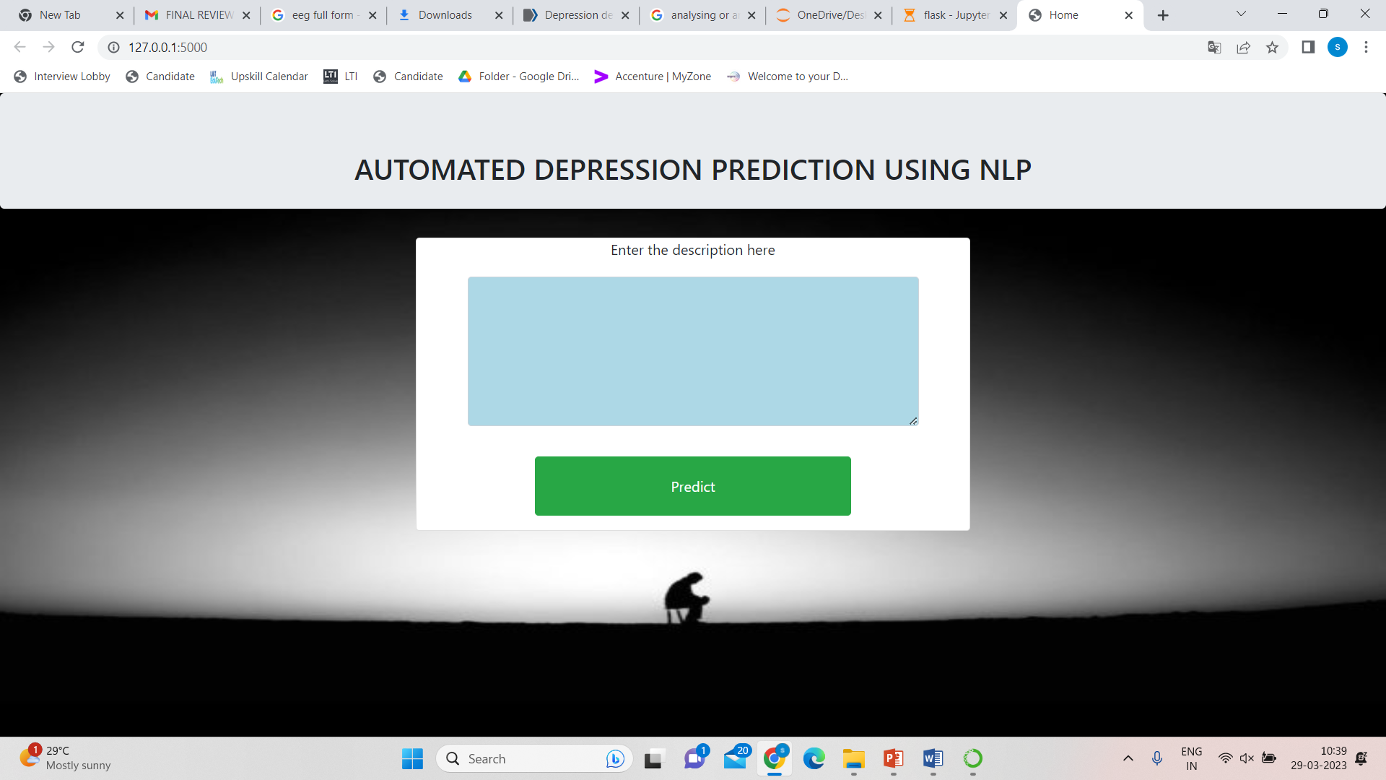
Input Design

Slide 33
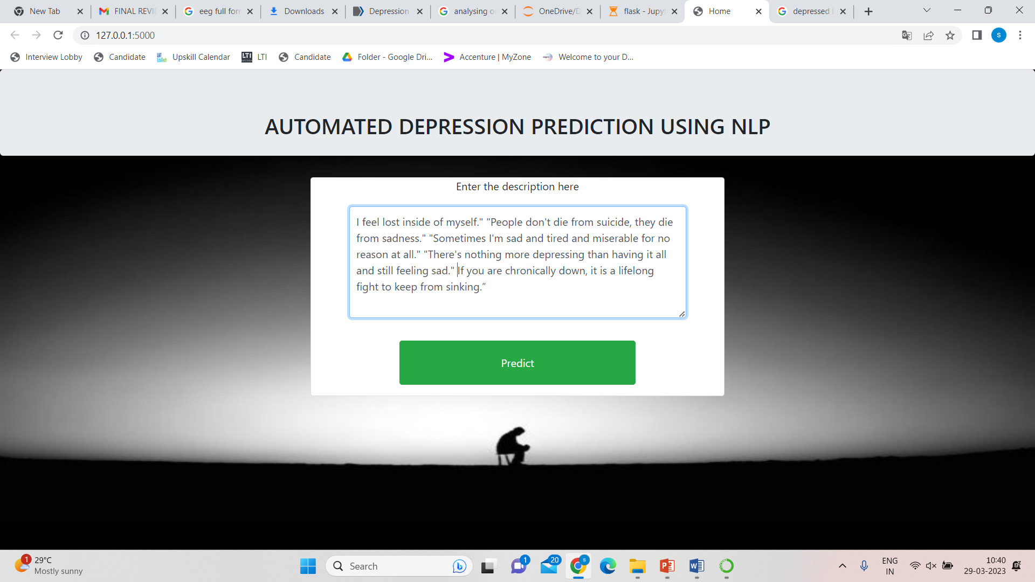
Input Design

Slide 34
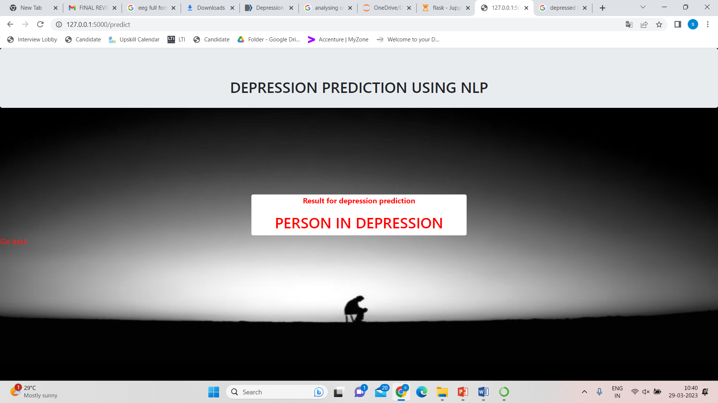
Output Design

Slide 35
Conclusion
The analytical process started from data cleaning and processing, missing value, exploratory analysis and finally model building and evaluation. The best accuracy on public test set of higher accuracy score algorithm will be find out. The founded one is used in the application which can help to find the depression of the people.

Slide 36
Disadvantages
Can be implemented only in English.
Illiterate people face difficulties while using this software.

Slide 37
Future Work
Implementing in other languages.
Deploying the project in the cloud.
Implementing it with more datas.
Implementing voice input.

Slide 38
Base Paper Link
https://ieeexplore.ieee.org/document/9750390

Slide 39
References
[1] Likun Xia; Yuan Feng; Ziheng Guo “MuLHiTA: A Novel Multiclass Classification Framework With Multibranch LSTM and Hierarchical Temporal Attention for Early Detection of Mental Stress” 06,April,2022.
[2] K V K Alekhya; K Yeshwanth; Praveen Tumuluru “Prediction of Public Mental Health by using Machine Learning Algorithms” 25, February,2022.
[3] Sandhya P, Mahek Kantesaria “Prediction of Mental Disorder for employees in IT Industry” , Volume-8 Issue-6S, April 2022.

Slide 40
Thank you

