Slide 1
CREDIT CARD APPROVAL PREDICTION
INFO 6105- Data Science Engineering Methods and Tools
Team Members
Tharoon Kumar Viswanathan– 001585510
Lokesh Balaji Parameswaran – 001562875
Krishna Ravichandran - 001001577

Slide 2
Problem statement
Background
Credit score cards are a common risk control method in the financial industry. It uses personal information and data submitted by credit card applicants to predict the probability of future defaults and credit card borrowings. The bank is able to decide whether to issue a credit card to the applicant.
Credit scores can objectively quantify the magnitude of risk. Generally speaking, credit score cards are based on historical data. Once encountering large economic fluctuations. Past models may lose their original predictive power. Logistic model is a common method for credit scoring. Because Logistic is suitable for binary classification tasks and can calculate the coefficients of each feature. In order to facilitate understanding and operation, the score card will multiply the logistic regression coefficient by a certain value (such as 100) and round it.
At present, with the development of machine learning algorithms. More predictive methods such as Boosting, Random Forest, and Support Vector Machines have been introduced into credit card scoring. However, these methods often do not have good transparency. It may be difficult to provide customers and regulators with a reason for rejection or acceptance.
Task
Build a machine learning model to predict if an applicant is 'good' or 'bad' client, different from other tasks, the definition of 'good' or 'bad' is not given. You should use some technique, such as vintage analysis to construct you label. Also, unbalance data problem is a big problem in this task

Slide 3
Data Source, Packages and Libraries Used.
The dataset has been taken from Kaggle:
Credit Card Approval Prediction Dataset
https://www.kaggle.com/rikdifos/credit-card-approval-prediction
Software and Libraries used:
Numpy Get_dummies
Pandas RepeatedStratifiedKFold
Matplotlib Pydotplus
Seaborn
Metrics
Scikitlearn Tree
XG Boost Classifier
DecisionTreeClassifier
train_test_split
sklearn.ensemble
RandomForestClassifier
plotly.graph_objects
sklearn.preprocessing

Slide 4
Existing Solutions
Below is the link for the Previous solution
The approach to the data preprocessing was done in a way by implementing feature engineering to every columns in the dataset and it was implemented in a single ML Model.
https://www.kaggle.com/rikdifos/credit-card-approval-prediction-using-ml

Slide 5
Idea or Approach
Our idea or approach to this problem statement is to determine whether a every applicant is 'good' or 'bad'. We will be achieving this by building a machine learning model to learn the features and tune it to predict the target (STATUS) variable.
Using supervised machine learning methods to predict the STATUS value of an asteroid as Y/N
To determine the most efficient algorithms with the highest accuracy score for the given Dataset
Visualizing the performance of the models using confusion matrix and ROC curves.

Slide 6
Description of Dataset
The Credit card Approval Prediction Dataset contains all the information contains about an applicant and credit status to date.
The STATUS column (Target variable column) tells us if an applicant is 'good' or 'bad' client for availing a credit card or not and uses Boolean value (Y or N). It uses over due days and loan months.
The dataset consists of two .csv file which is 70 MB and has 438558 records and contains 21 columns.
Of which:
9 Attributes of String, 10 Attributes of Int, 2 Attributes of Decimal

Slide 7
Steps Performed
Data Cleaning:
Data provided was heterogenous with a couple columns containing missing values.
Many rows had Null values which can degrade the model’s performance, hence we need to take care of all the rows with Null values.
We used the mode values of the features to fill in the missing fields instead of leaving them Null and removed the rows that had null
values after filling the mean values.
Feature Selection:
The data originally had 20 columns, this can lead to too much noise and degrade the performance of the model.
To avoid this noise we dropped and retained selected features based on the correlation matrix and comparing how it affects the target variable.
Also, removed duplicate columns which were highly correlated to each other.

Slide 8
Steps Performed
Exploratory Data Analysis:
After cleaning the data and sorting it we have done feature selection on it using various pandas and matplotlib commands. We have shown
A histogram of all relevant columns using hist() and visualized the percentage of features and also printed a bar chart of STATUS count in the dataset. This visualization was used to identify the imbalance in the dataset.
Models Used:
The Dependent Target Variable is STATUS which contains a boolean value of Y or N.As the Target Variable is a discrete class value, the prediction model used is Classification.
The dataset with its matrix of features (independent variables) is trained on various Classification models to predict the class value of the dependent target variable.
Different types of classifiers used in the project are-
XG Boost Classification using SMOTE,
Decision Tree Classification
K Nearest Neighbor Classification with Hyperparameter tuning
Random Forest Classification
Deep Neural Network

Slide 9
Performance Metric Measures
Model | Precision | Recall | Accuracy | F1 Score
XG Boost Classification | 0.6268 | 0.6206 | 0.8429 | 0.6235
Decision Tree Classifictaion | 0.6199 | x0.6329 | 0.8311 | 0.6257
K Nearest Neighbour Classification | 0.6738 | 0.5903 | 0.8722 | 0.6115
KNN with hyperparameter tuning | 0.6216 | 0.5277 | 0.8712 | 0.5263
Random Forest Classifictaion | 0.71 | 0.6172 | 0.8801 | 0.6439
Deep Neural Network | 0.4391 | 0.5 | 0.8782 | 0.9351

Slide 10
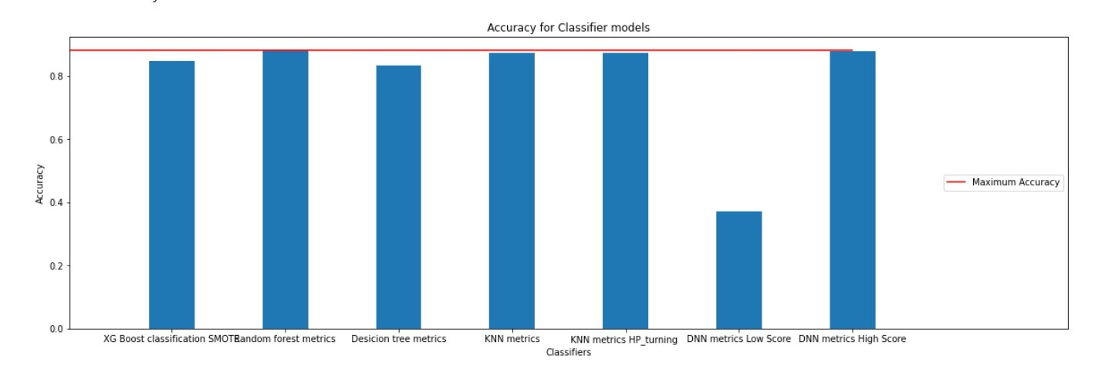
Accuracy Scores
Bar graph of accuracy scores for all models

Slide 11
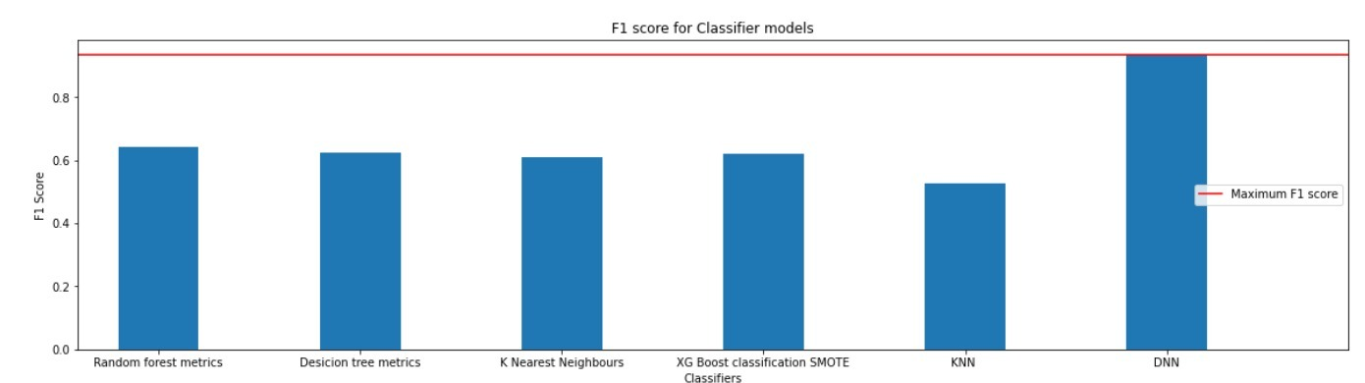
F1 Scores
Visualizing F1 scores of all models as a bar graph

Slide 12
Future Scope
In future we will be able to extend tis model to various banks if more historical data on customers and pattern are provided.
Better results can be obtained and predicted with the dataset containing linked bank accounts of the applicants.
A better history on the transaction on every applicant will help us to determine if they are eligible for the credit card.

Slide 13
References
https://www.digitalocean.com/community/tutorials/how-to-build-a-deep-learning-model-to-predict-employee-retention-using-keras-and-tensorflow
https://stackoverflow.com/questions/50920908/get-confusion-matrix-from-a-keras-multiclass-model
https://de.mathworks.com/help/matlab/ref/colormap.html
https://machinelearningmastery.com/evaluate-performance-deep-learning-models-keras/
https://machinelearningmastery.com/how-to-calculate-precision-recall-f1-and-more-for-deep-learning-models/
https://towardsdatascience.com/https-medium-com-vishalmorde-xgboost-algorithm-long-she-may-rein-edd9f99be63d#:~:text=What%20is%20XGBoost%3F,all%20other%20algorithms%20or%20frameworks

