Slide 1
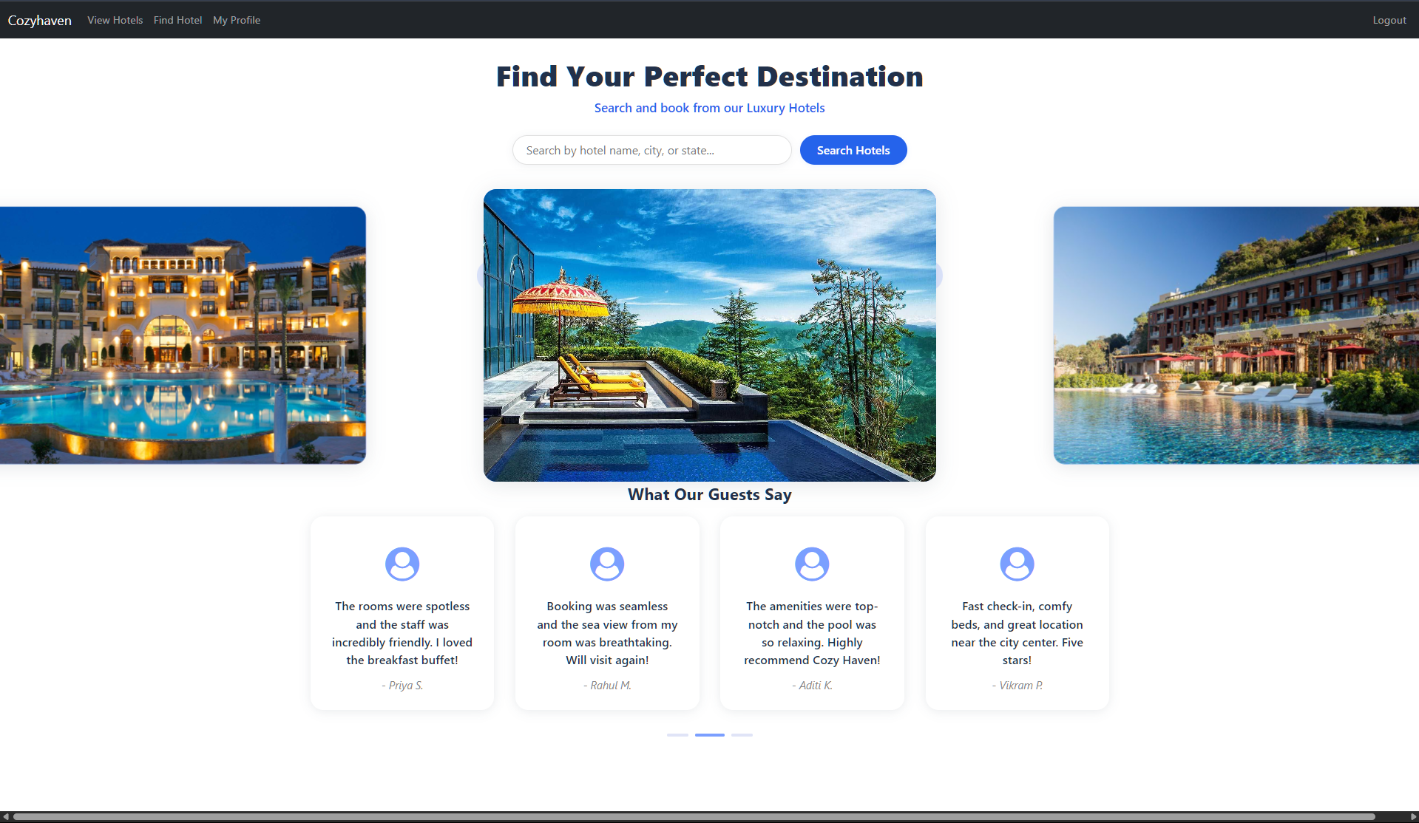
CozyHaven Project Workflow
Tharnidhar S

Slide 2
Project Introduction
What is CozyHaven?
A platform for hotel/room booking and management
Key features: User registration & login, Booking system, Admin & owner dashboards
Tech stack: Angular (frontend), Java Spring Boot (backend)

Slide 3
High-Level Architecture
Frontend: Angular SPA
Backend: Java Spring Boot REST API
Communication: HTTP (with JWT authentication)
Database: MySQL/PostgreSQL
Asset management: Static files (images, CSS)

Slide 4
Frontend Workflow
Angular app structure: Components (Home, Login, Booking, etc.), Services (AuthService, etc.)
Routing via app-routing-module.ts
User flow: Navigation through Navbar
Route guards for protected pages

Slide 5
Backend Workflow
Spring Boot setup with Security (JWT), CORS
REST endpoints: user, booking, admin, owner
Data flow: Request → Authenticate → Process → Respond

Slide 6
Authentication & Authorization
User registration & login with JWT token
Angular stores JWT in localStorage
Interceptor attaches token to requests
AuthGuard restricts protected routes
Backend validates JWT per request

Slide 7
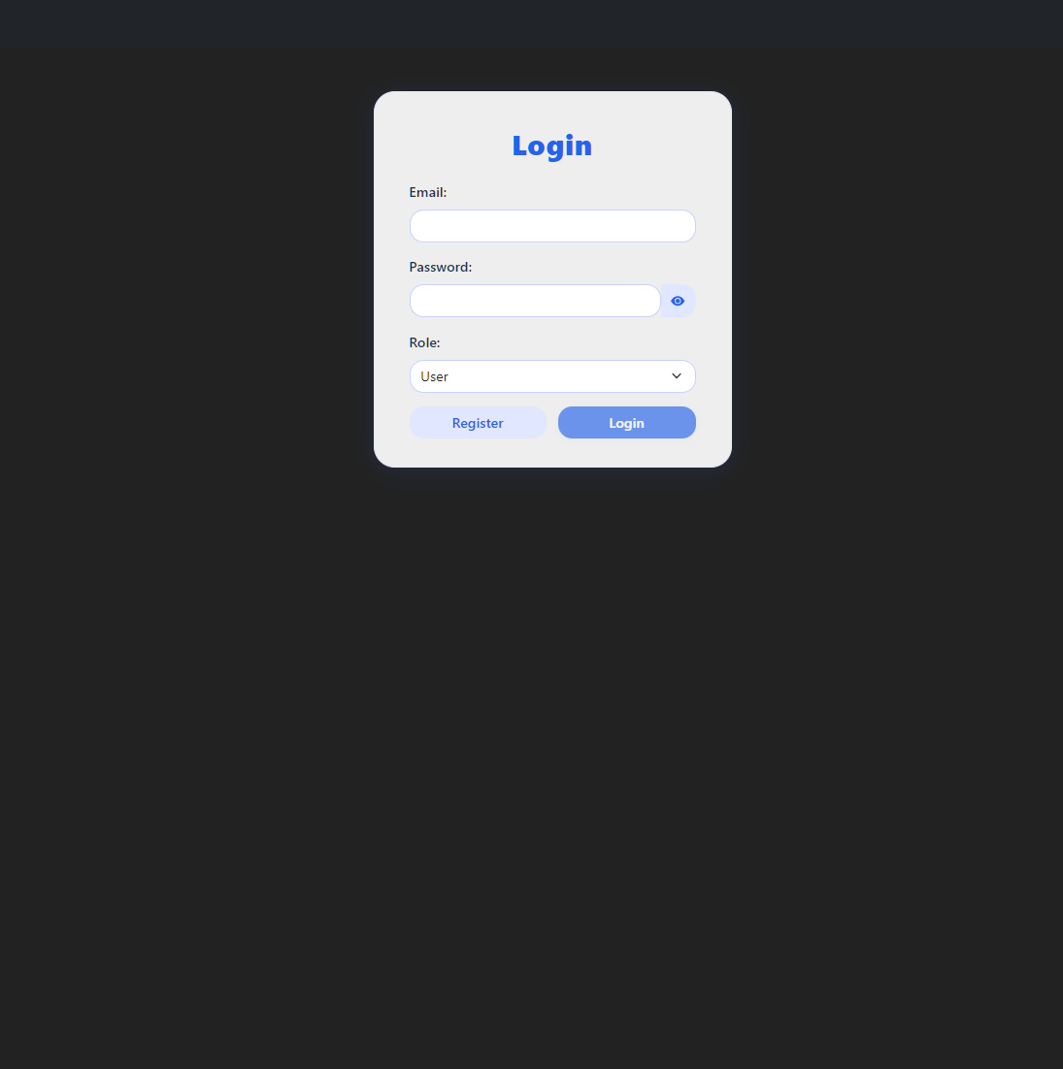
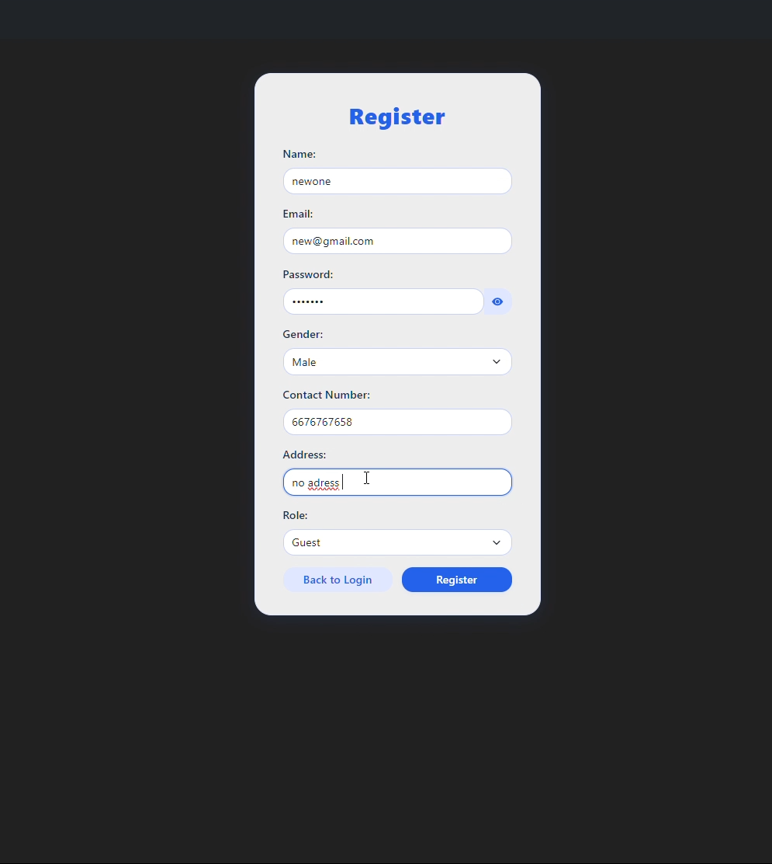

Slide 8
Booking Workflow
User selects hotel/room
Booking form with input validation
Booking request sent to backend
Backend processes & stores booking
Confirmation sent to user

Slide 9
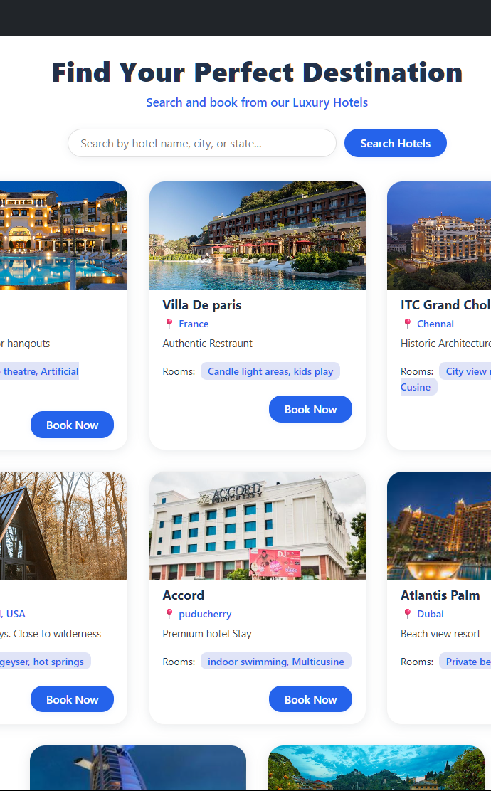
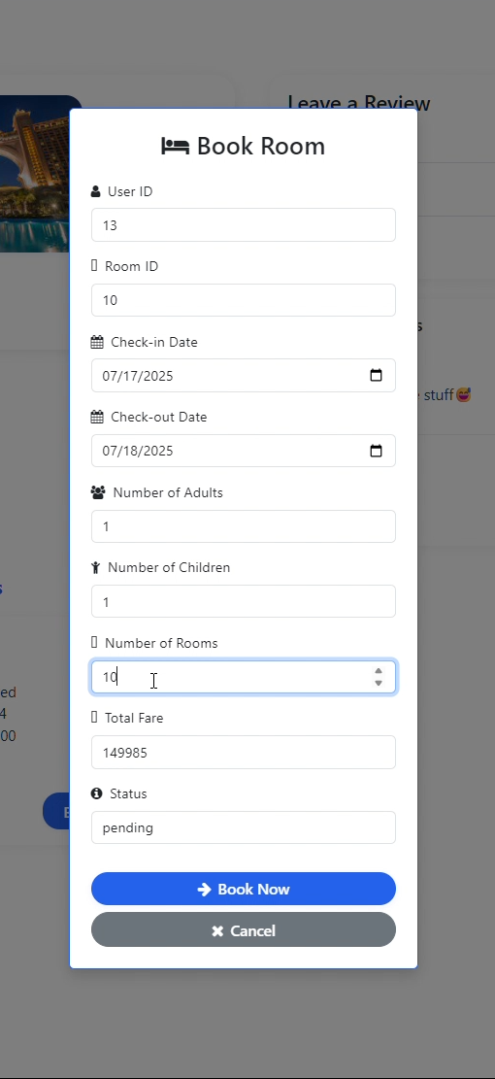
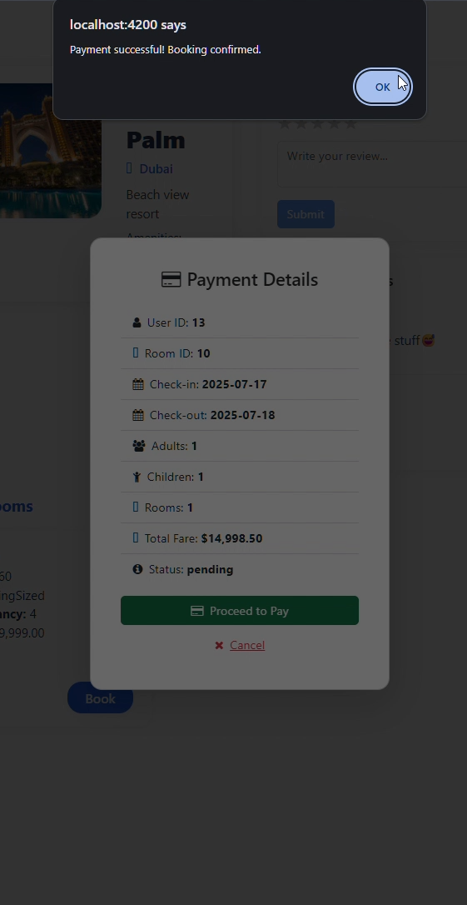

Slide 10
Admin & Owner Dashboards
Admin: Manage users, view all bookings
Owner: Manage listings, view own bookings
Role-based access: Routes and endpoints protected

Slide 11
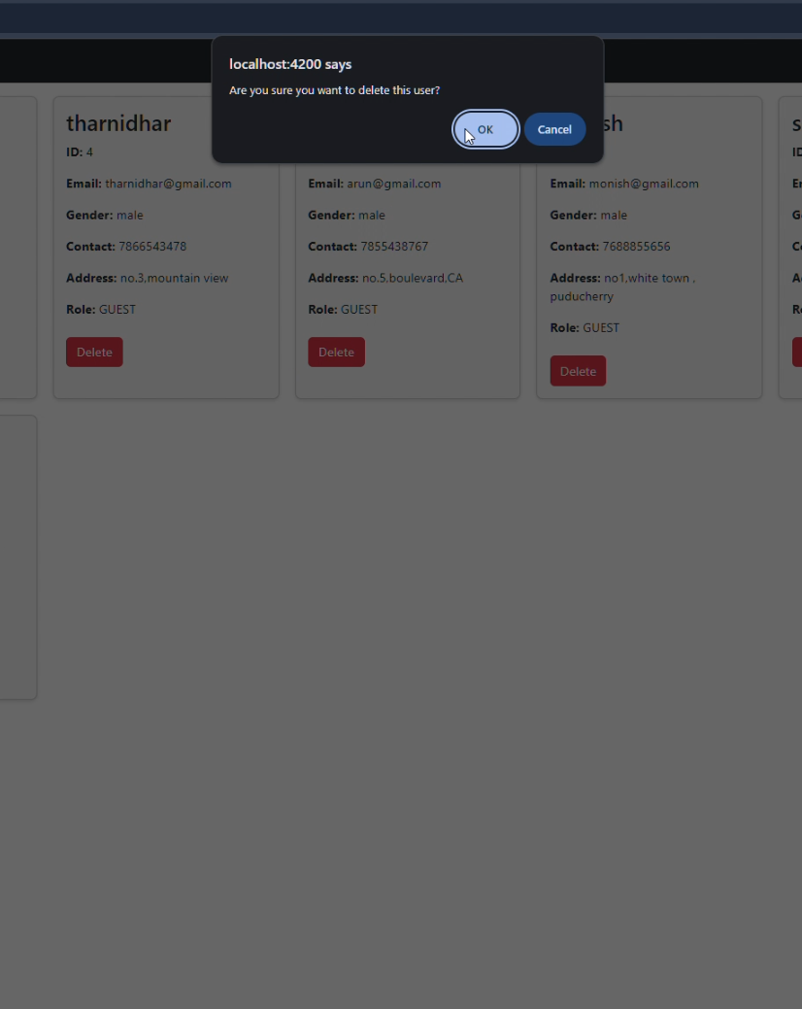
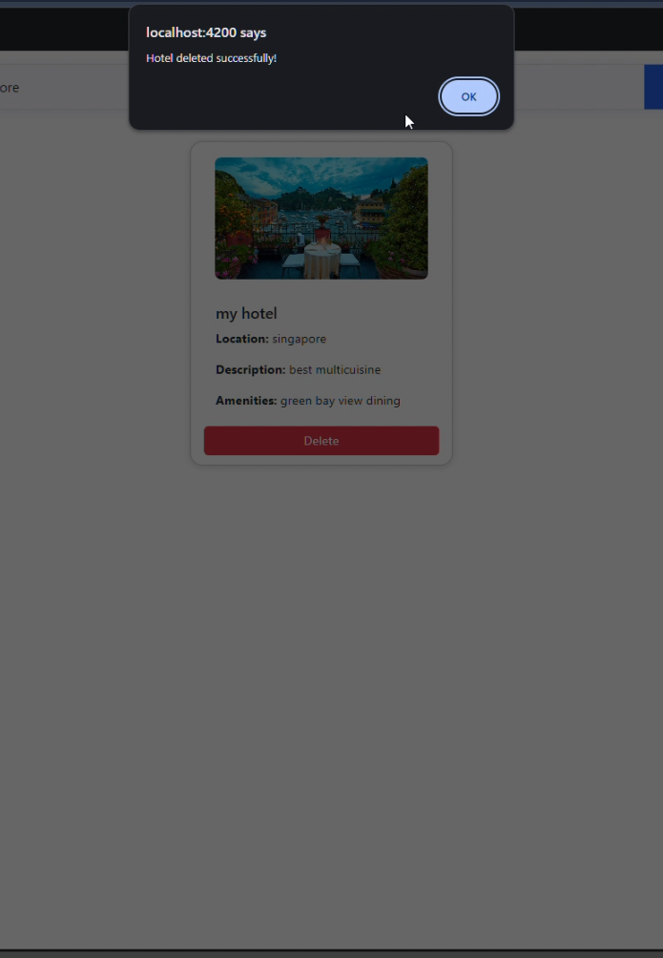

Slide 12
Development & Deployment
Local Dev: Angular (ng serve), Spring Boot run
Build: Angular (ng build), Backend (JAR/WAR)
Deploy: Serve frontend via Nginx/Apache, deploy backend to server/cloud

Slide 13
THANK YOU

