Slide 1
Cozy Haven – Hotel Booking System
Backend Implementation with Spring Boot & JWT
Tharnidhar S

Slide 2
Project Overview
Online hotel room booking platform with secure access
User roles: Guest, Owner, Admin
Core Modules: User, Hotel, Room, Booking, Review

Slide 3
Tech Stack
Backend: Java, Spring Boot 3.5.3
Database: MySQL
ORM: Spring Data JPA + Hibernate
Security: Spring Security + JWT
API Docs: Swagger/OpenAPI
Lombok for boilerplate reduction

Slide 4
Key Functionalities
User: Register, Login, Secure access via JWT
Hotel: Add, View, Search hotels
Room: Add rooms to hotel
Booking: Book rooms, auto fare calculation
Review: Rate and comment on hotels

Slide 5
API Authentication (JWT Flow)
1. User registers or logs in
2. JWT token is issued
3. Token passed via Authorization header
4. Backend filters & verifies the token

Slide 6
Project Architecture
Client (Swagger/Postman/Frontend) → Controller → Service → Repository → MySQL
DTOs used between layers for clean separation
Entities mapped via JPA and Hibernate

Slide 7
Entity Relationships
User ──< Booking >── Room ──< Hotel
User ──< Review >── Hotel
One user can have multiple bookings and reviews
Each hotel contains multiple rooms

Slide 8
Clean API Design
DTOs used for request and response bodies
Avoids exposing JPA entities directly
Swagger UI for interactive API docs
Basic exception handling implemented

Slide 9
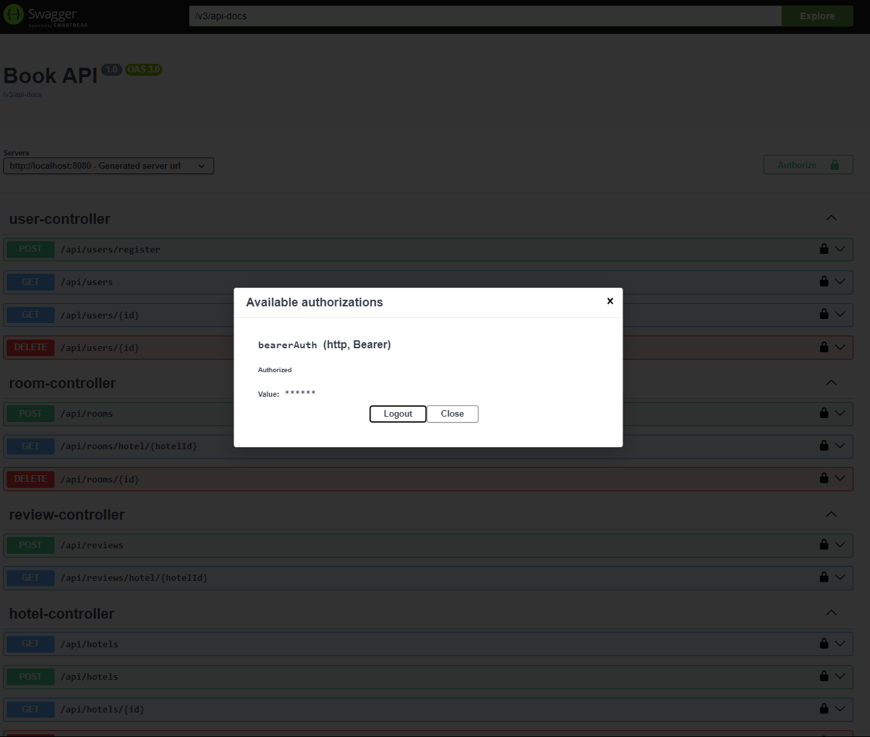
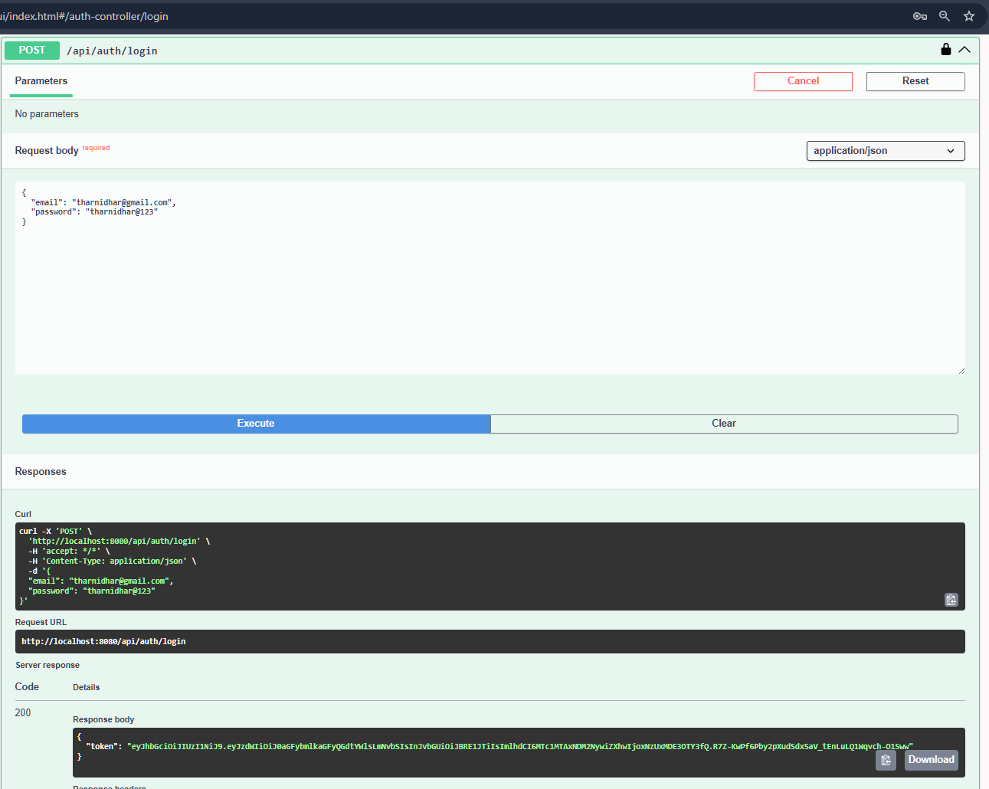
Screenshots of Swagger Demo

Slide 10
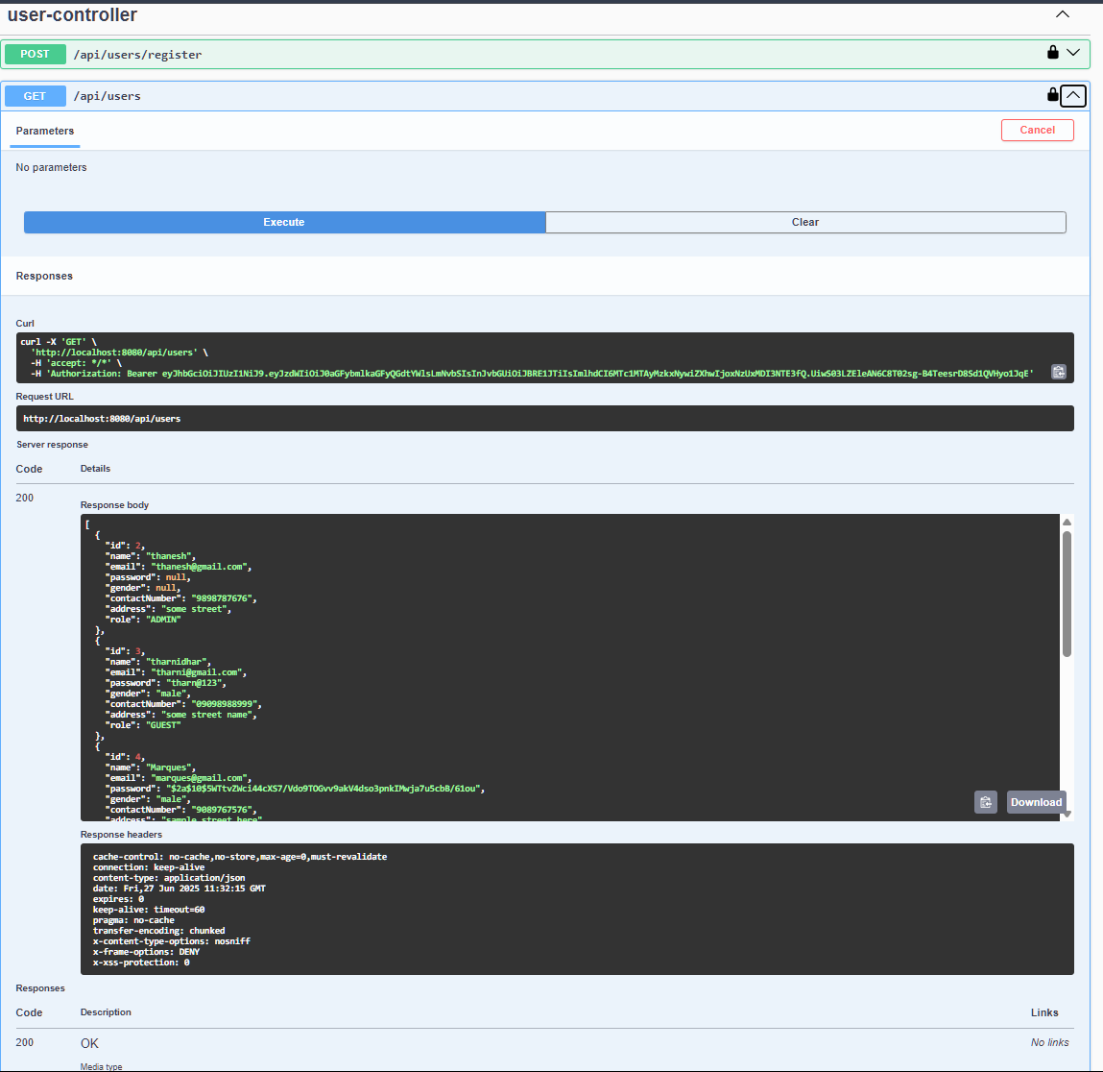
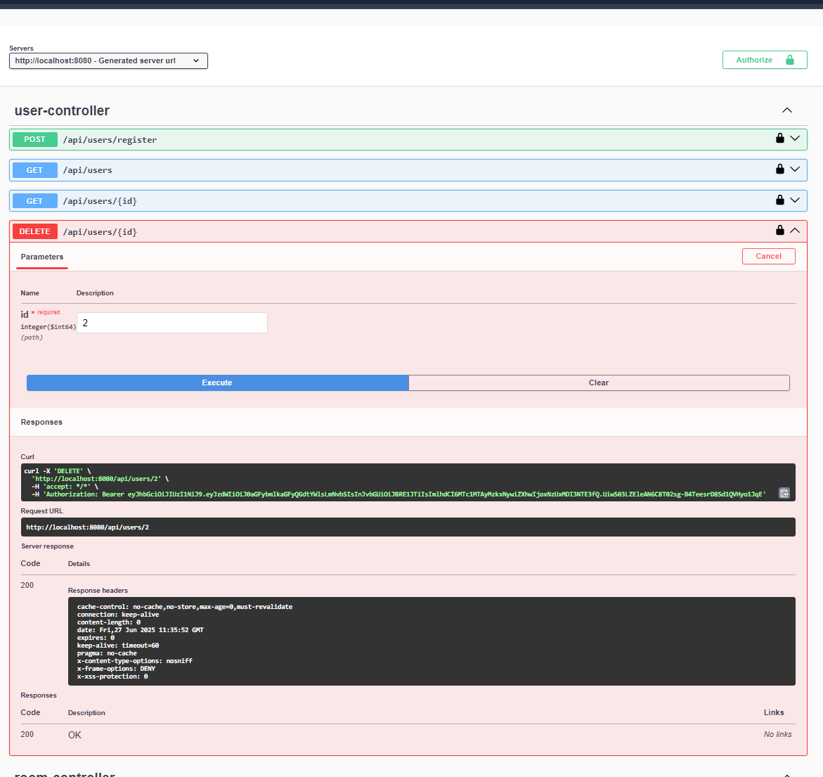

Slide 11
Challenges & Design Decisions
Avoided exposing entity graph – used DTOs
Manual entity-to-DTO mapping
Resolved Swagger deep request nesting
Chose JWT over session/cookie auth for statelessness

Slide 12
Future Enhancements
Frontend UI with Angular/React
Admin dashboard & hotel approval flow
Add payment gateway integration
Improve validation and exception handling

Slide 13
Thank You
https://github.com/tharnidhar/cozyhaven

