Slide 1
ASYNC JS
Nest is a framework for building efficient, scalable Node.js server-side application.

Slide 2
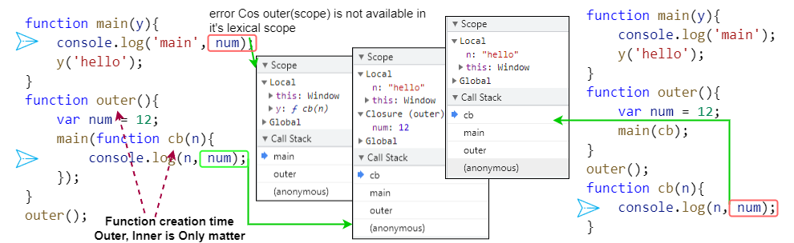
closure
closure gives you access to an outer function’s scope from an inner function.
closures are created function creation time.

Slide 3
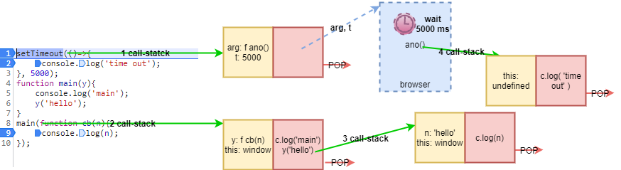
Callback
Call stack == main Thread
Every thig in JS execute through call-stack
Call stack is empty now, after 4700ms some <anonymous> comes

Slide 4
Callback
Garbage collection & remove event listener
Event listeners are taking memory, we don’t know when a user click that button so that closure {count: 4} need to be keep.
So event listeners are heavy so when we are not using them we remove them.

Slide 5
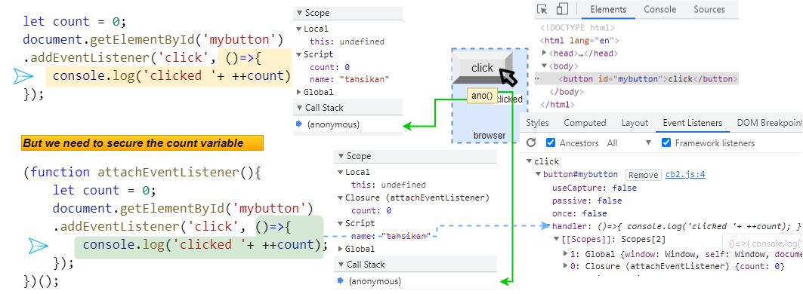
Callback

Slide 6
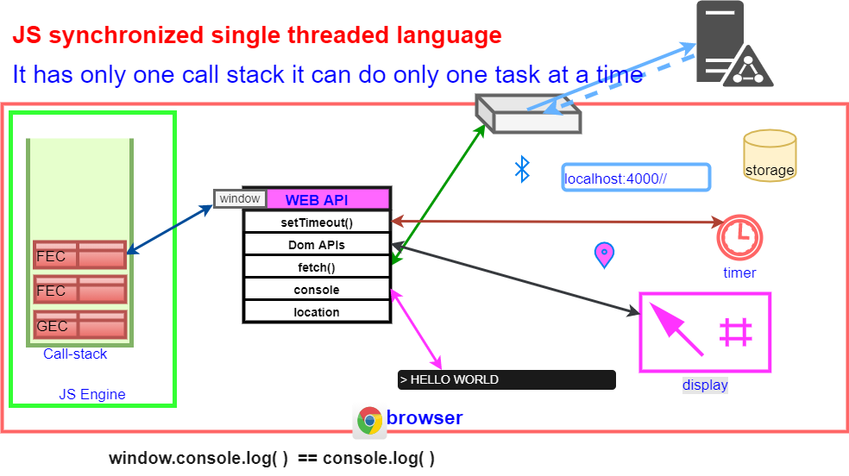
Event Loop

Slide 7
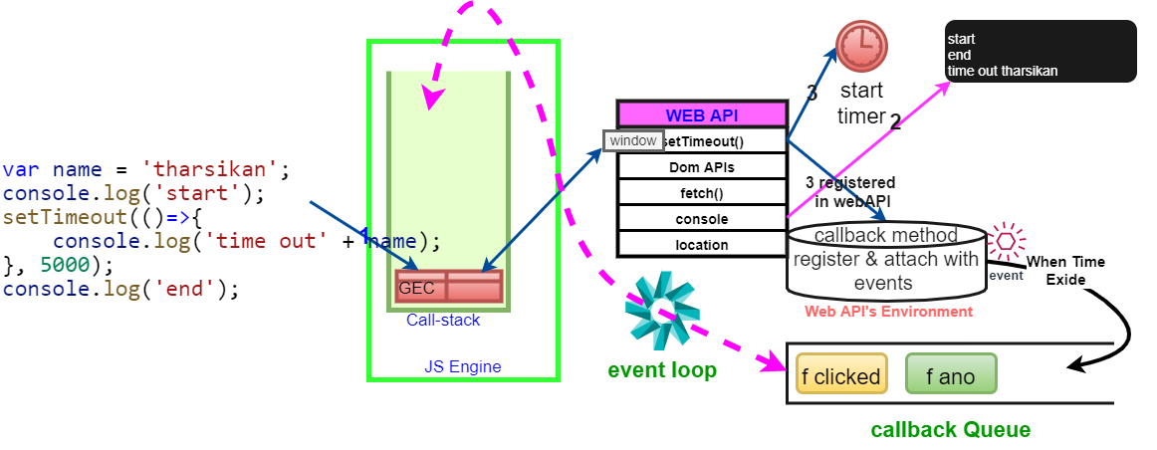
Event loop

Slide 8
Event loop
GEC created and put it inside call-stack
document.getElementById() ➔ is calling DOM APIs, it assess the “document object model”, find and Fetch the DOM element.
DOMelement.addEventListener(‘click’,cb) ➔ cb will be registered in side the WEB API’s environment. then click event will be attached to IT.
Pop out GEC from the call-stack
Registered cb inside “web api’s environment” will stay and wait for user click that button.

Slide 9
Event loop
When button clicked cb will be pushed inside the callback queue. And waits there the time to executed.
Event-Loop consciously monitoring the call stack and callback queue.
If the call stack is empty & there is function in side callback queue.
Then only add the function inside the call stack
Then execution will be started

Slide 10
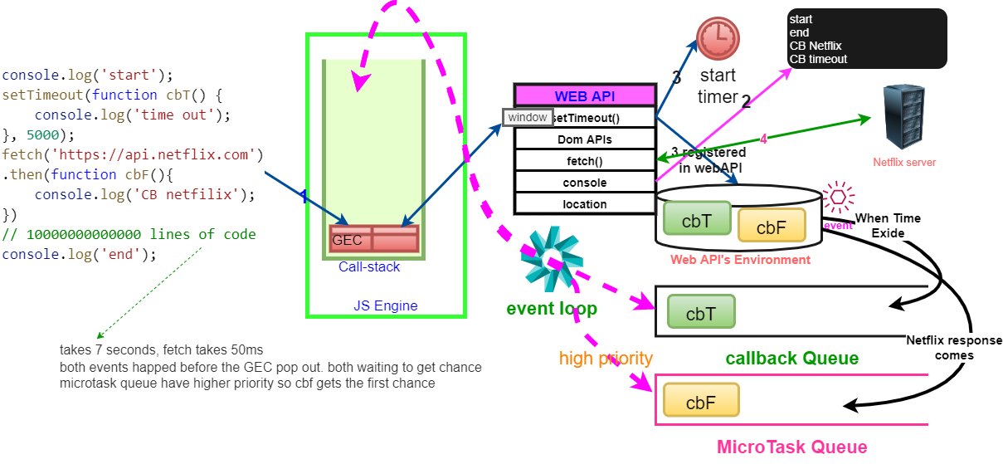
Event loop

Slide 11
Event loop
Promises and MutationObservers goes into the Microtask queue.
Other callback functions goes into the callback queue.
MutationObservers keeps on checking there is mutation in the DOM or not. If there is change executes callback functions.
One microtask execution may generate another microtask if it’s goes on. Microtask queue has higher priority, so callback method don’t get chance to execute. This known as STARVATION of the callback queue.

Slide 12
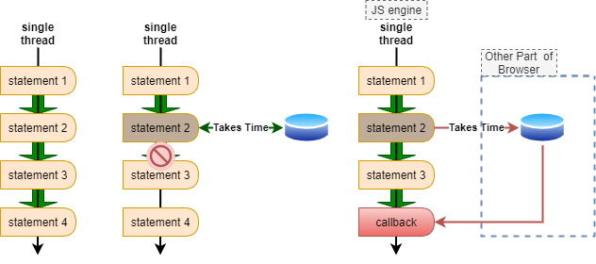
Async JavaScript
Means how we perform tasks which takes some time to complete.
Getting data from a Database

Slide 13
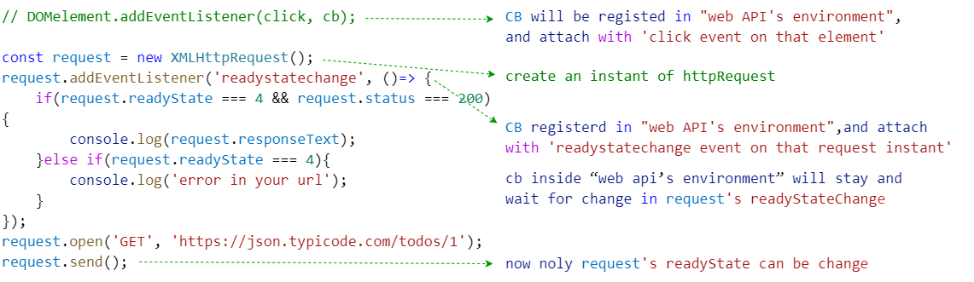
Async JavaScript : XMLHttpRequest
Creating Request object and attach an event. When event happens the callbackFuntion will be added to the callback stack, when call-stack free will be pushed to call-stack and executed.

Slide 14
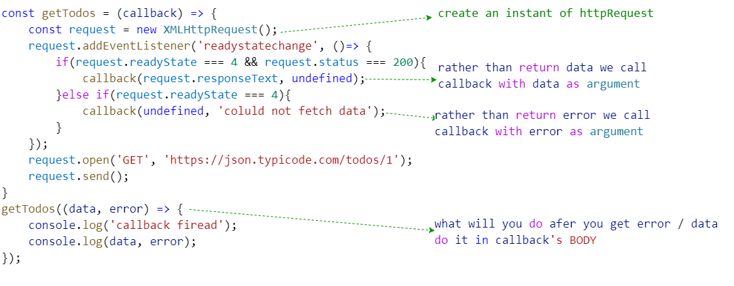
Async JavaScript : XMLHttpRequest

Slide 15
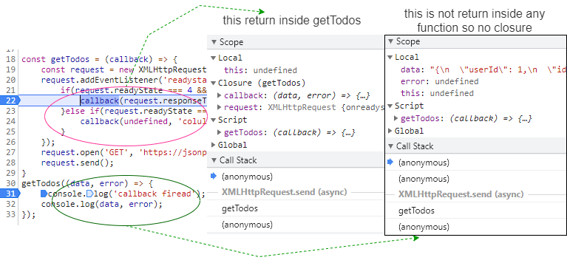
Async JavaScript : XMLHttpRequest

Slide 16
Async JavaScript : XMLHttpRequest
Creating Request object and attach an event. When event happens the callbackFuntion will be added to the callback stack, when call-stack free will be pushed to call-stack and executed.

Slide 17
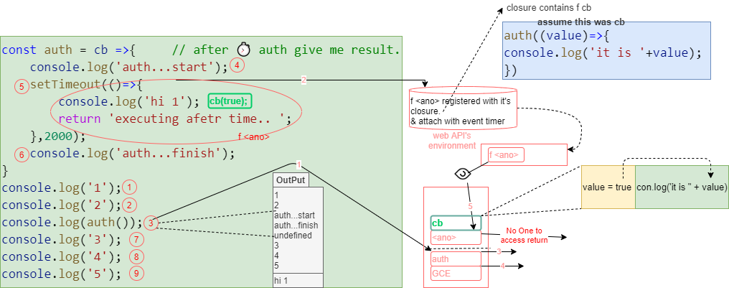
Async JS: Why Use CB rather than ‘return’

Slide 18
Async JS: Why Use CB rather than ‘return’
It’s not possible because when execution path reach this line there is nothing to return. Only registration on web API’s environment Is happens.
So data will be undefined. Same reason above case we got undefined with in console.log
So in order to handle asynchronous functions we have 2 ways
Callback
Promise

Slide 19
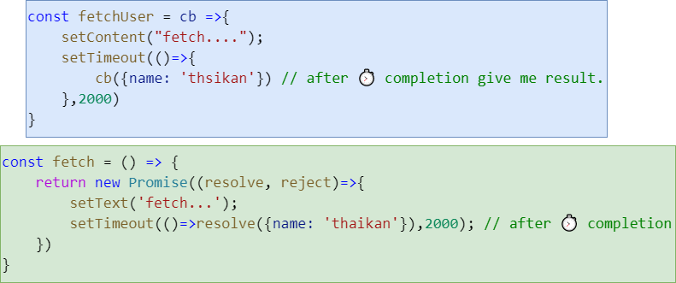
callback vs promise

Slide 20
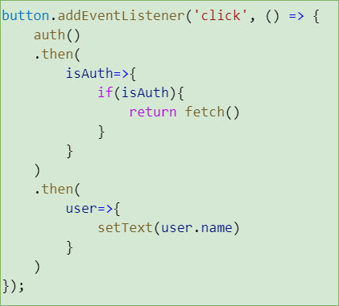
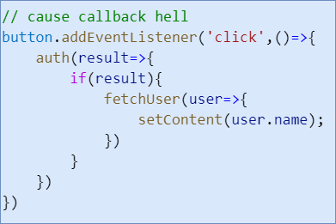
callback vs promise

Slide 21
Promise > Callback
Promises allow you to choose when you want to handle the result of an asynchronous call
Promises can be chained, and chains can be extended at any time
Promises allow you to effortlessly handle errors, even when chaining

Slide 22
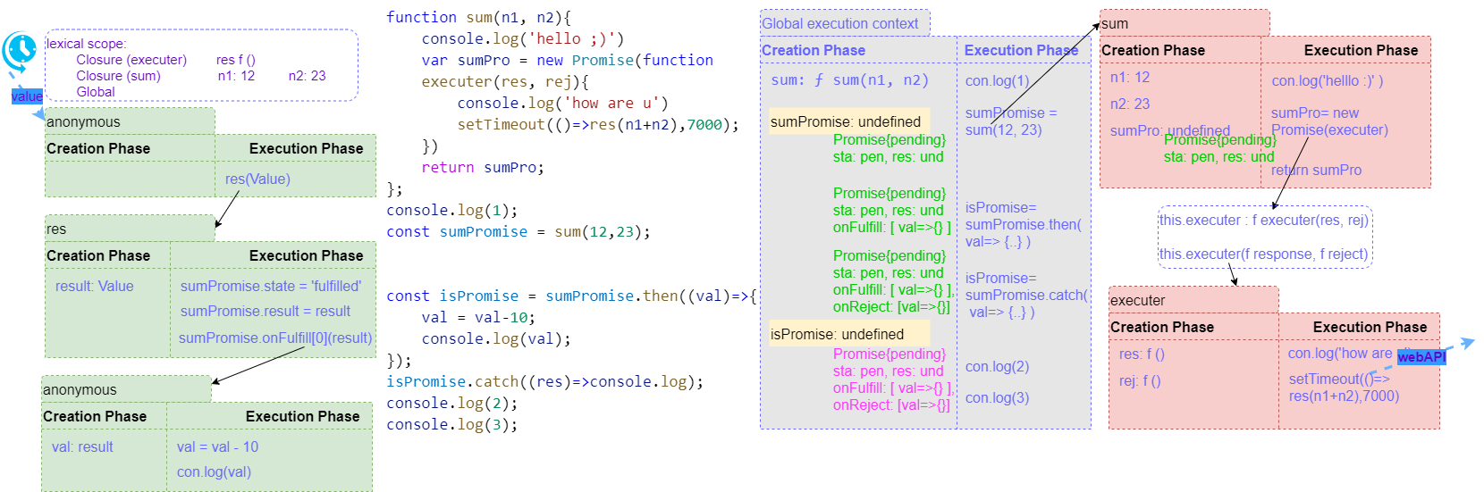
Promise

Slide 23
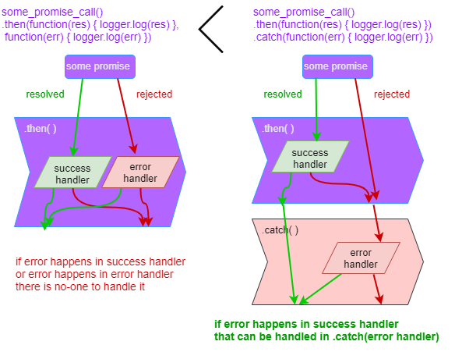
Promise

Slide 24
Using Promise
An Object with Properties and Methods
Represents the eventual Completion (or Failure) of an Asynchronous Operation and its resulting value.
Most case we are consuming promises, rather than creating It.
Essentially Promise: returned object, to this we attach callbacks.

Slide 25
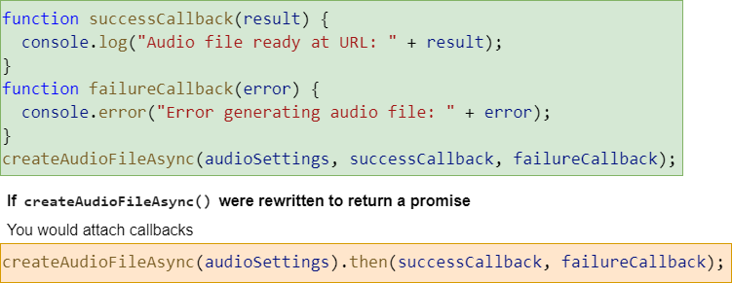
Using Promise
Imagine a Service: createAudioFileAsync() this will retune a audio File, based on our configurations.
Need to pass one configurationFile and 2 callback functions. One called if audio file creates successfully other called if an error occur.

Slide 26
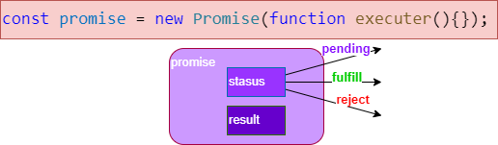
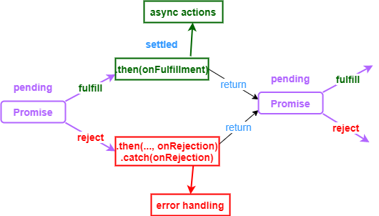
Async JavaScript : XMLHttpRequest

