Slide 1

DriverPass System Analysis
Tammy Hartline
Notes:
[No speaker notes required for this slide.]

Slide 2

System Requirements
Functional Requirements
User account creation functionality
User login and logout functionality
DMV connection that will allow the system to remain up-to-date on driving laws, policies, and procedures.
Non-Functional Requirements
User accessible functionality that will allow them to recover/reset their password.
Data storage to manage and store customer account information, (such as login info and package purchases), Calendar and Schedule data, Driver data, test and course information, available packages, etc.
Notes:
The user’s ability to create an account, then login/logout of that account is a critical functional requirement in order for the user to view their account information. The DMV functional requirement will allow the system to remain up-to-date, ensuring users get course material that is accurate and relevant to help them practice and prepare for their actual exam.
The non-functional requirement of password reset/recovery options is a nice to have UI functionality that will allow users to reset/recover their password in case they have forgotten it, or it has been compromised, or just to update for security reasons. The data storage to manage and locate customer information is needed to ensure clients who purchase packages, get access to all the features they paid for, are scheduled as intended with the driver that is available, and so on.

Slide 3
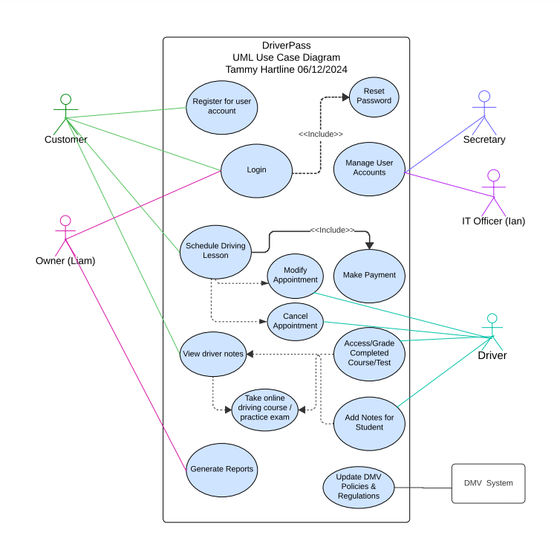
Use Case Diagram
Notes:
This diagram demonstrates the roles and access each stakeholder will have with the system based on the initial consult. The customer should be able to create an account, then login using their selected username/email and password. They should also be an option that will allow them to reset/recover their password. They should also be able to see and purchase available company packages. Based on the package selected, they can schedule, reschedule, or cancel their appointment with the driving instructor. Other features for the customer include access to up-to-date course and practice test material and notes containing tailored feedback from their instructor.
The owner will be able to login using their secure credentials, and generate reports to offer a full view of how the business and students are doing.
Both the office administrator/secretary and the IT officer will have secure login credentials that will allow them schedule, reschedule, or cancel appointments on the customers behalf for scenarios of customers coming into the office or calling to purchase a package. The access will also allow them the ability to add/update customer data in the system.
The DMV’s system will allow DriverPass to stay updated, containing the most relevant and reliable information contained in the courses and testing.
Another user is the employed driver. They will be able to access the system using secure login credentials that will allow them to view and grade students courses and practice tests, as well as add in additional tailored feedback in a notes section that the student can access. They will also be able to reschedule or cancel appointments as needed in case of emergencies or scenarios where they have a schedule conflict.

Slide 4
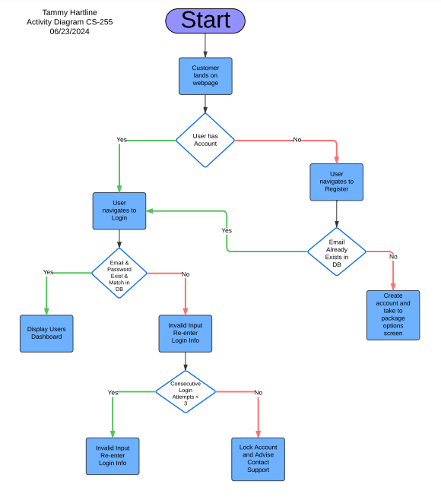
Activity Diagram
Notes:
Here is a visual presentation of how the login process for customers will work. The user lands on the DriverPass websites home page, and is then asked whether they have an account already. If they do, then they can select login and it will take them to the login screen. They can attempt to login using their credentials up to three times. If after the third attempt the credentials do not match, then the account is locked until they contact support and verify their information, or they can attempt to reset/recover their password. If they enter the a matching username and password on any of the first three attempts, they will be routed to their dashboard.
If the user is new, and does not yet have an account, they can select register, which will take them to the registration screen where they will need to input all of the relevant customer information and create the account. If upon submission, the email they entered is already found in the system, then it will notify them of the existing account and redirect to the login page. If the account is not found, then one is created with the entered information, and the customer is routed to the package options page.

Slide 5
Security
User verification
Admin verification
Limited login attempts
Offer Multi-factor Identification
Assign different permission levels based on role
Notes:
For security, we chose to take a simple, yet effective and efficient approach. Each user must verify their account by entering in a username/email and password, which is then compared to what is stored in the database.
If a user attempts to login and fails to enter the correct information three consecutive times, the account will be locked until they either verify their identity by resetting/recovering their password, or until they contact an administrator, who is able to verify their identity and reset their account.
One option included that increases security is multi-factor authentication. This is where the user can select to enable to enable this, which requires them to verify it is them each time they login using two different devices.
Finally, by limiting permissions on an as needed basis, you prevent access to proprietary information and data corruption. For example, adding permissions for your IT Officer to be able to view the database, update info manually if needed, and perform any updates as needed is not something you would want the customer to be able to access.

Slide 6
System Limitations
Internet Dependency
Scalability Challenges
Security Concerns
DMV Update Reliance
Limited Offline Access
Notes:
Most system functions require an internet connection. Limited offline functionality (mainly report downloading for the owner). Users without reliable internet access may face difficulties.
Potential issues handling rapid growth or expansion to multiple locations. Possible system overload with a sudden influx of customers.
While security measures are in place, online systems always face some level of cybersecurity risk.
System accuracy depends on timely updates from the DMV. Potential for outdated information if there are delays in receiving updates.
Most functionality requires an internet connection. Users can't access most information without internet access.
These limitations are common to many online systems and are not unique to DriverPass. They don't undermine the overall functionality and benefits of the system. The DriverPass system is designed to be dynamic and should meet all the specified requirements effectively.

