Slide 1
Ejercicio 4.1

Slide 2
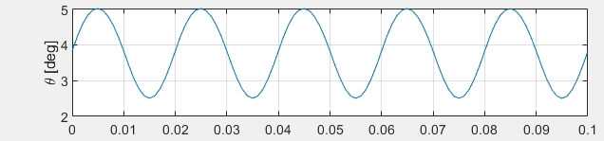
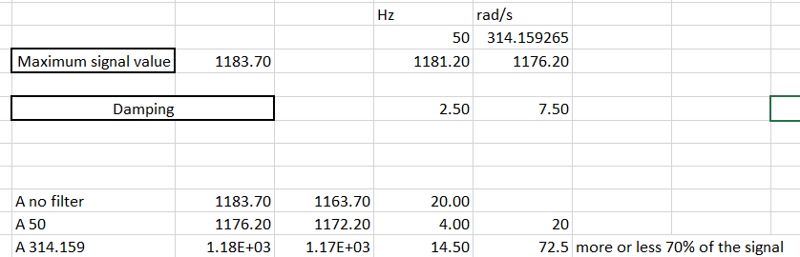
Apartado a)
Amplitude:
A = max(logsout.get('u').Values.theta_c.Data*360/2/pi) - min(logsout.get('u').Values.theta_c.Data*360/2/pi) = 2.5130
The signal is damped a 70% at 50Hz with a phase shift of 45 degrees which is a 6.2500 s time delay considering a period of 0,02 s of the signal

Slide 3
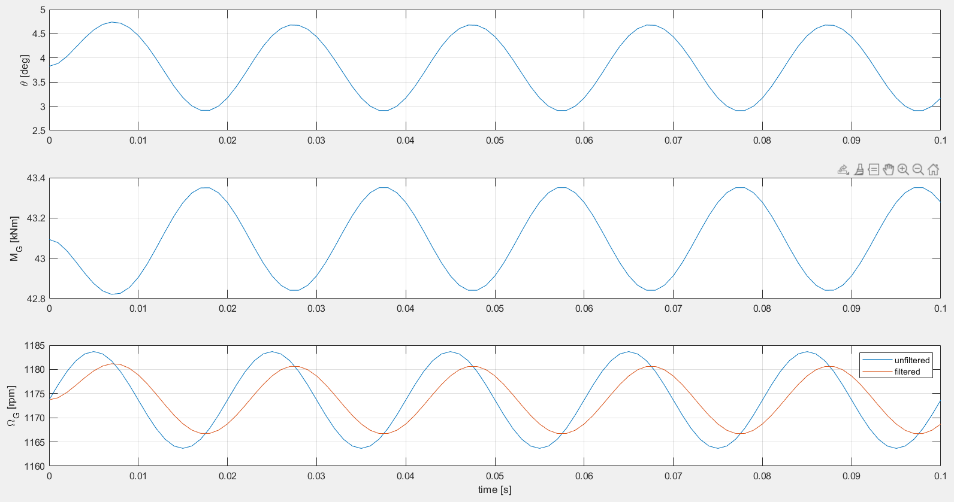
Apartado b)
The signal is damped a 70% in amplitude at 50Hz with a phase shift of 45 degrees which is a 6.2500 s time delay considering a period of 0,02 s of the signal
0.0290
$∆T=\frac{45}{360}·\frac{1}{f}=\frac{45}{360}·T=\frac{45}{360}·0,02=0.0025$s

Slide 4
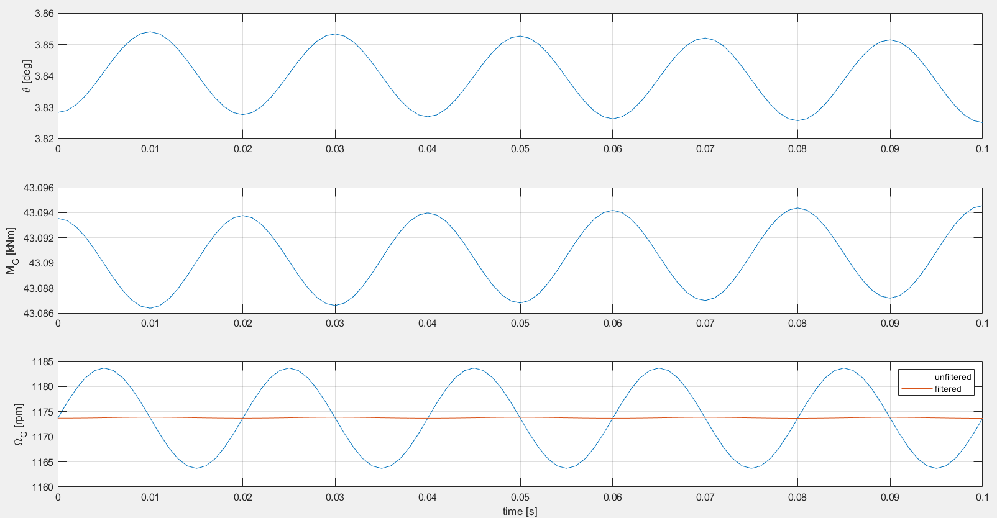
Apartado c)
A_pitch = 0.0290 deg
f = 0,5 Hz

Slide 5
Apartado d)
A notch filter because it allows to filter out a determined frequency

Slide 6
Ejercicio 4.2

Slide 7
Apartado a)
This frequency is making the tower vibrate to its natural frequency increasing the loads in the wind turbine system at some point if the loads are continuously being amplified by the resonance the turbine could collapse
The actuators (blade pitch angle and generator) are also experiencing higher usage which means a reduction in their useful lifetime
The power output will also present higher harmonics which will need to be filtered by the power electronics control

Slide 8
Apartado b)
f = 0,01 Hz to damp -40dB which is a 100% damping value
We have a larger motion when a change in the windspeed happens that seems not to be stabilized by the controller

Slide 9
Apartado c)
Parameters:
Parameter.Filter.NotchFilter.Enable = 1;
Parameter.Filter.NotchFilter.f = 0.324; % [Hz]
Parameter.Filter.NotchFilter.BW = 0.1; % [Hz]
Parameter.Filter.NotchFilter.D = 0.0; % [-]
The tower amplitude is reduced to up to a 95% of the value without the filter after applying the wind change

