Slide 1

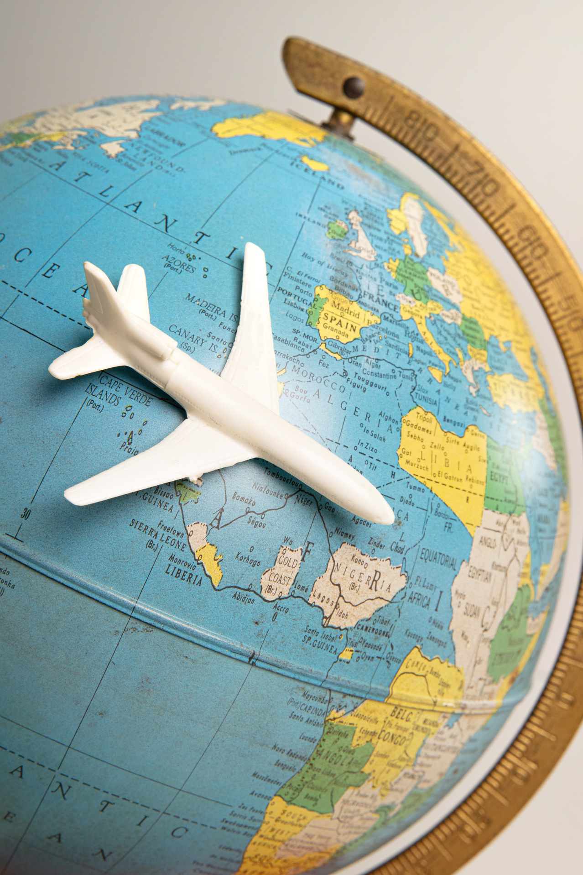
AIRLINE CUSTOMER SATISFACTION
Group 8
Fonseka G. T. A. - 15352
Kodikara G. A. T. I. - 15365
Gunathilaka K. K. D. S. N. - 15355
Page |
01

Slide 2


Group 8
PROBLEM
STATEMENT
Identify the key factors which lead to the satisfaction of airline passengers
Page |
02

Slide 3



Group 8
DATA SET
AND PREPARATION
Checking for missing values/duplicates.
Data Source :
Kaggle
A new columns 'Year' and 'Age Group' 'were added
Experience Attribute was grouped into 5 categories and stored under a new column 'Experience Category' in a new sheet
Page |
03

Slide 4
Group 8
KEY INSIGHTS
Number of responses are approximately equal in both years.
More than 80% of the passengers are returning customers.
Most people who have responded have flown for business reasons.
Net promoter score has increased by 46 units.
In overall net promoter score is high in 2022 compared to 2021.
As delays in flights increase average passenger score decreases.
Ease of booking and in-flight Wi-Fi services scores have increased in 2022.
Online booking, departure and arrival time convenience and in-flight Wi-Fi services have low satisfaction ratings.
Page |
04

Slide 5


Group 8
THANK YOU
Page |
5

