Slide 1
Capstone Project Shop For Home
Team:
Tharun kumar Chinchili
Saurav Kumar
Avula Venkata Mallikarjuna Gagandeep Reddy
Vedapriya M N
Srinivas Mundlamuri

Slide 2
INTRODUCTION
ShopForHome is a popular Store in the market for shopping the home décor stuff .Due to Covid 19 all the offline shopping stopped. So, the store wants to move to the online platforms and wants their own web application.
There are 2 users on the application: -
User
Admin
Online shopping or shopping is a form of electronic commerce which allows consumers to directly buy goods or services from a seller over the internet using a web browser.
It is a B2C process i.e. business to computer ecommerce.
As of 2016 ,customers can shop online using a range of different computers and devices ,including desktop computers, laptops, tablet computers and smartphones.
Online customers must have access to the internet and a valid method of payment in order to complete a transaction.
Online stores are usually available 24 hours a day and many consumers in Western countries have Internet access both at work and at home.

Slide 3
Objectives
Provide visitors a personalized experience.
Make your website responsive
Improve Customer Loyalty
Refine Service Efficiency
Establish Deeper Business Relationships

Slide 4
Online shopping Vs. Traditional Shopping
Online Shopper
I want to buy a dress let’s checkout online.
Easy to find best online stores.
Searching online styles.
I got a best coupon to shop.
Wow, Good discount
Hooray! Got it.
Traditional Shopper
1.I want to buy handbag lets go out find best store
2.Time to find out best store.
3.Oh,I got stucked in traffic
4.I found a shop at least
5.Salesman says no discount.
6.No Home delivery..

Slide 5
Features
User Stories –
User can login, Logout and Register into the application.
User can see the products in different categories.
User can sort the products.
User can add the products into the shopping cart.
User can increase or decrease the quantity added in the cart.
User can add “n” number of products in the cart.
User can get the Wishlist option where I can add those products which I want but don’t want to order now.
As a user I should get different discount coupons.

Slide 6
Admin Stories –
Admin can login, Logout and Register into the application.
Admin can perform CRUD on Users.
Admin can Perform CRUD on the products.
Admin has bulk upload option to upload a csv for products details
Admin is able to get the stocks.
Admin gets mail if any stock is less than 10.
Admin can get the sales report of a specific duration.
Admin is able to set the discount coupons for the specific set of users

Slide 7
System Requirements
CPU: Intel Core or Xeon 3GHz (or Dual Core 2GHz) or equal AMD CPU
Cores: Single (Dual/Quad Core is recommended)
RAM: 4 GB (6 GB recommended)
Graphic Accelerators: nVidia or ATI with support of OpenGL 1.5 or higher
Display Resolution: 1280×1024 is recommended, 1024×768 is minimum.

Slide 8
Tools used
Eclipse 2021-12
MySQL Workbench
Spring Boot
MySQL
Jdk 11
Vscode

Slide 9


Modules
The admin can login the system
Admin can create categories
Admin can upload products
Admin can create coupons
The Admin can create subcategories
Admin can upload product features
The buyers can login the system
The buyers can order a product
The buyers can search for a particular product
Buyer can apply coupons

Slide 10
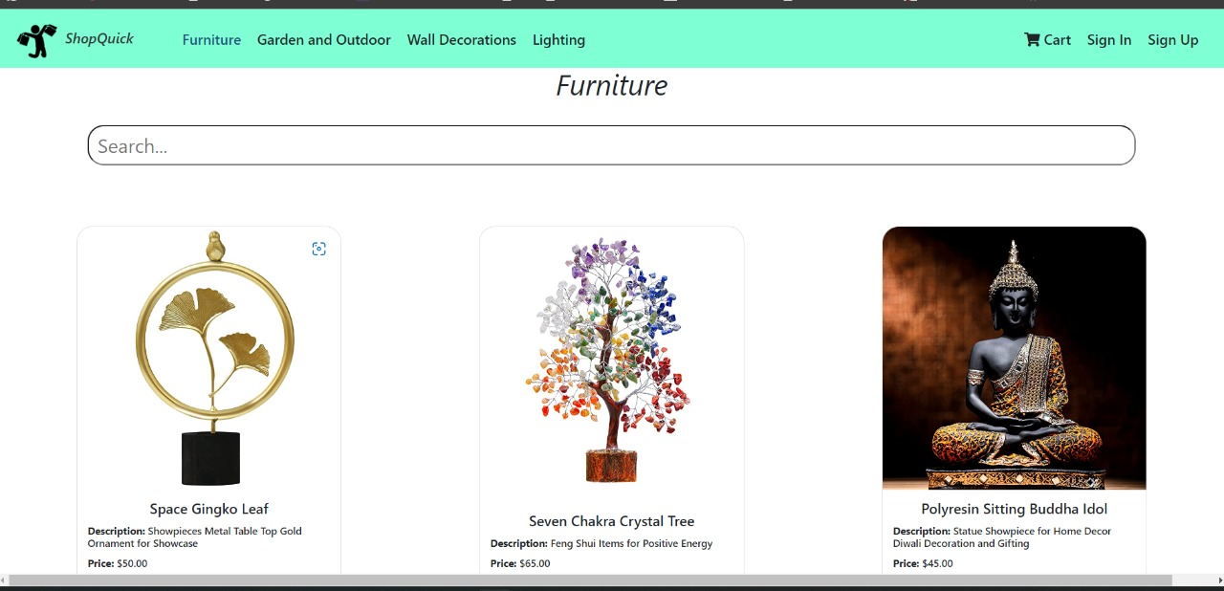
Screenshot
Welcome page

Slide 11
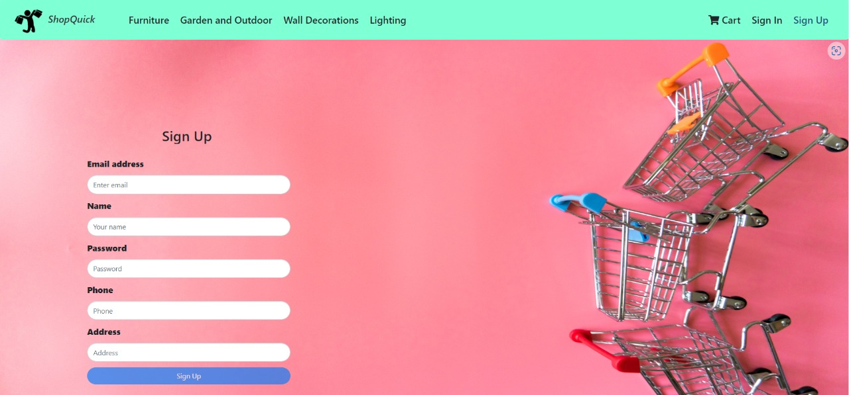
Signup page

Slide 12
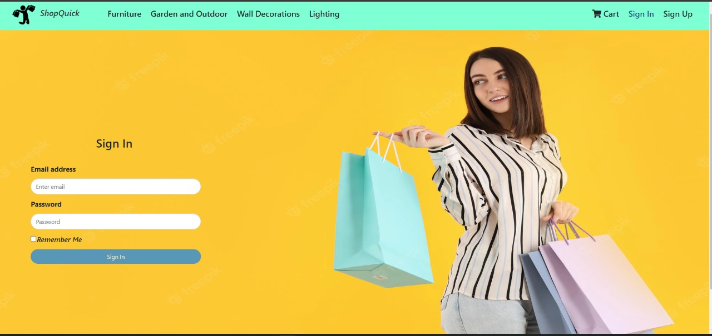
Sign-in page

Slide 13
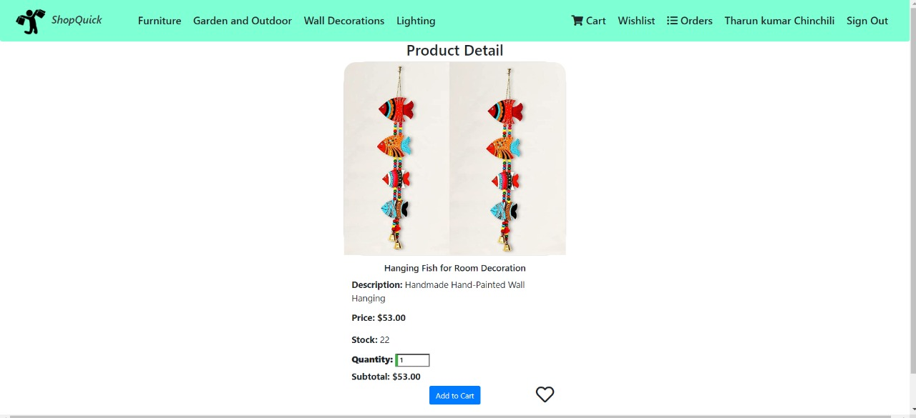
Product details page

Slide 14
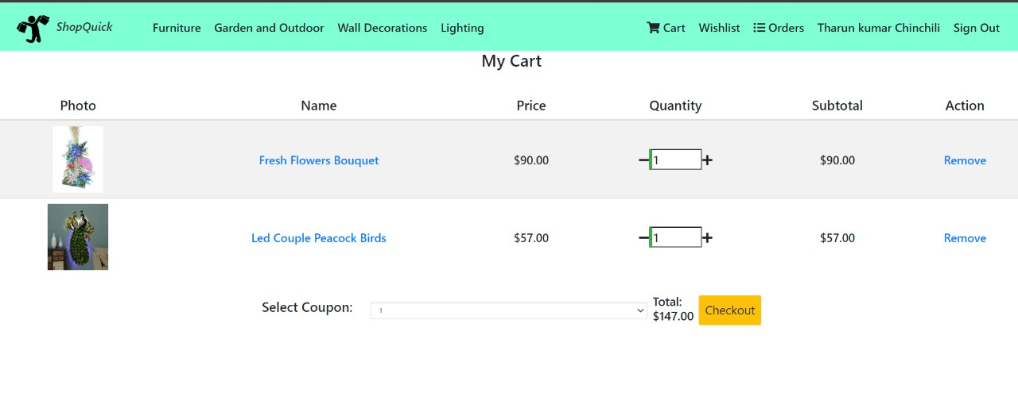
Cart page

Slide 15
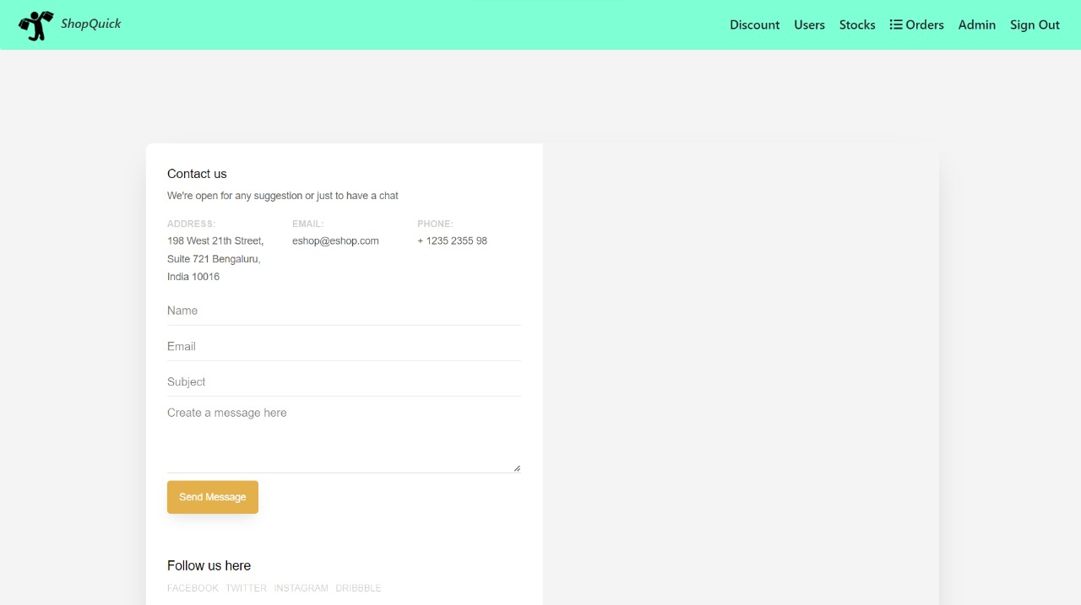
Contact page(when stock <10)

Slide 16
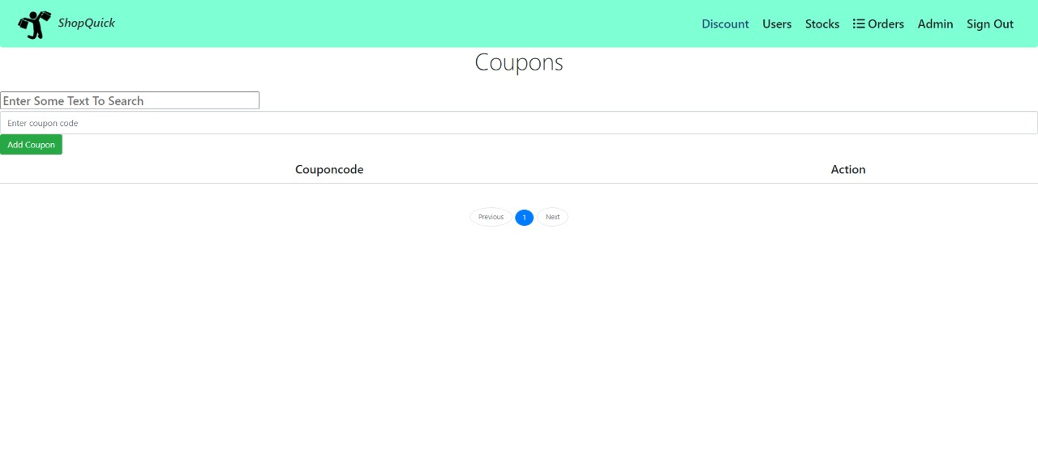
Coupons page

Slide 17
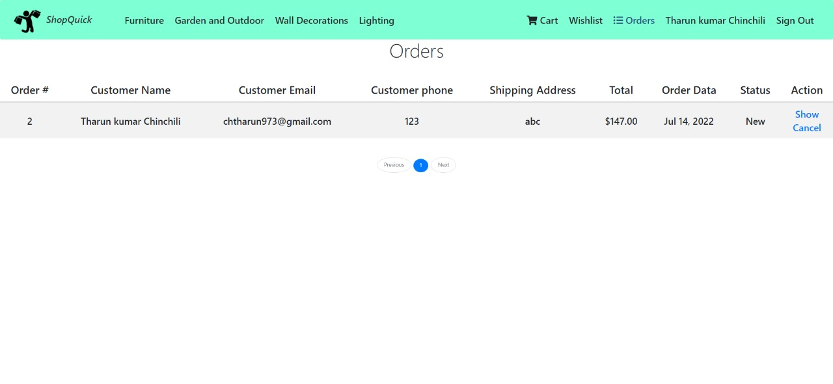
Orders page

Slide 18
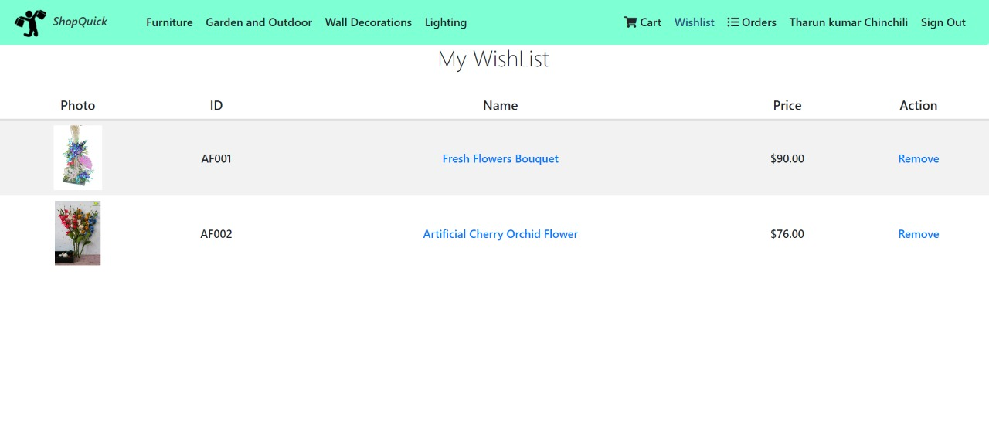
Wishlist page

Slide 19
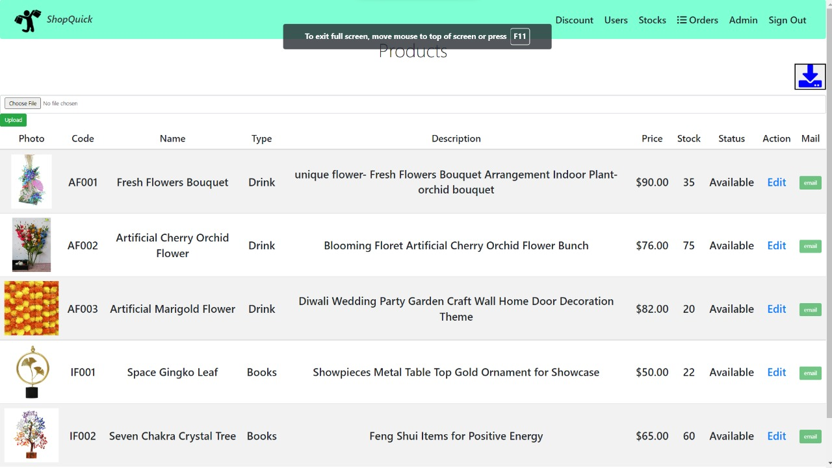
All products page(can add bulk product)

Slide 20
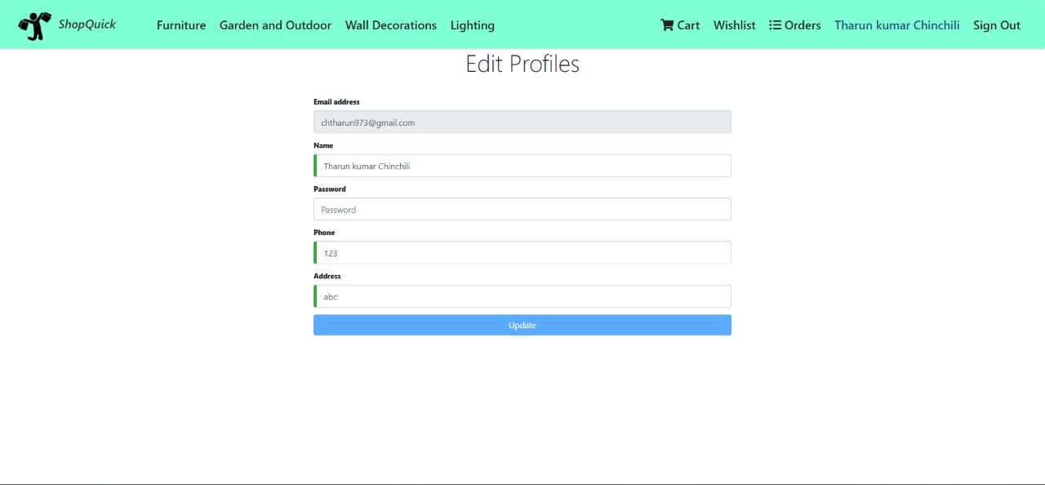
Edit profile page

Slide 21
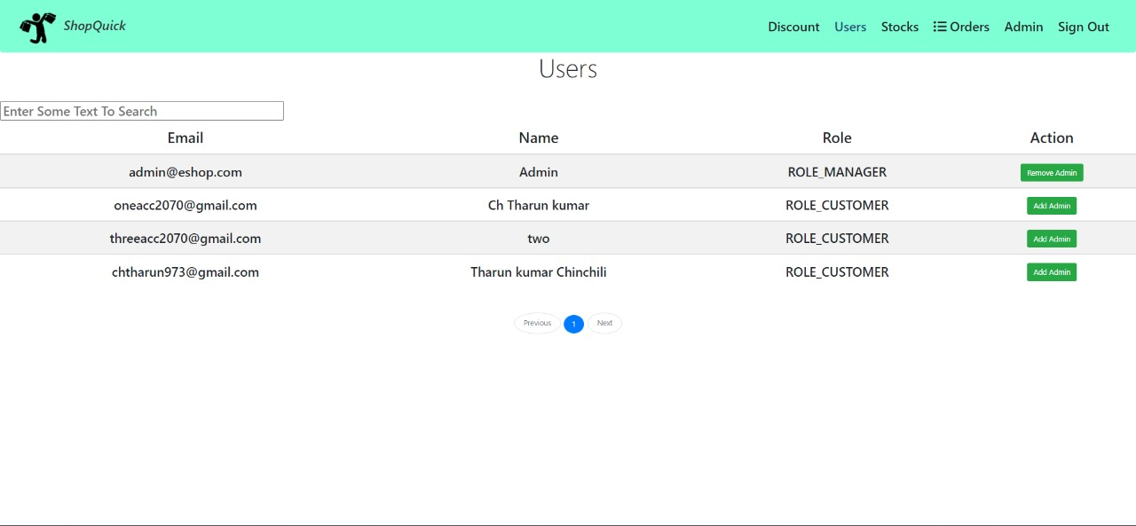
All users page

Slide 22
Future Scope
Social networking sites facilitate the purchasing of products from the comfort of our homes, offices, or anywhere with easy login.
As internet use has increased, the eCommerce business has also witnessed a sudden flourishing with it. This leads to an understanding that the internet has influenced the broadening of eCommerce businesses to a considerable proportion. So, we may expect the blooming of in near future in connection with the rise in internet usage.
Also, eCommerce has made the transportation of goods and services between consumers and online shops an effortless task. It even offers customers a tension-free environment to customers and makes their purchases more smooth.

Slide 23
Pros…
Can shop for 24*7.
No need for cash in hand.
A lot of stores within a click away.
Comparison is easy.
No queue to wait.
Shopping Privacy.
Regular discount coupons available

Slide 24
Cons
Not able to touch or ty.
Shipping and handling cost is more.
Credit/Debit card insecurity.
Take much time if connection is slow.
Returning goods is difficult.
Actual product may differ.
Availability of internet is a must.

Slide 25
Tips For Protection
Secured sites should be used.
Spams should be avoided.
Keep password private.
Read privacy and security policy carefully.
Consider alternative payment method.
https:// should be preferred.

Slide 26
Conclusion
It is an user friendly application and promotes user to purchase and shop faster.
With new technology comes better way of doing things.
Being able to buy anytime anywhere.
Allows to place order before purchasing.
Home delivery - you don’t have to travel to shops.
Widespread effects on economy and e-commerce.

