Slide 1
FORWARD DEPLOYED ENGINEER • CASE STUDY
Improving the MoveInSync
Employee App Rating
Public-evidence diagnosis, prioritized fixes, and a practical 30-day plan
Prepared by Tharun Teja
Evidence-led • Practical • Repeatable

Slide 2
01 • PROBLEM FRAMING
The assignment: move from rating to action
1. Establish the baseline
2. Diagnose the experience
3. Turn findings into fixes
Capture listing rating, total ratings, available distribution and collection date.
Use reviews to identify repeated pain points; compare negative and positive feedback.
Prioritize work, define owners, validate root causes and measure outcomes.
The goal is not just to describe the rating—it is to explain what to investigate and what the team should do next.
Public reviews show reported experiences, not proof of technical root cause.
The process should be repeatable as ratings and feedback change.
02

Slide 3
02 • EVIDENCE APPROACH
Data strategy: context + diagnosis
Listing context
All-rating sample
Low-star diagnosis
Current displayed rating, total ratings, update/version metadata and histogram when available.
Recent accessible reviews across 1–5 stars to understand the mix of reported experiences.
1–2 star reviews help surface specific failures and guide manual investigation.
Recorded collection run
1,000 unique reviews • 11 Oct 2026 UTC • newest accessible review pages • India storefront / English locale
Limitation: additional targeted 1-star / 2-star retrieval failed; the 292 low-star reviews came from the all-rating sample.
03

Slide 4
03 • SAMPLE PROFILE
What the collected sample contains
Star rating
5 stars
640
64.0%
292 low-star reviews
259 one-star + 33 two-star reviews in this sample.
1 star
259
25.9%
4 stars
42
4.2%
Interpretation
2 stars
33
3.3%
Recent convenience sample—not a representative estimate of all employees or historical reviews.
3 stars
26
2.6%
Listing-level score and total ratings were not captured in the saved metadata; verify separately.
04

Slide 5
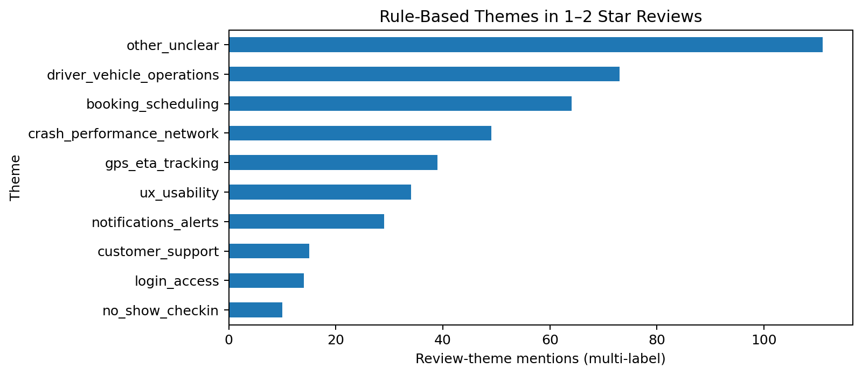
04 • THEME ANALYSIS
Reported pain points in low-star reviews
Largest buckets
Other / unclear, driver / vehicle operations, booking / scheduling.
Interpret carefully
Keyword tags can overlap. Counts are theme mentions, not mutually exclusive reviews.
Next: manually audit the largest categories and refine labels before making strong claims.
05

Slide 6
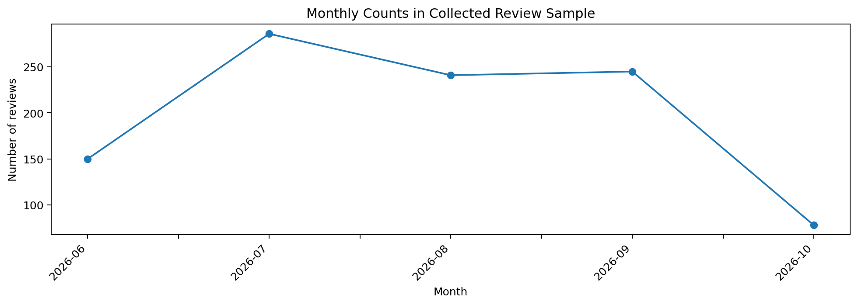
05 • TIME PATTERN
When were reviews in this sample posted?
Observed counts
Jun 150 • Jul 286 • Aug 241 • Sep 245 • Oct 78
Important caveat
October ends on 9 Oct and is incomplete. Counts are not normalized by trips or users.
Do not infer product quality improved or worsened from raw monthly counts alone.
06

Slide 7
06 • EVIDENCE DISCIPLINE
What public evidence can—and cannot—say
Supported by this analysis
Not established yet
• Users publicly report problems
• Theme patterns can guide investigation
• Help Center pages document support topics
• True prevalence among all trips
• Technical root cause of each complaint
• Whether one theme explains the overall rating
Validation requires authorized internal data
Booking/trip-state events and no-show dispute outcomes.
GPS/ETA timestamps, notification milestones, app version and crash data.
Support contacts and release timeline, using privacy-safe identifiers.
07

Slide 8
07 • RECOMMENDATIONS
Prioritize by impact and evidence—not volume alone
P0 • Booking correctness
P0 • No-show decisions
P1 • GPS / ETA
Trace booking intent vs. persisted trip state; add regression tests.
Audit check-in state, grace periods, overrides and disputes.
Measure location freshness and ETA error at journey checkpoints.
P1 • Notifications
P2 • Booking UX
Instrument trigger-to-delivery milestones; add useful fallback visibility.
Clarify confirmation, next steps and current booking state.
Provisional priorities: confirm them against operational evidence before committing to a fix.
08

Slide 9
08 • DELIVERY
A practical 30-day execution plan
Days 1–2
Confirm baseline; audit 50–100 reviews; align on issue definitions.
Days 3–5
Trace real cases with Product, Support and Operations; separate app vs. operational causes.
Week 2
Rank confirmed issues; agree owners, acceptance tests and baseline metrics.
Week 3
Ship one focused fix to a limited cohort; monitor outcomes and rollback criteria.
Week 4
Compare against baseline; document what improved and what should happen next.
Weekly rhythm: learn → assign owner → act → measure → share results.
09

Slide 10
09 • SUCCESS METRICS
Measure employee outcomes, not only stars
Booking mismatch rate
Stale-location rate
ETA error
Intent vs. persisted booking
Tracking updates older than threshold
Predicted vs. actual arrival
Notification latency
False no-show rate
Low-star share
Trigger to delivery milestone
Audited incorrect no-show decisions
New 1–2 star reviews / all new reviews
Set thresholds after baseline; document metric owner, source query, time window and exclusions.
10

Slide 11
10 • OPERATING MODEL
Make the review-to-action loop repeatable
Collect
Classify
Validate
Prioritize
Ship & learn
Refresh public feedback and listing snapshot
→
Tag themes; manually audit sample
→
Check authorized trip/support data
→
Rank by impact and confidence
→
Release fix; measure; update backlog
Keep source URL, collection timestamp, tag rationale, owner, decision and release annotation for each material finding.
Keyword or AI tags should assist triage—not be treated as ground truth.
11

Slide 12
CONCLUSION
Make the employee journey dependable.
Then prove the fix worked.
Listen to employees, validate the failure, fix the highest-impact issue, and measure the journey outcome.
Thank you • Tharun Teja
Evidence-led • Practical • Repeatable

