Slide 1

LEARNING JOURNEY / TECHNICAL DEMO
Learning & Application
Development Journey
Scala, Apache Wicket & PL/SQL
From concepts to a practical Metro UFM demo application
LEARN
PRACTICE
BUILD
IMPLEMENT
IMPROVE
01 / 12

Slide 2
01 / PURPOSE
Objectives & Technology stack
A focused learning path: framework skills applied through a small enterprise-style demo.
STACK
01
Scala for application development
S
Scala
AW
Apache Wicket
02
Apache Wicket server-side web development
LANGUAGE
WEB UI
S
sbt
H/
HTML / CSS
03
PL/SQL and database-side programming
BUILD
VIEW
04
Apply concepts in a practical application
JDBC
PL/SQL / Oracle
J
P/
DATA ACCESS
DATABASE
05
Understand enterprise application structure
METRO UFM DEMO • LEARNING JOURNEY

Slide 3
02 / LANGUAGE
Scala learning & implementation
Concepts learned, then applied to the page, service and data-model code.
APPLIED IN THE DEMO
01
02
03
Pages
Wicket screens + event handlers
FOUNDATIONS
DATA MODELING
COMPOSITION & SAFETY
. Variables
· Data types
· Functions
. Classes & Objects
· OOP
. Collections
· Case Classes
· Option
. Pattern Matching
. Higher-order functions
. Exception handling
Services
Application behavior and coordination
Models
Form-bound values and domain data
Repositories
Oracle supplier query + mock data paths
LEARNING → PRACTICE
Scala is the application language for page logic, service code, models and repository implementations.
Examples in the repository: page-level state, service/repository boundaries, case-class data models.
METRO UFM DEMO • LEARNING JOURNEY

Slide 4
03 / WEB FRAMEWORK
Apache Wicket learning & implementation
A server-side, component-based framework: HTML markup is bound to Scala components.
HTML
WICKET
SCALA
SERVER
wicket:id
Component tree
Page logic
Processing
PAGE & CONTENT
FORMS & CHOICE
. WebPage · Panels · ListView
. DataTable · Label · Link
. Form · TextField · TextArea
. DropDownChoice · CheckBox · RadioChoice · Button
BINDING & FEEDBACK
ASYNC & EVENTS
Models · PropertyModel
CompoundPropertyModel · FeedbackPanel · Validation
AJAX · AjaxButton . AjaxRequestTarget
CORE IDEA
Component IDs in markup must match the Wicket component tree.
METRO UFM DEMO • LEARNING JOURNEY

Slide 5
04 / DATABASE
PL/SQL learning & implementation
Database programming concepts studied alongside the application data-access path.
SQL fundamentals
Variables & Data Types
Conditionals
Loops
Procedures
Functions
Cursors
Exceptions
Triggers
Database Business logic
CONCEPTUAL INTEGRATION FLOW
Application
Service / DAO
JDBC
Oracle
PL/SQL
SCOPE CHECK
Oracle supplier lookup is wired through JDBC. Broader PL/SQL routines and business writes are implemented.
METRO UFM DEMO • LEARNING JOURNEY

Slide 6
05 / PROJECT
Metro UFM Demo — project overview
An enterprise-style UI demonstration for ordering, stock assignment and parameter screens.
PROJECT PURPOSE
Login + shell
Implemented UI / flow
Practice the full path from web interaction to application and data-access code.
DSD Order
Interactive UI
Scala 2.13 • Apache Wicket • sbt
HTML/CSS • JDBC • Oracle driver
Stock Assignment
Mock-backed results
Steering Parameter
Page-local state
CURRENT SCOPE
METRO UFM DEMO • LEARNING JOURNEY

Slide 7
06 / ARCHITECTURE
Architecture & technology integration
The source has a Wicket → Scala → service/repository shape; only selected data paths reach Oracle.
USER
Browser interaction
WICKET
Render screens and handle requests
APACHE WICKET UI
Pages · panels · component tree
SCALA APP LOGIC
Page behavior · models · validation
SCALA
Hold application behavior and models
SERVICE LAYER
Feature orchestration
REPO
Read from Oracle data
REPOSITORY / DAO
Oracle supplier query repositories
JDBC
Connection + SQL for supplier lookup
PL/SQL
Specified as future database-side logic
ORACLE
Supplier lookup; broader PL/SQL
METRO UFM DEMO • LEARNING JOURNEY

Slide 8
07 / APPLICATION MAP
Modules & navigation
A simple path through the demo; badges distinguish implemented interaction from data backing.
LOGIN
APPLICATION SHELL
ORDERING
ORDERING
PARAMETER
DSD ORDER
STOCK ASSIGNMENT
STEERING PARAMETER
Oracle supplier lookup article rows
Stock-backed result rows
Page-local controls / state
METRO UFM DEMO • LEARNING JOURNEY

Slide 9
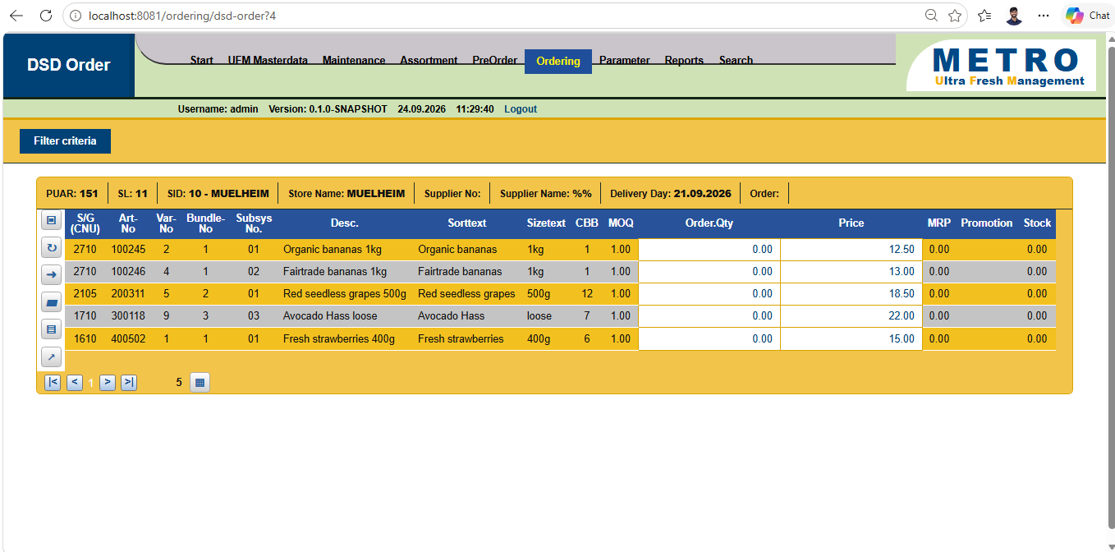
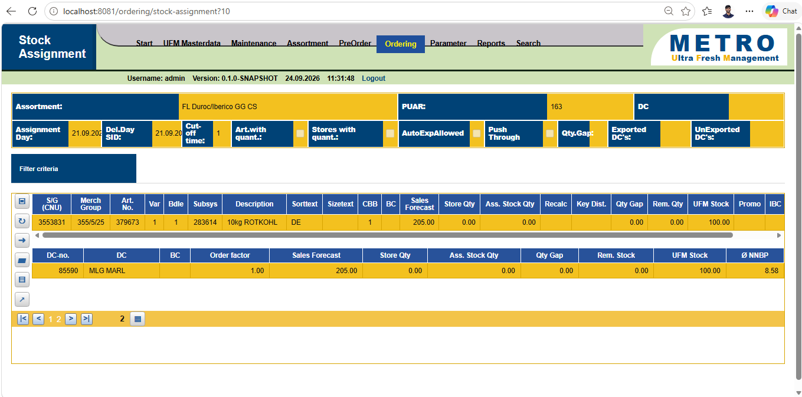
08 / LIVE WALKTHROUGH
Implementation & live demonstration
• UI images below are project reference screenshots.
1
Login
7
Supplier lookup
2
Application Shell
8
Order results
3
Navigation
9
Stock Assignment
4
DSD Order
DSD Order result • UI reference
10
Assignment day / date
5
Filter functionality
11
Steering Parameter
6
Delivery day / date
Presenter cue
Call out the Oracle-backed supplier lookup rows.
Stock Assignment • UI reference
The walkthrough demonstrates UI and selected interactions; it is not an end-to-end persistent order workflow.
METRO UFM DEMO • LEARNING JOURNEY

Slide 10
09 / ENGINEERING PRACTICE
Challenges & solution approach
Representative Wicket and integration checkpoints — framed as investigation patterns, not a defect log.
01
ID mismatch
02
Input compatibility
03
AJAX refresh
CHECK › Compare HTML wicket:id with the component tree
CHECK › Check HTML input type against Wicket field model
CHECK › Verify updated component is attached to the page
APPROACH › Keep markup and Scala IDs aligned
APPROACH › Use a component-compatible input type
APPROACH › Refresh the intended output container
04
ListView partial update
05
Supplier lookup
06
Runtime debugging
CHECK › Check the repeater’s parent markup / output markup
CHECK › Trace service → Oracle repository → JDBC settings
CHECK › Read the exception and follow the component/data path
APPROACH › Target a refreshable wrapper when needed
APPROACH › Separate lookup boundary from mock rows
APPROACH › Reproduce, isolate, then verify interaction
KEY LEARNING
A Wicket screen is a contract across markup, components, models, behaviors and update targets.
Data-boundary challenge observed in this project: Oracle supplier lookup coexists with mock article / assignment data.
METRO UFM DEMO • LEARNING JOURNEY

Slide 11
10 / REFLECTION
Key learnings
What the build helped make concrete — and what remains beyond the current implementation.
LEARNED THROUGH BUILDING
Scala application structure
Pages, services, repositories and models
Wicket component architecture
Markup IDs, model binding, form controls
AJAX interaction
Partial-page update targets
Data access boundaries
JDBC supplier query repositories
Enterprise design thinking
Separate UI behavior from persistence
PL/SQL is a learning/specification area in this demo; broader stored-program behavior is future scope.
METRO UFM DEMO • LEARNING JOURNEY

Slide 12
11 / 12 • CONCLUSION
From Learning to
Implementation
LEARN
UNDERSTAND
PRACTICE
BUILD
DEBUG
IMPLEMENT
“The learning journey helped me move beyond theoretical knowledge by applying Scala, Apache Wicket, and PL/SQL concepts in a practical application and understanding how the technologies work together in an enterprise application.”
Thank You
METRO UFM DEMO • TECHNICAL DEMONSTRATION
12 / 12

