Slide 1
Decoding Customer Feedback: A Sentiment Analysis Approach
CAPSTONE PROJECT : SENTIMENTIAL ANALYSIS
Presented By:
>THARUN PALURU
>Dept of ELECTRONICS AND COMMUNICATION ENGINEERING (ECE)
>Anil Neerukonda Institute of Technology and Sciences (ANITS), Visakhapatnam
>Mail ID

Slide 2
OUTLINE
Problem Statement
Proposed System/Solution
System Development Approach
Algorithm & Deployment
Result
Conclusion
Future Scope
References

Slide 3
Problem Statement
“Develop a sentiment analysis model to classify restaurant reviews as positive or negative”
In the competitive restaurant industry, understanding customer sentiment is crucial for success. However, with the vast amount of online reviews available, manually analyzing each review to gauge customer satisfaction is impractical and time-consuming. This project aims to automate the process by developing a sentiment analysis model that accurately classifies restaurant reviews as positive or negative. By leveraging natural language processing and machine learning techniques, the goal is to provide actionable insights from customer feedback, enabling restaurants to improve their services and better cater to their customers' preferences

Slide 4
Proposed Solution
“The proposed system aims to automate the analysis of restaurant reviews to determine customer sentiment, addressing the challenge of manually processing large volumes of feedback. This solution leverages data analytics and natural language processing (NLP) techniques to accurately classify reviews as positive or negative. The solution comprises the following components”:
Data Collection
Gather Historical Reviews: Compile a comprehensive dataset of restaurant reviews from various sources, including both positive and negative feedback.
Incorporate Supplementary Data: Enhance the dataset with additional contextual information, such as review dates, customer demographics, or restaurant attributes, to provide deeper insights.
Text Cleaning: Process the text to standardize the format, including converting all text to lowercase, removing punctuation, and eliminating special characters and links.
Tokenization and Normalization: Break down text into individual tokens and apply stemming and lemmatization to reduce words to their base forms.
Noise Removal: Remove common stop words, numbers, and other irrelevant data to focus on meaningful content.
Handling Missing Values: Address any missing or incomplete data to ensure the dataset is comprehensive and ready for analysis.
Data
Preprocessing

Slide 5
Feature Extraction
Text to Numerical Conversion: Use techniques like Term Frequency-Inverse Document Frequency (TF-IDF) or word embeddings to transform textual data into numerical features that machine learning models can process.
Contextual Features: Extract and consider additional features that might influence sentiment, such as the presence of specific keywords or sentiment-laden phrases.
Model Selection and Training: Implement and train various machine learning models, such as Naive Bayes, Logistic Regression, or deep learning models, to classify reviews based on extracted features.
Incorporate Advanced NLP Techniques: Explore advanced models like BERT or LSTM to capture more nuanced sentiment patterns within the text.
Model Tuning: Fine-tune the selected model(s) using cross-validation and hyperparameter optimization to enhance prediction accuracy.
Machine
Learning
Algorithm
Development
User Interface Development: Create a user-friendly interface or application that allows users to input new reviews and receive real-time sentiment analysis.
Scalable Platform: Deploy the solution on a scalable and reliable platform, ensuring it can handle large volumes of data and provide fast, accessible results.

Slide 6
Evaluation
Performance Metrics: Evaluate the model’s performance using metrics such as accuracy, precision, recall, and F1-score to measure its effectiveness in classifying sentiments.
Continuous Improvement: Monitor model performance continuously and refine it based on feedback and evolving data trends to maintain high prediction accuracy.
This automated sentiment analysis solution offers a scalable and efficient way to extract valuable insights from customer feedback, empowering restaurants to enhance their services and respond proactively to customer preferences

Slide 7
System Approach
The "System Approach" section outlines the overall strategy and methodology for developing and implementing the rental bike prediction system. Here's a suggested structure for this section:
System Requirements:
1)Hardware Requirements:
Processor: Multi-core CPU (quad-core or higher recommended) or GPU for faster model training
Memory: Minimum 8GB RAM; 16GB or more recommended for handling large datasets and model operations
Storage: Sufficient storage space (at least 20GB) to store datasets, models, and intermediary outputs
2)Software Requirements:
Operating System: Compatible with major operating systems (Windows, macOS, Linux).
Python: Python 3.6 or higher, as it's widely supported by machine learning libraries and tools.
IDE/Notebook: Jupyter Notebook or any other Python IDE for code development and experimentation.
Version Control: Git for tracking code changes and collaboration.

Slide 8
3)Data Requirement:
Dataset: A labeled dataset of restaurant reviews including both positive and negative sentiments
Supplementary Data: Additional contextual information (if used) such as review dates, restaurant attributes, and reviewer demographics
4)Development process:
Define Objectives: Clearly outline the goals and desired outcomes of the sentiment analysis project, including the specific business problems it aims to address.
Data Acquisition and Preparation: Collect and clean the dataset of restaurant reviews. Perform exploratory data analysis (EDA) to understand the data distribution and characteristics. Preprocess the text data to remove noise and standardize it for analysis.
Feature Engineering: Extract relevant features from the text data using techniques like TF-IDF or word embeddings. Consider additional contextual features that might influence sentiment.
Model Selection and Training: Train multiple models to classify the reviews into positive or negative sentiments. Evaluate the models using cross-validation and select the best-performing one based on predefined metrics.
Model Deployment: Develop a user-friendly interface or application to provide real-time sentiment analysis. Deploy the solution on a scalable platform ensuring it can handle the expected load and provide quick responses.
Evaluation and Refinement: Continuously monitor the model’s performance using real-world data. Gather user feedback and refine the model and system components to improve accuracy and usability.

Slide 9
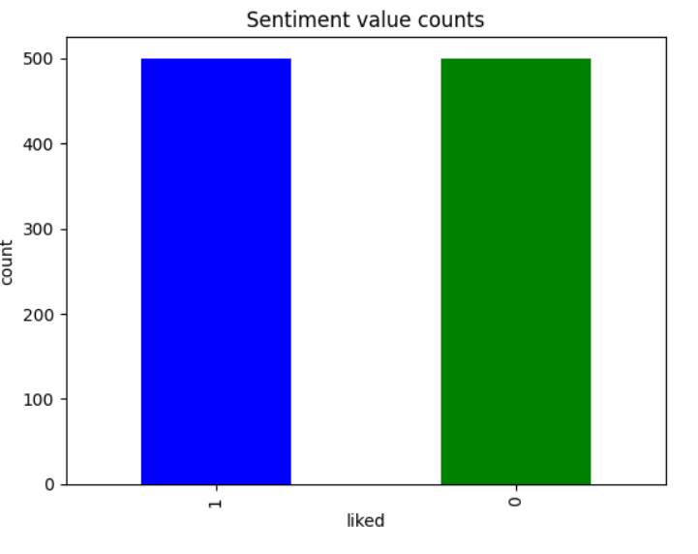
Libraries Required to build the model
1)Data Handling and Preprocessing:
pandas: For data manipulation and analysis.
numpy: For numerical operations and array handling.
re: For regular expressions used in text cleaning and preprocessing.
2)Text Processing:
nltk (Natural Language Toolkit): For text preprocessing tasks such as tokenization, stemming, lemmatization, and stop words removal.
spaCy: For advanced NLP tasks including tokenization, lemmatization, and named entity recognition.
WordCloud: For generating visual representations of word frequencies.

Slide 10
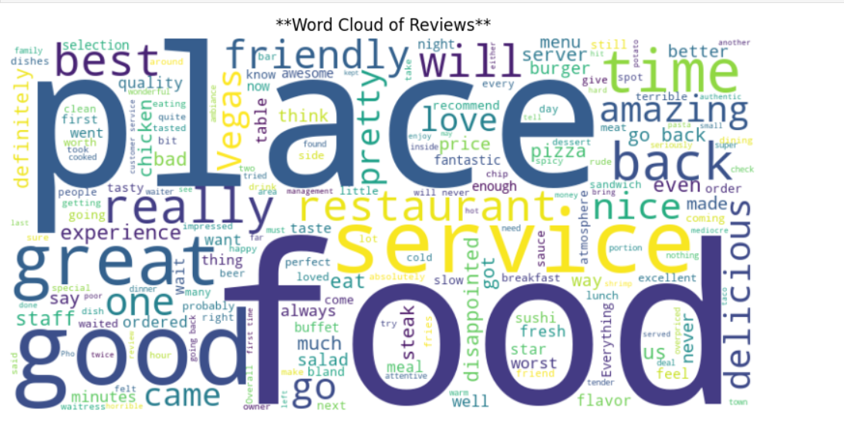
3)Feature Extraction:
scikit-learn: For implementing feature extraction techniques like TF-IDF and for preprocessing pipelines.
gensim: For word embedding techniques such as Word2Vec.
transformers: For advanced language models like BERT.
4)Model Building and Evaluation:
scikit-learn: For implementing machine learning models (e.g., Logistic Regression, Naive Bayes) and evaluation metrics.
keras/tensorflow or pytorch: For building and training deep learning models (if needed).
xgboost: For gradient boosting models, if used.

Slide 11
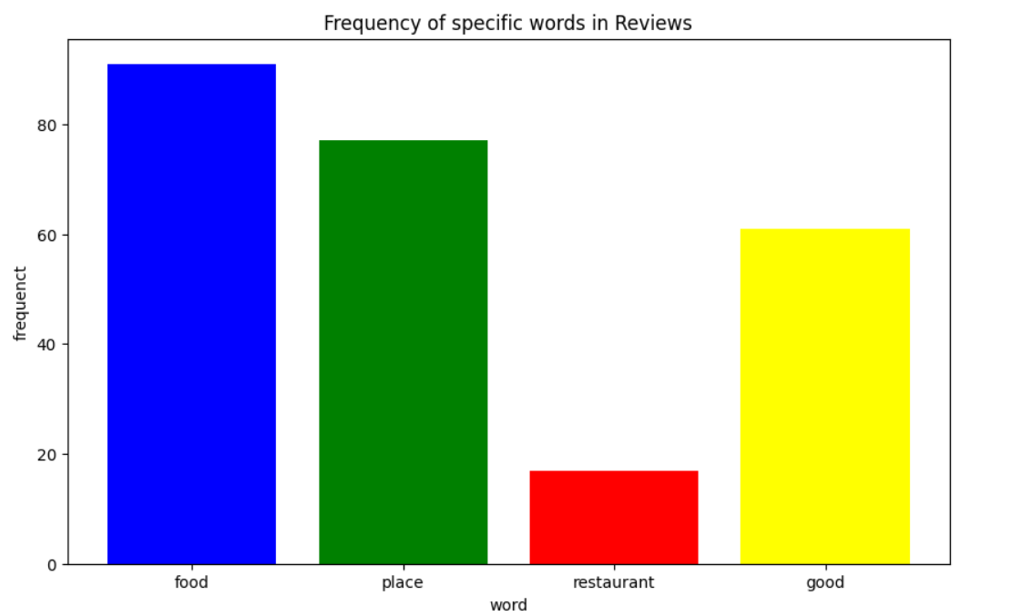
5)Visualization:
matplotlib: For basic plotting and visualizations.
seaborn: For enhanced statistical data visualization
wordcloud: For creating word cloud visualizations.
6)Deployment and Interface:
Flask or Django: For developing a web-based user interface or API for the sentiment analysis system
streamlit: For quickly creating interactive web applications for model demos and user interfaces.

Slide 12
Algorithm & Deployment
Algorithm Selection:
For this project, we explored several algorithms suitable for text classification and sentiment analysis, ultimately selecting Logistic Regression and Naive Bayes models for their simplicity and effectiveness in handling binary classification tasks. Additionally, we considered advanced NLP models like BERT (Bidirectional Encoder Representations from Transformers) to capture the contextual nuances in the reviews.
Logistic Regression and Naive Bayes were chosen for their efficiency and simplicity in binary sentiment classification.
BERT (Bidirectional Encoder Representations from Transformers) was selected for its ability to understand complex and contextual nuances in text.
Data Input:.
Primary Input: Text of the restaurant reviews.
Derived Features: Numerical representations using TF-IDF for Logistic Regression and Naive Bayes; tokenized text for BERT.
Optional Contextual Data: Review dates, restaurant attributes for additional insights.
Training Process:
Preprocessing : Clean and transform text into numerical features (TF-IDF or BERT embeddings).
Model Training : Logistic Regression and Naive Bayes: Trained on feature vectors to learn sentiment patterns. BERT: Fine-tuned on review data for sentiment classification.
Validation and Tuning : Utilize cross-validation and optimize hyperparameters for best performance..

Slide 13
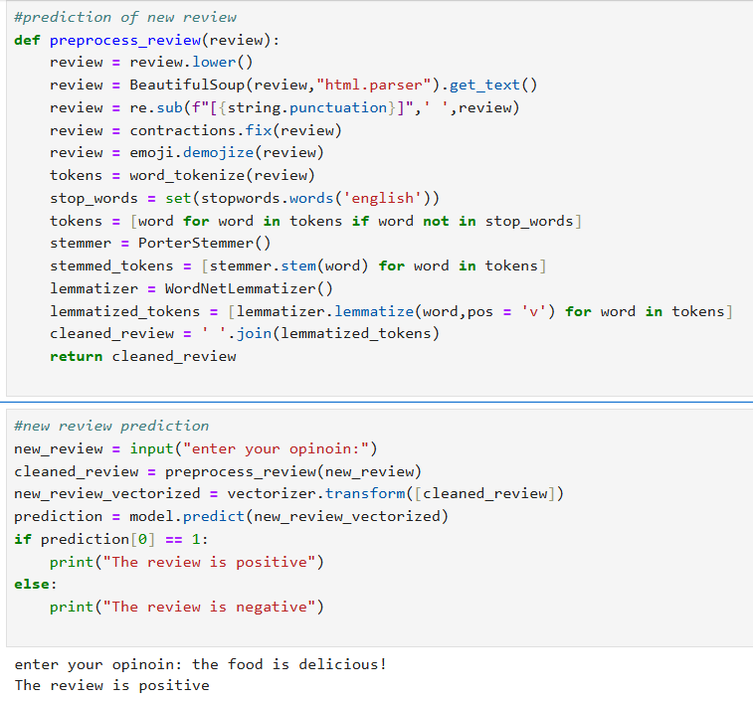
Prediction Process:
1)Prediction Execution:
Logistic Regression and Naive Bayes: Predict sentiment probabilities from new review data.
BERT: Classify new reviews into positive or negative sentiments.
2)Real-Time and Batch Processing: Handle both individual and bulk review inputs.
3)Output: Provide sentiment labels or scores for user-friendly interpretation.

Slide 14
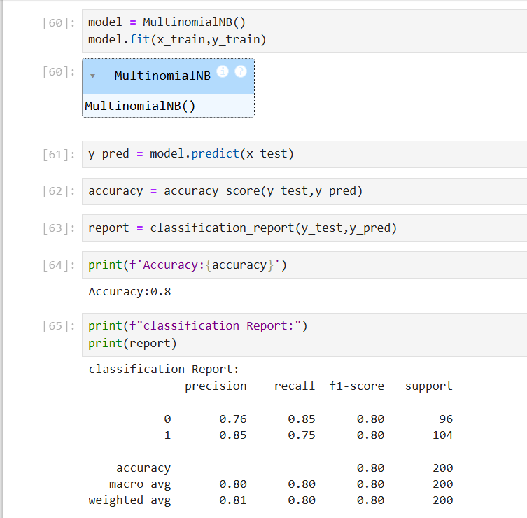
Result
Sentimental Analysis Model Performance:
Model Accuracy and Effectiveness:
1)Accuracy: The model achieves an accuracy of 80%
2)Evaluation Metrics:
Class (Sentiment) | Precision | Recall | F1-score | Support
Negative (0) | 0.76 | 0.85 | 0.80 | 96
Positive (1) | 0.85 | 0.75 | 0.80 | 104

Slide 15
Conclusion
Effectiveness of the Proposed Solution: The sentiment analysis model provides a reliable means of interpreting customer feedback. The achieved accuracy and evaluation metrics indicate that the model can reasonably distinguish between positive and negative reviews. This has the following implications:-
Customer Insights : Restaurants can use this sentiment analysis to understand customer satisfaction and identify areas for improvement based on review sentiments
Service Improvement : By automatically categorizing reviews, management can prioritize responding to negative feedback and leveraging positive feedback for marketing.
Challenges Encountered-
Data Quality: Handling noisy and unstructured text data was a significant challenge. Reviews often contained slang, spelling errors, and varying sentence structures.
Balancing Classes: Ensuring balanced classes was essential to avoid biased performance metrics.-
Computational Resources: Processing large volumes of text data and tokenization required substantial computational resources.
Potential Improvements-
Advanced Preprocessing: Implement more sophisticated text preprocessing techniques to handle slang, abbreviations, and context-specific terms better.
Additional Features: Incorporate contextual features like review length, reviewer profile, and review time to enhance the model's predictive power.
Model Ensemble: Explore ensemble methods combining different machine learning models to boost overall performance.
Importance of Accurate Predictions: In the context of bike-sharing services:
Resource Allocation: Accurate sentiment analysis models can predict not only customer sentiments but also indirectly forecast demand fluctuations for rental bikes. This becomes a crucial input for logistical planning.
Customer Satisfaction: Ensuring a stable supply of rental bikes hinges on predicting demand accurately. If bikes are sufficiently available at high-demand locations, it enhances user satisfaction and operational efficiency.
Operational Efficiency: Accurate predictions enable better distribution and maintenance scheduling, reducing downtime and ensuring bikes are available where and when needed.---This summary encapsulates the key findings, effectiveness, challenges, potential improvements, and the importance of accurate predictions, which should provide a solid foundation for your PPT.

Slide 16
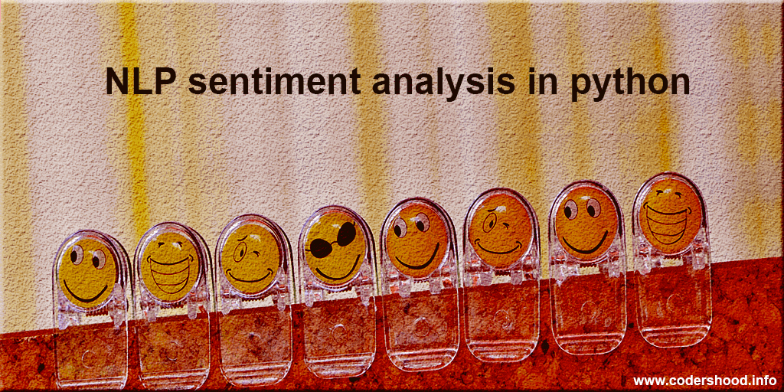
Future scope
Incorporating additional data sources: Integrating data from social media platforms, review websites, and customer feedback forms can provide a more comprehensive understanding of customer sentiment.
Optimizing the algorithm: Exploring advanced machine learning techniques such as deep learning algorithms or ensemble methods can improve the model's ability to capture complex patterns and nuances in reviews.
Expanding to cover multiple cities or regions: Scaling the system to cover multiple locations can provide insights into regional variations in customer sentiment.
Integration of emerging technologies: Incorporating edge computing can enable real-time sentiment analysis and reduce latency.
Continuous model improvement: Regularly updating and retraining the sentiment analysis model with new data can help adapt to changing customer preferences and language patterns.
Integration with other business systems: Integrating the sentiment analysis system with CRM or marketing automation platforms can enable businesses to take immediate actions based on customer sentiment.

Slide 17
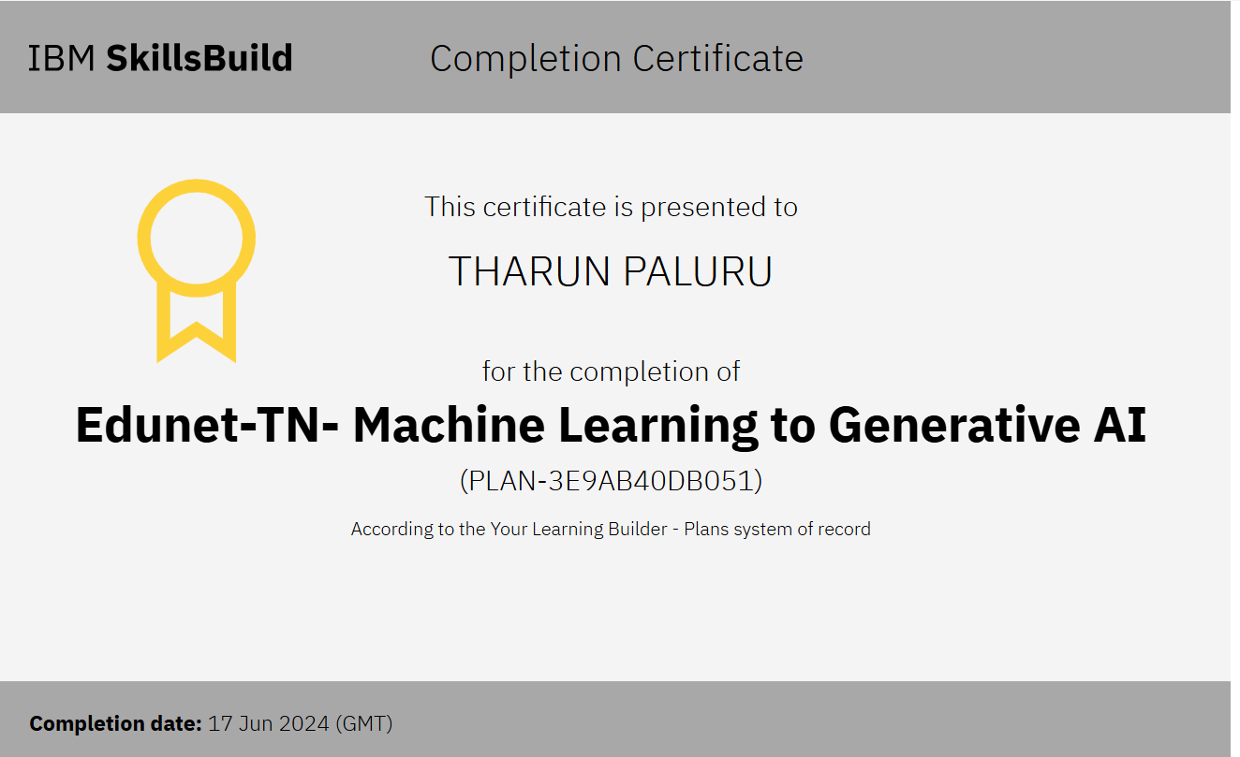
References
APSSDC (Andhra Pradesh State Skill Development Corporation)
Edunet foundation
IBM Skill Build Website
Google
Chat GPT
Course Completion Certificate

Slide 18


