Slide 1

Enhancing QoE Prediction with Deep Learning and User-Centric Preferences
BY
Tharun Vemula 2020bcs0066
Harisankar S 2020bcs0102
Desale Kaustubh Suvalal 2020bcs0169
Maloth Sai Ram Naik 2020bcs0064
Department of Computer Science and Engineering
Guided By,
Dr. Cinu C Kiliroor

Slide 2
Table of Contents
Introduction
Phase I Summary
Literature Review
Problem Statement
Objective
Proposed Methodology
Architecture
Experimental Results
Conclusion
References

Slide 3
Introduction
Rising demand for network resources, driven by over-the-top media services and complex mobile multimedia services like video gaming and ultra-high definition video.
Necessity to enhance end-users' perceived Quality of Experience (QoE) due to these trends.
Increasing preference for a QoE-aware network planning approach.
Emerging design challenges, including how to quantify and measure QoE effectively.
QoE defined as the user's degree of delight or annoyance with an application or service, considering their expectations, utility, enjoyment, personality, and current state.
Assessing and predicting end-user QoE is crucial for optimizing mobile streaming service delivery and efficient QoE management.
Internet Service Providers (ISP) are therefore calling for new methods for handling network resources in order to maximize the perceived quality in video services, which directly reflects the opinion customers have on the network infrastructure

Slide 4
Phase I Summary
In Phase I, our project emphasized Quality of Experience (QoE) prediction by leveraging the power of Deep Learning and incorporating User-Centric Preferences
The primary goal is to elevate user satisfaction in digital experiences.
Successfully conducted a comprehensive literature review on QoE prediction models.
Successfully conducted a comprehensive review on different ML and DL Algorithms, Feature Selection Techniques
Designed a preliminary architecture for the project.

Slide 5
Literature Review 1/6
Dynamic Adaptive Streaming over HTTP (DASH) Video[7] [Current Implementation]
DASH (Dynamic Adaptive Streaming over HTTP) is a technology for adaptive bitrate streaming, dividing multimedia files into segments delivered via HTTP.
DASH is not tied to specific audio/video codecs, offering multiple representations of files with varying resolutions and bit rates.
It allows adaptive streaming by dynamically selecting representations based on factors like network conditions, device capabilities, and user preferences to ensure QoE fairness.
DASH doesn't dictate the specific adaptive bitrate streaming logic, and it is compatible with various application layer protocols.
The agnostic nature makes DASH a versatile choice for adaptive streaming across different devices and network scenarios.
Challenges:
Limited Support & High CPU Usage

Slide 6
Literature Review 2/6
Optimised Quality of DASH [2][IEEE Conference, 2017 ]
Optimized Quality of DASH (OQD) is a framework designed to select video quality based on predicted user Mean Opinion Score (MOS).
OQD consists of three main components: a QoE prediction system, QoE variation monitoring, and a Reinforcement Learning (RL) based controller.
The results indicate that OQD-ABR outperforms the Greedy method in several crucial metrics:
Zero re-buffering instances in OQD-ABR.
A 53% improvement in video rate compared to Greedy.
A minimum 4-second reduction in start-up delay with OQD-ABR. Few Metrics
Challenges
Including factors like screen parameters, delay
Pre Selection of factors
User Profile

Slide 7
Literature Review 3/6
CLN & RLN Model [3] [IEEE Transactions, 2022]
Existing learning-based models for QoE and QoS mapping suffer from high regression errors (RMSE) exceeding 10%, which is unacceptable for Mobile Network Operators (MNOs) requiring accurate user QoE information.
Deep Neural Networks (DNNs) are chosen due to their ability to handle high-dimensional input data effectively, both for classification and regression tasks.
A novel deep network architecture called CLN-RLN, comprising two cascaded DNNs, is introduced. The first-level DNN classifies the dataset into subsets with similar characteristics, while the second-level DNN subnets are dynamically constructed for each subset, reducing training errors.
Reasonable data partitioning and subnetwork selection significantly reduce regression errors in QoE/QoS mapping.
The proposed model is evaluated using datasets from a simulator, with separate training for data from different eNodeBs, leveraging the power of DNNs for improved results.
Challenges:
Adjusting the network parameters

Slide 8
Literature Review 4/6
Bayesian Network Model [6][IEEE Conference, 2020]
The user experience in multimedia streaming depends on two critical factors:
(i) Visual quality and its variations (ii) Frequency and duration of re-buffering events
Re-buffering events and start-up delay cannot be directly measured but must be predicted from traditional Quality of Service (QoS) metrics, allowing the inference of Quality of Experience (QoE) factors using legacy QoS monitoring systems.
The paper proposes a Bayesian Network (BN) model to predict the re-buffering ratio, providing a valuable tool for estimating and managing re-buffering events.
The focus then shifts to hidden variables, which are metrics not directly measurable but can still be inferred from QoS metrics. Using these predicted hidden variables as features can enhance the accuracy of predicting re-buffering events, further improving QoE.
Additionally, the paper emphasizes the importance of incorporating information about networks and devices.
Challenges:
Few metrics and No Video Profiling

Slide 9
Literature Review 5/6
QoE Evaluation [4][IEEE Conference, 2020]
The framework focuses on evaluating Quality of Experience (QoE) by utilizing both network Quality of Service (QoS) Key Performance Indicators (KPIs) and user QoE Key Quality Indicators (KQIs).
The central idea of the framework is to provide an end-to-end solution that covers real-time data collection and user QoE prediction.
The QoS metrics from the network are collected and stored in a cloud database.
A KPI selection module is employed to choose relevant KPI features for analysis.
In the machine learning model training phase, the QoS KPIs and QoE KQIs are aligned, and the dataset is split into training and test sets.
An Extra-Trees classifier is used as the machine learning model due to its efficiency in various tasks, such as image classification, and competitive performance compared to state-of-the-art systems.
The trained model is deployed in the prediction module, where it takes either the test dataset or incoming QoS KPIs as input and generates predicted QoE KQIs.
The results, including QoE states, are then fed into the Network Management engine.
The Network Management engine initiates remedial actions aimed at improving the network's QoE state, moving it from a lower to a higher QoE state based on the predictions made by the framework.

Slide 10
Literature Review 6/6
A Survey on Multimedia Services QoE Assessment [1] [IEEE Access, 2022]
The paper offers a comprehensive survey of Quality of Experience (QoE) Assessment, with a strong emphasis on defining QoE and providing methods for its quantification.
A methodology for assessing QoE metrics is detailed in the paper, helping to establish a structured approach to QoE evaluation.
The paper introduces the concept of QoE Influencing Factors (IFs), which are defined as the actual conditions or adjustments of various aspects related to users, systems, services, applications, or contexts. These IFs have the potential to impact a user's perceived quality of experience.
These QoE IFs are categorized into three broad classes:
Human-related, System-related, Context-related
By considering and analyzing these three classes of QoE Influencing Factors, a more comprehensive understanding of the factors affecting user experience can be gained, leading to improved QoE assessment and management.

Slide 11
Problem Statement
In the realm of multimedia services like video streaming, online gaming, and cloud-based applications, achieving End User Quality of Experience (QoE) is of utmost importance. However, conventional QoE prediction models typically fall short in accommodating individual user preferences, resulting in subpar service quality. Therefore, an urgent demand exists for an innovative QoE prediction framework that harnesses advanced deep learning techniques while integrating user preferences to improve service quality.

Slide 12
Objective
To predict the user perceived QoE, by applying state-of-the-art deep learning techniques, and train the model based on collected network measurements and user feedback

Slide 13
Proposed Methodology
The proposed methodology includes 2 prediction models.
Each one of the model is used to predict one of the target variables.
MOS, AvgVideoBitRate are the target variables
Neural Network has been employed to predict the target variable.
A QoE tracker can be implemented at the client side that sends QoS data along with MOS to the server.
The QoE tracker follows a client-server architecture.
It runs on the user’s device, monitoring the network in the background and analyzing logs generated by the user's video stream while the user performs certain tasks.
At the end of the video session users evaluate the session by giving the score (of the MOS scale)

Slide 14
Proposed Methodology
All the metrics collected is sent to the server.
Server consolidates all the data
Two models are trained based on the collected data.
Once the model has been deployed, MOS for each session can be calculated and necessary improvements can be done accordingly
If the predicted MOS is greater than or equal to the threshold, then no modifications are needed
If the predicted MOS is less than the threshold (in our case, 3), then an DL model is triggered that predicts AvgVideoBitRate for that session
Video can then be fragmented and sent accordingly

Slide 15
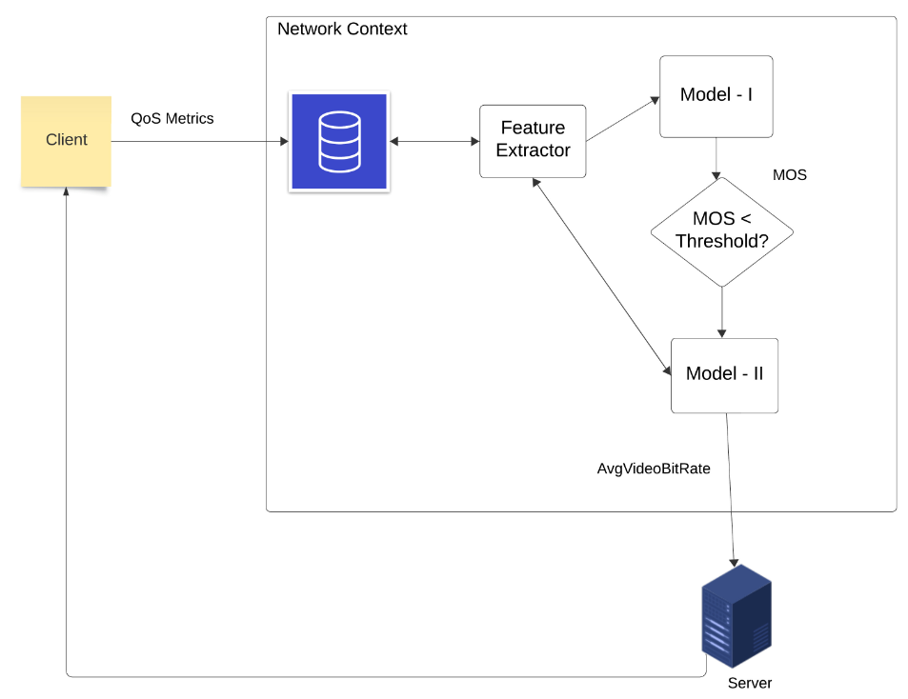
Architecture

Slide 16
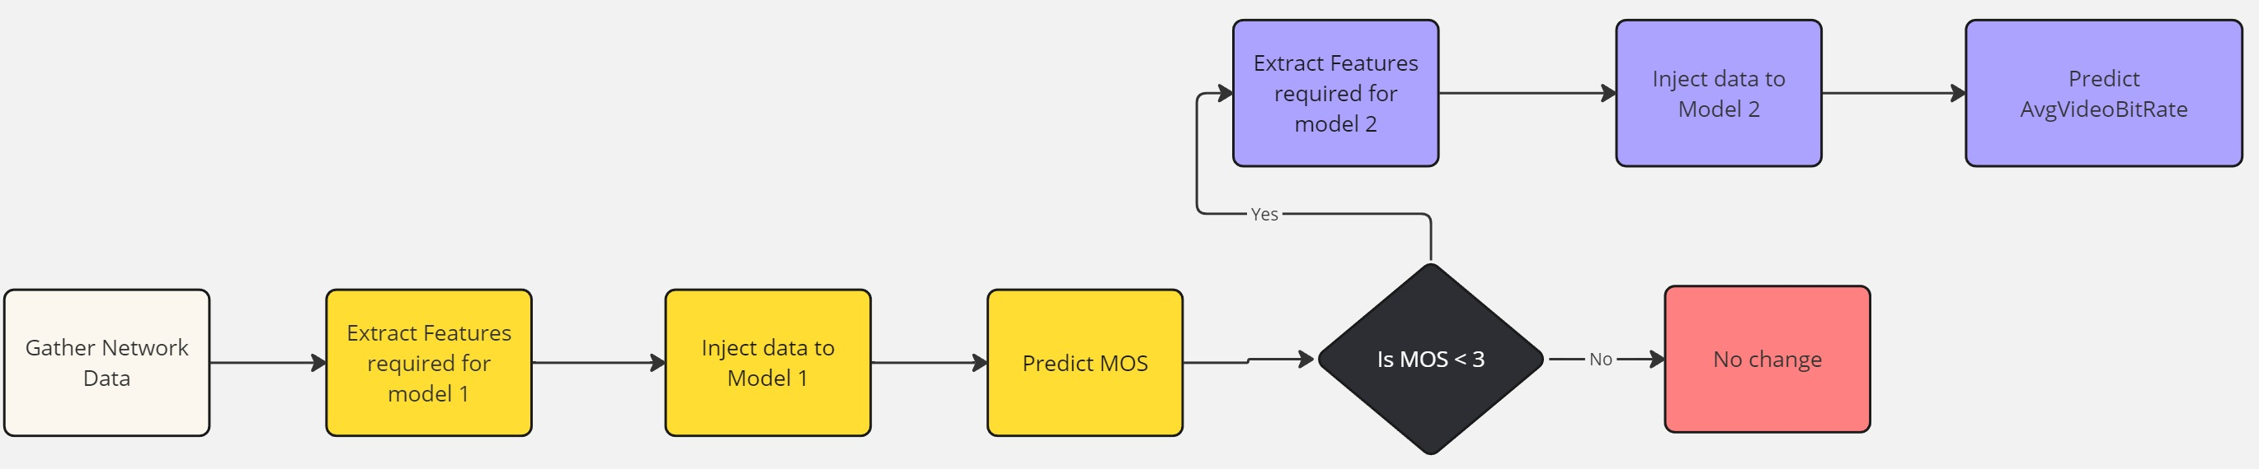
Flowchart

Slide 17
Experimental Results
Model – I (Predicting MOS)
Each variable in the dataset belongs to a category of QoE Influence Factors (QoE IFs) that consists:
Network parameters (QoS)
Video content analysis results
VLC player indicators
Device characteristics (QoD)
User's MOS score

Slide 18
Experimental Results
The data is loaded from a CSV file and split into features (X) and the target variable (y).
The given data has no null values
Ordinal Encoding is used for categorical data
Standardization is applied to the features using StandardScaler. Standardization ensures that each feature has a mean of 0 and a standard deviation of 1, which can help the model converge faster.

Slide 19
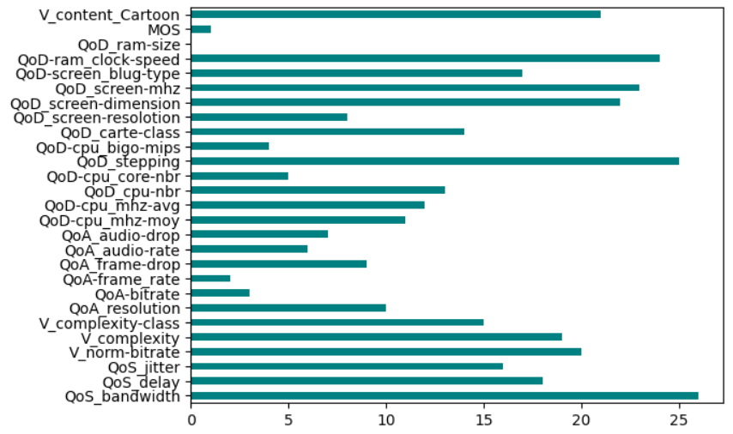
Experimental Results
The Fisher Score algorithm is used for feature selection.
The algorithm returns the ranks of the variables based on the fisher’s score in descending order.

Slide 20
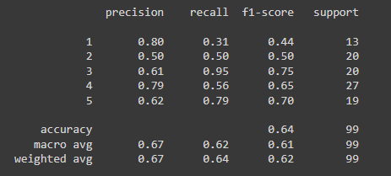
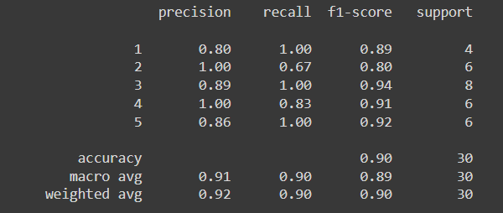
Experimental Results
Initially Random Forest Classifier is used but results are not satisfactory. Instead, Balanced Random Forest Classifier algorithm is us to predict MOS and results are improved. Below is the comparison between the two models.
Random Forest Classifier
Balanced Random Forest Classifier

Slide 21
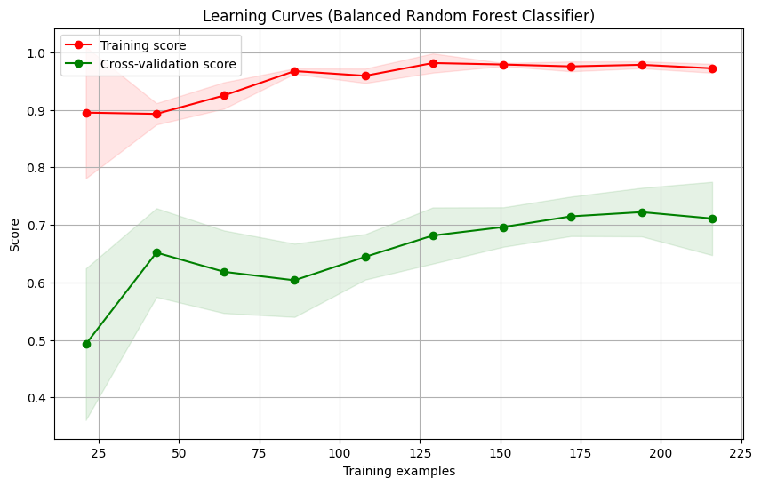
Experimental Results

Slide 22
Experimental Results
Model – II (Predicting AvgVideoBitRate)
Architecture
The model is a Sequential model, meaning it consists of a linear stack of layers where each layer has exactly one input tensor and one output tensor.
Conv1D layer is added with 64 filters, a kernel size of 3, and ReLU activation.
MaxPooling1D layer is added with a pooling size of 2, reducing the spatial dimensions of the representation.
Flatten layer is added to transform the output from the convolutional and pooling layers into a flat 1D array, which can be fed into the fully connected layers.
Two dense layers are added with ReLU activation. The first dense layer has 64 neurons and other layer has single neuron

Slide 23
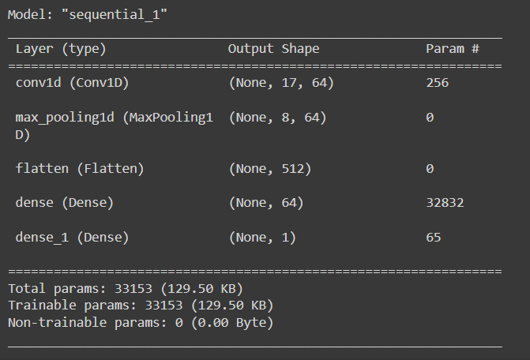
Experimental Results
Model Architecture
Test MAE: 69547.96

Slide 24
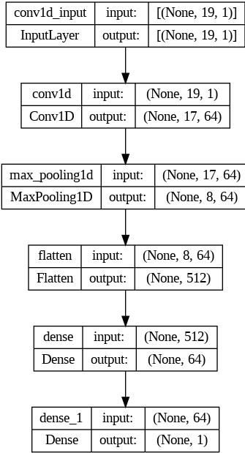
Experimental Results

Slide 25
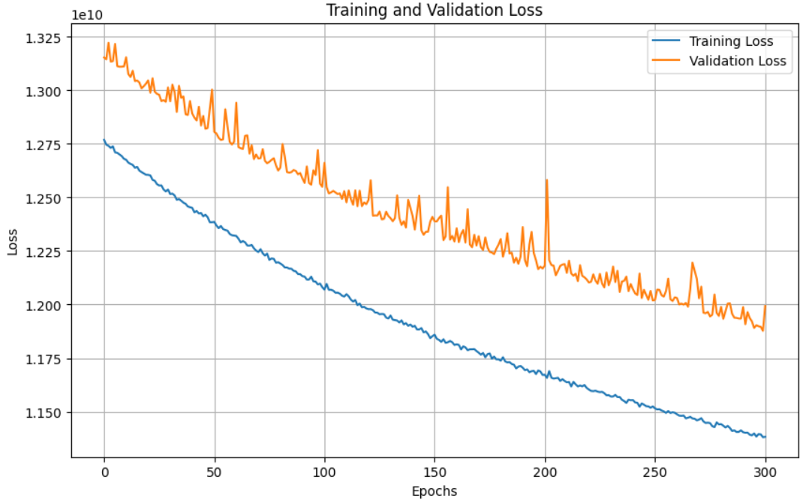
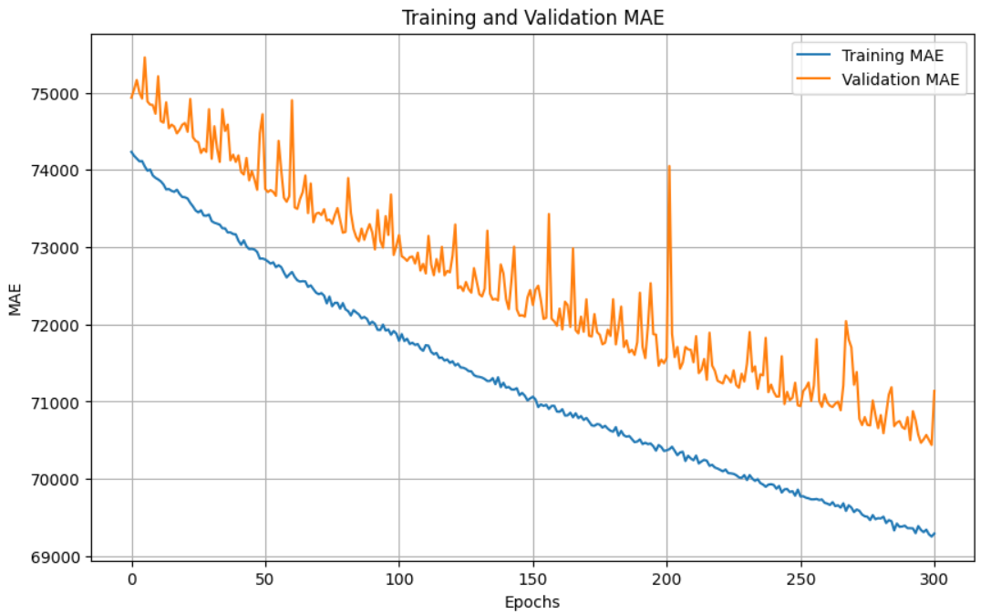
Experimental Results

Slide 26
Conclusion
The startup delay and buffering ratio affect the QoE significantly.
Sessions with startup delay higher than 10 sec obtain lower QoE scores
Sessions with poor network performance during the last 15 sec are likely to be terminate with poor connectivity.
In several sessions, we observed that a rate adaptation could reduce the buffering ratio and improve the QoE.
In general, it is difficult to obtain the “ground truth” about the QoE.

Slide 27
Conclusion
Through the QoE tracker and proposed algorithms, the provider can learn more about its customers (e.g., their traffic, usage pattern, end-to-end network performance, QoE profile), infrastructure and service performance.
This can enable the provider to improve the adaptation mechanisms, provide better customer service, assess its agreements with infrastructure/network providers, and potentially perform better pricing.

Slide 28
References
[1] Kougioumtzidis, G., Poulkov, V., Zaharis, Z.D. and Lazaridis, P.I., 2022. A survey on multimedia services QoE assessment and machine learning-based prediction. IEEE Access, 10, pp.19507-19538.
[2] Amour, L., Mushtaq, M.S., Souihi, S. and Mellouk, A., 2017, October. Qoe-based framework to optimize user perceived video quality. In 2017 IEEE 42nd conference on local computer networks (LCN) (pp. 599-602). IEEE.
[3]Liu, X., Chuai, G., Wang, X., Xu, Z. and Gao, W., 2021. QoE assessment model based on continuous deep learning for video in wireless networks. IEEE Transactions on Mobile Computing.
[4]Zhu, Y., Sun, T., Li, Q., Lu, L., Duan, X. and Li, W., 2020, October. Machine learning based user QoE evaluation for video streaming over Mobile network. In 2020 IEEE International Conference on Smart Data Services (SMDS) (pp. 18-25). IEEE.
[5]Charonyktakis, P., Plakia, M., Tsamardinos, I. and Papadopouli, M., 2015. On user-centric modular QoE prediction for VoIP based on machine-learning algorithms. IEEE Transactions on mobile computing, 15(6), pp.1443-1456.
[6]Vasilev, V., Leguay, J., Paris, S., Maggi, L. and Debbah, M., 2018, May. Predicting QoE factors with machine learning. In 2018 IEEE International Conference on Communications (ICC) (pp. 1-6). IEEE.
[7] DASH HTTP Video – MDN Documentation

Slide 29
THANK YOU

