Slide 1

Smart stress detection and relief system using voice and image processing
by
K.M.THARUN
Roll No. 234G5A0515
B.ARAVIND KUMAR
Roll No. 224G5A0505
B.KEERTHI
Roll No. 224G1A0536
Under the guidance of
Mr. L. SUMAN ,M. Tech, (Ph.D.)
Assistant Professor
Department of Computer Science and Engineering
Srinivasa Ramanujan Institute of Technology
(Affiliated to JNTUA & Approved by AICTE) (Accredited by NAAC with ‘A’ Grade & Accredited by NBA (EEE, ECE & CSE) Rotarypuram Village, B K Samudram Mandal, Ananthapuramu – 515701.
2025-2026
B13
DEPT. OF COMPUTER SCIENCE AND ENGINEERING
01
SRINIVASA RAMANUJAN INSTITUTE OF TECHNOLOGY

Slide 2
Smart stress detection and relief system using voice and image processing
Contents
Title Justification
Abstract
Problem statement
Objectives of Project
Literature survey for objectives
Proposed Work -(Methods to be followed for proposed system)
References
GitHub Link
Queries
B13
DEPT. OF COMPUTER SCIENCE AND ENGINEERING
02
SRINIVASA RAMANUJAN INSTITUTE OF TECHNOLOGY

Slide 3
Smart stress detection and relief system using voice and image processing
Title Justification
The title “Smart stress detection and relief system using voice and image processing” is appropriate because the project focuses on detecting human stress levels by analyzing voice tone, speech patterns and facial expressions using machine learning.
The term “smart” highlights the use of ML models, while “stress detection and relief” clearly describes the purpose of the system. The inclusion of “voice and image processing” reflects the multimodal nature of the approach. Thus, the title accurately represents the goals, technology, and functionalities of the project.
B13
DEPT. OF COMPUTER SCIENCE AND ENGINEERING
03
SRINIVASA RAMANUJAN INSTITUTE OF TECHNOLOGY

Slide 4
Smart stress detection and relief system using voice and image processing
Abstract
Stress has become a common issue due to increasing mental pressures, creating a need for automated systems that can detect mental strain accurately. This project is aimed at identifying stress levels through natural human cues.
The objective is to develop a multimodal system that analyzes facial expressions using CNNs and voice patterns using LSTM-based speech analysis.
The system processes these signals to classify stress levels and provides suitable stress-relief suggestions.
By integrating image and voice processing with machine learning, this project demonstrates an effective and user-centric approach to early stress identification.
The system has potential applications in educational institutions, workplaces, mental health monitoring tools, and personal wellness systems, making stress management more accessible and intelligent.
B13
DEPT. OF COMPUTER SCIENCE AND ENGINEERING
04
SRINIVASA RAMANUJAN INSTITUTE OF TECHNOLOGY

Slide 5
Smart stress detection and relief system using voice and image processing
Problem Statement
Stress is a major issue affecting students, employees, and individuals due to fast-paced lifestyles. Traditional stress assessment methods rely on manual observation, self-reporting, or clinical tests, which are often inaccurate or inaccessible.
Human stress can be reflected in voice variations (pitch, tone, pace) and facial patterns (muscle tension, expressions), but these signals are rarely analyzed automatically.
There is a need for a smart, automated, and real-time system that detects stress using natural human cues and provides timely guidance to reduce it.
Therefore, this project proposes a multimodal ML system that accurately identifies stress and offers useful coping recommendations.
B13
DEPT. OF COMPUTER SCIENCE AND ENGINEERING
05
SRINIVASA RAMANUJAN INSTITUTE OF TECHNOLOGY

Slide 6
Smart stress detection and relief system using voice and image processing
Objectives of Project
Objective 1:
To develop an automated system that detects human stress levels by analyzing voice patterns and facial expressions using machine learning techniques.
Objective 2:
To design and evaluate a personalized stress-reduction module that recommends relaxation techniques based on the detected stress level.
B13
DEPT. OF COMPUTER SCIENCE AND ENGINEERING
06
SRINIVASA RAMANUJAN INSTITUTE OF TECHNOLOGY

Slide 7
Smart stress detection and relief system using voice and image processing
Literature Survey
No | Title | Author | Journal Name & Year | Methodology / Approach Used | Key Findings | Gaps Identified
1 | Audio Signal Based Stress Recognition System using AI and ML | Megha Gupta & Shubhangi Vaikole. | Journal of Algebraic Statistics, 2022 | RNN, LSTM | Accurate speech-based stress detection | Audio-only, no multimodal fusion
2 | Stress Detection in IT Professionals Using Image Processing & ML | Abdul Rahim et al. | IJMM, 2023 | Facial image processing + ML | Effective live detection | Image-only, no voice analysis
3 | Real-Time Image Sequences-Based Stress Assessment Vision System | Khomidov et al. | Electronics, 2024 | rPPG-based HR/HRV + ML models | High accuracy (up to 99%) in stress detection | Uses only physiological signals
4 | Multimodal Stress Detection Using Facial Landmarks and Biometric Signals | Majid Hosseini et al. | arXiv, 2023 | Facial landmarks, biometric signals | Uses multimodal signals, high accuracy | Limited dataset size and diversity
B13
DEPT. OF COMPUTER SCIENCE AND ENGINEERING
07
SRINIVASA RAMANUJAN INSTITUTE OF TECHNOLOGY

Slide 8
Smart stress detection and relief system using voice and image processing
Proposed System
The system captures voice and facial inputs, processes them using LSTM (voice) and CNN (face) models, and classifies stress into low, medium, or high. The multimodal outputs are combined for higher accuracy.
Based on the detected stress level, the system provides personalized recommendations to reduce the stress such as breathing exercises, relaxation music, or mindfulness tips through a simple user interface.
B13
DEPT. OF COMPUTER SCIENCE AND ENGINEERING
08
SRINIVASA RAMANUJAN INSTITUTE OF TECHNOLOGY

Slide 9
Smart stress detection and relief system using voice and image processing
References
[1] A. Rahim, G. L. Ahari, G. Bhumika, and G. Divya Jyothi, “Stress Detection in IT Professionals by Image Processing and Machine Learning,” International Journal of Multidisciplinary Methods (IJMM), vol. 11, no. 2, pp. 1–6, 2023. ISSN: 2454-5007.
[2] M. Gupta and S. Vaikole, “Audio Signal Based Stress Recognition System using AI and Machine Learning,” Journal of Algebraic Statistics, vol. 13, no. 2, pp. 1731–1740, 2022.
[3] M. Khomidov, D. Lee, C.-H. Kim, and J.-H. Lee, “The Real-Time Image Sequences-Based Stress Assessment Vision System for Mental Health,” Electronics, vol. 13, no. 11, p. 2180, 2024.
B13
DEPT. OF COMPUTER SCIENCE AND ENGINEERING
09
SRINIVASA RAMANUJAN INSTITUTE OF TECHNOLOGY

Slide 10
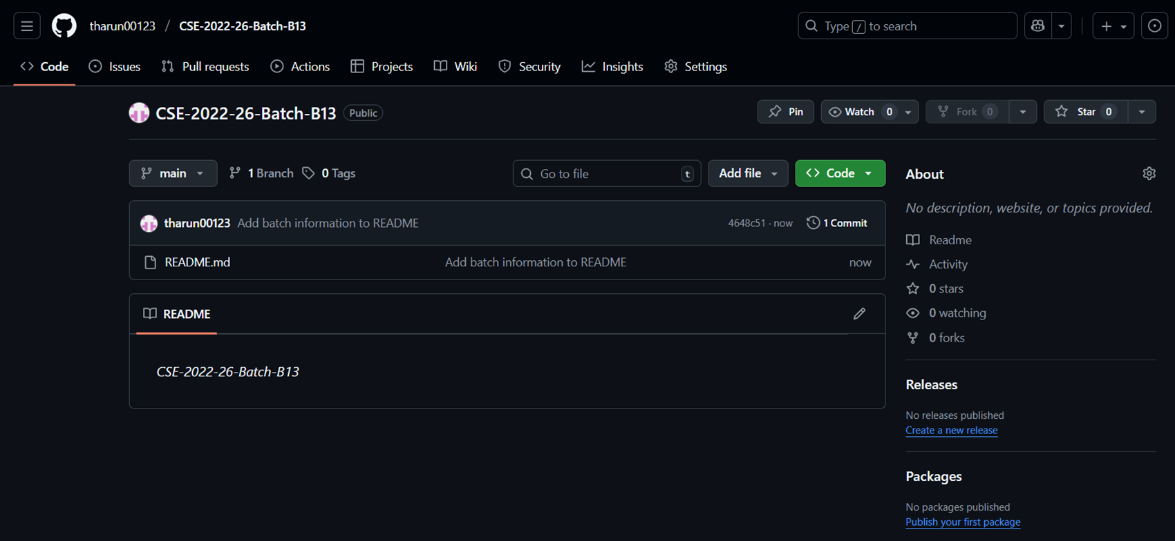
Smart stress detection and relief system using voice and image processing
GitHub Dashboard
GitHub Link : https://github.com/tharun00123/CSE-2022-26-Batch-B13
DEPT. OF COMPUTER SCIENCE AND ENGINEERING
11
B13
SRINIVASA RAMANUJAN INSTITUTE OF TECHNOLOGY

Slide 11
Smart stress detection and relief system using voice and image processing
Any Queries?
B13
DEPT. OF COMPUTER SCIENCE AND ENGINEERING
12
SRINIVASA RAMANUJAN INSTITUTE OF TECHNOLOGY

