Slide 1


Deforestation(Fire Classification)
Name: Badavath Tharun
Student ID :23N31A3305
AICTE ID :STU682188f9f0bcb1747028217

Slide 2

Learning Objectives
To understand the use of MODIS satellite data in detecting forest fires across India.
To classify different types of fire (Vegetation Fire, Volcano, etc.) using machine learning algorithms.
To learn and apply preprocessing, model training, and evaluation techniques on real-world environmental datasets.
To develop a Streamlit-based interactive web application for real-time fire-type prediction.
To visualize fire incidents on an interactive map using Folium and analyze geographic patterns.
GOAL
Source :
www.freepik.com/

Slide 3
Tools and Technology used
Python – Data processing and model development
Pandas, NumPy – Data handling and numerical operations
Scikit-learn – ML model building and evaluation
XGBoost – Advanced classification algorithm
Streamlit – Web app development
Folium – Map visualization of fire incidents
Google Colab – Model development and training environment
GitHub – Version control and project hosting

Slide 4
Methodology
Data Collection
Used 3 datasets: MODIS India fire data from 2021, 2022, and 2023
Preprocessing
Cleaned, merged datasets, converted dates, encoded labels
Feature Engineering
Added month, day, and year columns
Removed irrelevant fields (instrument, version)
Model Training
Used Random Forest Classifier with train/test split
Web App
Developed Streamlit app with sidebar inputs and folium map
Evaluation
Verified accuracy and tested real-time fire-type predictions

Slide 5
Problem Statement:
Forest fires are a growing concern in India due to rising temperatures and changing environmental conditions. There is a need for:
Accurate fire-type classification using satellite data.
A predictive system that helps monitor fire-prone regions.
A visual interface that allows easy exploration of past incidents.

Slide 6
Solution:
Built a machine learning-based solution to classify fire types from MODIS satellite data (2021–2023).
Developed a user-friendly web app using Streamlit, where users can input fire-related features (location, brightness, satellite info, etc.) and get predicted fire type.
Used Folium maps to visualize fire locations for better geographical understanding.
🔗 GitHub Repository:
https://github.com/tharun1503/Deforestation_Detection-Fire_Classification-_Week3.git

Slide 7
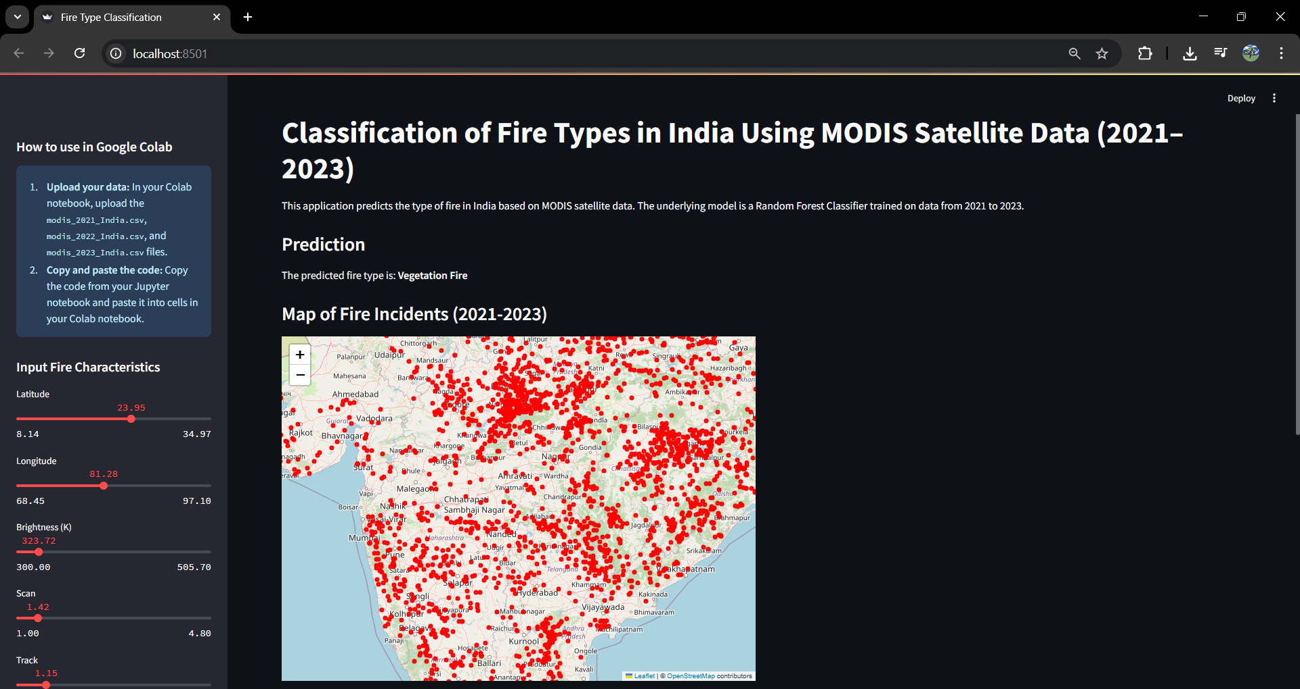
Screenshot of Output:

Slide 8
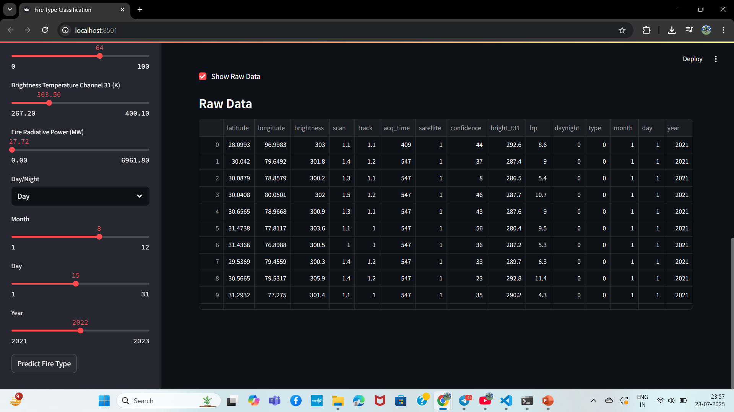
Screenshot of Output:

Slide 9
Conclusion:
Successfully created a fire classification pipeline using MODIS satellite data.
Gained hands-on experience in preprocessing, ML model building, evaluation, and deployment.
Built a fully functional interactive web app using Streamlit, integrated with visualization.
This project has broadened my understanding of applying AI for real-world environmental challenges.

