Slide 1
🍽 Weekly Meal Planner & Grocery Generator 🛒
A beginner-friendly Java console application built on CO1, CO2 & CO3 fundamentals
Team Members
About This Project
P. Tharun Karthik — 2620030494
P. Sai Sravan — 2620090089
K. Saketh Reddy — 2620090009
Purpose: Smart meal planning and budget management application
Based on: CO1 (Variables & Operators), CO2 (Selection & Loops), CO3 (Methods & Arrays)
Language: Java — Console Application

Slide 2





PROJECT OVERVIEW
📋 Features at a Glance
Beautiful Console UI
7-Day Meal Plan
Smart Grocery List
Decorative borders, emojis, and formatted tables for a visually impressive terminal experience
3 meals per day (breakfast, lunch, dinner) stored and managed using 2D arrays
Auto-generated based on food preferences — Veg 🥗 / NonVeg 🍗 / Mixed 🍱
Budget Tracking
Search Function
Cost calculation, progress bar visualization, and remaining budget classification
Find items in grocery list by name using linear search algorithm

Slide 3
CODE — PART 1 OF 3
🎯 Complete Java Code — Core Structure
import java.util.Scanner;
public class MealPlannerApp {
// CO1 - Variables and Data Types
static String userName = "";
static int familyMembers = 0;
static double weeklyBudget = 0.0;
static int foodPreference = 0; // 1=Veg, 2=NonVeg, 3=Mixed
// CO3 - 2D Array for Meal Plan
static String[][] mealPlan = new String[7][3];
// CO3 - 1D Arrays for Grocery
static String[] groceryItems = {"Rice","Dal","Vegetables",
"Milk","Eggs","Bread","Oil","Salt","Spices","Paneer"};
static double[] quantities = {5,2,5,7,12,2,1,0.5,0.5,1};
static double[] prices = {300,240,500,420,100,100,150,50,100,200};
static double totalGroceryCost = 0.0;
static Scanner scanner = new Scanner(System.in);
public static void main(String[] args) {
showWelcomeScreen();
// CO2 - do-while Loop for Main Menu
do {
displayMenu();
} while (true);
}
// CO3 - Method: Display Main Menu
static void displayMenu() {
System.out.println("╔══════════════

Slide 4
CODE — PART 2 OF 3
🎯 Complete Java Code — User Profile & Meal Plan
// CO3 - Method: Enter User Details
static void enterUserDetails() {
System.out.print(" Enter your name: ");
userName = scanner.nextLine();
System.out.print(" Number of family members: ");
familyMembers = scanner.nextInt();
System.out.print(" Weekly grocery budget (₹): ");
weeklyBudget = scanner.nextDouble();
scanner.nextLine();
selectFoodPreference();
}
// CO2 - if-else for Preference Display
static void displayUserProfile() {
String prefText = "";
if(foodPreference == 1) prefText = "Vegetarian";
else if(foodPreference == 2) prefText = "Non-Vegetarian";
else prefText = "Mixed";
System.out.println("

Slide 5
CODE — PART 3 OF 3
🎯 Complete Java Code — Grocery, Search & Budget
// CO3 - Method: Linear Search
static void searchGroceryItem() {
System.out.print("

Slide 6
SAMPLE OUTPUT
📊 Sample Output & Features Demo
🛒 Weekly Grocery List Output
╔════════════════════════════════════════════╗
║

Slide 7

SYLLABUS MAPPING
🧠 CO1, CO2, CO3 Concepts Covered
CO1 — Variables & Operators
CO2 — Selection & Loops
CO3 — Methods & Arrays
Data Types: String (userName), int (familyMembers, choice), double (budget, prices), boolean (found)
Arithmetic: +, -, *, / for cost calculation and budget analysis
Comparison: ==, <, > for budget classification and search matching
Assignment: =, += for accumulating totals
if-else: Search result display (found / not found)
if-else-if: Budget classification (LOW / MEDIUM / HIGH)
switch-case: 9-option main menu dispatcher
for loop: Array traversal for grocery list and cost calculation
Nested for: 2D array population and meal plan display
do-while: Continuous main menu loop; break to exit search early
Methods: 13 static void methods — modular, readable, reusable design
1D Arrays: groceryItems[], quantities[], prices[]
2D Array: mealPlan[7][3] — rows = days, columns = meals
Linear Search: Loop + compare + break in searchGroceryItem()

Slide 8

TEAM
👥 Team Roles & Presentation Plan
🕐 Welcome — 1 min
1
Responsibility Summary
Project intro, team intro, application overview
Member | Owns
Tharun Karthik | CO1 vars, Scanner, switch
Sai Sravan | CO2 loops, CO3 2D arrays
Saketh Reddy | CO3 1D arrays, search, budget
2
👤 Tharun Karthik — 2 min
User Profile section: enterUserDetails(), selectFoodPreference(), displayUserProfile()
Explains: Scanner input, data types, switch statement
🍽 Sai Sravan — 2 min
3
Meal Planning section: generateMealPlan(), displayMealPlan()
Explains: 2D arrays, nested loops, if-else logic
Each member should be ready to explain their methods line-by-line during viva. Know your CO mappings! 💡
4
🛒 Saketh Reddy — 3 min
Grocery & Budget section: generateGroceryList(), searchGroceryItem(), checkBudget()
Explains: 1D arrays, linear search, arithmetic, if-else-if
❓ Q&A — 2 min
5
All members handle viva questions together

Slide 9
VIVA PREP
❓ Key Viva Questions & Answers
Q1: Why use double for budget?
Q2: How does mealPlan[7][3] work?
Can store decimal values like ₹3500.50; int only stores whole numbers — precision matters for money calculations.
First index = day (0–6 for Mon–Sun). Second index = meal (0=breakfast, 1=lunch, 2=dinner). Total: 21 cells.
Q3: Explain linear search in searchGroceryItem()
Q4: Why use nested loops for meal plan?
Outer loop = 7 days, inner loop = 3 meals per day. Together they traverse all 21 cells of the 2D array.
Loop through array comparing each item name with equalsIgnoreCase(). If match found, set found=true and break.
Q5: What does if-else-if do in budget check?
Q6: Why use switch for menu?
Classifies remaining budget as LOW (<20%), MEDIUM (<50%), or HIGH (≥50%) to give the user a meaningful status message.
Cleaner and more readable than 9 chained if-else blocks. Each case maps directly to one menu option.

Slide 10
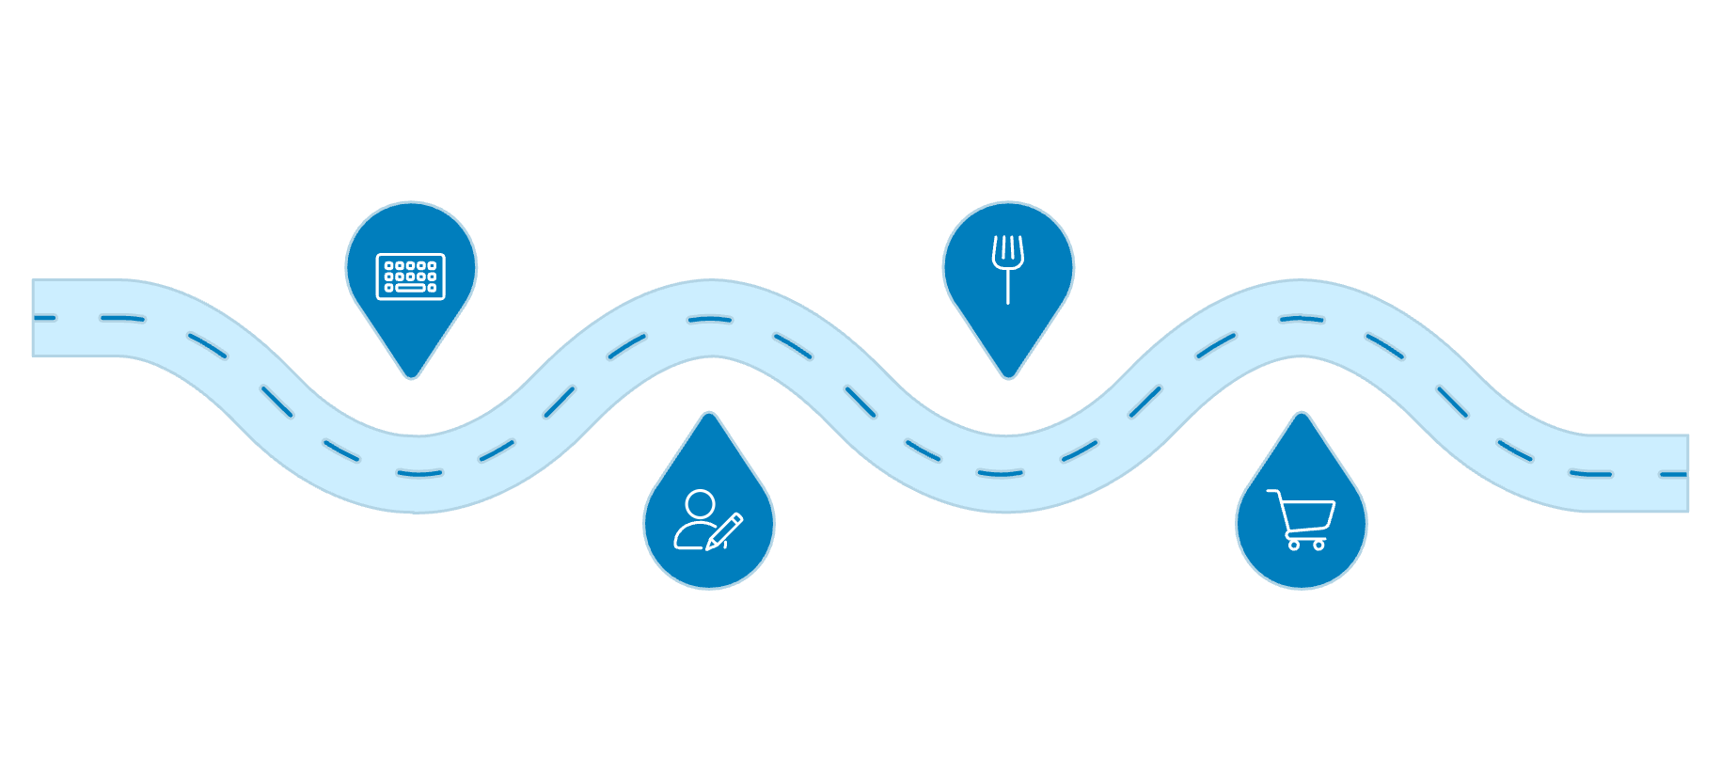
HOW TO RUN
✅ How to Run & Test the App
Setup & Execution
01
Recommended Demo Sequence
Save the File
Start
Meal Plan
Save as MealPlannerApp.java — filename must match the class name exactly
Press Enter to begin demo
Generate and view meals
02
Compile
Run javac MealPlannerApp.java in terminal — generates the .class bytecode file
Profile
Grocery
03
Enter user profile details
Generate and view grocery list
Run
Key features to highlight: Beautiful UI formatting, 2D array meal display, grocery receipt, budget progress bar, and linear search functionality.
Execute java MealPlannerApp — the welcome screen appears with team info

