Slide 1
Colsheet
A Website that matters …

Slide 2

What’s the scenario?
Any faculty has their own
Publications
Workshops
Journals
Books
Research Students
colsheet

Slide 3

Title and Content Layout with Chart
A Recent Study at Cambridge University has shown that
The number of Journals , Publications, Conferences have only Increased in the past 20 years, But has never decreased.
colsheet

Slide 4

The Point is…
There is no all in one Famous Proper platform to Showcase your Works and about Research.
colsheet

Slide 5

Here we come…
Using Colsheet ,
You will be able to create your standard Profile with options of Adding
Your Publications
Your Articles
Your Journals
Your Books
Your Research Students
colsheet

Slide 6

So…
You can either mention your works
Or there is a special option to link it to a Specific URL, or to Upload it to our Website.
Our special Sorting System provides you all the easy work of Sorting according to any field in a click away.
colsheet

Slide 7
How’s it different from others
colsheet

Slide 8
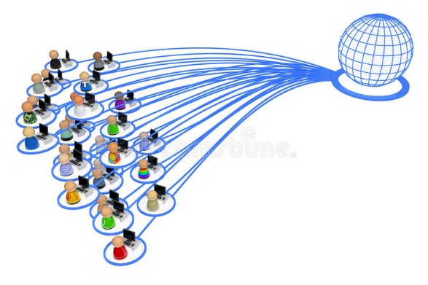
Colsheet
The Colleges participate in Creating an account for their own colleges which will be verified by us.
If a faculty has an account at Colsheet , can link their profile with the specific College .
colsheet

Slide 9
Colsheet
Now even the college has a Profile of their own where the count of the
ARTICLES
JOURNALS
BOOKS
CONFERENCES
Of the faculties linked with the college are shown.
colsheet

Slide 10
All of these in an organized way ,optimized, all at one place -Colsheet
colsheet

Slide 11




The technology we are planning to use:
HTML-CSS
MySql
PHP/JS
A hosting platform

Slide 12
THAT’S COLSHEET FOR YOU
colsheet

Slide 13
An Idea and PPT by
Tharun K
Team:
Tharun K
Venkat SN

