Slide 1

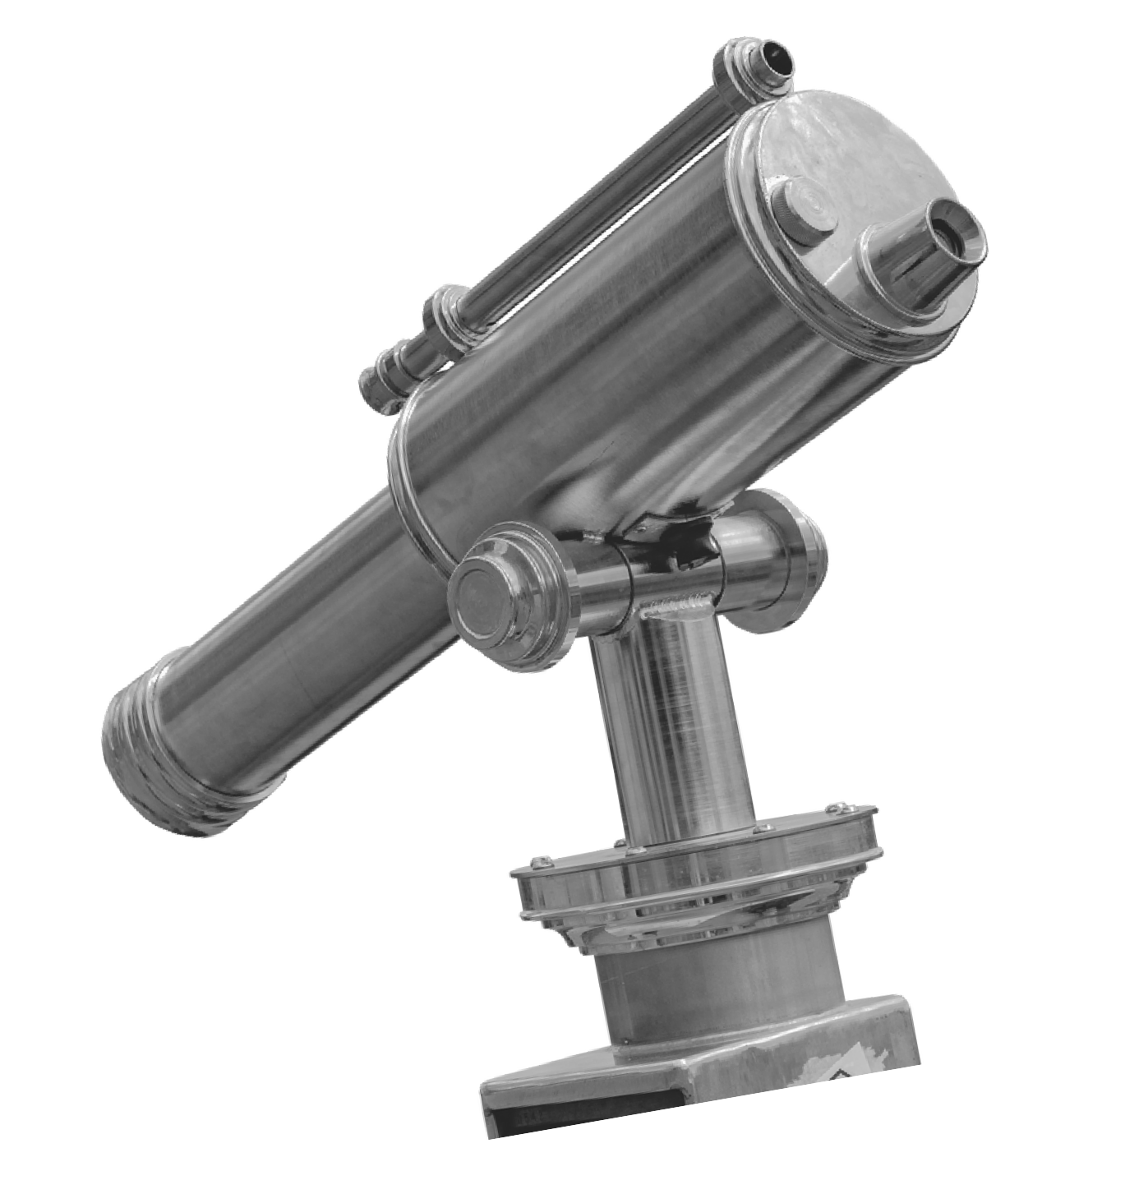

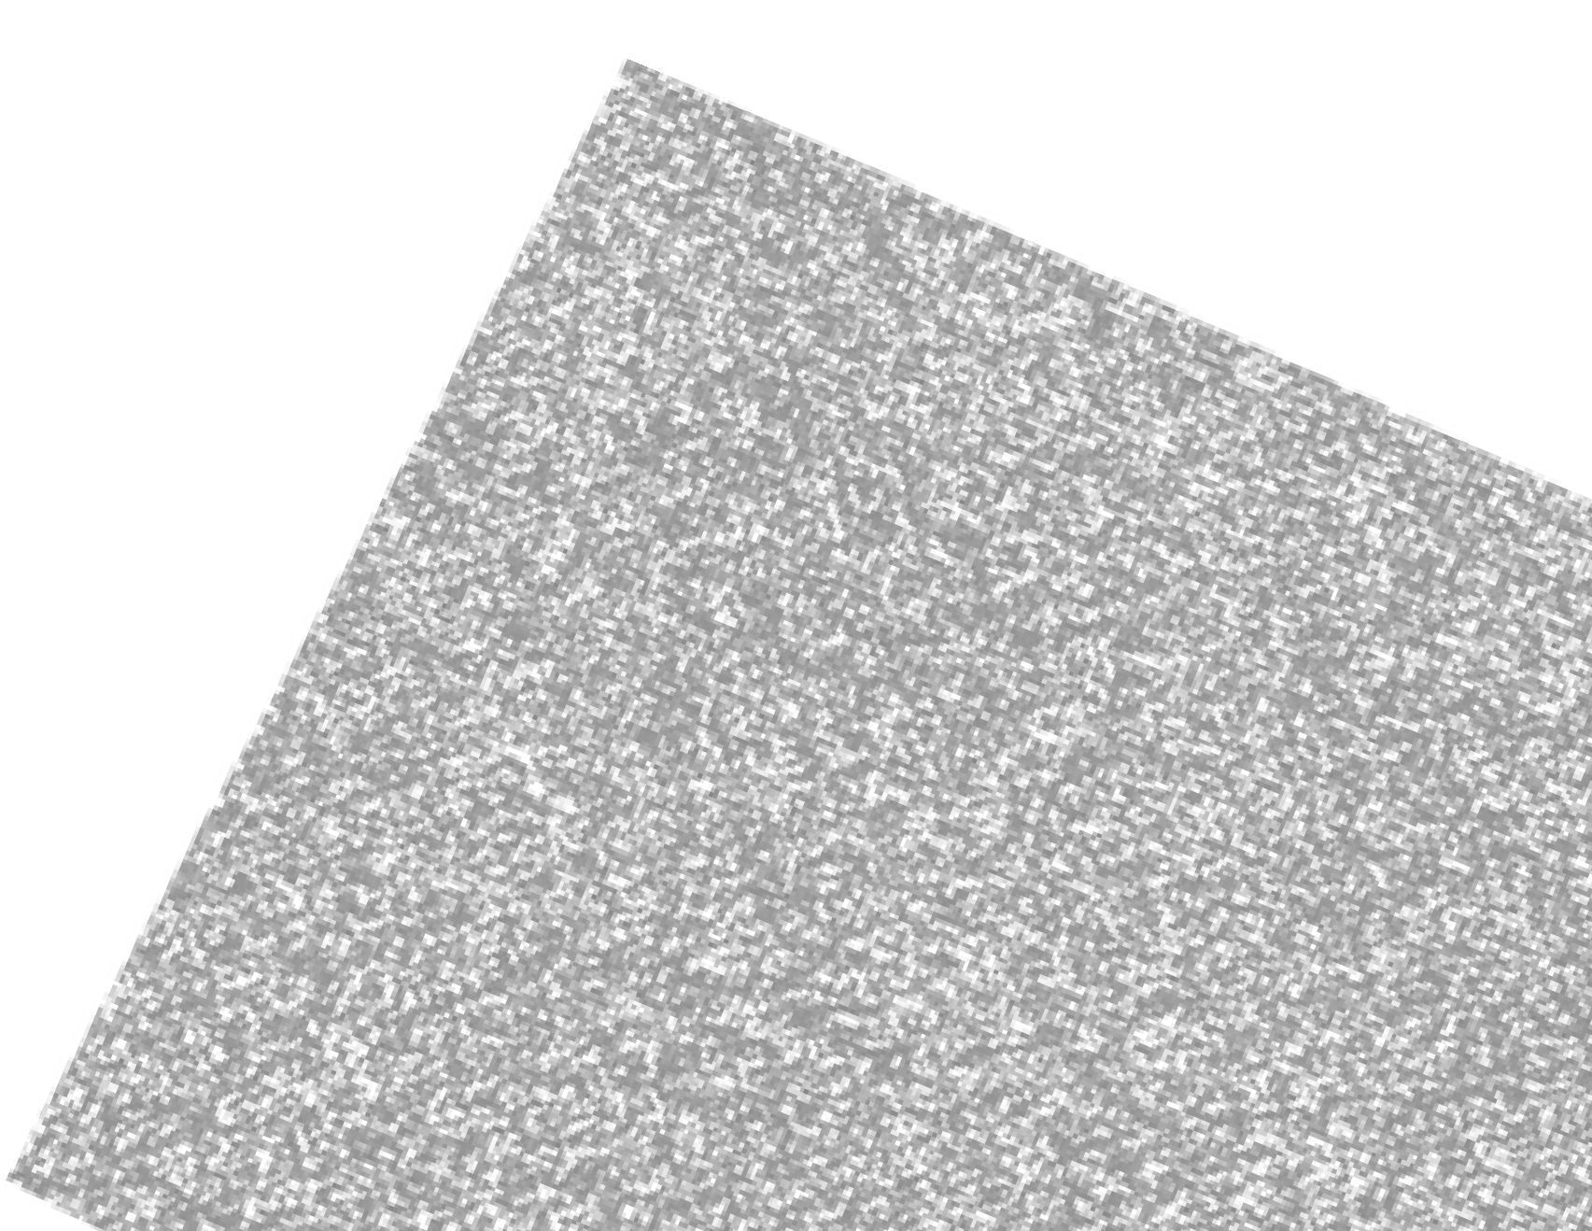


Notes App
MOBILE APPLICATION WITH JAVA
JVS Sankar
CNV Tharuna Sree
Y.Sai Chandana Sri
M.Jyothi Sree
E.Shiva Krishna
AP22110011317
AP22110011316
AP22110011323
AP22110011333
AP22110011233

Slide 2
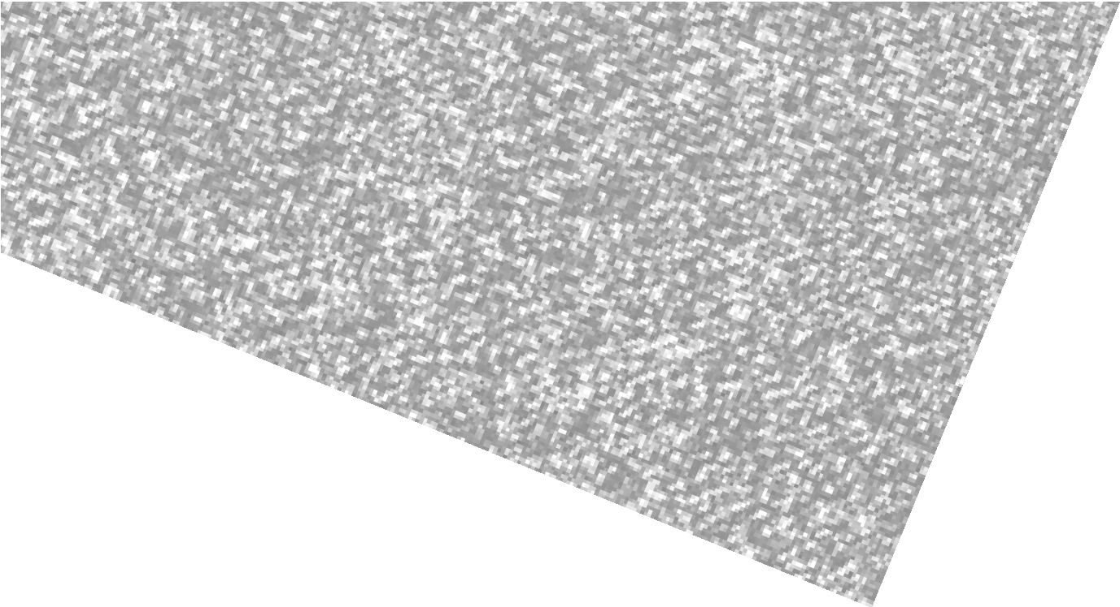





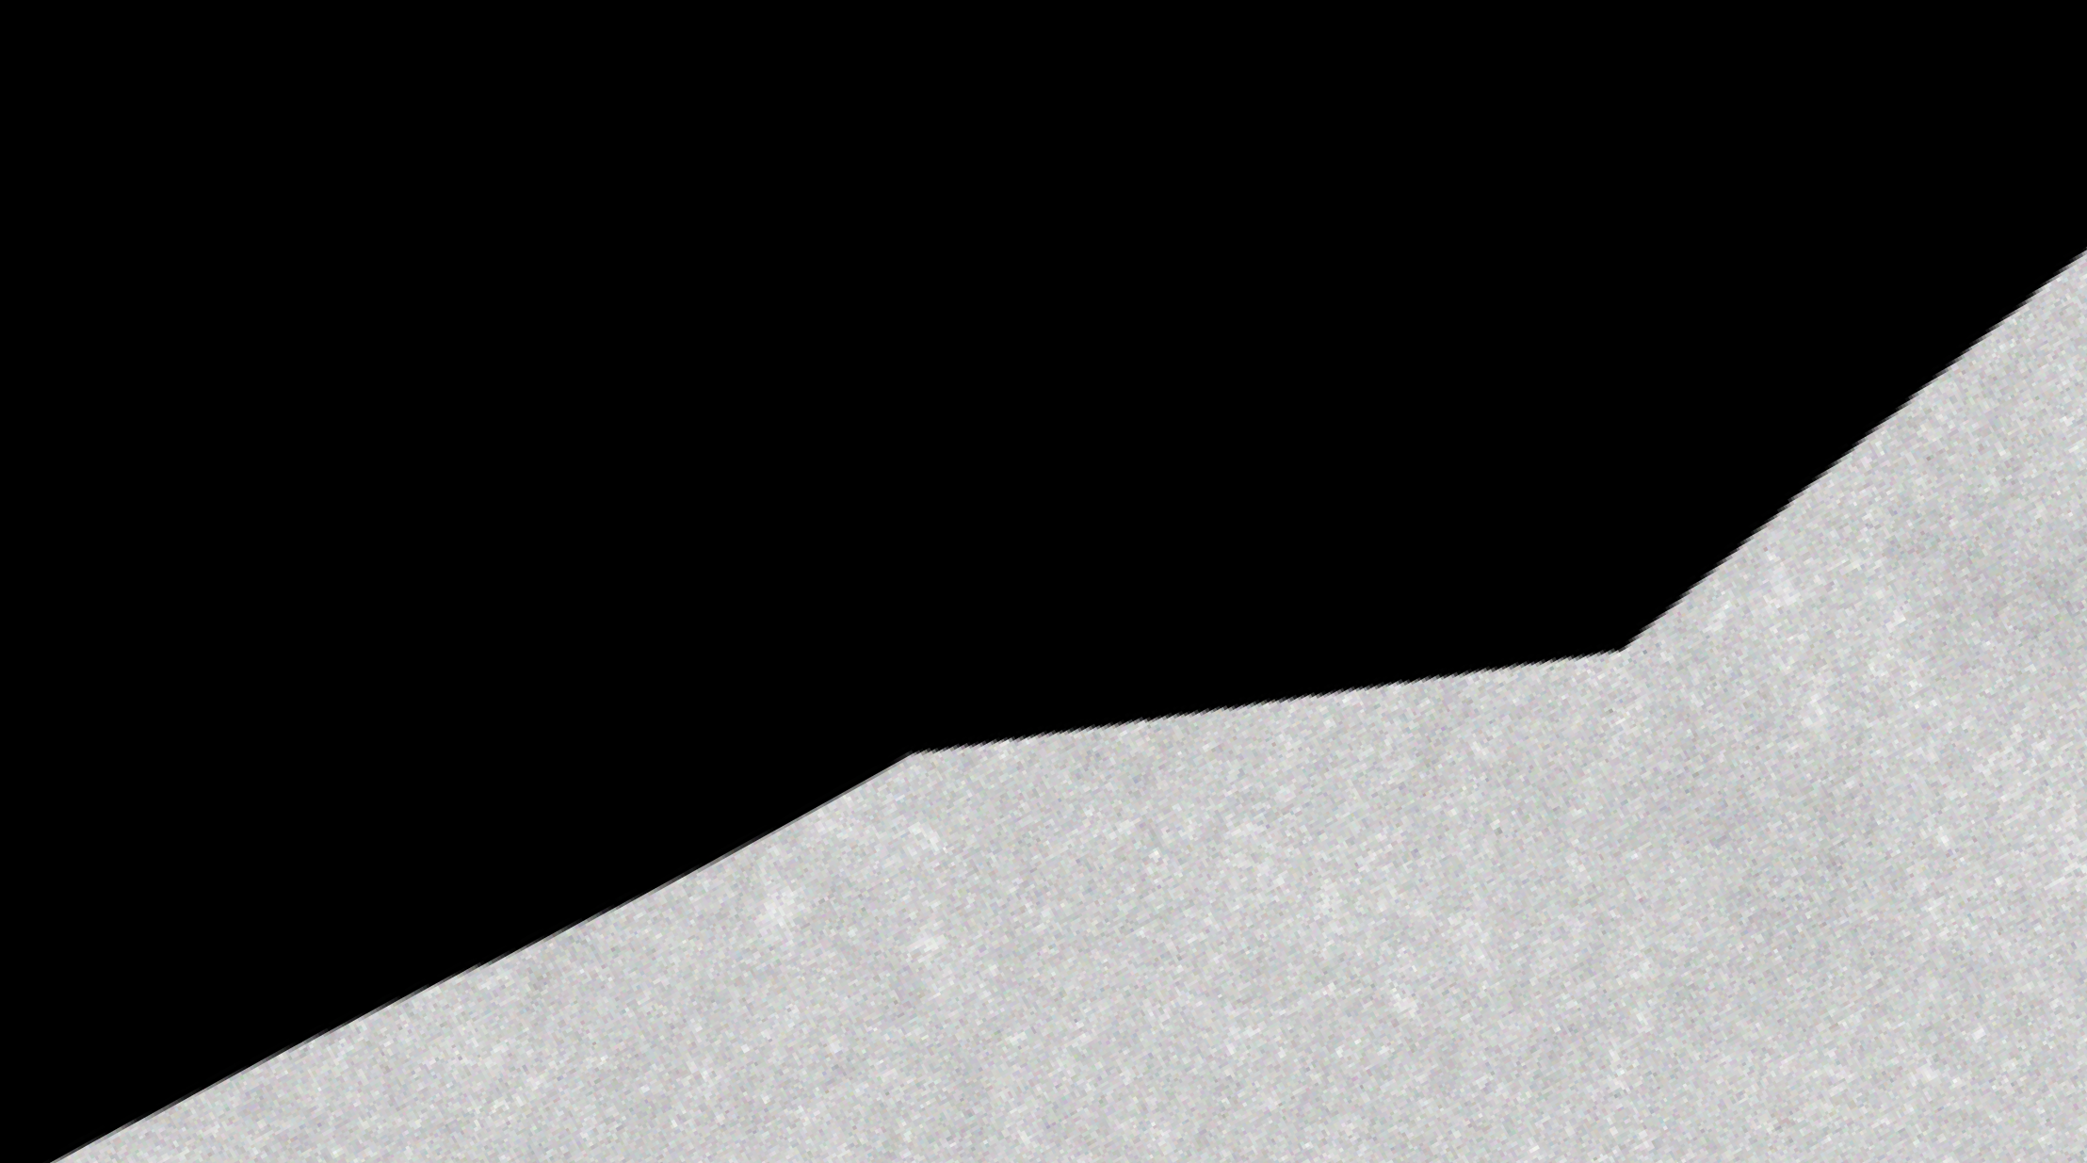
Introduction
This is a simple, intuitive mobile application that allows users to take and manage personal notes efficiently.
Designed for productivity and ease of use, it supports basic CRUD operations (Create, Read, Update, Delete) for notes.
The main goal of the app is to eliminate the need for physical note-taking by providing a digital alternative that is accessible anytime, anywhere.
The app also helps in understanding real-world development concepts like activity lifecycle, data persistence, and responsive UI design.

Slide 3


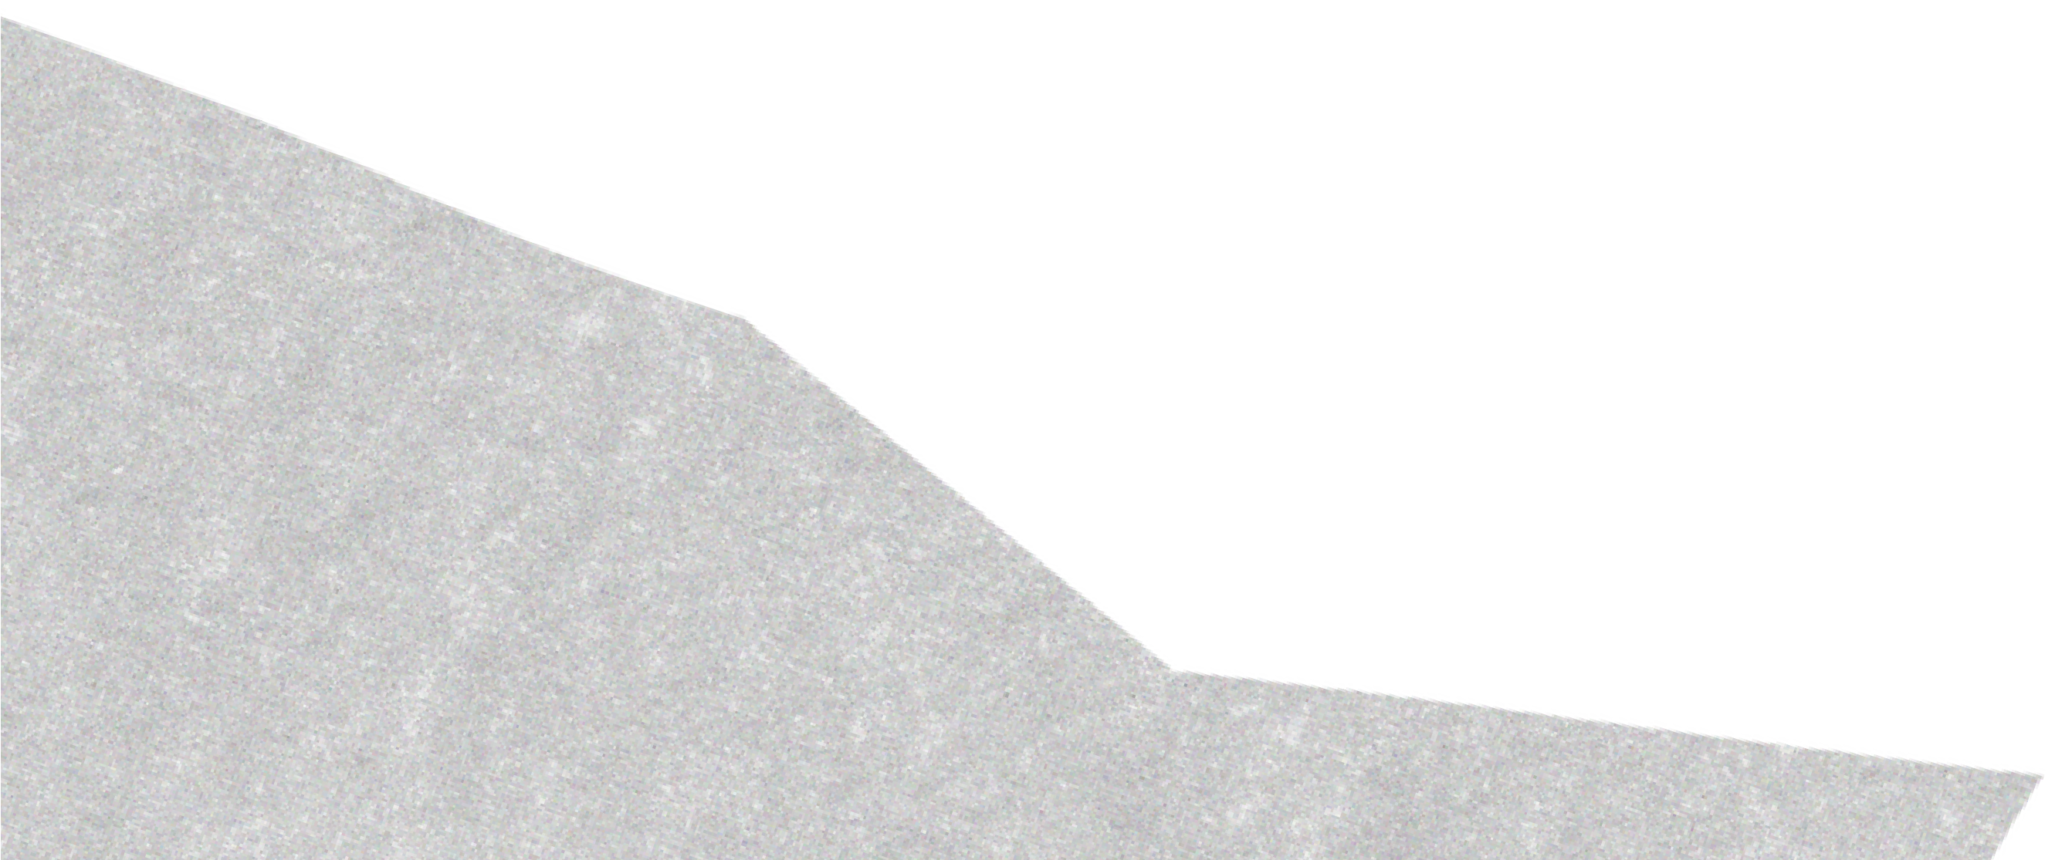

Technologies Used
Programming Language: Java
Platform: Android Studio
UI: XML

Slide 4


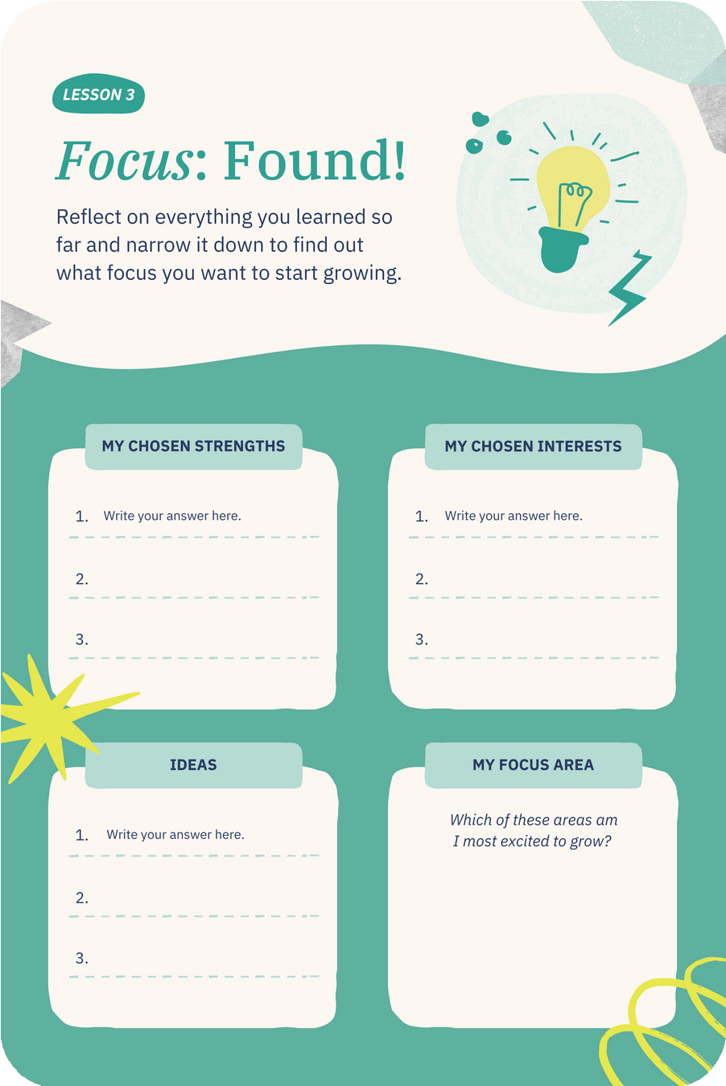
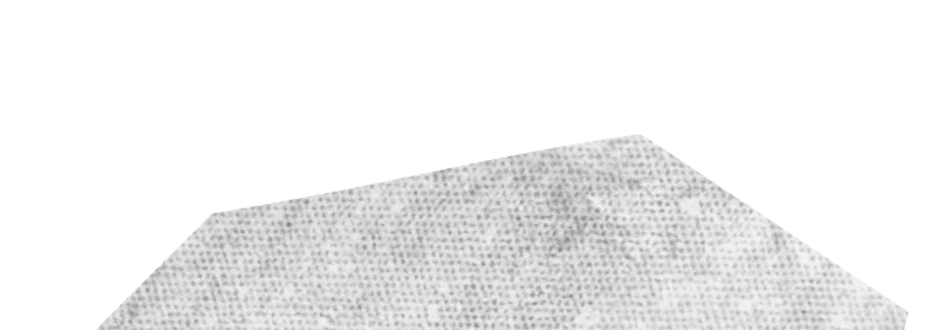
Key Features
Create and save notes
Edit and delete existing notes
Search and organize notes
User-friendly interface

Slide 5
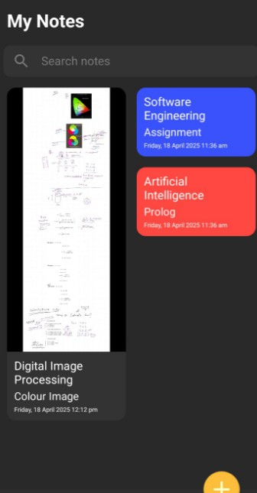
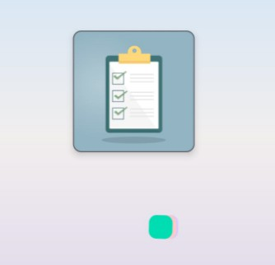
User Interface

Slide 6
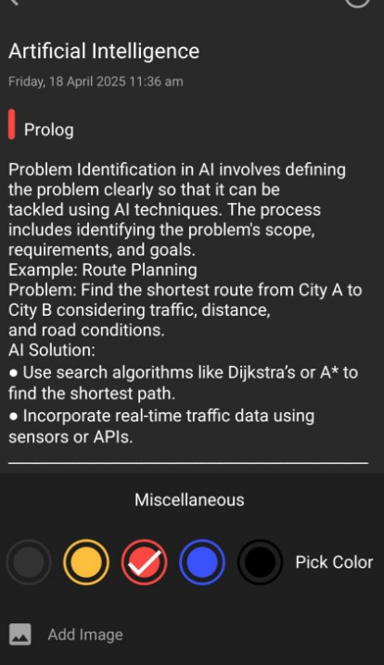
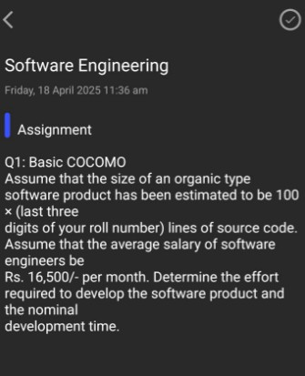
User Interface

Slide 7






Challenges Faced
UI layout and responsiveness
Data persistence
Error handling
Learning curves with Android components

Slide 8

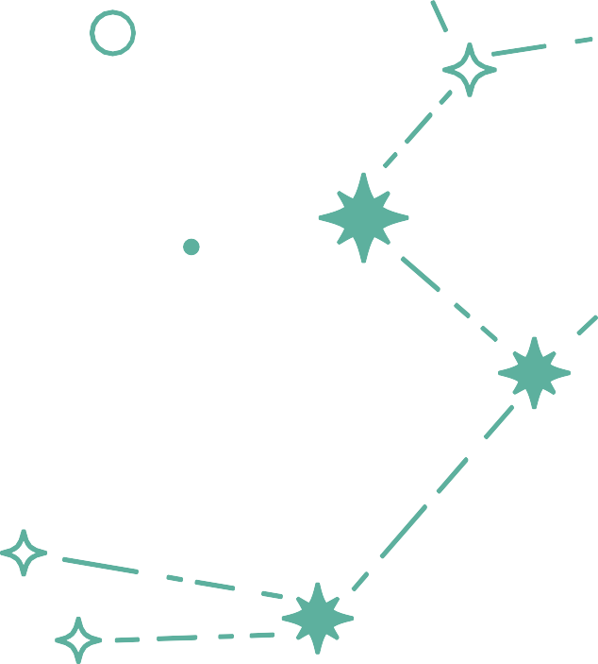
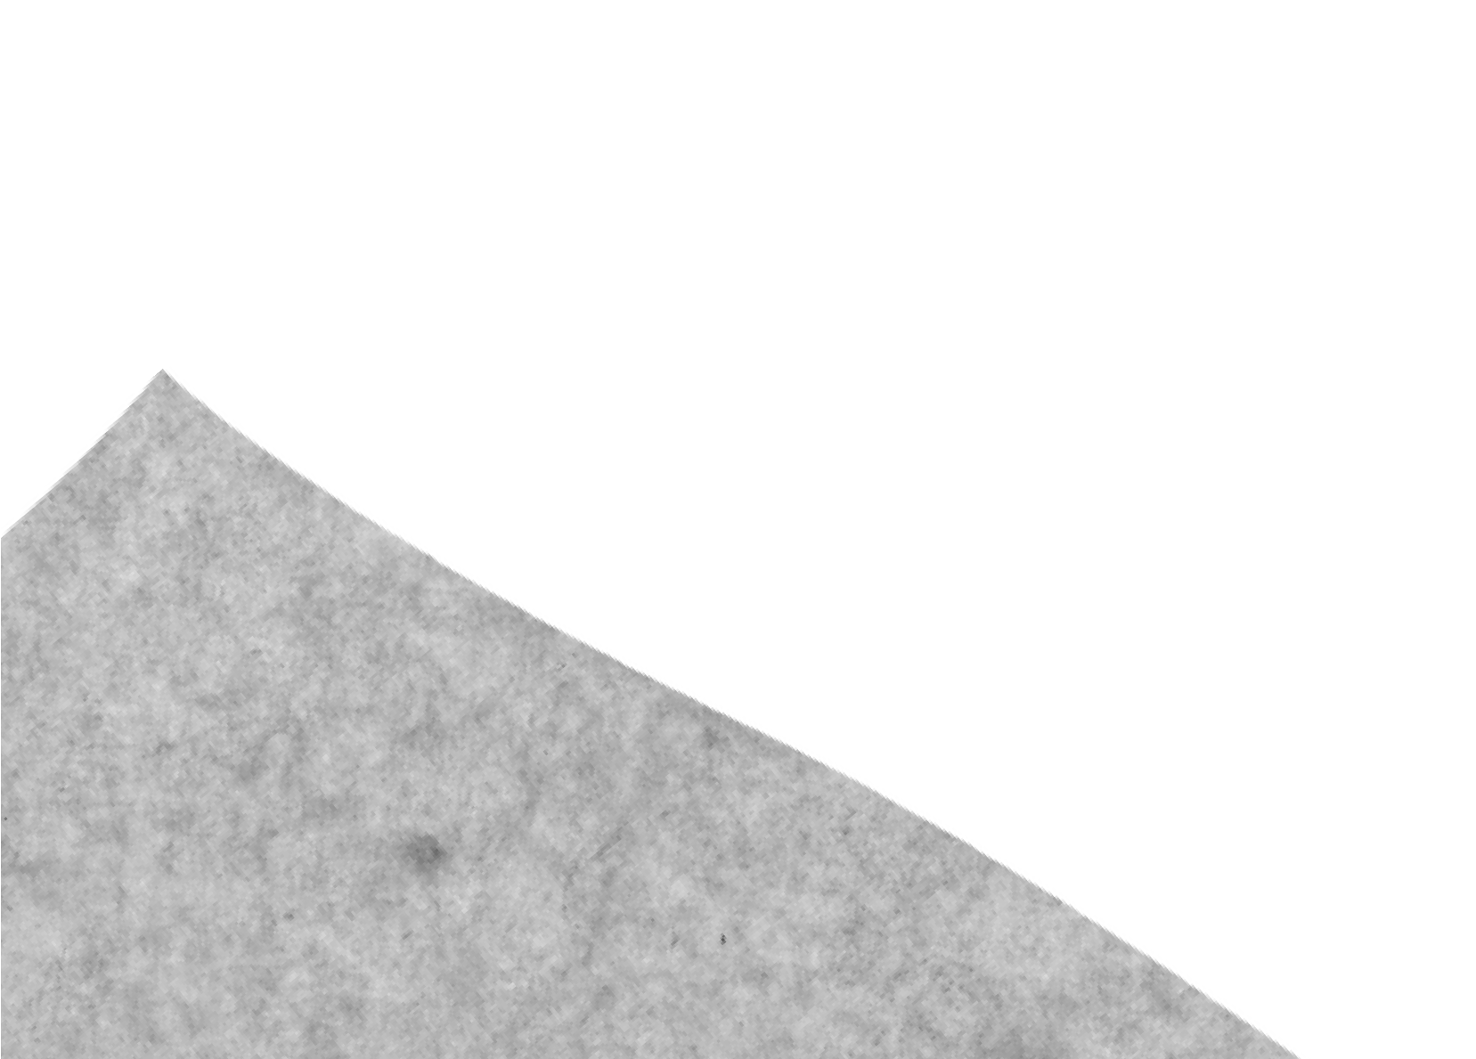
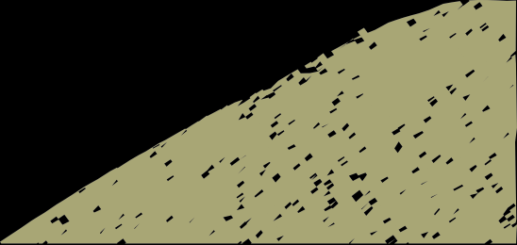
🧠 What I Have Learned
Gained hands-on experience with Java and Android Studio.
Learned how to design responsive and user-friendly mobile UIs using XML. Understood activity lifecycle and how to manage user interactions effectively.
Improved problem-solving and debugging skills while building and testing the app.
Learned how to structure a mobile app using modular and maintainable code.

Slide 9

🌍 Real-World Use Case
The app serves as a digital notebook for students, professionals, and anyone who needs to jot down quick thoughts, tasks, or reminders.
It can replace physical notepads and improve productivity by keeping notes organized and easily accessible.
With future enhancements like cloud sync and reminders, it can evolve into a full- featured personal productivity tool, similar to Google Keep or Microsoft OneNote — but simpler and lighter for everyday use.

Slide 10

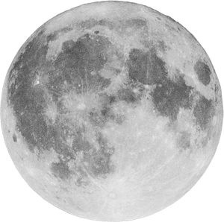
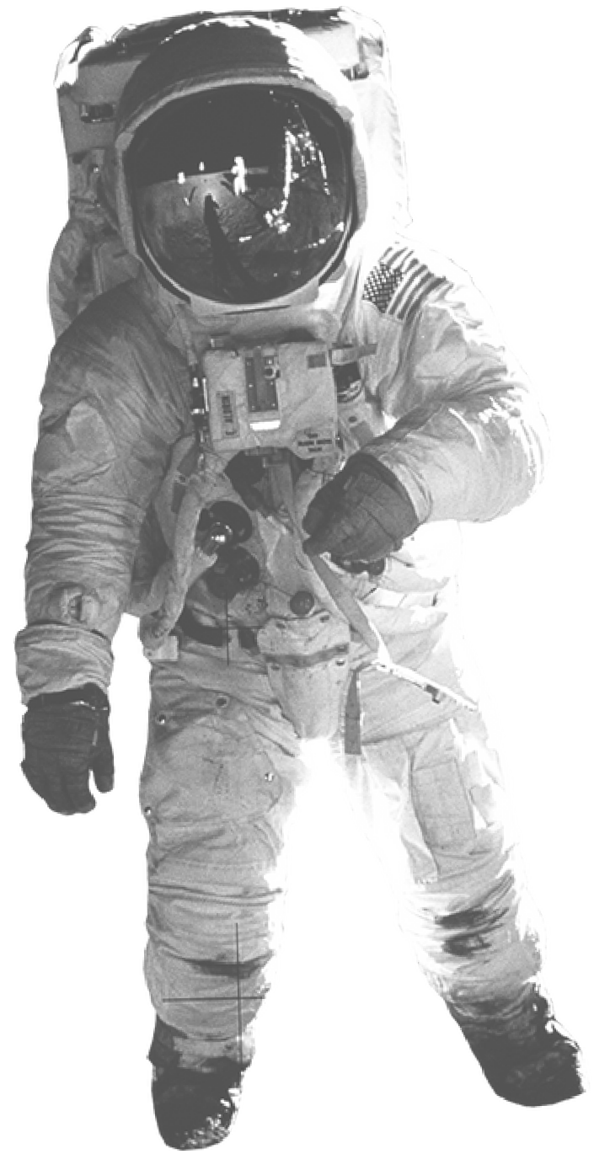
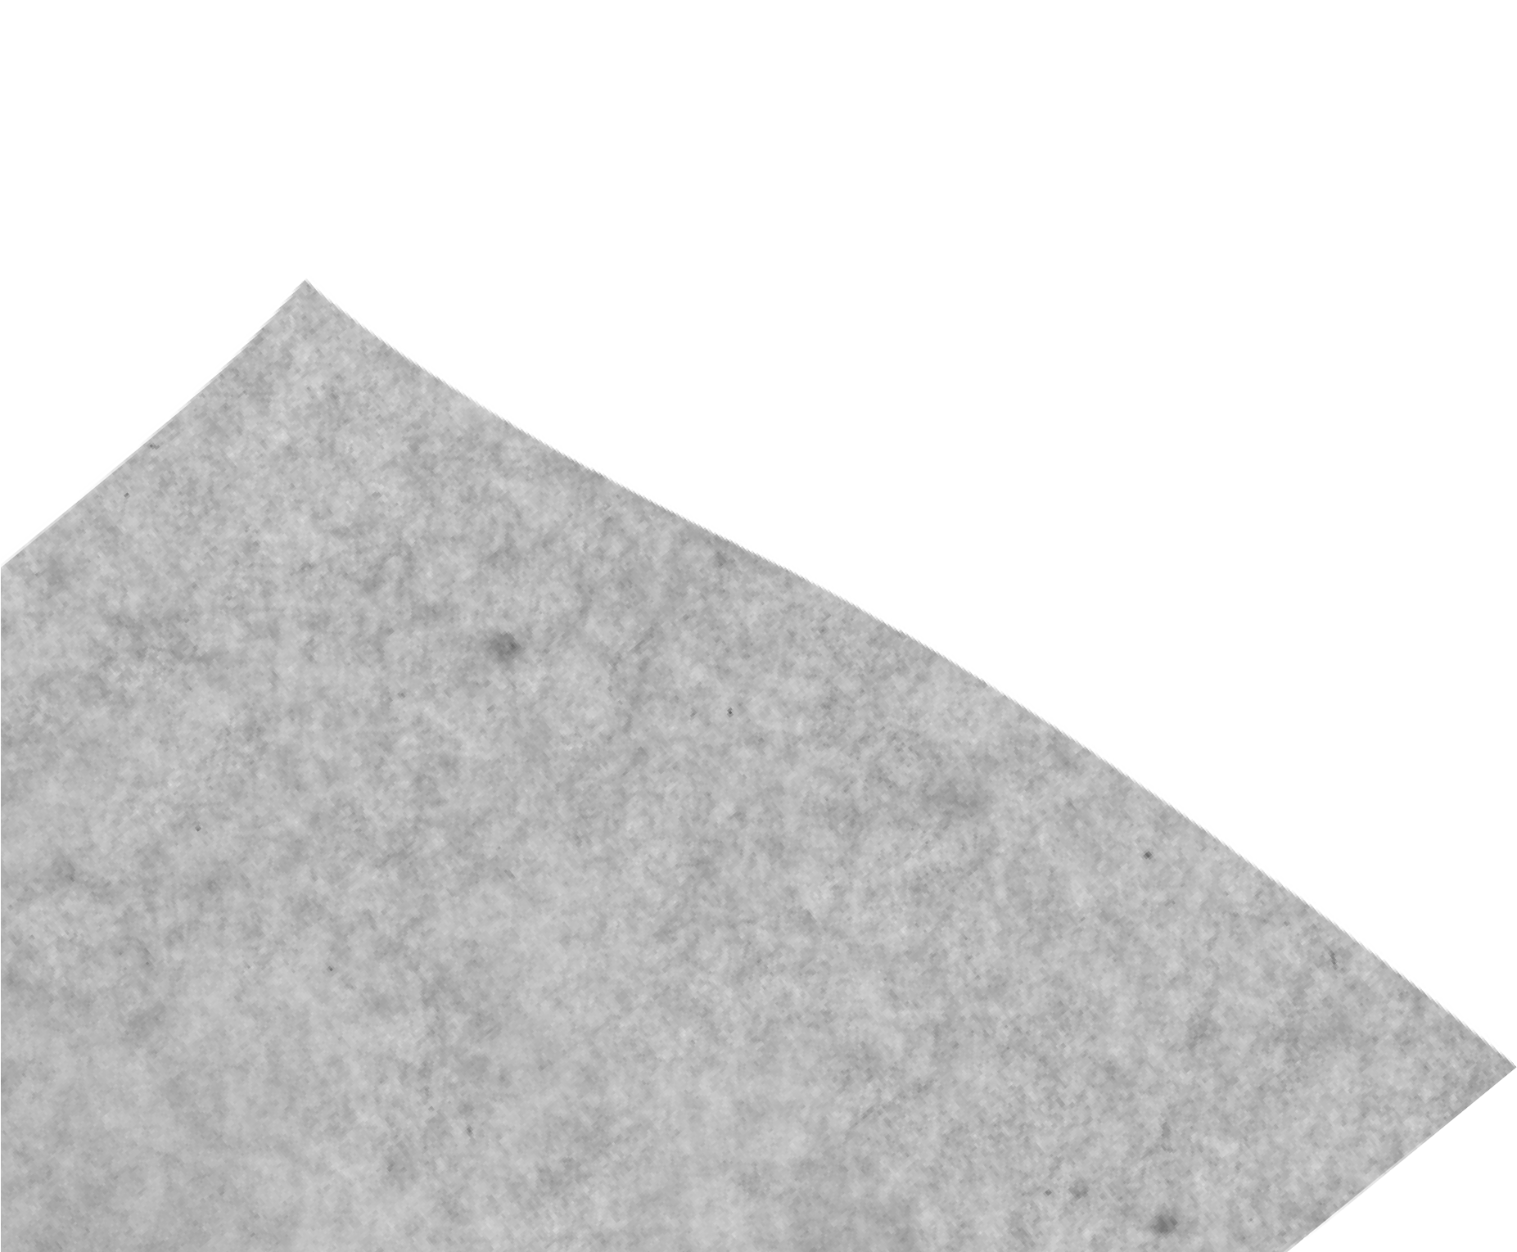
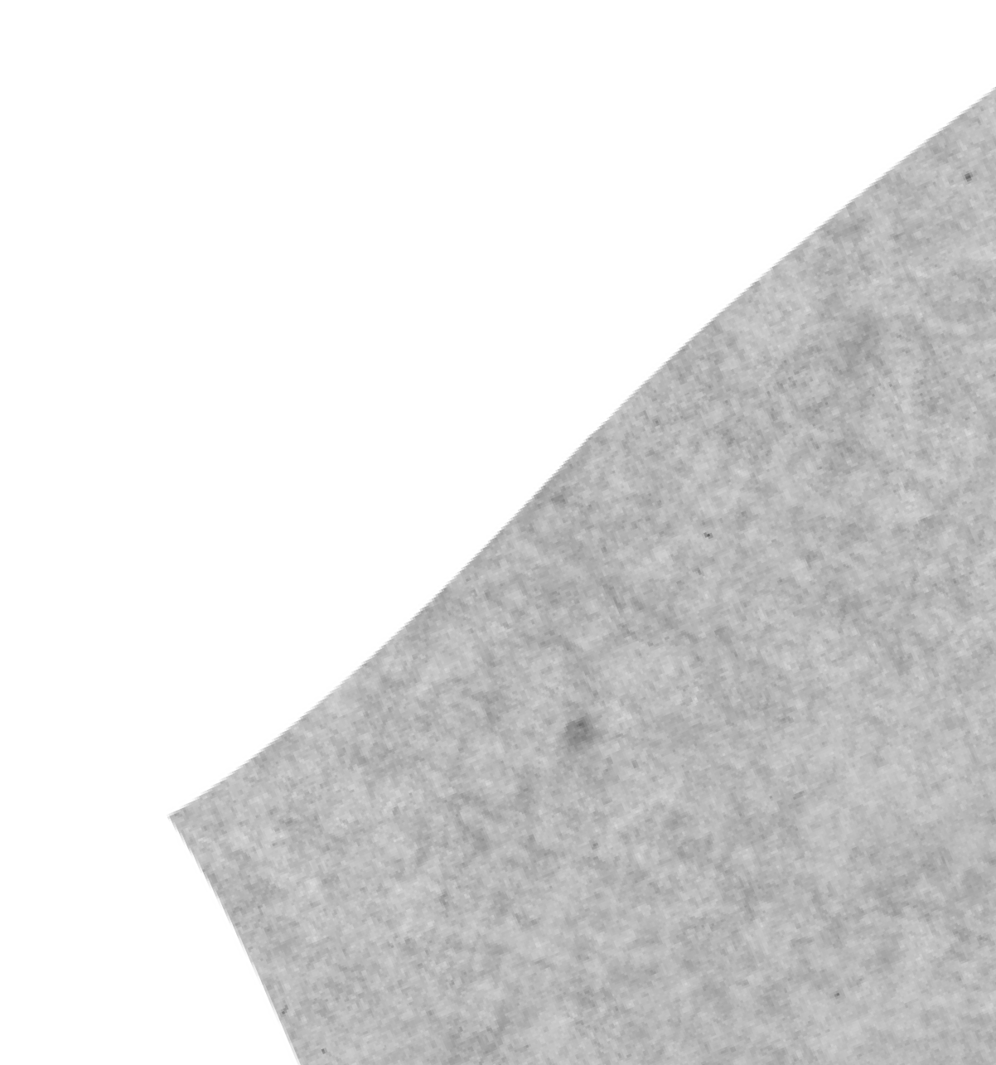


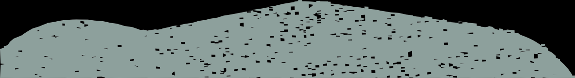
Thank You

