Slide 1

FAKE NEWS DELECTION SYSTEM
CSA1711-ARTIFICAL INTELLIGENCE
GUIDED BY: PRESENTED BY:
Dr.Krishna Kumar K A.Tharun kumar Reddy(192572068)
A.Meghanadh(192572132)

Slide 2


INTRODUCTION
Fake news refers to false or misleading information presented as genuine news.
The rapid growth of the internet and social media has made it easy for fake news to spread quickly.
Fake news can influence public opinion, create confusion, and spread misinformation.
It can negatively affect important areas such as politics, healthcare, education, finance, and society.

Slide 3
PROBLEM STATEMENTS
The rapid growth of social media and online news platforms has increased the spread of fake and misleading information.
Users often find it difficult to differentiate between real news and fake news.
Fake news can spread quickly and create confusion, fear, misinformation, and incorrect public opinions.
Manual fact-checking of every news article is time-consuming and requires significant human effort.
The large volume of online news makes it difficult for fact-checkers to verify all information manually.
.

Slide 4
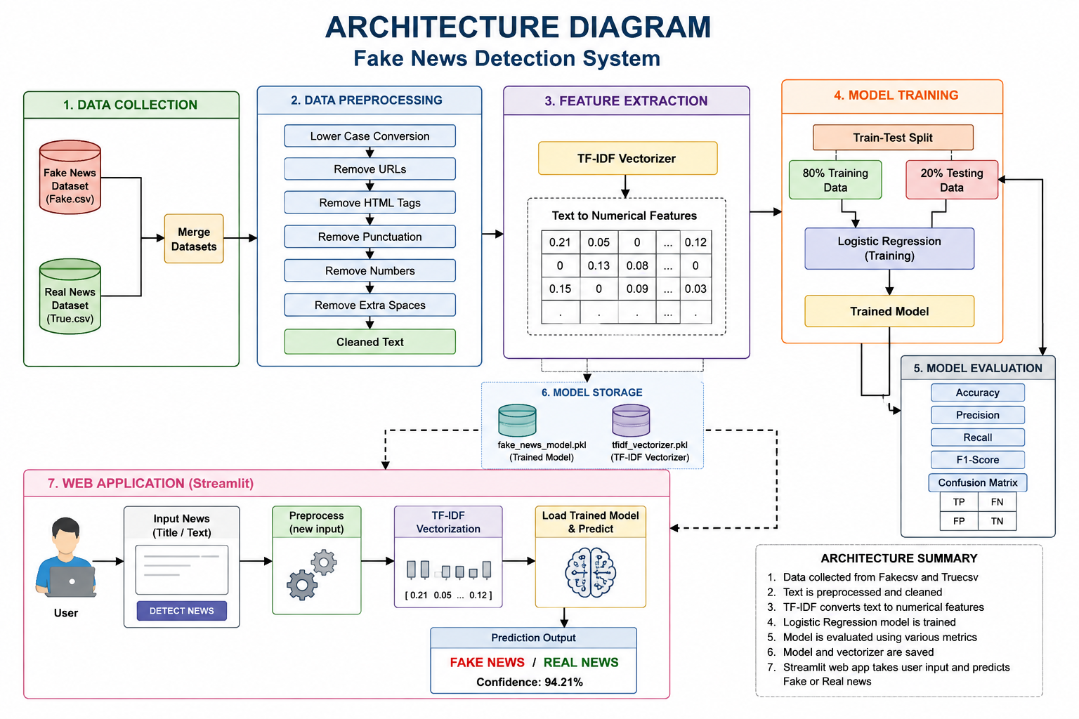

Slide 5
MODULE 1– PREPROCESSING
Description:
Text Preprocessing is the first stage of the Fake News Detection System. In this module, the raw news articles from Fake.csv and True.csv are cleaned and prepared for machine learning.
Output
Merged dataset with Real and Fake news labels.
Cleaned and normalized news text.
TF-IDF feature vectors ready for machine learning.
Preprocessed dataset prepared for training.

Slide 6
MODULE 2– NLP Model Training
Description:
The NLP Model Training module is the core component of the Fake News Detection System. .
Algorithms:TF-IDF + Logistic Regression
TF-IDF converts text into numerical values.
Logistic Regression is a supervised machine learning algorithm used for binary classification.
Since the output has only two classes (Real or Fake), Logistic Regression is an efficient and accurate choice. Output
Real News or Fake News prediction.

Slide 7
MODULE 3–WEB DEPLOYMENT
.
Description:
The Web Deployment module is the final stage of the Fake News Detection System. In this module, the trained NLP model is integrated into a web application Output:
Displays whether the entered news article is Real News or Fake News.

Slide 8
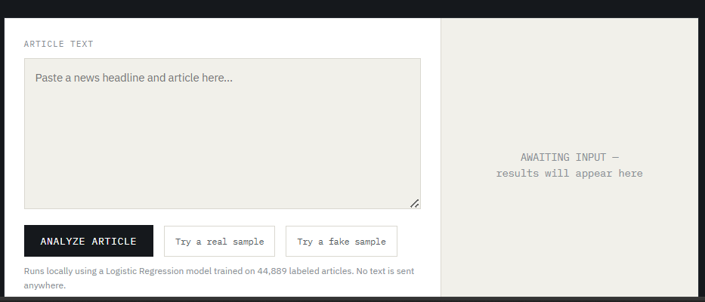

Slide 9
CONCLUSION
The Fake News Detection System provides an effective solution for identifying whether a news article is Real or Fake using Natural Language Processing (NLP).
The Text Preprocessing module cleans and prepares the news text by removing unnecessary words and symbols, improving data quality.
The NLP Model Training module converts text into numerical features using TF-IDF and trains a Logistic Regression model to accurately classify news articles.

Slide 10
REFERENCE
K. Shu, A. Sliva, S. Wang, J. Tang, and H. Liu, “Fake news detection on social media: A data mining perspective,” ACM SIGKDD Explorations Newsletter, vol. 19, no. 1, pp. 22–36, 2017.
K. Shu, D. Mahudeswaran, S. Wang, D. Lee, and H. Liu, “FakeNewsNet: A data repository with news content, social context, and dynamic information for studying fake news on social media,” Big Data, vol. 8, no. 3, pp. 171–188, 2020.
N. Ruchansky, S. Seo, and Y. Liu, “CSI: A hybrid deep model for fake news detection,” in Proc. ACM Conf. Information and Knowledge Management (CIKM), 2017, pp. 797–806.
V. Pérez-Rosas, B. Kleinberg, A. Lefevre, and R. Mihalcea, “Automatic detection of fake news,” in Proc. 27th Int. Conf. Computational Linguistics (COLING), 2018, pp. 3391–3401.
Y. Wang, “Liar, liar pants on fire: A new benchmark dataset for fake news detection,” in Proc. 55th Annual Meeting of the Association for Computational Linguistics (ACL), 2017, pp. 422–426.

Slide 11
THANK YOU

