Slide 1
Disaster Preparedness and Response Education System
For Schools and Colleges
CSA0804-PYTHON PROGRAMMING
PRESENTEDV BY:
Revanthsai(192525451)
A.Tharun Kumar Reddy(192572068)
Likith chowdary(19252471)
Gudied by:
Dr.A.Jegatheessan
1

Slide 2
Introduction
Disasters can occur unexpectedly in schools, colleges and surrounding communities.
Students need awareness of safety procedures and emergency-response techniques.
Conventional disaster education is often limited to classroom teaching and occasional drills.
An interactive digital platform can make disaster education more engaging, accessible and measurable.
The proposed system combines learning, assessment and simulation in one platform.
2

Slide 3
Problem Statement
Existing Challenges:
Limited practical knowledge of disaster-response procedures.
Lack of interactive disaster-preparedness training.
Difficulty in assessing students' emergency-response knowledge.
Teachers have limited tools for tracking individual student progress.
Disaster-learning resources are often scattered across different sources.
Need:
A centralized platform that allows students to learn → practice → evaluate → improve.
3

Slide 4
Objectives:
To develop an interactive web-based platform for teaching students about different disasters, safety procedures, and emergency-response methods.
To provide interactive learning and assessment through learning modules, quizzes, and mock emergency scenarios.
To monitor and improve student preparedness using progress tracking, scores, badges/certificates, and teacher/admin dashboards.
4

Slide 5
Proposed System
The proposed system is a web-based disaster education platform with two major user roles:
Student:
Access learning modules
Attempt quizzes
Participate in mock scenarios
View scores and progress
Earn badges/certificates
Teacher:
Monitor student performance
View quiz results
Track learning progress
5

Slide 6
Types of Disasters Covered
• Earthquakes
• Floods
• Fire Emergencies
• Cyclones
• Thunderstorms
• Volcanic Eruptions
• Industrial Accidents
• General Emergency Situations
6

Slide 7
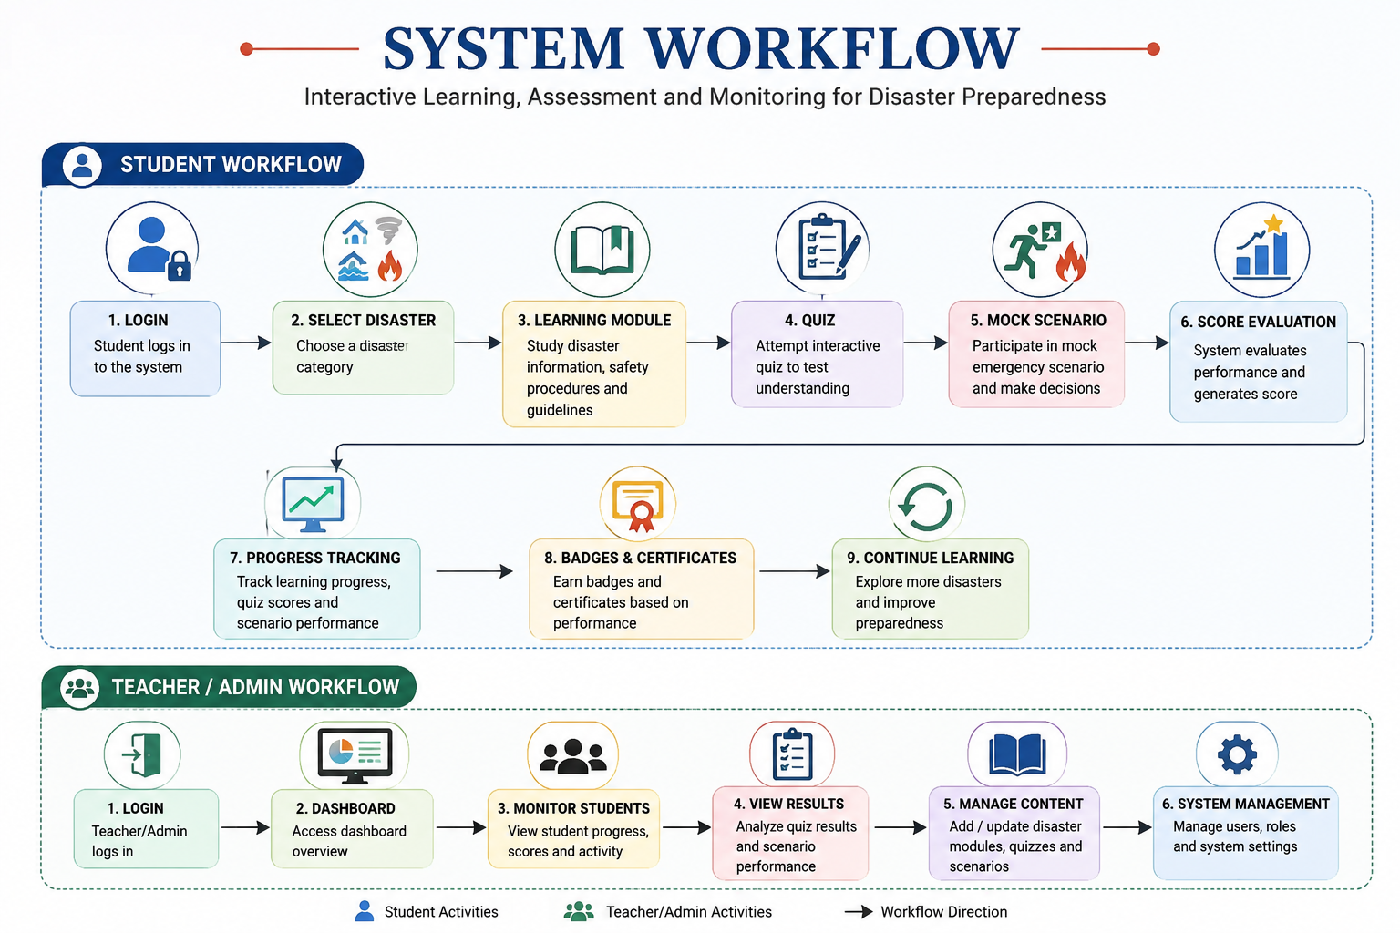
System Workflow
7

Slide 8
Key Features
• Learning Modules – disaster information and safety instructions.
• Interactive Quizzes – test student understanding.
• Mock Scenarios – practice emergency decision-making.
• Progress Tracking – monitor completed modules and performance.
• Badges & Certificates – motivate students.
• Dashboards – monitor student performance and manage content.
8

Slide 9
Technologies Used
Technology | Purpose
Python | Backend programming and application logic
Flask / Django | Web application framework
HTML | Web-page structure
CSS | Styling and layout
JavaScript | Interactive functionality
Bootstrap | Responsive user interface
MySQL | Data storage and management
10

Slide 10
Expected Outcomes and Benefits
Expected Outcomes:
Improved disaster awareness among students.
Better understanding of emergency procedures.
Increased engagement through interactive learning.
Improved assessment of disaster-preparedness knowledge.
Easy monitoring of student performance.
Benefits:
Accessible through a web browser.
Centralized learning platform.
Encourages continuous learning.
Supports teachers and administrators.
Can be expanded with new disasters and scenarios.
11

Slide 11
Future Scope
• Mobile application support.
• AI-based personalized learning recommendations.
• Real-time emergency alerts.
• Gamification and leaderboards.
• Virtual reality-based disaster simulations.
• Multilingual learning content.
• Integration with institutional emergency-management systems.
13

Slide 12
Conclusion
• The system provides an interactive and structured approach to disaster preparedness education.
• Students learn through modules, quizzes and mock scenarios.
• Teachers and administrators can monitor learning progress through dashboards.
• The platform supports a stronger culture of safety, awareness and preparedness.
12

Slide 13


