Slide 1
Automatic Generation Image Captions based on Deep Learning and Neural Network
Yashwanth Nalamasa – 700747715
Sreeja Madhagoni -700755861
Tharun Bhukya –700747504
Shravya Mendu –700755784

Slide 2
MOTIVATION
Various image sources, including television, the internet, and news outlets, contribute to a vast pool of images. While a significant portion of these images lacks accompanying descriptions, humans possess the ability to interpret them independently.
In contrast, machines face considerable challenges in understanding images without descriptive information. The need for descriptions becomes crucial for machines to comprehend visual content.
In the realm of artificial intelligence, the research focus on captioning natural scenes has emerged as a critical endeavor. This area aims to provide detailed descriptions for images, addressing the gap in machine understanding

Slide 3
PROBLEM STATEMENT
CNN-RNN framework-based image captioning technique has two drawbacks in training phase. First drawback is each caption gets equal importance without their individual importance and second drawback is during caption generation objects may not be correctly recognized.
In this paper we have also suggested called Reference based long short term memory (R-LSTM) that main aim is by implementing reference information to give more descriptive caption for a query image.

Slide 4
OBJECTIVES
Should implement a CNN-RNN model by building an image caption generator.
The main aim is by implementing reference information to give more descriptive caption for a query image using Long short term memory.
This system is developing in the high-level languages and uses advanced front-end and back-end technologies .The response time on the client system should be very less.

Slide 5
PAPER 1 CONTRIBUTION:
Paper Title: Refining object detection in video with Recurrent neural network
core content: RNN(Recurrent Neural Network)
Contribution:
A Recurrent Neural Network reads in a sequence of provisionally labeled frames using the contextual information to output refined predictions.
Recurrent model, we demonstrate an efficient and effective training strategy that simultaneously employs localization-level strong supervision, category-level weak supervision, and a penalty encouraging smoothness of predictions across adjacent frames
On a video dataset with sparse object-level annotation, our framework proves effective, as validated by extensive experiments.

Slide 6
PAPER 2 CONTRIBUTION:
Paper Title: An Approach for Rainfall Prediction Using Long Short Term Memory Neural Network
Core Content:
Long Short-Term Memory
Contribution:
LSTM network is an extended special network architecture of Recurrent Neural Network (RNN)
LSTM was designed to overcome the shortcomings of RNN such as vanishing gradient because of having short term memory.
Long Short-Term Memory can solve the long-range dependency issue of RNN as it can retain the findings for a long-range of time.

Slide 7
PAPER 3 CONTRIBUTION:
Paper Title: Face Mask Detection using deep neural networks
Core Content: CNN (Convolutional Neural Network)
Contribution:
CNN is a type of artificial neural network which widely used for image /object recognition and classification
It is a neural network that has one or more convolutional neural network and are used for image processing/classification and also for other auto corrected data.

Slide 8
PAPER 4 CONTRIBUTION:
Paper Title: Convolutional Neural Networks for image classification
Core Content: CNN(Convolutional Neural Networks)
Contribution:
Convolutional Neural Networks (CNNs) and their use in image classification tasks. The authors provide a comprehensive explanation of how CNNs work, including their architecture, components, and mathematical operation.
Main contribution is to provide a detailed understanding of CNNs and their application to image classification, along with experimental evidence of their effectiveness.

Slide 9
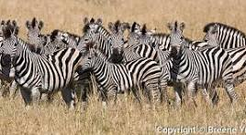

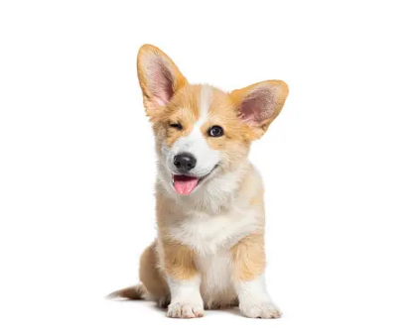
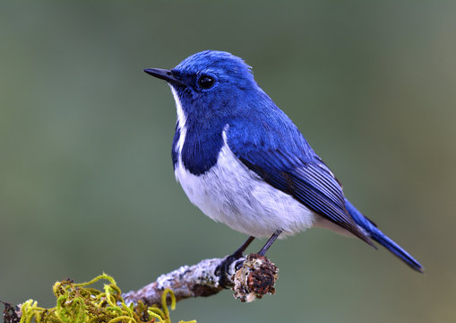
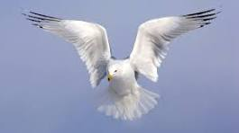
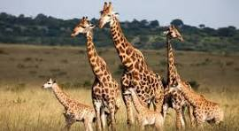
RESULTS
Gathered the Required information and resources required to complete the project
FIG1: <start> a group of zebras are standing in a field . <end>
FIG2: <start> a group of people standing around a table with a remote . <end>
FIG3: <start> a brown and white dog with a red collar . <end>
FIG4: <start> a bird standing on branch. <end>
FIG5: <start> a large white bird flying in the sky . <end>
FIG6: <start> a group of giraffes are standing in the grass . <end>

Slide 10
REFERENCES: 1.Graves, A.; Liwicki, M.; Fernández, S.; Bertolami, R.; Bunke, H.; Schmidhuber, J. (May 2009). "A Novel Connectionist System for Unconstrained Handwriting Recognition". IEEE Transactions on Pattern Analysis and Machine Intelligence. 2. Li, Xiangang; Wu, Xihong (2014-10-15). "Constructing Long Short-Term Memory based Deep Recurrent Neural Networks for Large Vocabulary Speech Recognition 3. Wu, Yonghui; Schuster, Mike; Chen, Zhifeng; Le, Quoc V.; Norouzi, Mohammad; Macherey, Wolfgang; Krikun, Maxim; Cao, Yuan; Gao, Qin (2016-09-26). "Google's Neural Machine Translation System: Bridging the Gap between Human and Machine Translation 4. Mayer, H.; Gomez, F.; Wierstra, D.; Nagy, I.; Knoll, A.; Schmidhuber, J. (October 2006). A System for Robotic Heart Surgery that Learns to Tie Knots Using Recurrent Neural Networks. 2006 IEEE/RSJ International Conference on Intelligent Robots and Systems. pp. 543–548. 5. Rodriguez, Jesus (July 2, 2018). "The Science Behind OpenAI Five that just Produced One of the Greatest Breakthrough in the History of AI". Towards Data Science. Archived from the original on 2019-12-26. Retrieved 2019-01-15.

Slide 11
6. Li, Xiangang; Wu, Xihong (2014-10-15). "Constructing Long Short-Term Memory based Deep Recurrent Neural Networks for Large Vocabulary Speech Recognition 7. K. Cho, B. Van Merriënboer, Ç. Gülçehre, D. Bahdanau, F. Bougares, H. Schwenk, Y. Bengio, Learning phrase representations using rnn encoder–decoder for statistical machine translation, in: Proceedings of the 2014 Conference on Empir-ical Methods in Natural Language Processing (EMNLP), Association for Computational Linguistics, Doha, Qatar, 2014. 8. Rashtchian C, Young P, Hodosh M, Hockenmaier J. (2010) Collecting image annotations using Amazon’s Mechanical Turk. In: Proceedings of the NAACL HLT 2010 workshop on creating speech and language data with Amazon’s Mechanical Turk. Association for Computational Linguistics. 9. D. Lin, An information-theoretic definition of similarity, in: Proceedings of the Fifteenth International Conference on Machine Learning 10. Dewa Made Sri Arsa, I.P.A. Bayupati & Kadek Sastrawan ,” Detection of fake news using deep learning CNN–RNN based methods” 11. Anjali Samad,Bhagyanidhi and Vaibhav Gautam, "An Approach for Rainfall Prediction Using Long Short Term Memory Neural Network"
11

Slide 12
THANK YOU

