Slide 1


PANIMALAR ENGINEERING COLLEGE
Department of Computer Science and Engineering
CS8811 PROJECT WORK
URINARY BIOMARKERS FOR PANCREATIC CANCER PREDICTION USING DATA SCIENCE TECHNIQUE
Batch Number: C13
VISHWA S [REGISTER NO: 211419104310]
THARUN C [REGISTER NO: 211419104291]
SANDEEP V [REGISTER NO: 211419104230]
MRS. VIJAYALAKSHMI.P,
M.C.A.,M.Phil.,M.Tech.,
ASSISTANT PROFESSOR
GRADE 1

Slide 2
INTRODUCTION
Pancreatic cancer is the fourth most common cancer-related cause of death in the United States and is usually asymptomatic in early stages. There is a scarcity of tests that facilitate early diagnosis or accurately predict the disease progression. To this end, biomarkers have been identified as important tools in the diagnosis and management of pancreatic cancer. Despite the increasing number of biomarkers described in the literature, most of them have demonstrated moderate sensitivity and specificity and are far from being considered as screening tests. More efficient non-invasive biomarkers are needed to facilitate early-stage diagnosis and interventions. Multi-disciplinary collaboration might be required to facilitate the identification of such markers. Data mining is a commonly used technique for processing enormous data. Researchers apply several data mining and machine learning techniques to analyse huge complex data, to helping the prediction of pancreatic cancer. Different algorithms are compared and the best model is used for predicting the outcome.

Slide 3
LITERATURE SURVEY
TITLE | DESCRIPTION | AUTHOR1 | YEAR
1. Predicted Prognosis of Pancreatic Cancer Patients by Machine Learning | They collected samples from 191 patients and compared support vector machines (SVM) with various kernels of ranging complexity and a neural network. Models were trained using k-fold crossvalidation (with various choices of k) or leave-one-out cross-validation or a 50/50 split to evaluate generalizability. | Julius M. Kernbach, and Victor E. Staartjes | 2020
2. Management of Metastatic Pancreatic Adenocarcinoma | In the year 2016, there will be approximately 53,000 estimated new individuals diagnosed with PDAC in the United States, representing approximately 3% of all cancer | Ahmad R. Cheema, MDa,b, Eileen M. O’Reilly, MDc,d, | 2016
3. Diagnostic, Predictive and Prognostic Molecular Biomarkers in Pancreatic Cancer: An Overview for Clinicians | Pancreatic ductal adenocarcinoma (PDAC) is the most common pancreatic malignancy and is associated with aggressive tumor behavior and poor prognosis. Most patients with PDAC present with an advanced disease stage and treatment-resistant tumors. | Dimitrios Giannis , Dimitrios Moris , and Andrew S. Barbas | 2021

Slide 4
LITERATURE SURVEY
TITLE | DESCRIPTION | AUTHOR1 | YEAR
4. A Survey On Prediction Of Survival Time On Pancreatic Cancer Using Machine Learning Paradigms Towards Big Data | The paper evaluated the proposed approaches in a database of review records of careful resections of pancreatic disease. | Santosh Reddy P | 2020
5.Pancreatic cancer: Clinical presentation, pitfalls and early clues | The diagnosis of pancreatic cancer usually depends upon symptoms; consequently it is late when there is no chance for cure. At this point, pain, anorexia, early satiety, sleep problems and weight loss are present. Back pain also may be prominent, which predicts unresectability and shortened survival after resection. | E. P. DiMagno | 1999

Slide 5
PROBLEM STATEMENT
Pancreatic cancer is the fourth most common cancer-related cause of death in the United States and is usually asymptomatic in early stages. There is a scarcity of tests that facilitate early diagnosis or accurately predict the disease progression. To this end, biomarkers have been identified as important tools in the diagnosis and management of pancreatic cancer. Despite the increasing number of biomarkers described in the literature, most of them have demonstrated moderate sensitivity and specificity and are far from being considered as screening tests. More efficient non-invasive biomarkers are needed to facilitate early-stage diagnosis and interventions. Multi-disciplinary collaboration might be required to facilitate the identification of such markers. The goal is to develop a machine learning model for Pancreatic cancer , to potentially replace the updatable supervised machine learning classification models by predicting results in the form of best accuracy by comparing supervised algorithm.

Slide 6
TECHNOLOGY STACK
Software Requirements:
Operating System : Windows
Tool : Anaconda with Jupyter Notebook
2. Hardware requirements:
Processor : Intel core i3
Hard disk : minimum 300 GB
RAM : minimum 4 GB

Slide 7
SYSTEM ARCHITECTURE

Slide 8
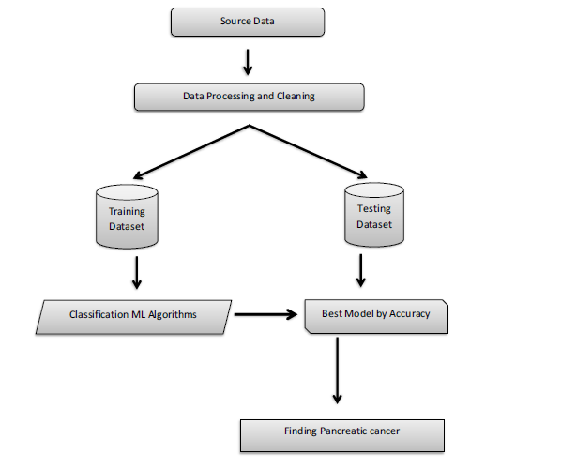
SYSTEM DESIGN

Slide 9
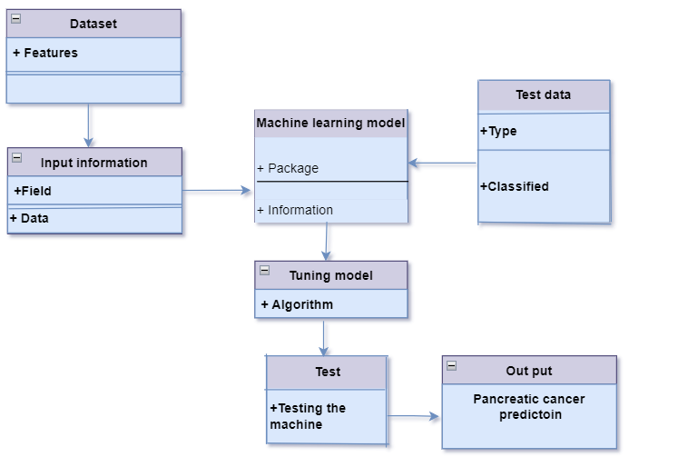
CLASS DIAGRAM

Slide 10
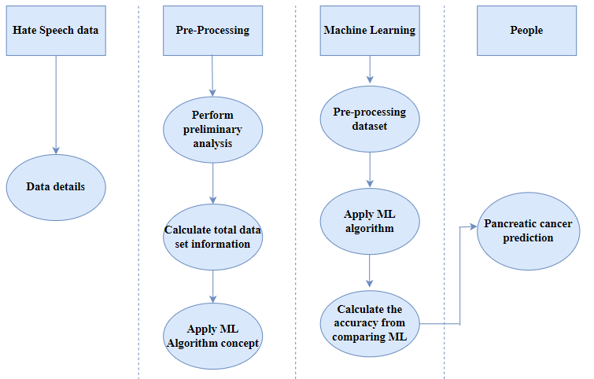
ACTIVITY DIAGRAM

Slide 11
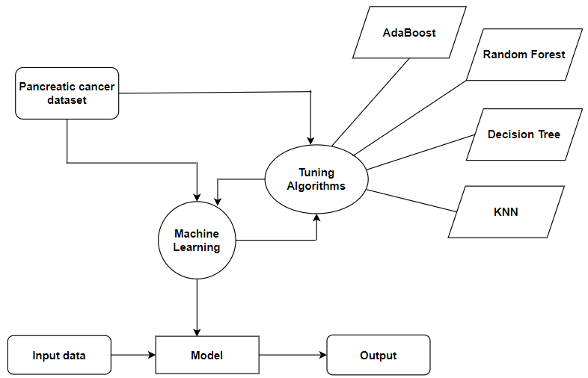
ER DIAGRAM

Slide 12
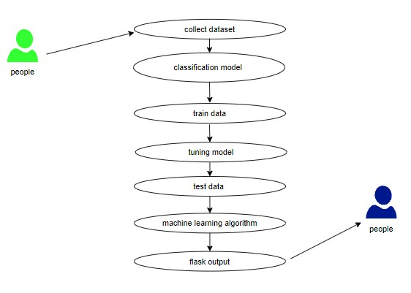
USECASE DIAGRAM

Slide 13
MODULE DESCRIPTION
Module Names
Data Pre-processing
Data Analysis of Visualization
Comparing Algorithm with prediction in the form of best accuracy result
Deployment Using Flask
Algorithms Compared
➢ KNN
➢ Random Forest
➢ Decision Tree
➢ AdaBoost

Slide 14
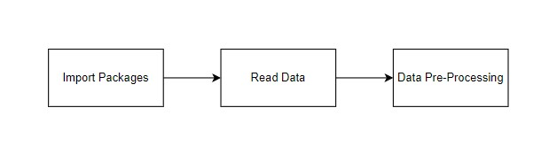
Data Pre-processing
Validation techniques in machine learning are used to get the error rate of the Machine Learning (ML) model, which can be considered as close to the true error rate of the dataset.
If the data volume is large enough to be representative of the population, you may not need the validation techniques. However, in real-world scenarios, to work with samples of data that may not be a true representative of the population of given dataset. To finding the missing value, duplicate value and description of data type whether it is float variable or integer.
The sample of data used to provide an unbiased evaluation of a model fit on the training dataset while tuning model hyper parameters.

Slide 15

Data Validation/ Cleaning/Preparing Process:
Importing the library packages with loading given dataset. To analyzing the variable identification by data shape, data type and evaluating the missing values, duplicate values.
A validation dataset is a sample of data held back from training your model that is used to give an estimate of model skill while tuning model's and procedures that you can use to make the best use of validation and test datasets when evaluating your models.
Data cleaning / preparing by rename the given dataset and drop the column etc.

Slide 16
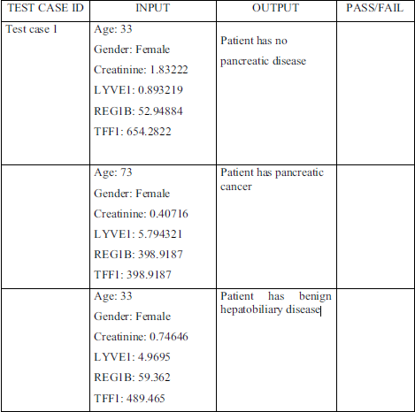
SYSTEM TESTING
Test Case 2
Test Case 3

Slide 17
SCREENSHOTS :
Figure 1. Sample Output Screen

Slide 18
Figure 9.2 Sample Output Screen

Slide 19
Figure 3 Sample Output Screen

Slide 20
CONCLUSION
The analytical process started from data cleaning and processing, missing value, exploratory analysis and finally model building and evaluation. The best accuracy on public test set of higher accuracy score algorithm will be find out. The founded one is used in the application which can help to find the Pancreatic cancer of the patient.

Slide 21
REFERENCES
1. Al Bakir, I., Curtius, K., Graham, T. A., & McDonald, S. A. C. (2019). Predicting
pancreatic cancer risk using machine learning techniques. Gut, 68(2), 440-441.
2. Bustin, S. A. (2019). A guide to the technology and its applications for quantifying
gene expression by real-time quantitative PCR. In A-Z of quantitative PCR (pp. 1-
9). Springer, Cham.
3. Chen, Y., Shen, H., & Zhu, X. (2020). Machine learning in cancer biomarker
discovery. Epigenomics, 12(10), 881-895.
4. Cho, Y., Kim, J. H., Kim, Y. H., Song, M., Lee, H. W., Kim, K. P., ... & Hwang, D. W.
(2020). Urinary biomarkers for pancreatic ductal adenocarcinoma identified via
proteomic analysis. Scientific Reports, 10(1), 1-9.
5. De Oliveira, C. P., Stefani, J. P., & Gimenez, I. F. (2020). The role of machine
learning techniques in pancreatic cancer prediction. Journal of Personalized
Medicine, 10(2), 56.

Slide 22
REFERENCES
6. Dong, Y., Skelton, R., Ventura, I. A., Segal, M., & Gilbertson, J. R. (2021). A
machine learning approach for predicting pancreatic cancer using urinary
biomarkers. Journal of Medical Systems, 45(2), 1-7.
7. Ferreira, M. A., Souto, E. B., & Teixeira, J. A. (2019). Bioinformatics and machine
learning in the development of urinary biomarkers of prostate cancer. Trends in
Biotechnology, 37(3), 267-279.
8. He, Y., Deng, S., Wang, S., & Shi, Y. (2020). Early diagnosis of pancreatic cancer
using machine learning and serum biomarkers. Journal of Healthcare
Engineering, 2020, 1-11.
9. Isayeva, T., Imangaliyev, S., Kim, J. H., Cho, Y., Kim, Y. H., & Hwang, D. W. (2020).
Urinary biomarkers for pancreatic cancer detection: current status and future
perspectives. Cancers, 12(6), 1526.
10. Kalimuthu, S. N., Prasad, R., & Ramanathan, A. (2021). Machine learning and
urinary biomarkers for pancreatic cancer detection. Current Pharmaceutical
Design, 27(14), 1644-1652.

