Slide 1

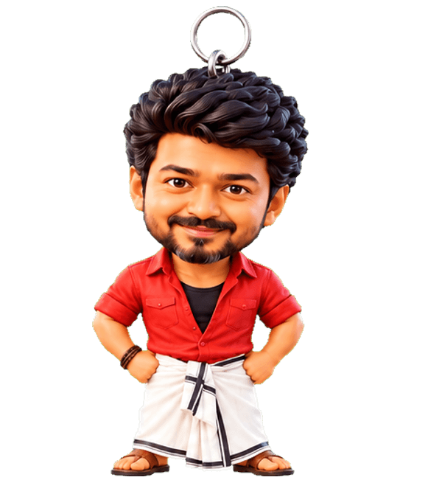

DeskCharm for Teams
Gentle wellness nudges your people actually enjoy, fully private.
Free 30-day pilot · Windows
DeskCharm
1 / 11
Notes:
Position as a light, friendly wellbeing perk.

Slide 2
THE PROBLEM
Teams sit too long and forget the basics
Body
Mind
Programs
Long sitting, poor posture, little water.
Back-to-back meetings, little time to breathe or reset.
Wellness programs are often unused because they live outside the workday.
DeskCharm
2 / 11
Notes:
Qualitative problem; no made-up statistics.

Slide 3

HOW IT WORKS
A charm on every desk
• Lives right where people work
• Friendly, not a nagging alarm
• Fun enough that people keep it on
DeskCharm
3 / 11
Notes:
Engagement is the hard part of wellness; delight solves it.

Slide 4
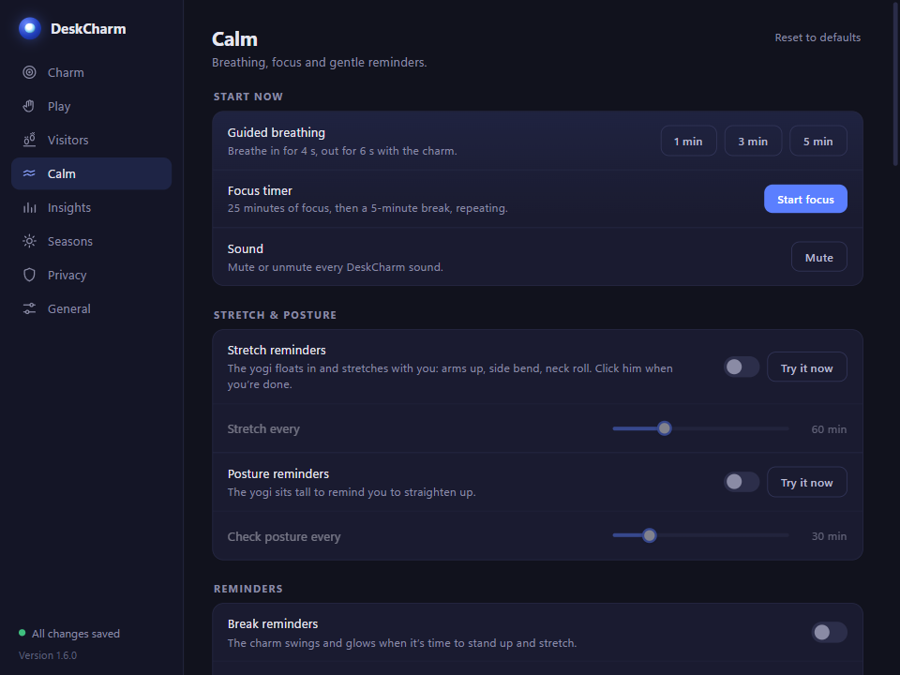
NUDGES
Breaks, posture, water, mood, focus
• Break and posture reminders
• Water with Vijay the visitor
• Breathing, mood check-ins, focus sessions
DeskCharm
4 / 11
Notes:
Walk through the calm tools in Settings.

Slide 5
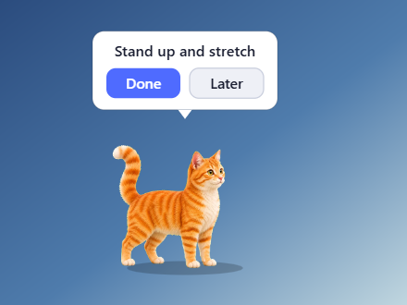
MEETING-AWARE
Quiet when it matters
• Holds nudges during meetings and full-screen work
• Optional calendar link (opt-in)
• Never interrupts a presentation
DeskCharm
5 / 11
Notes:
Calendar is opt-in.

Slide 6
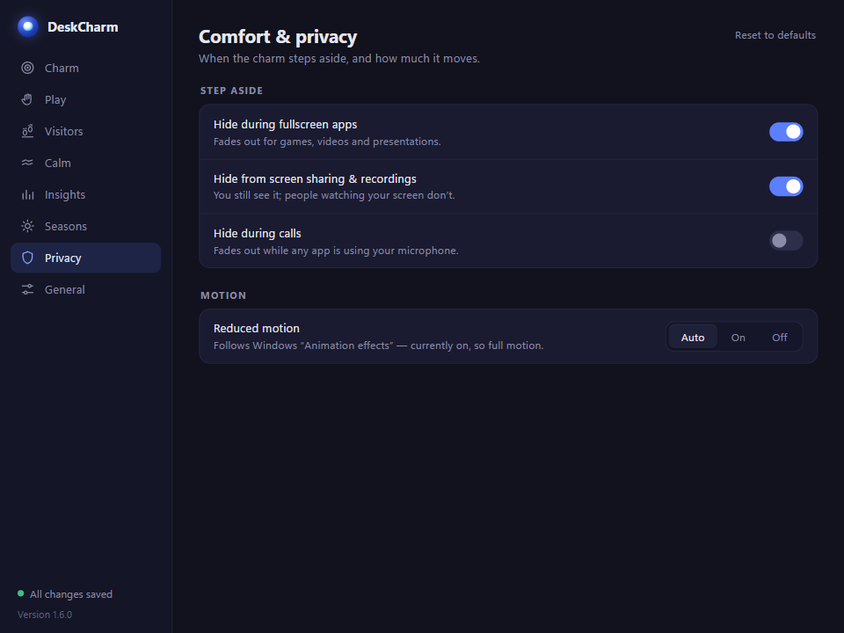
PRIVACY FOR EMPLOYEES
Nothing is tracked by the employer
• All data stays on each PC
• No accounts, no dashboards of individuals
• Team summary will be opt-in and anonymous (planned)
DeskCharm
6 / 11
Notes:
This is the key trust point for employees and HR.

Slide 7
ROLLOUT
Simple to roll out
Install
Share a config
Later
Standard Windows installer. Store packaging ready.
Use settings backup to export one team configuration and import it on every PC.
Central settings management is planned.
DeskCharm
7 / 11
Notes:
Today: installer plus settings backup file. Central management is planned.

Slide 8
PILOT OFFER
Free 30-day pilot
Who
What you get
Cost
3–5 companies, any team size that works at desks.
DeskCharm for the team, a shared config, and direct founder support.
Free during the pilot. Pricing comes later, shaped with pilot partners.
DeskCharm
8 / 11
Notes:
We want proof and feedback, not revenue, at this stage.

Slide 9
WHAT WE MEASURE
Self-reported, never tracked
Start survey
End survey
Shared result
Short anonymous survey on breaks, water, stress and comfort.
Same questions after 30 days, plus what people liked.
An aggregate summary for the team. No individual data.
DeskCharm
9 / 11
Notes:
All measurement is self-reported; the app sends nothing.

Slide 10
NEXT STEPS
Start in a week
1. Call
2. Setup
3. Pilot
30-minute chat to fit the pilot to your team.
We prepare the team config and install guide.
30 days, start and end survey, shared results.
DeskCharm
10 / 11
Notes:
Make the next step small and concrete.

Slide 11

Let us talk
Bring a calmer desk to your team.
deskcharm.in
Email: support@deskcharm.in
Tharuneshwar S · Saransakthi N
DeskCharm
11 / 11
Notes:
Close warmly. Share the contact details and invite questions.

