Slide 1

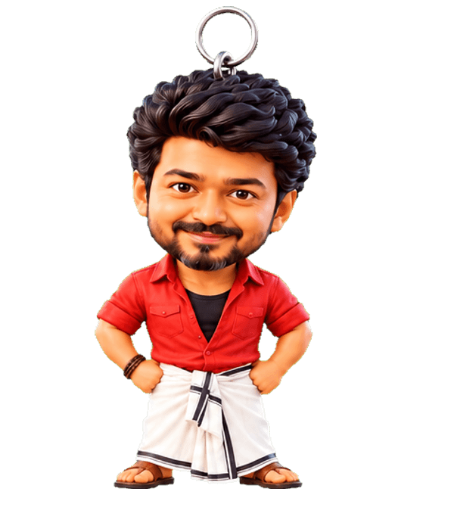

DeskCharm
Culture-led desktop wellness: a charm people love, habits that stick.
Investor & incubator deck · October 2026
DeskCharm
1 / 13
Notes:
One-line pitch: a delightful, culture-led desktop companion that quietly builds healthy habits.

Slide 2
PROBLEM
Desk work quietly wears people down
Sitting
Forgetting
Screen fatigue
Long hours in one chair, few real breaks, sore necks and backs.
Water, stretching and breathing get lost in back-to-back work.
Most break apps are cold timers that people mute within a week.
DeskCharm
2 / 13
Notes:
We describe the audience qualitatively: students, developers, office and remote workers. We do not quote market numbers we cannot cite.

Slide 3
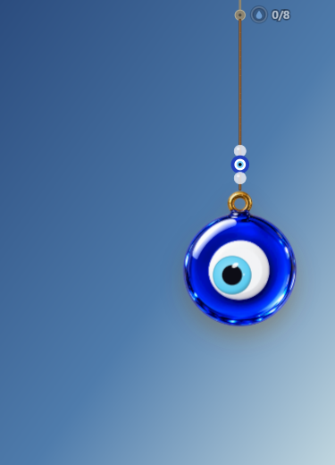
SOLUTION
A charm that cares, right on the desktop
• A physics charm people want to touch
• Visitors and festivals bring delight
• Gentle nudges: breaks, water, breathing, posture, mood, focus
DeskCharm
3 / 13
Notes:
Delight earns attention; wellness earns daily use.

Slide 4
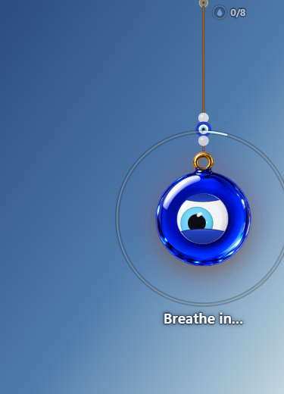

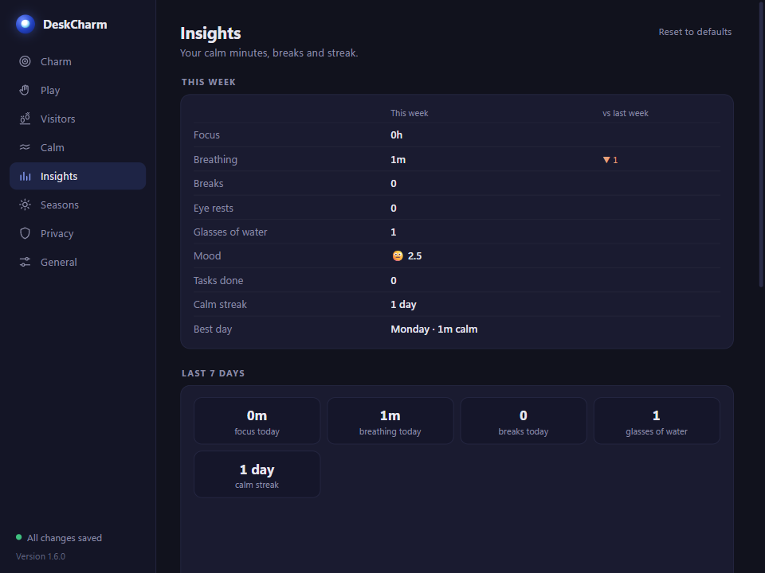
DEMO
Real product, shipping today
Vijay the water buddy
Breathing on the charm
Insights
DeskCharm
4 / 13
Notes:
These are real screenshots from v1.6.0. A 3-minute explainer video is also ready.

Slide 5
WHY NOW · WHY US
The right moment and the right team
Why now
Why us
Built well
Hybrid and remote work made the desk the whole day. People want wellbeing that is not another chore.
We are the audience: Tamil, Indian, at a desk all day. We ship fast: 6 releases in one month.
Tauri + Rust: small, fast, native. 168 automated tests. Store packaging ready.
DeskCharm
5 / 13
Notes:
Founder-market fit and execution speed.

Slide 6
DIFFERENTIATION
Not another break timer
Culture-led
Private
Delightful
Nazar, temple bells, Diwali, Pongal, Tamil friends. Content generic apps cannot copy quickly.
Everything on the PC. No account, no tracking. Trust for users and employers.
A toy first, a tool second. Play brings people back every day.
DeskCharm
6 / 13
Notes:
Generic break apps compete on features; we compete on feeling.

Slide 7
BUSINESS MODEL
Freemium + B2B
Free
Pro
B2B
Classic charms, all visitors, all calm tools. Wide reach.
Lifetime licence, 7-day trial: ₹69 launch / ₹99, one time. Packs, two charms, full Insights.
Team wellness pilots now (free, 30 days); paid plans after proof.
DeskCharm
7 / 13
Notes:
Pro: sold on deskcharm.in via Razorpay, priced in ₹ (international cards coming soon; a Microsoft Store listing later). B2B pricing after pilots.

Slide 8
GO-TO-MARKET
Start where the culture lives
Creators
Launches
Campus & teams
Tamil and Indian creators: festival and fan-favourite charm moments made for short videos.
Product Hunt and deskcharm.in for discovery; a Microsoft Store listing later.
College communities and company wellness pilots.
DeskCharm
8 / 13
Notes:
Festivals are natural launch moments.

Slide 9
TRACTION PLAN
Honest start: 0 users today
Today
60-day goal
Pilot goal
Product shipped (v1.6.0), repo private, 0 public downloads.
500 beta users, with weekly feedback loops.
3 companies on a free 30-day pilot with a simple survey.
DeskCharm
9 / 13
Notes:
We are pre-traction. These are goals, not results.

Slide 10
ROADMAP
Trust, then reach
Next 3 months
Then
Idea
Code signing, public beta, Pro packs.
Microsoft Store listing, macOS build, team features (opt-in anonymous summary, central settings).
A mobile companion that carries the charm with you.
DeskCharm
10 / 13
Notes:
Team features and mobile are planned, not built.

Slide 11
TEAM
Two founders, one shipped product
Tharuneshwar S
Saransakthi N
How we work
Co-founder. Product, desktop engineering (Tauri + Rust), charm physics and design.
Co-founder. Product, community, culture content and testing.
6 releases in one month. 110 JS + 58 Rust tests. Full user guide and a 3-minute explainer video.
DeskCharm
11 / 13
Notes:
Introduce both founders. Emphasise speed of shipping: six releases in a month, with real tests and documentation.

Slide 12
THE ASK
Incubation and grant support
Mentoring
Credits
Reach
Go-to-market, B2B sales and pricing guidance.
Code-signing certificate and cloud credits.
Marketing help (and a Microsoft Store listing later), e.g. via Startup TN or college incubators.
DeskCharm
12 / 13
Notes:
We are not naming an amount; we are asking for incubation and grant support.

Slide 13
Thank you
Let us make the desk a kinder place.
deskcharm.in
Email: support@deskcharm.in
Tharuneshwar S · Saransakthi N
DeskCharm
13 / 13
Notes:
Close warmly. Share the contact details and invite questions.

