Slide 1
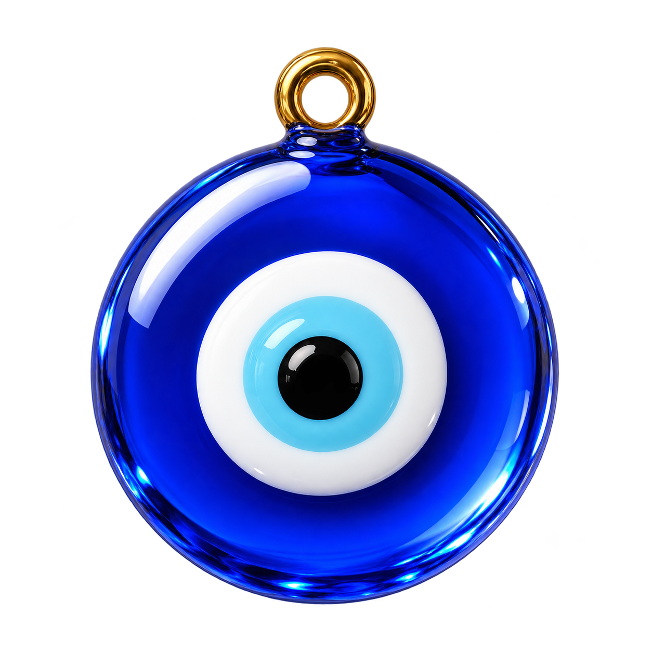
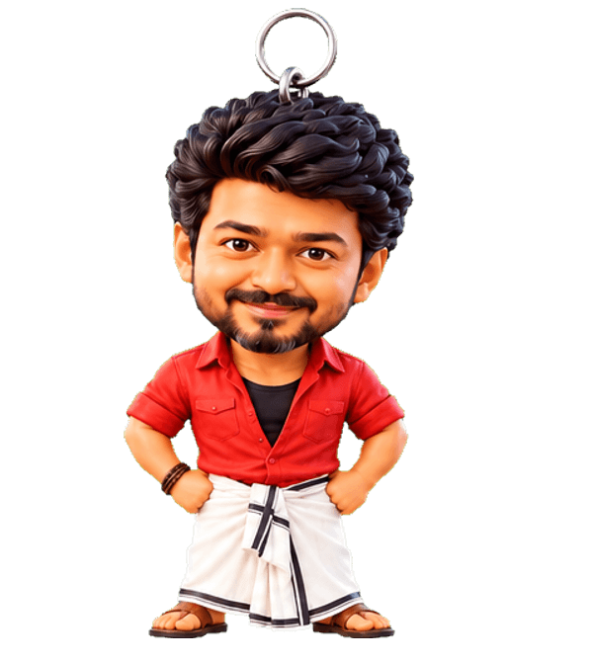

DeskCharm
A little charm for your desktop that keeps you calm, watered and smiling.
Free beta for Windows · v1.6.0
DeskCharm
1 / 13
Notes:
Open with the charm itself. DeskCharm is a desktop companion for Windows: a hanging charm that lives on your screen.

Slide 2
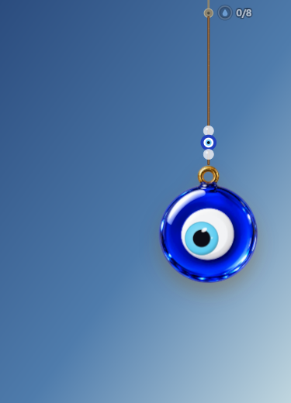
WHAT IT IS
A charm that hangs on your screen
• Nazar, temple bells, Ganesha and more hang above your windows
• It sways with real physics when you move it
• Click through to your work, it never gets in the way
DeskCharm
2 / 13
Notes:
Explain the basic idea: a real-feeling charm on a string, floating over your desktop.

Slide 3
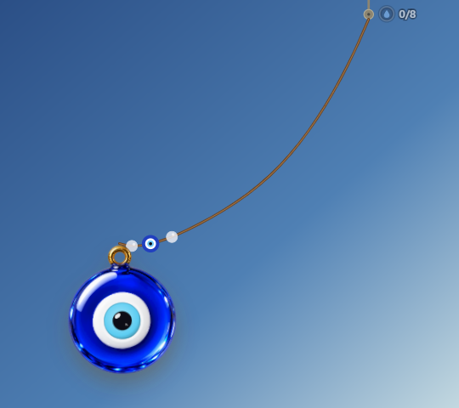
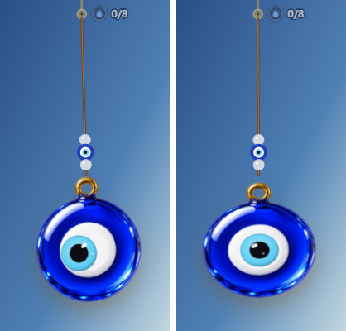
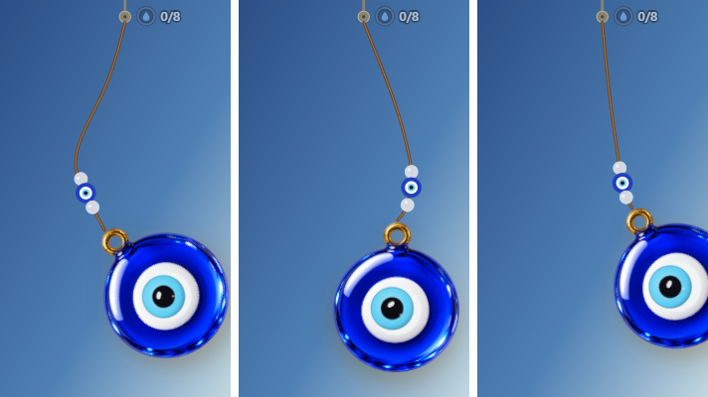
WHY IT IS FUN
Drag it, fling it, squeeze it
Drag
Fling
Squeeze
DeskCharm
3 / 13
Notes:
Show the toy side. People play with it between tasks. That small joy is the hook.

Slide 4
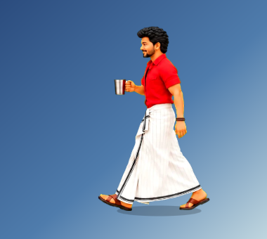
VISITORS
Friends drop by, like Vijay with water
• Visitors walk onto your screen with a gentle ask
• Vijay reminds you to drink water
• All visitors are free
DeskCharm
4 / 13
Notes:
Visitors are the most loved part in testing. Vijay the water buddy is a favourite.

Slide 5
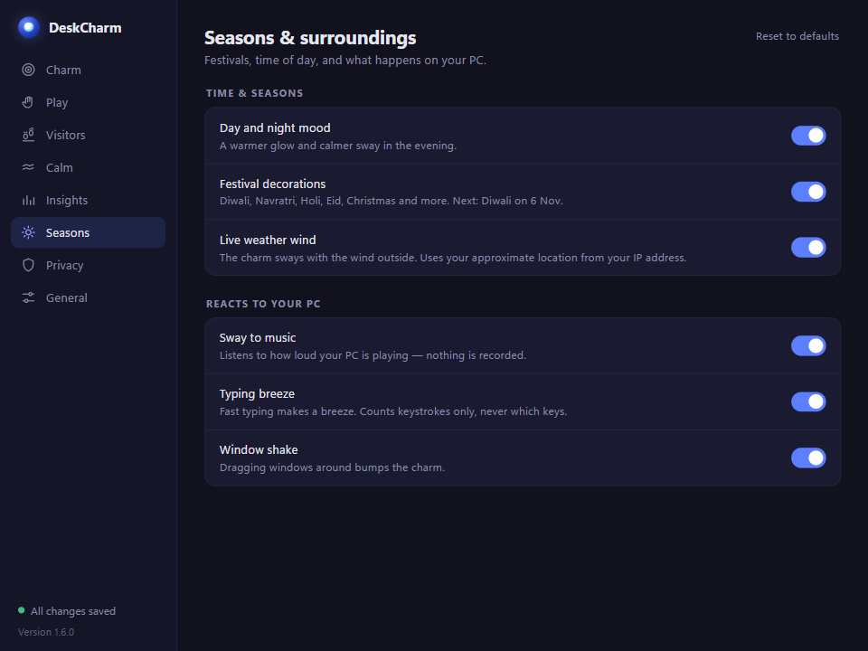
CULTURE MOMENTS
Diwali, Holi, Pongal, Christmas
• Festival decor arrives on the day
• Tamil and Indian culture at the heart
• Charms that feel like home
DeskCharm
5 / 13
Notes:
Culture is what makes DeskCharm different. Festivals change the charm and decorations automatically.

Slide 6
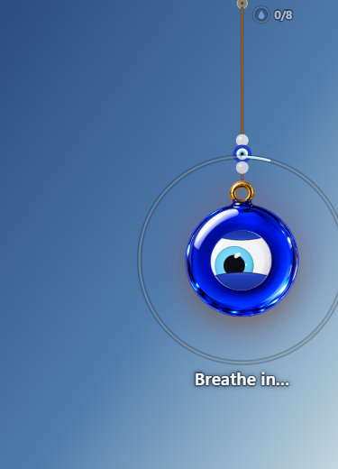
CALM TOOLS
Breaks, water, breathing, mood
• Gentle break and posture nudges
• Guided breathing on the charm
• Mood check-ins, focus time, reminders
• Quiet during meetings
DeskCharm
6 / 13
Notes:
The charm gets attention; the calm tools keep people using it every day.

Slide 7
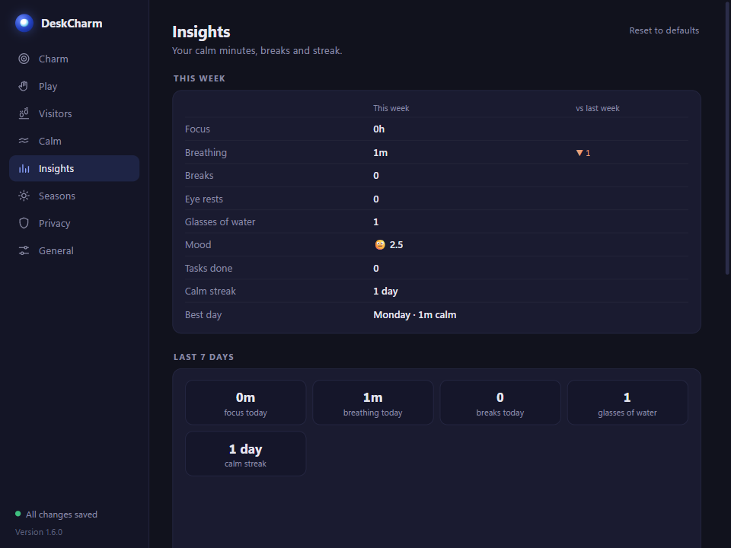
INSIGHTS
See your week, kindly
• Breaks taken, water, mood
• No scores, no guilt
• Stored only on your PC
DeskCharm
7 / 13
Notes:
Insights show simple patterns. Nothing leaves the computer.

Slide 8
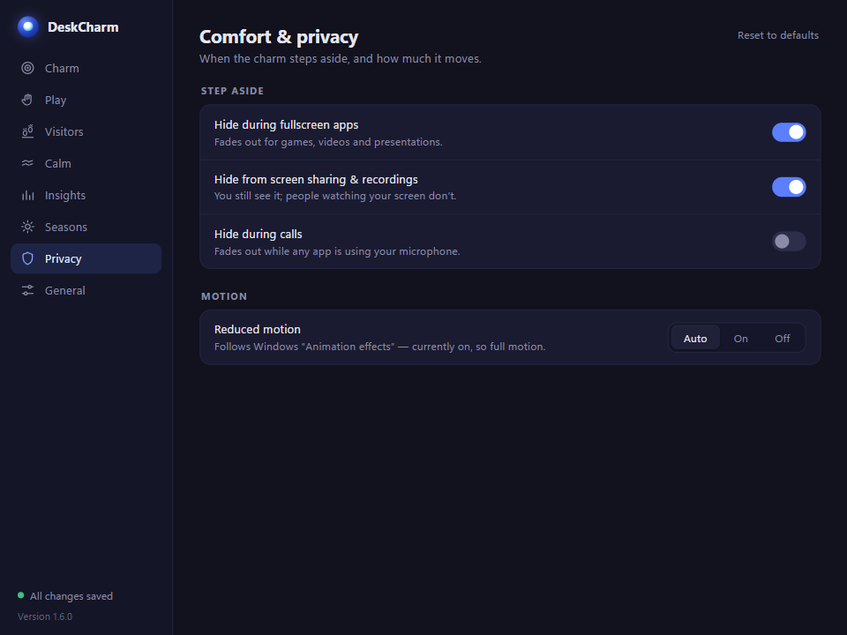
PRIVACY
Everything stays on your PC
• No account, no tracking
• Only exceptions: update check, opt-in weather and calendar
• You can see and clear your data
DeskCharm
8 / 13
Notes:
Privacy by design. Be precise about the exceptions: update check, and opt-in weather and calendar.

Slide 9
FREE VS PRO
Free to love. Pro to collect.
Free
Pro
Fair
Classic charms (Nazar, Gods), all visitors, all calm tools.
Lifetime licence, 7-day trial. ₹69 launch / ₹99 on deskcharm.in. All charm packs, two charms, full Insights.
Wellness is never behind a paywall. Pro is about collecting and personalising.
DeskCharm
9 / 13
Notes:
Pro is one-time, no subscription. Calm tools stay free forever.

Slide 10
TRY THE BETA
Join the beta today
1. Download
2. Install
3. Tell us
Get the Windows installer from our GitHub page.
The build is not signed yet, so Windows may warn you. Choose “More info → Run anyway”.
Share what you love and what annoys you. Every release comes from feedback.
DeskCharm
10 / 13
Notes:
Be honest about the unsigned build warning; code signing is on the roadmap.

Slide 11
ROADMAP
What comes next
Now
Next
Later
Public beta on deskcharm.in, code signing.
Pro charm packs and themes, more visitors and festivals.
Microsoft Store listing, macOS build and a mobile companion idea.
DeskCharm
11 / 13
Notes:
Roadmap order: trust first (signing), then Pro; the Store comes later, then new platforms.

Slide 12
TEAM
Two founders, one shipped product
Tharuneshwar S
Saransakthi N
How we work
Co-founder. Product, desktop engineering (Tauri + Rust), charm physics and design.
Co-founder. Product, community, culture content and testing.
6 releases in one month. 110 JS + 58 Rust tests. Full user guide and a 3-minute explainer video.
DeskCharm
12 / 13
Notes:
Introduce both founders. Emphasise speed of shipping: six releases in a month, with real tests and documentation.

Slide 13

Come hang a charm with us
Beta testers, creators and friends welcome.
deskcharm.in
Email: support@deskcharm.in
Tharuneshwar S · Saransakthi N
DeskCharm
13 / 13
Notes:
Close warmly. Share the contact details and invite questions.

