Slide 1

UE19CS353 – Object Oriented Analysis and Design with Java
Theory ISA (Mini Project)
Presentation on
Movie Ticket Booking System
By:
6th Semester G
Name | SRN
Tankala Sunaina | PES2UG19CS427
Toshani Rungta | PES2UG19CS4333
Venkata Krishnarjun Vuppala | PES2UG19CS451
PES University, Bengaluru
(Established under Karnataka Act 16 of 2013)
Department of Computer Science & Engineering
Session: Jan - May 2022

Slide 2
Object Oriented Analysis and Design with Java (Mini Project)
Project Description
This interface is a Web application which has the following modules:
The admin manages the collection of movies available in theatre where he/she can perform the various functionalities:
Add a movie to the collection.
Delete a movie from the collection.
Update the details of a movie in the existing collection.
Any user, be it admin or customer can book a ticket for the user by taking in details such as Name of the movie , movie timing, movie hall number, etc.
Users can also search for a particular movie within the collection.
If the user does not want to go for a particular movie, he/she can cancel his ticket.
The booked tickets is shown in a personalized profile page with user-specific details.
Users can search over the database of movies and decide which movie he/she wants to go for.
GitHub Link -https://github.com/theprojectrepo123/Movie-Ticket-Booking-System

Slide 3
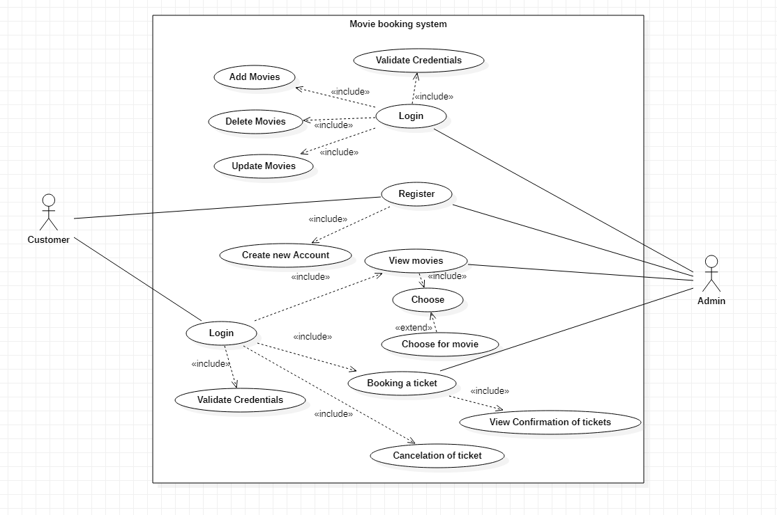
Object Oriented Analysis and Design with Java (Mini Project)
Analysis and Design Models
Use Case Diagram:

Slide 4
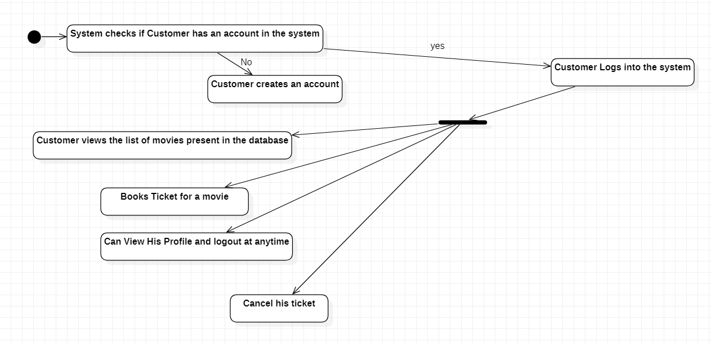
Object Oriented Analysis and Design with Java (Mini Project)
Analysis and Design Models
State Transition Diagram:
For Customer:

Slide 5
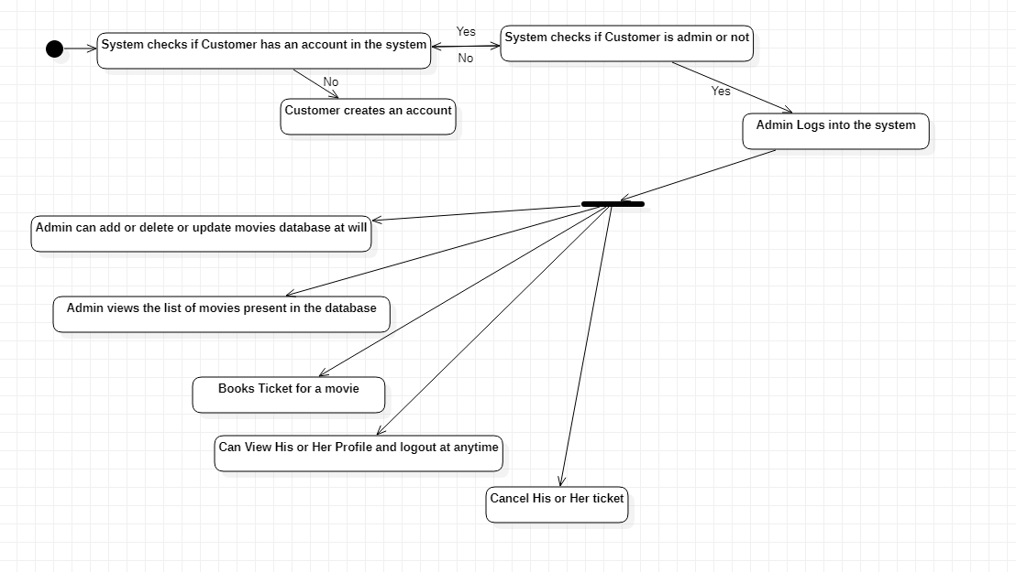
Object Oriented Analysis and Design with Java (Mini Project)
Analysis and Design Models
State Transition Diagram:
For Admin:

Slide 6
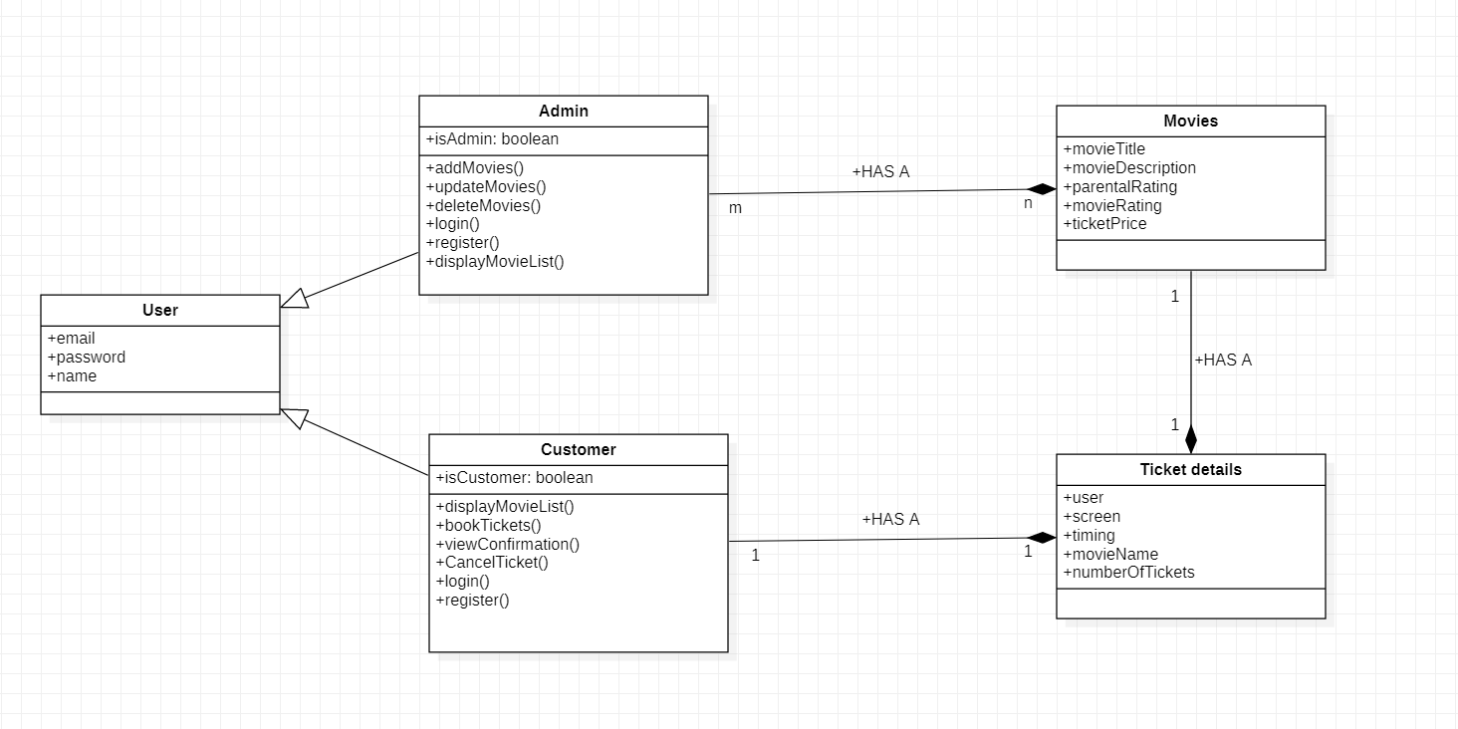
Object Oriented Analysis and Design with Java (Mini Project)
Analysis and Design Models
Class Diagram:

Slide 7
Object Oriented Analysis and Design with Java (Mini Project)
Tools and Frameworks Used
Spring Boot
Hibernate
Database Used: MySQL
Thymeleaf
Spring Devtools
Spring-Security
HTML/CSS/JS
Bootstrap

Slide 8
Object Oriented Analysis and Design with Java (Mini Project)
Design Principle and Design Patterns Applied
Chain Of Responsibilities (Behavioral Pattern)
Proxy Pattern (Structural Pattern)
Model View Controller Pattern
Bridge Pattern (Behavioral Pattern)
Factory Pattern (Creational Pattern)
Singleton Pattern (Creational Pattern)
Command Pattern (Behavioral Pattern)
Iterator Pattern (Behavioral Pattern)
Follows all SOLID principles.

Slide 9
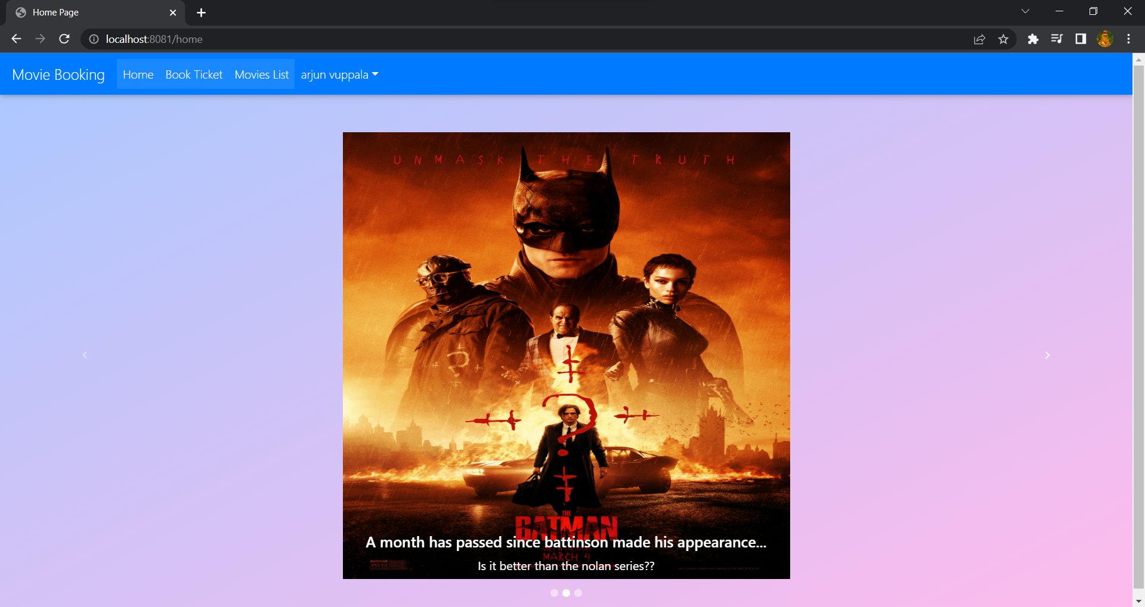
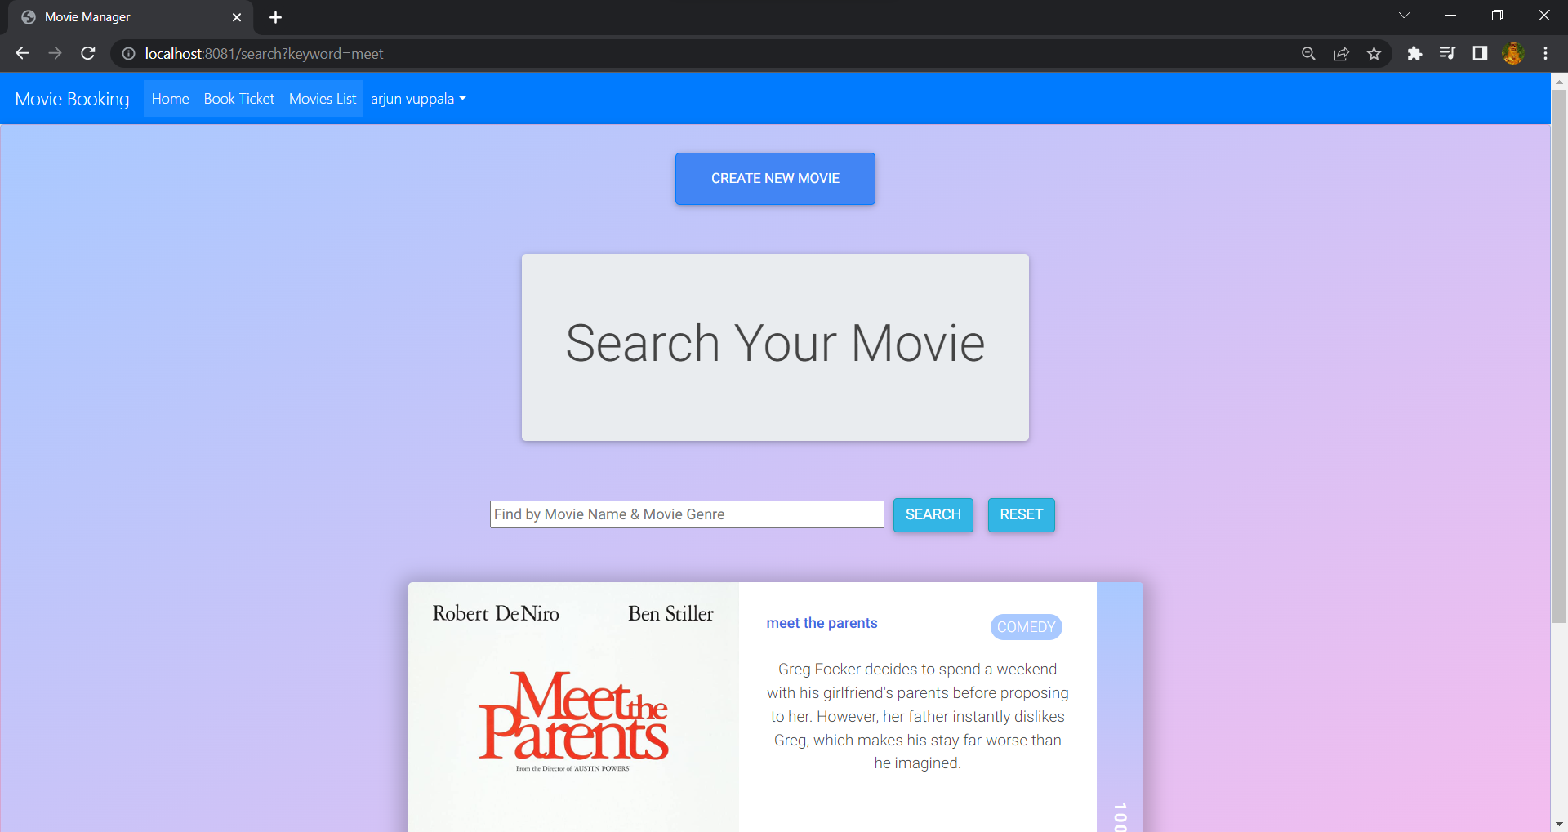
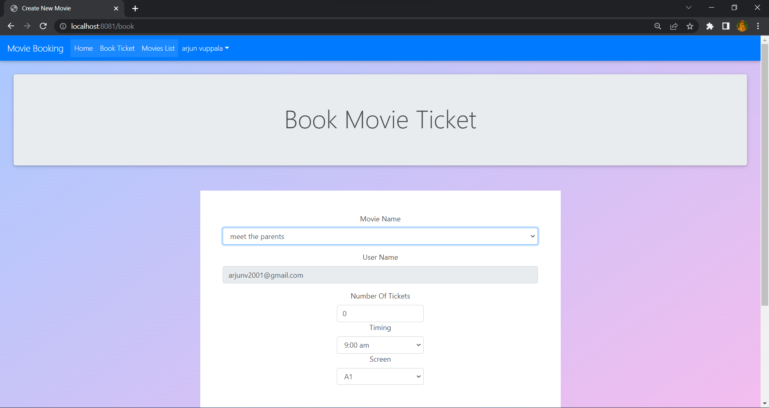
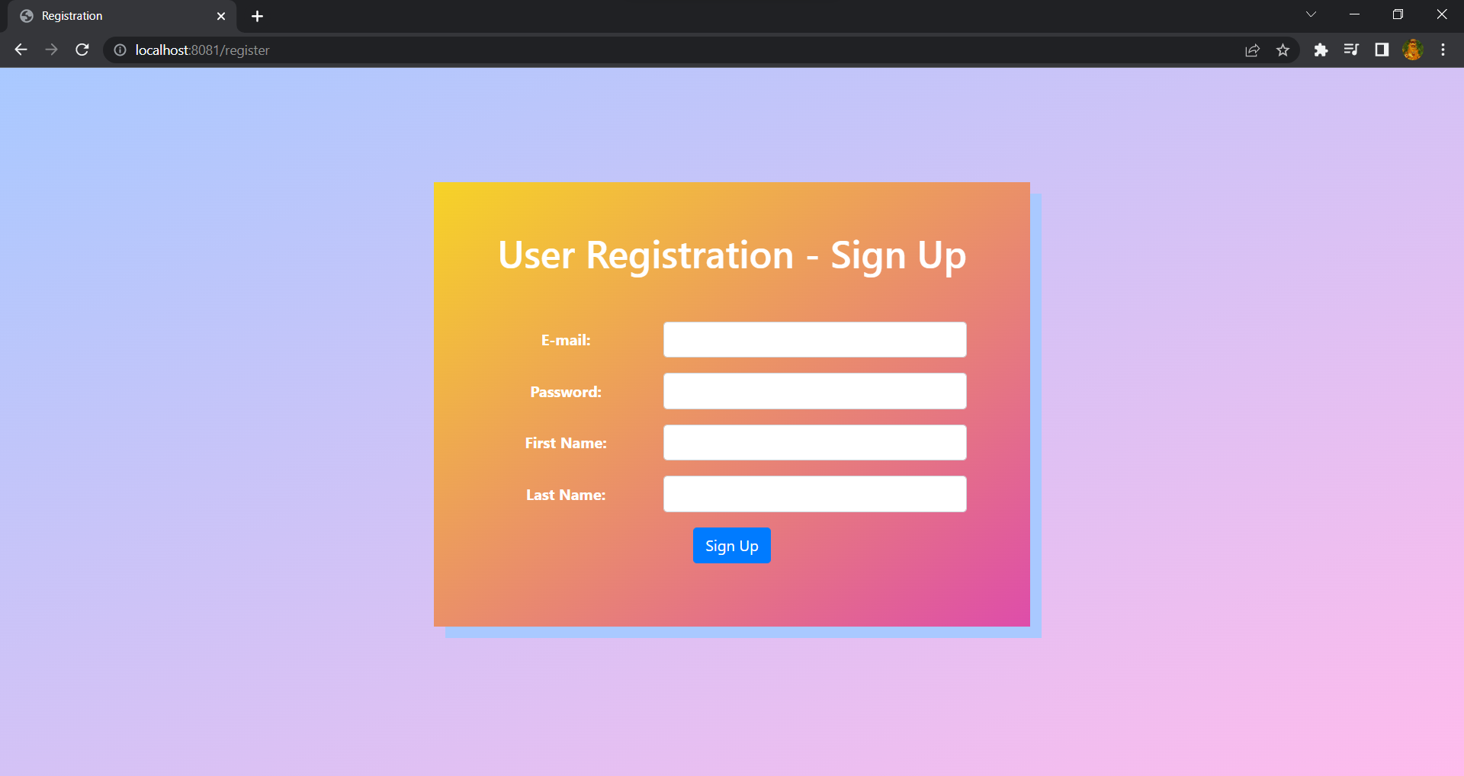
Object Oriented Analysis and Design with Java (Mini Project)
Screenshots

Slide 10
Object Oriented Analysis and Design with Java (Mini Project)
Team member contributions
Name | Contributions
Tankala Sunaina | Login and Register Page
Toshani Rungta | Book ticket and confirmation Page
Venkata Krishnarjun Vuppala | CRUD operations for movies list, Search in database, integration of all modules, Cancellation of Movie Ticket

