Slide 1

SHANMUGA INDUSTRIES ARTS AND SCIENCE COLLEGE
Department of Computer Science · Tiruvannamalai
P
PROMPTORA
Universal AI Prompt and Multi-Model Content Creation Platform
Turn any idea into a clear AI instruction for text, image and video.
Presented by
· Tamilsevan D 20924U18177
· Tharunkumar D 20924U18178
· Tharun R 20924U18179
· Theerthagiri M 20924U18180
· Thirumaran V 20924U18181
Under the guidance of PROF.A.JESUDASAN,M.C.A.,M.Phil.,B.Ed., Assistant Professor, Department of Computer Science · Academic Year 2025–2026

Slide 2
Agenda
1
Abstract
2
Introduction
3
Existing System
4
Proposed System
5
System Requirements
6
System Architecture
7
System Modules
8
Application Screens
9
Conclusion

Slide 3



Abstract
Promptora helps anyone turn a short everyday idea into a structured, age-safe prompt for text, image or video generation.
Prompt Generator
Idea → structured prompt
It adds multi-model chat (OpenRouter and Google Gemini), a personal prompt library, usage analytics and account settings — built with React, Supabase Auth and PostgreSQL with Row Level Security.
Multi-model Chat
Compare answers side by side
Library & Insights
Save, reuse and track usage

Slide 4




Introduction
Why Promptora was built
The problem
Vendor lock-in
Beginners cannot write precise instructions for text, image and video AI models.
Most tools tie users to one vendor or demand paid keys on the server.
Our idea
Who it is for
One simple workspace: describe in plain language and get a model-ready prompt.
Students, teachers, curious kids and first-time creators.

Slide 5




Existing System
How people write AI prompts today
Single chatbot tab
Scattered notes
Copy-paste
No history
One public chatbot open in a browser tab.
Half-remembered prompts in phone or Word files.
Manual copying into image or video websites.
No common account or usage record the learner owns.

Slide 6




Proposed System
One platform with seven connected parts
Marketing pages
Authentication
Prompt Generator
AI Chat
Home, Features, About — no login needed
Sign up, sign in or continue as guest
Structured prompts for text, image, video
Multiple models and skills in parallel
Guest or User
Guests browse and generate; registered users also get cloud save.
Library
Overview & Dashboard
Profile & Settings
Save and reuse your best prompts
Usage statistics, charts and export
Own API keys and custom models

Slide 7
System Requirements
Hardware and software needed
Hardware | Specification
Processor | Dual-core 2.0 GHz or higher
RAM | 8 GB (16 GB recommended)
Storage | 10 GB free
Display | 1366×768 min · 1920×1080 best
Network | Internet for npm, Supabase, AI APIs
End user | Smartphone / laptop with modern browser
Software | Used
Language | JavaScript (ES modules), JSX
UI / Bundler | React 19 · Vite 8 · React Router 7
Runtime | Node.js 20 or later
Backend | Supabase (Auth, Postgres, Storage)
AI APIs | OpenRouter · Google Gemini
Browser / OS | Chrome, Edge, Firefox · Windows 10/11

Slide 8
System Architecture
Three lanes: what users see, how it works, where data lives
PRESENTATION LANE · React pages
Home · Generator · AI Chat · Library · Overview · Settings — Navbar, AppSidebar, MobileBottomNav, UsageChart
APPLICATION LANE · Contexts and services
AuthContext · promptStore · apiKeysStore · skillsStore · usageStore · profileStore · aiChat
RESOURCE LANE
RESOURCE LANE · Backend and providers
Supabase
Auth · Postgres · Storage
Local fallback
localStorage
AI providers
OpenRouter · Gemini

Slide 9


System Modules
Four modules with clear responsibilities
M1
M2
M3
M4
Auth & Profile
Prompt Studio
Multi-model Chat
Insights & Settings
Session, local fallback, avatar and protected routes
Build and enhance prompts, save to library
Provider calls, skills, chat-only model filter
Usage charts, export, API keys and models

Slide 10


How It Works
From sign-up to a saved prompt
Sign up
Add keys
Generate
Chat
Save
Export
or continue as guest
OpenRouter / Gemini in Settings
Fill idea, type, tone; preview
Pick skill and models
Store in your library
Charts, CSV or JSON

Slide 11
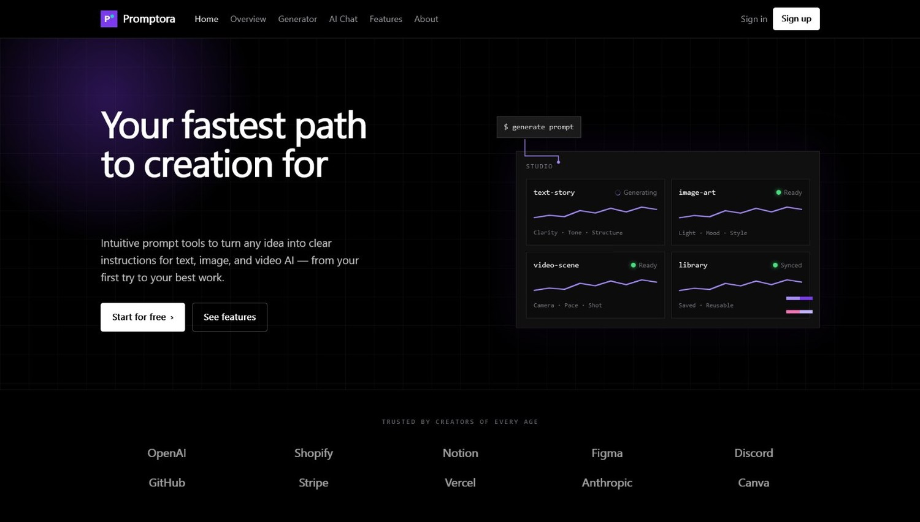
Home Page
Application screen 1 of 6
"Your fastest path to creation" hero
Click, click, done: pick a model, describe the idea, get a prompt
Open to guests — no login needed
Landing page with live prompt preview

Slide 12
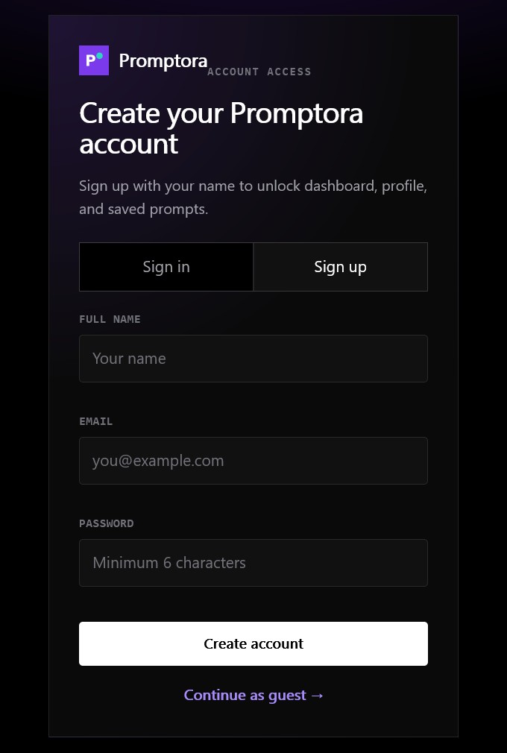
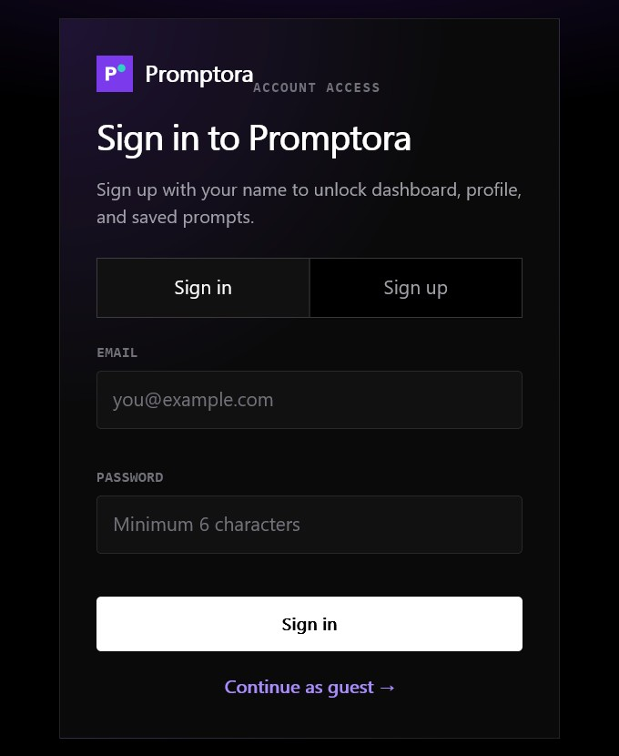
Sign Up & Sign In
Application screen 2 of 6
Sign up with name, email and password (min. 6 characters)
Supabase Auth, with a local fallback
"Continue as guest" for quick trials
Create account
Sign in

Slide 13
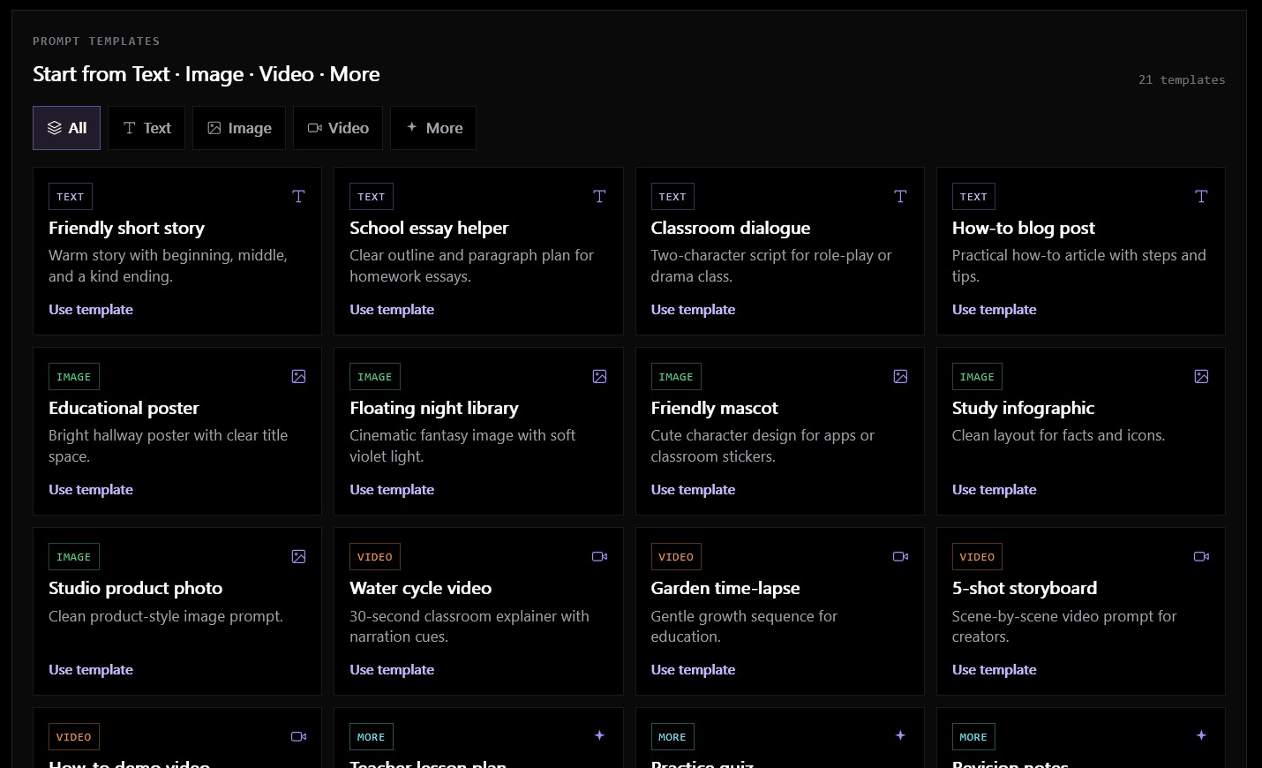
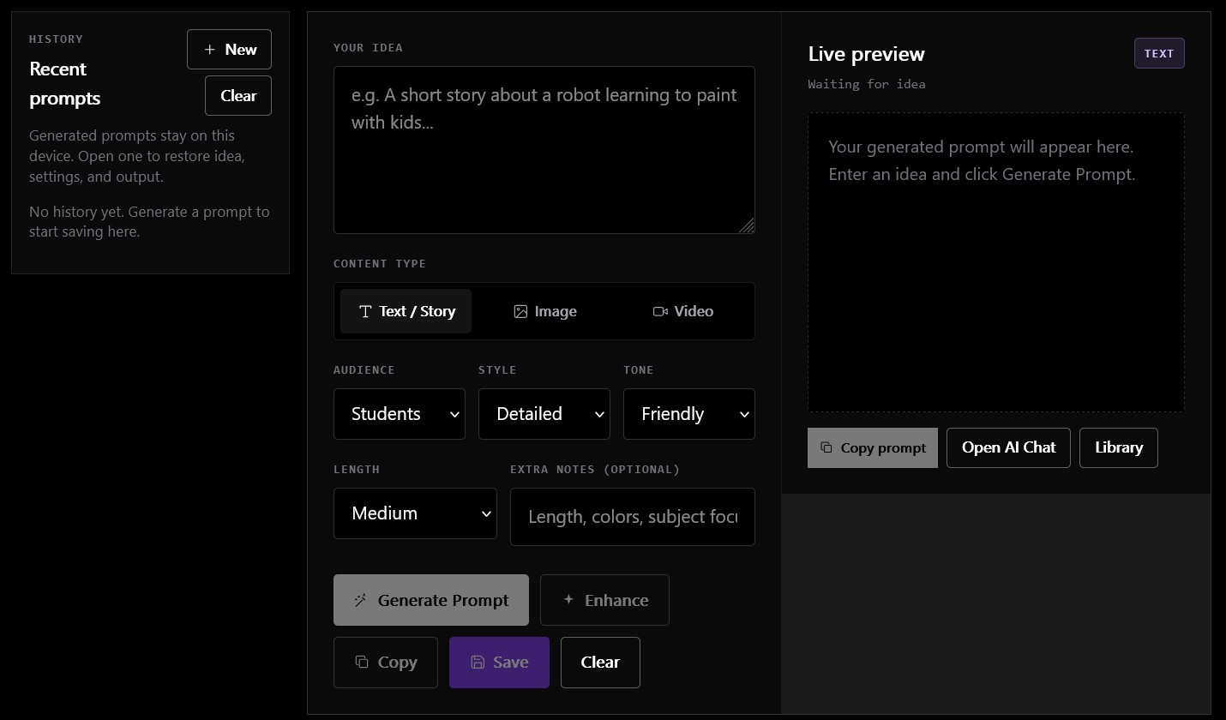
Prompt Generator
Application screen 3 of 6
21 ready-made templates: Text · Image · Video · More
Idea form with live prompt preview
Choose a content type, audience, style, tone and length — then Generate, Enhance, Copy or Save.

Slide 14
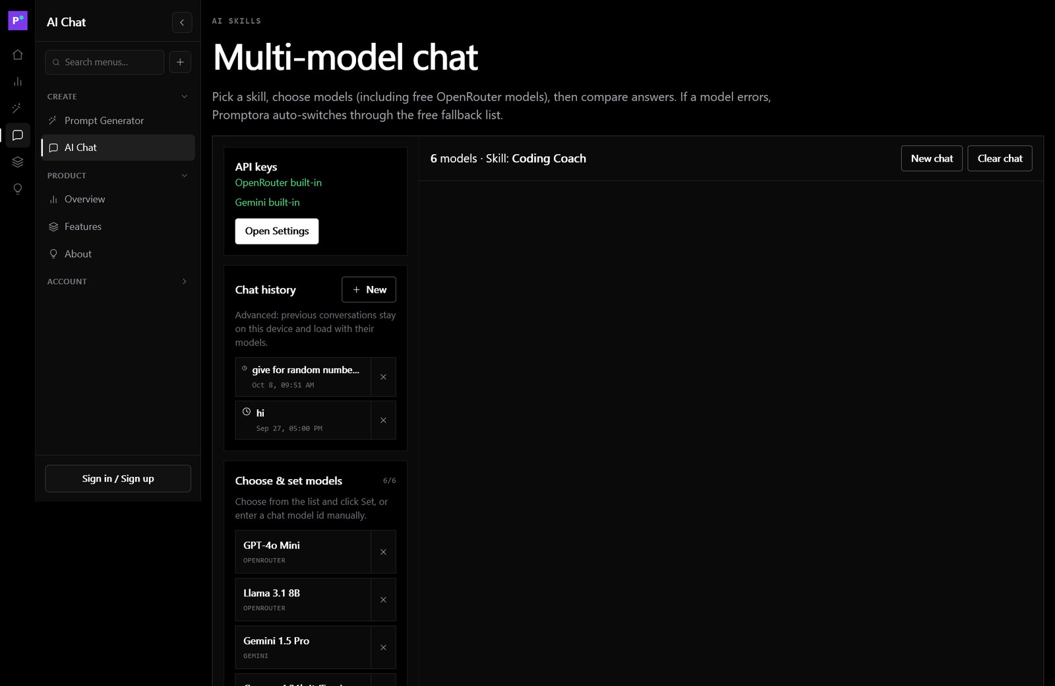
Multi-model AI Chat
Application screen 4 of 6
Choose models: OpenRouter (incl. free) and Gemini
Skills: General Assistant, Teacher, Coding Coach
Auto-fallback to free models on errors
Chat history stays on the device
Compare answers from up to six models

Slide 15
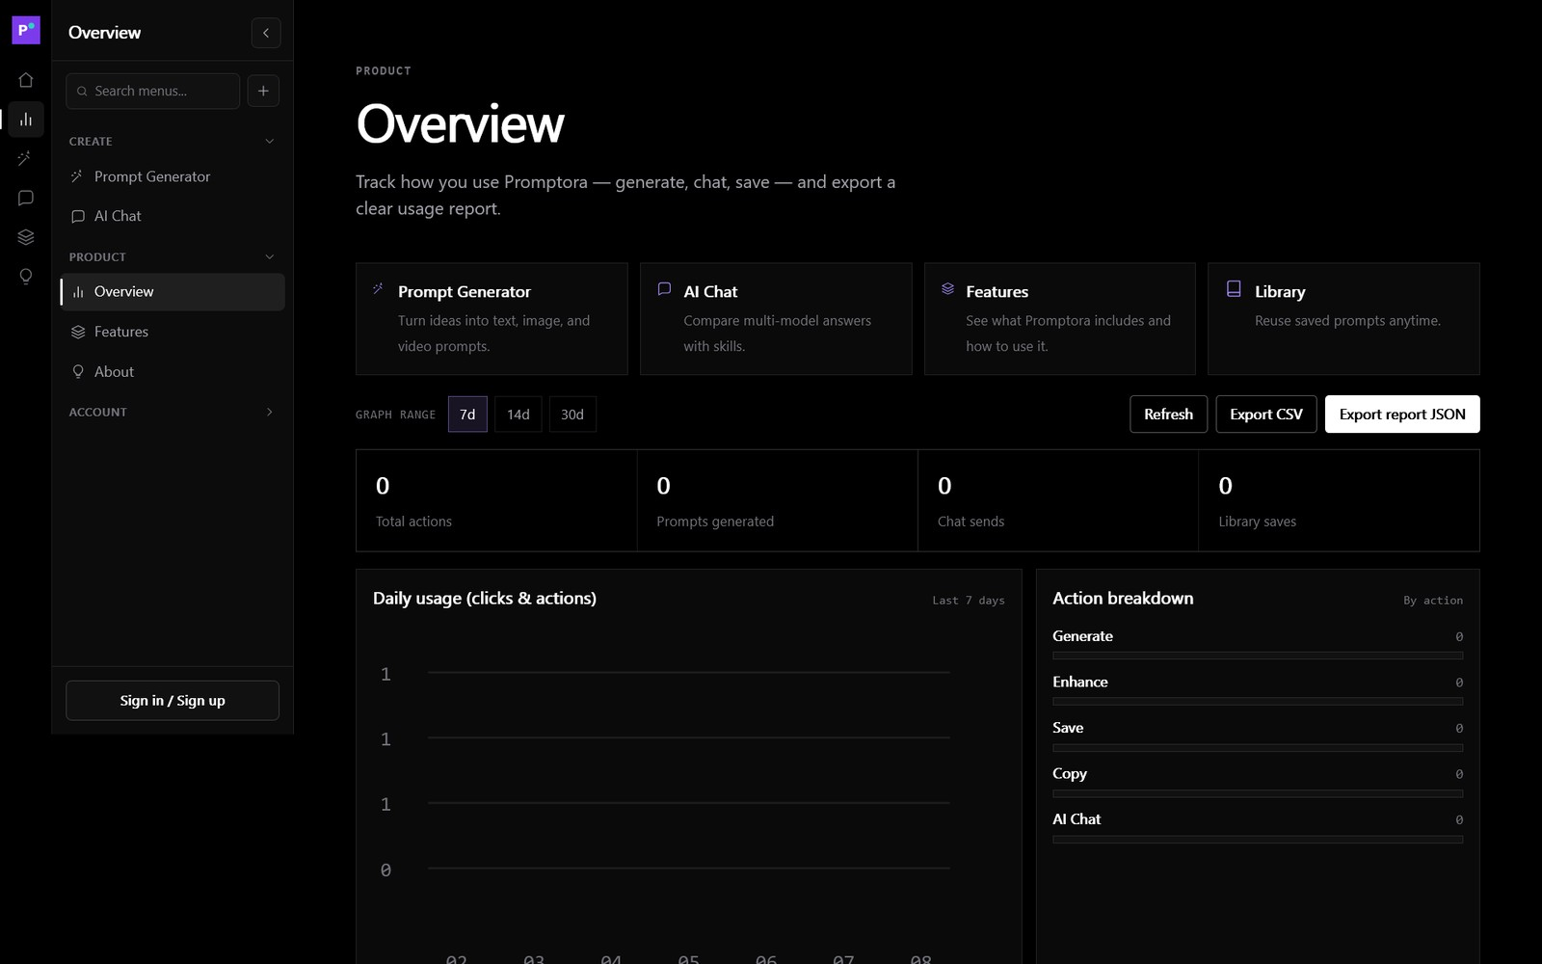
Overview & Usage Graphs
Application screen 5 of 6
Daily usage chart for 7, 14 or 30 days
Action breakdown by feature
Export report as CSV or JSON
Track generate, enhance, save, copy and chat actions

Slide 16
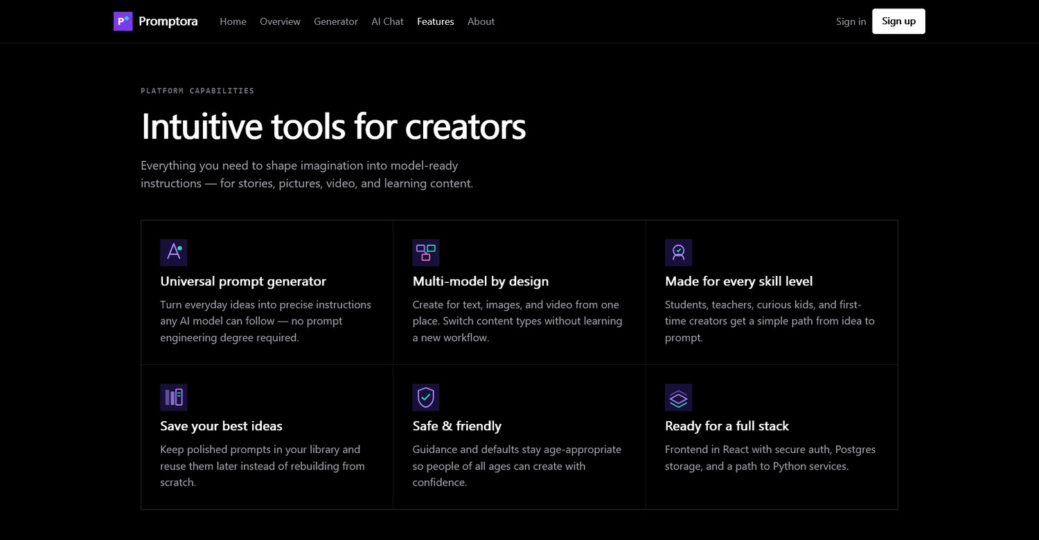
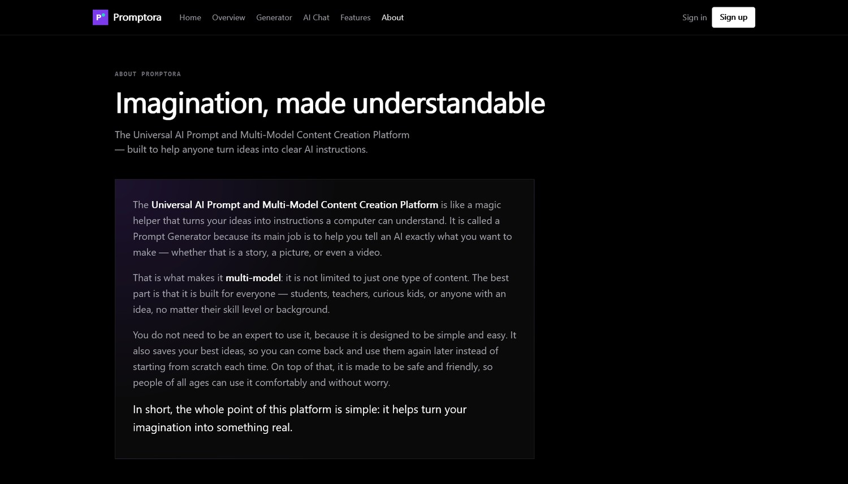
Features & About
Application screen 6 of 6
Features: tools for creators
About: imagination, made understandable
Safe and friendly defaults, a reusable library and a stack of React, Supabase and PostgreSQL.

Slide 17


Conclusion
Promptora gives beginners one private, simple workspace to build prompts, compare chat models and keep their best ideas — a demonstrable, documented undergraduate product.
3-in-1 prompt generator
Multi-model chat + skills
Per-user API keys
Row Level Security
Usage graphs & export
Responsive on mobile
Future scope: on-device image/video generation, automated testing in CI, formal accessibility audit.

Slide 18
Thank You
Promptora · Imagination, made understandable
Questions & Discussion

