Slide 1


Department of Computer Science and Engineering
GESTURE CONTROLLED
WIRELESS AGRICULTURAL WEEDING ROBOT
THARUN KUMAR C (211419104293)
VISHNUDHAR G R (211419104309)
RAMAKRISHNA P (211419104230)
Dr.M.MOHAN,PROFESSOR

Slide 2
Introduction
In the field of agriculture, various operations for handling heavy material are performed. For example, in vegetable cropping, workers should handle heavy vegetables in the harvest season. Additionally, in organic farming, which is fast gaining popularity, workers should handle heavy compost bags in the fertilizing season. These operations are dull, repetitive, or require strength and skill for the workers. In the 1980‟s many agricultural robots were started for research and development. Kawamura and co-workers developed the fruit harvesting in orchard. Grand and co-workers developed the apple harvesting robot. They have been followed by many other works.
Many of the works focus on structure systems design (e.g., mechanical systems design) of robot and report realization of the basic actions in actual open fields. However, many of the robots are not in the stages of diffusion but still in the stages of research and development. It is important to find rooms to achieve higher performance and lower cost of the robots. Agriculture involves the systematic production of food, feed, fibre, and other goods. In addition to producing food for humans and animals, agriculture also produces cut flowers, timber, fertilizers, animal hides, leather, and industrial chemicals

Slide 3
Objective of the Project
Robotic systems integrated with various control. methods can be very useful in doing repetitive work, such as seed sowing process. where the same movement is continuous. Previous weed removal robots included. optical image sensing which makes the system costlier. Our robot is cost-effective. which eliminates optical sensors. In this project, we have developed a Trainable automatic robot which helps in removing unwanted weed on agricultural fields using gesture to control a three-axis robotic arm to do the necessary work.

Slide 4
Literature Survey
AUTHOR | TITLE | SOURCE
Priyanka Y K | Detection and Get Rid of Blockage in a Manhole Pipe Using IoT | Internet of things (IoT) remains one of the most electrifying and fast burgeoning fields. It permits most of the things like any objects are controlled with very less manpower and we can control things anywhere and anytime by using network. In this paper that going to be constructing that the “Detection of Blockage in Manhole Using IoT”.

Slide 5
Literature Survey
AUTHOR | TITLE | SOURCE
Oluwatosin Ogundare, Srinivasan | Computational Acoustic Model for Non-intrusive Inspection of a Fluidic | The shortcomings of traditional pressure wave analysis for the detection of material deposits and structural compromises within a pipeline forms the motivation for this work. In many Oil and Gas pipelines, a pressure pulse generated using a fast-acting valve (hydrodynamic pressure) or an intrusive acoustic source (acoustic pressure) is often used for leak detection, deposition or blockage detection

Slide 6
Literature Survey
AUTHOR | TITLE | SOURCE
JIAN GUO 1 , (Fellow, IEEE), CHUNYING LI 1 , (Student Member, IEEE), AND SHUXIANG GUO | A Novel Step Optimal Path Planning Algorithm for the Spherical Mobile Robot Based on Fuzzy Control | In order to improve the ability of the spherical mobile robot to navigate and move autonomously in an unknown environment. This paper proposed a novel step optimal path planning method based on fuzzy control. Firstly, by analyzing the motion model of the spherical mobile robot, the arrangement and debugging of the ultrasonic sensors (HC-SR04) were completed.

Slide 7
Problem Statement
Automated processes in the field of agriculture have become more and more reliable and efficient. There are many difficulties faced when manpower is used. It is time. consuming and becomes tedious. Robotic systems integrated with various control. Methods can be very useful in doing repetitive work, such as seed sowing process. Where the same movement is continuous. Previous weed removal robots included. Optical image sensing which makes the system costlier.

Slide 8
Proposed System
Agricultural robots are becoming increasingly popular as they can perform various tasks such as planting, watering, harvesting, and weeding with greater precision and efficiency than human labour. Here are some key components that can be included in a proposed system for an agricultural robot:
Sensing and perception: The robot should be equipped with sensors such as cameras, lidar, and radar to detect and perceive its surroundings. This allows the robot to identify and locate crops, weeds, pests, and other obstacles in the field.
Navigation and mapping: The robot should have the ability to navigate autonomously through the farm using GPS, SLAM (Simultaneous Localization and Mapping), and other techniques. A map of the farm can be created using the robot's sensors, and this map can be updated in real-time as the robot moves through the field.

Slide 9
Software / Hardware used
Arduino
Jetson nano
Gyroscope
Flex sensor
Mems
Camera
Bluetooth
DC motor

Slide 10
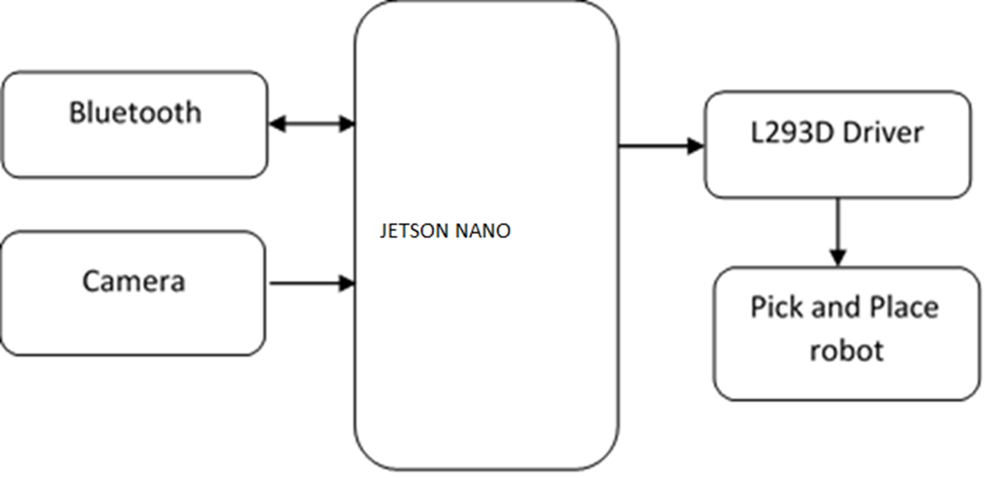
Architecture / Methodology used
The system architecture of the proposed glove, harvester and interface. The glove is the Human Control Interface (HCI). The user wears the glove which is embedded with accelerometer, gyrometer and flex sensors. The accelerometer gives the acceleration and tilt and the gyrometer provides the angular velocity and orientation. The harvester is the rover over which the arm is fixed. The sensors are embedded in the hand glove and are interfaced to the microcontroller unit (MCU). Three accelerometers to control the 3 links of the 4 DoF arm and two flex sensors to control the cutter are embedded in the glove. The user HCI is the transmitter and the robotic harvester is the receiver. The transmitter block contains all the sensors, Bluetooth and an MCU, all integrated into a wearable device. The wearable device transmits real time joint angles of the users arm to the robotic arm.

Slide 11
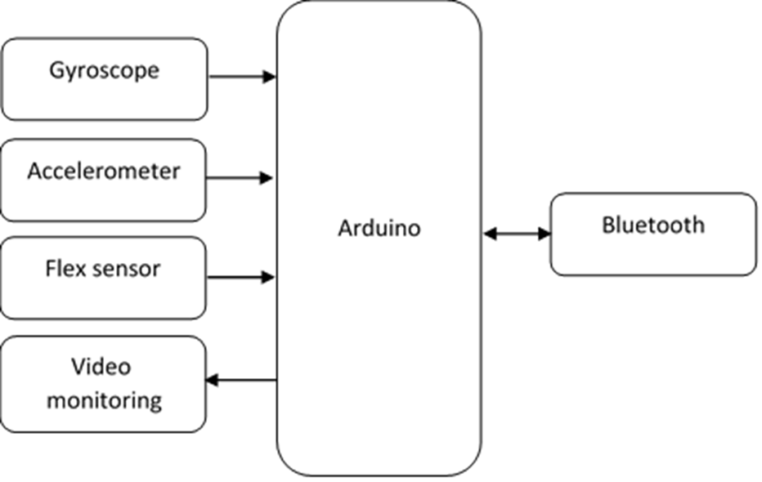
System Design

Slide 12
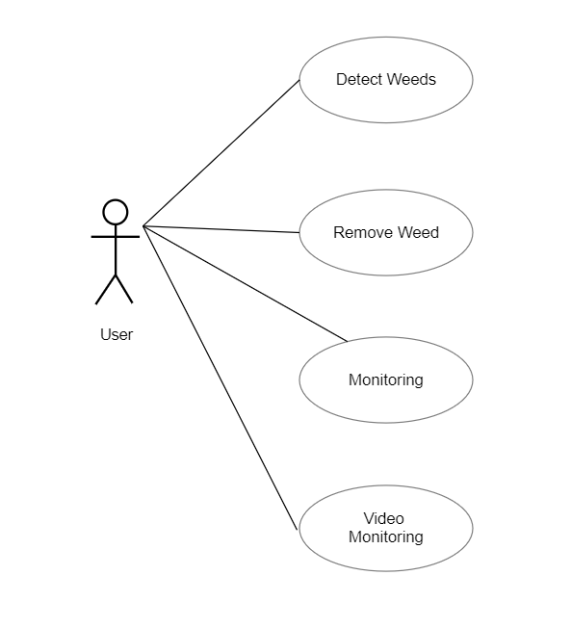
System Design –Use Case Diagram
Use case diagrams are considered for high level requirement analysis of a system. When the requirements of a system are analyzed, the functionalities are captured in use cases. We can say that use cases are nothing but the system functionalities written in an organized manner.

Slide 13
Module Description
DATA PRE-PROCESSING
Data preprocessing is a process of preparing the raw data and making it suitable for a machine learning model. It is the important process in machine learning model. When creating a machine learning project, it is not always a case that we come across the clean and formatted data so to verify that and to get a clean dataset we do data pre processing so after that we will be able to obtain clean and formatted dataset and then we can proceed further with our project implementation. -In this the input values will be in the form of raw dataset and after pre processing the output will be clean and formatted dataset. -To get pre processed data first we imported libraries like pandas and numpy where pandas is used to analyze big data and to make conclusions and numpy is used for working with arrays. After importing the libraries we will link the dataset with the notebook for processing with the help of df and read function. Then we use shape , size and column function to know more about the dataset for processing . is null function is used to return a dataframe object where values are replaced with true for null values and false for non-null values. We use dropna() function to remove rows which contain null values. And also we use group by and duplicate function for aggregation , analysis and remove duplicate values.

Slide 14
Module Description
ARDUINO SOFTWARE MODULE(IDE)
Writing Sketches
File
Edit
Sketch
Tools
Help
Preferences
Language Support
Boards
The Arduino Integrated Development Environment - or Arduino Software (IDE) - contains a text editor for writing code, a message area, a text console, a toolbar with buttons for common functions and a series of menus. It connects to the Arduino and Genuino hardware to upload programs and communicate with them.

Slide 15
Module Description
PYTHON MODULE
Python is an interpreted high-level programming language for programming Python offers multiple options for developing GUI (Graphical User Interface). Out of all the GUI methods, tkinter is most commonly used method. It is a standard Python interface to the Tk GUI toolkit shipped with Python. Python with tkinter outputs the fastest and easiest way to create the GUI applications. Creating a GUI using tkinter is an easy task.

Slide 16
Module Description
OPENCV MODULE
OpenCV-Python is a Python wrapper around original C++ implementation. And the support of Numpy makes the task more easier. Numpy is a highly optimized library for numerical operations. It gives a MATLAB-style syntax. All the OpenCV array structures are converted to-and-from Numpy arrays. So whatever operations you can do in Numpy, you can combine it with OpenCV, which increases number of weapons in your arsenal. Besides that, several other libraries like SciPy, Matplotlib which supports Numpy can be used with this. So OpenCV-Python is an appropriate tool for fast prototyping of computer vision problems.

Slide 17
Testing /Performance Evaluation / Results
UNIT TESTING
Unit testing is conducted to verify the functional performance of each modular component of the software. Unit testing focuses on the smallest unit of the software design (i.e.), the module. The white-box testing techniques were heavily employed for unit testing.
PERFORMANCE TESTING
In general testing performed to determine how a system performs in terms of responsiveness and stability under a particular workload. It can also serve to investigate, measure, validate or verify other quality attributes of the system, such as scalability, reliability and resource usage. Performance testing is a subset of performance engineering, an emerging computer science practice which strives to build performance into the implementation, design and architecture of a system.
VALIDATION TESTING
Verification and Validation are independent procedures that are used together for checking that a product, service, or system meets requirements and specifications and that it full fills its intended purpose. These are critical components of a quality management system such as ISO 9000. The words "verification" and "validation" are sometimes preceded with "Independent" (or IV&V), indicating that the verification and validation is to be performed by a disinterested third party. It is sometimes said that validation can be expressed by the query "Are you building the right thing?" and verification by "Are you building it right?". In practice, the usage of these terms varies. Sometimes they are even used interchangeably.

Slide 18
Testing /Performance Evaluation / Results
SYSTEM TESTING
System testing of software or hardware is testing conducted on a complete, integrated system to evaluate the system's compliance with its specified requirements. System testing falls within the scope of black box testing, and as such, should require no knowledge of the inner design of the code or logic. As a rule, system testing takes, as its input, all of the "integrated" software components that have passed integration testing and also the software system itself integrated with any applicable hardware system(s).
USER ACCEPTANCE TESTING
User acceptance of a system is the factor for the success of any system. The system under consideration is tested for the user acceptance by constantly keeping in touch with the prospective system users at the time of developing and making changes wherever required. 1. Input screen design. 2.Output screen design. 3.Online message to guide user. 4. Format of the ad-hoc reports and other outputs.

Slide 19
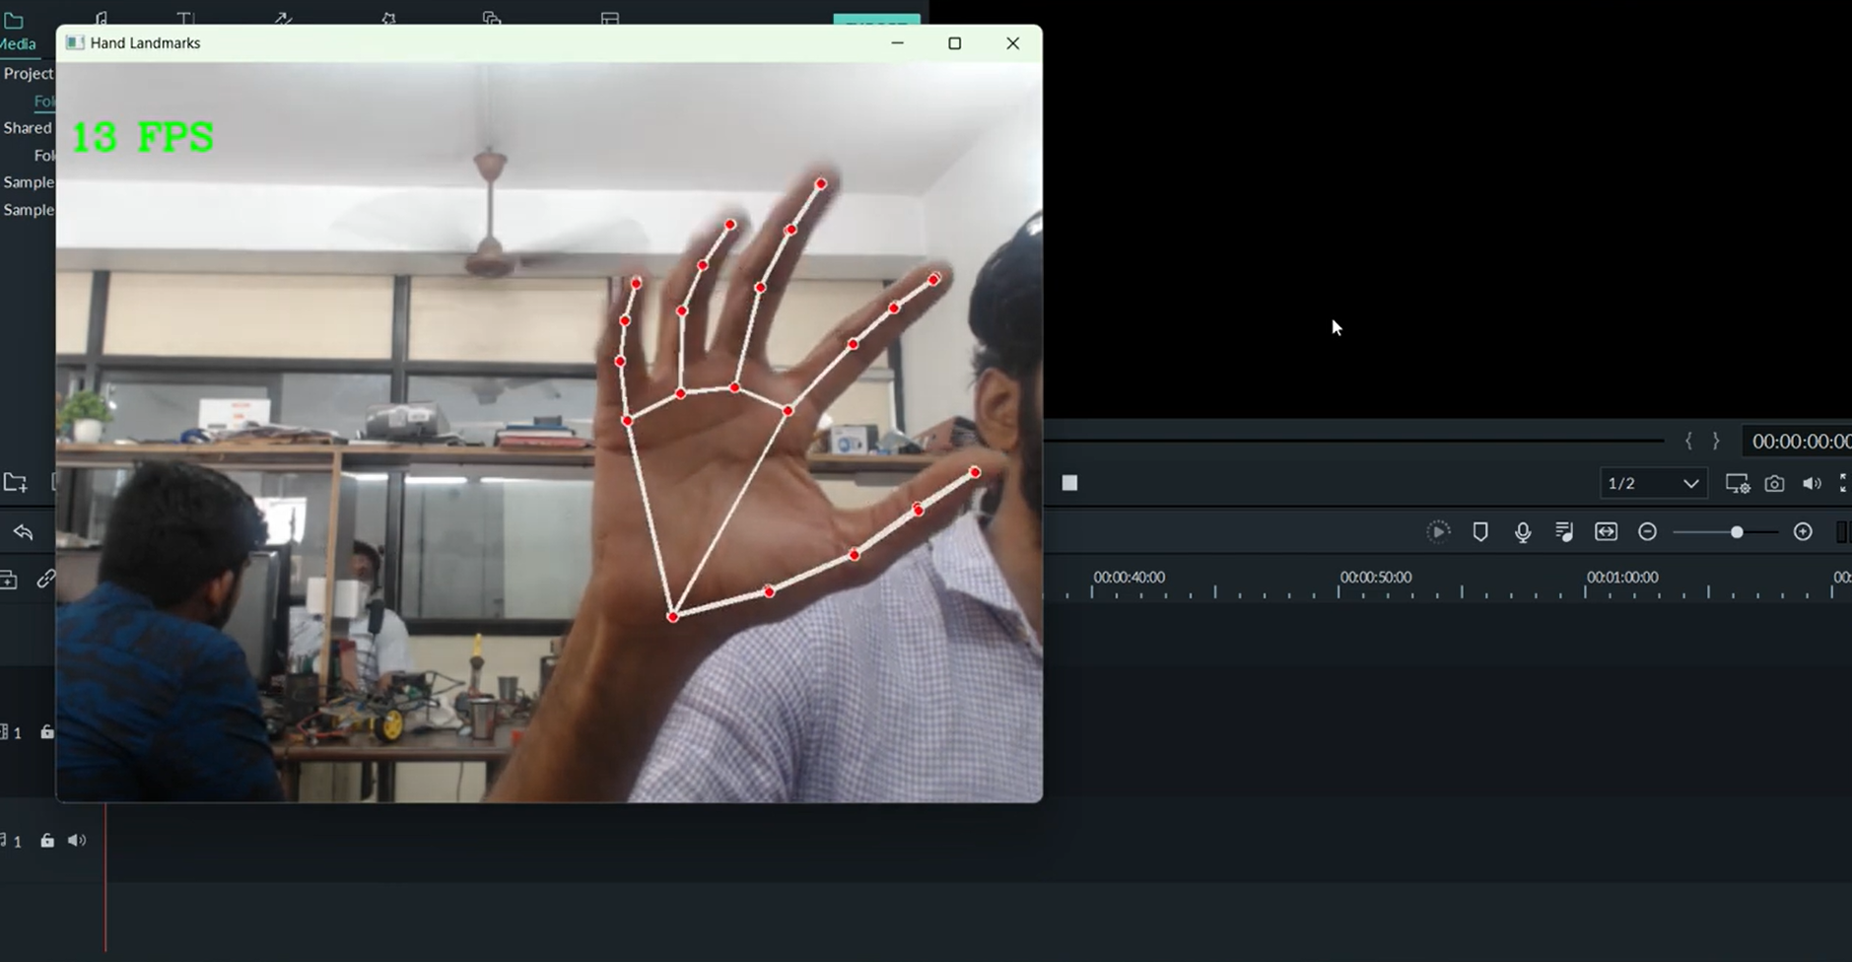
Screen Shots

Slide 20
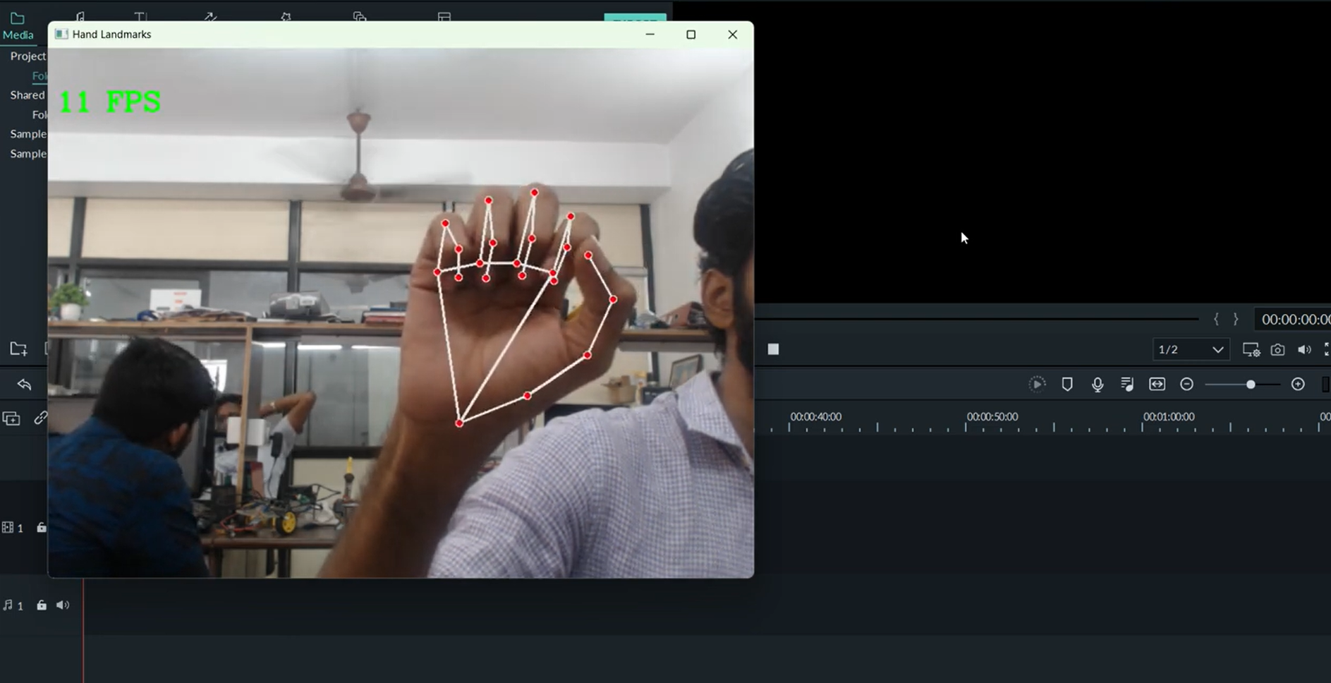
Screen Shots

Slide 21
Conclusion
In conclusion, the Gesture Controlled Wireless Agricultural Weeding Robot is a highly advanced and innovative technology that has the potential to revolutionize the agricultural industry. In this project, we have developed a Trainable automatic robot which helps in removing unwanted weed on agricultural fields using gesture to control a three-axis robotic arm to do the necessary work. The arm is placed on a rover which is controlled Wirelessly using Bluetooth. The arm is taught to do the repetitive motion with a gesture using a hand glove to do the necessary work. The setup of the rover with attached the robotic arm is tested and evaluation under normal environmental conditions This robot allows farmers to automate the weeding process, which can save a significant amount of time, effort, and money.

Slide 22
Reference Paper
[1] Nasser H. Dardas and Nicolas D. Georganas, “Real-Time Hand Gesture Detection and Recognition Using Bag-of-Features and Support Vector Machine Techniques”, IEEE transactions on instrumentation and measurement, vol. 60, no. 11, November 2011.
[2] L. Yun and Z. Peng, “An automatic hand gesture recognition system based on Viola-Jones method and SVMs,” in Proc. 2nd Int. Workshop Comput. Sci. Eng., 2009, pp. 72–76.
[3] W. Chung, X. Wu, and Y. Xu, “A real time hand gesturerecognition based on Haar wavelet representation,” in Proc. IEEE Int. Conf. Robot. Biomimetics, 2009, pp. 336–341.
[4] L. Juan and O. Gwun, “A comparison of SIFT, PCA-SIFT and SURF,” Int. J. Image Process. (IJIP), vol. 3, no. 4, pp. 143–152, 2009.
[5] L. Yeffet and L. Wolf, “Local trinary patterns for human action recognition,” in Proc. IEEE ICCV, 2009, pp. 492–497.
[6] Y. Ren and C. Gu, “Real-time hand gesture recognition based on vision,” in Proc. Edutainment, 2010, pp. 468–475

Slide 23
Conference / Publication / Project Contest Winner Certificates

