Slide 1
MACHINE LEARNING METHODS FOR SCORECARDS
Shiran Jia
Tanmay Sah
Tharun Kalyan Polamaraetty
Tianyu Cheng
Varsha Balachandran
Zhehong Zhu

Slide 2
AIM
Use historical loan application to predict whether or not an applicant will be able to repay a loan.
Standard Supervised Classification task
The target variable is a binary variable : 1 – bad client and 0 – good client.
Dataset – Home Credit Default Risk from Kaggle
Notes:
Include mortgage pricing

Slide 3
DATASET
0 : 282686
1: 24825
Total: 307,511
122 features
Float: 65
Int : 41
Categorical: 16

Slide 4
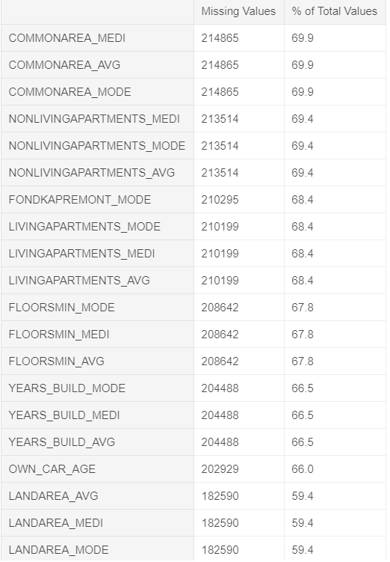
Handling Missing Values
If columns contain more than 50% missing values - we removed the features.

Slide 5
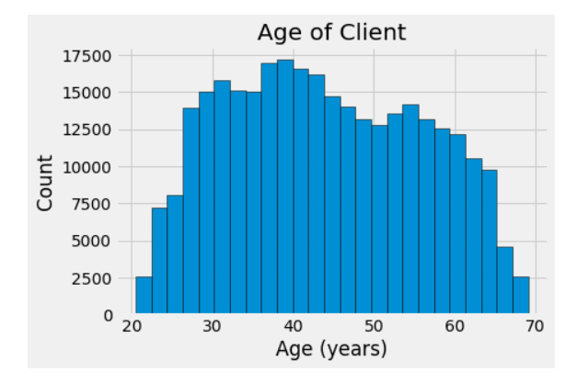
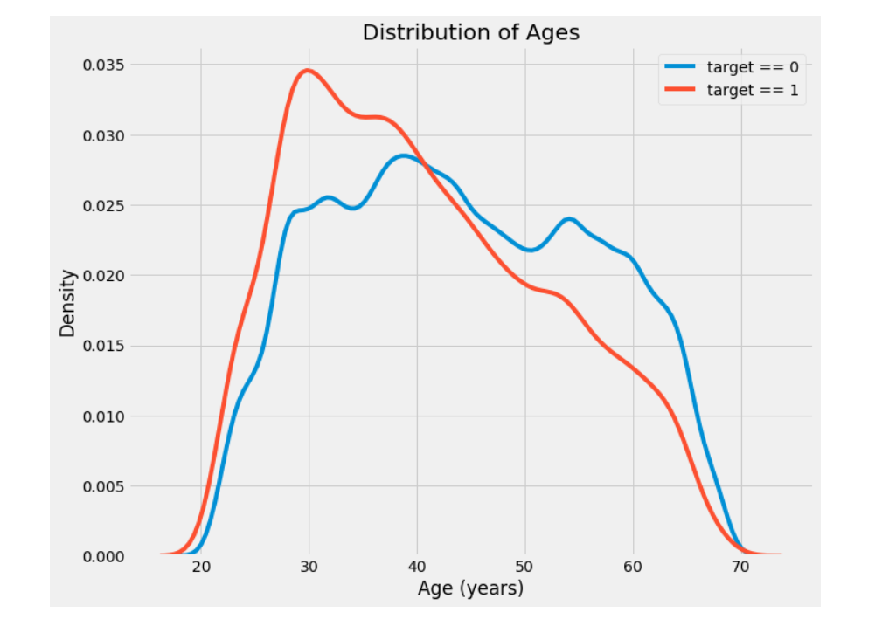
Exploratory Data Analysis
SK_ID_CURR

Slide 6
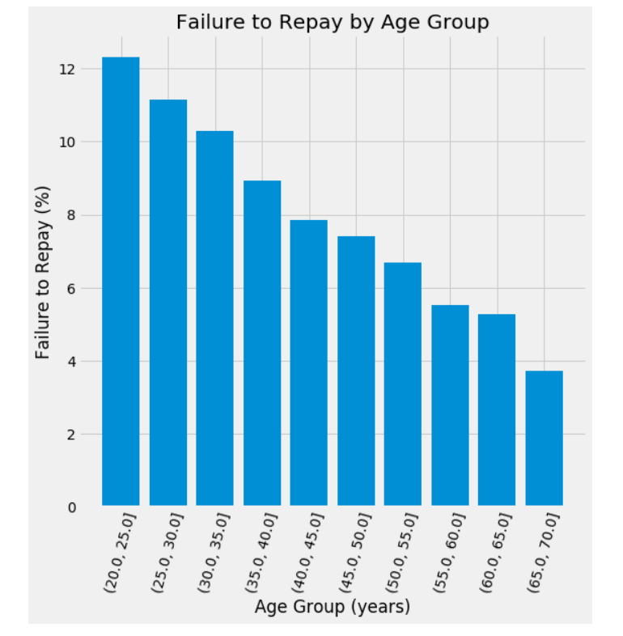
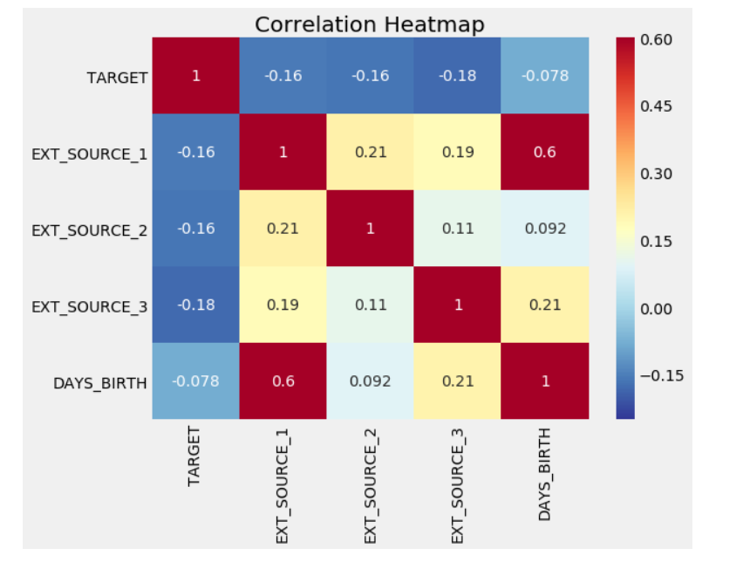
Exploratory Data Analysis

Slide 7
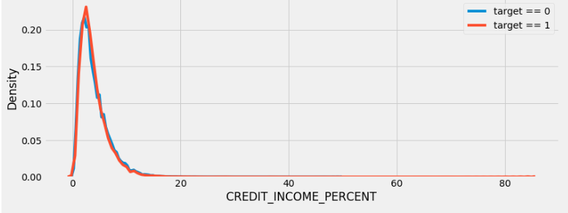
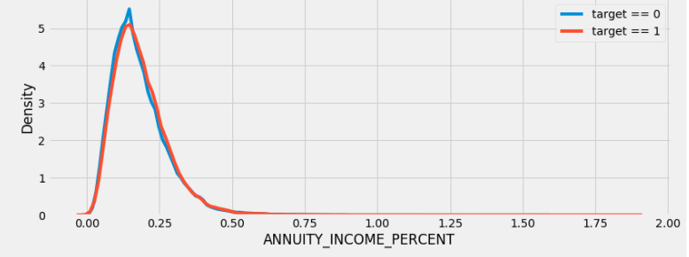
Exploratory Data Analysis

Slide 8
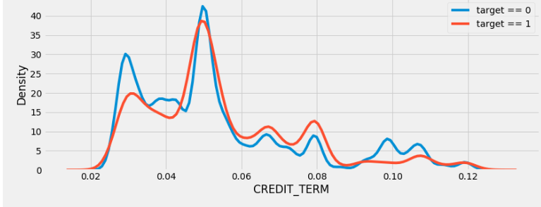
Exploratory Data Analysis

Slide 9
CATEGORICAL VARIABLES
Categorical variables are converted using LabelEncoder.
But they are not producing good result and most of the categorical variables are of bad quality.
So we removed the categorical variables.

Slide 10
Feature Selection
The process used in feature selection is as follows:
Forward Selection
Backward Elimination

Slide 11
Feature Selection
The features used are :
CREDIT_INCOME_PERCENT
ANNUITY_INCOME_PERCENT
CREDIT_TERM
DAYS_EMPLOYED_PERCENT
EXT_SOURCE_2
EXT_SOURCE_3
DAYS_ID_PUBLISH
DAYS_BIRTH
SK_ID_CURR
DAYS_EMPLOYED
AMT_ANNUITY
DAYS_LAST_PHONE_CHANGE
AMT_CREDIT
AMT_INCOME_TOTAL
EXT_SOURCE_1
REGION_POPULATION_RELATIVE
HOUR_APPR_PROCESS_START

Slide 12
Models Used
The models used are:
Logistic Regression
Random Forest
Gradient Boosting
Ensemble Method

Slide 13
Results
Models | Logistic Regression | Random Forest | Gradient Boosting | Ensemble Method
AUC | 0.69 | 0.71 | 0.75 | 0.81

Slide 14
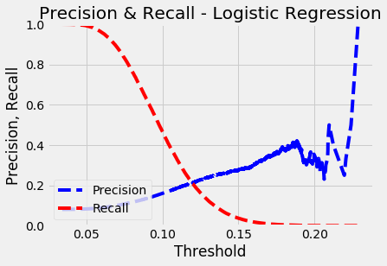
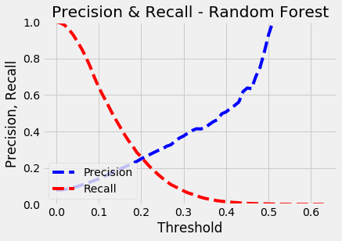
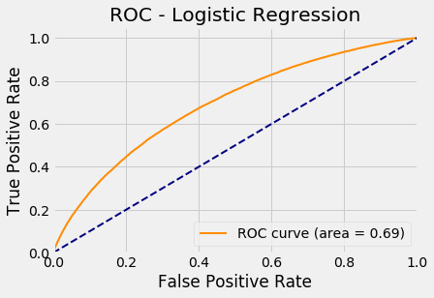
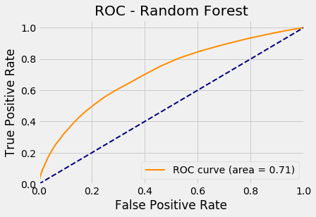

Slide 15
Thanks!
Q&A
Any questions?

