Slide 1


SMART INDIA HACKATHON 2024
Project & Team Details
Problem Statement ID - SIH1671
Problem Statement Title - Develop a functional solution that demonstrates the face liveness detection
Theme - Smart Automation
PS Category - Software
Team ID - 13378
Team Name - DeepTech

Slide 2

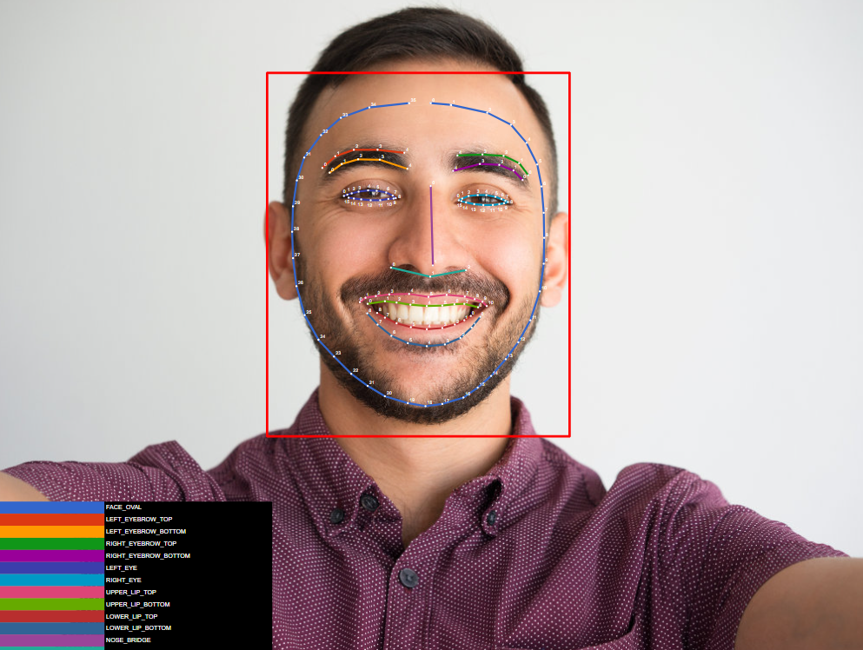
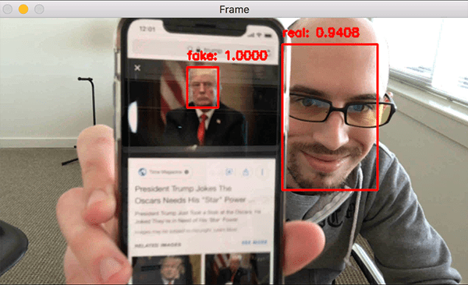
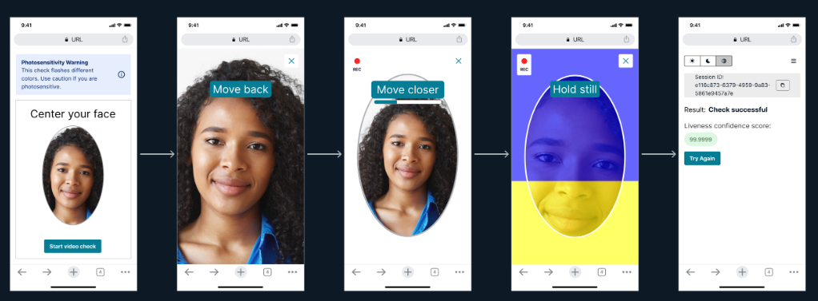
IDEA TITLE
AI-Powered Robust Face Liveness Detection System
Proposed Solution :
An AI-powered system for real-time face liveness detection using texture analysis, motion detection and Facial Parameters. A CNN trained on diverse data distinguishes live faces from spoof attempts by analyzing skin textures, facial movements and 3D contours.
Integrating texture, motion and depth cues, the system effectively counters spoofing methods, ensuring reliable face liveness detection.
The multi-cue approach enhances security, making the system robust against sophisticated spoofing attempts and adaptable to emerging threats through continuous learning.
Problem Addressed :
Innovation and uniqueness of the solution :

Slide 3
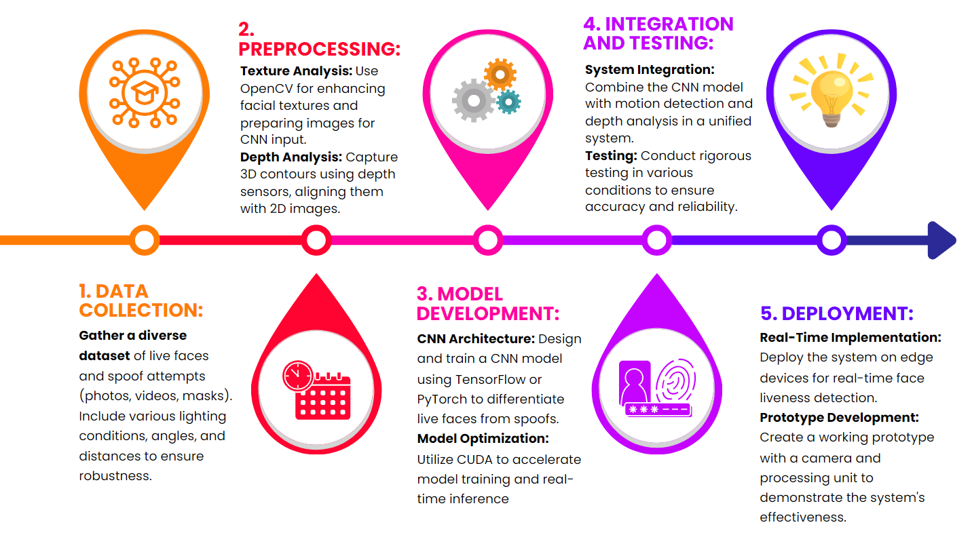

TECHNICAL APPROACH

Slide 4
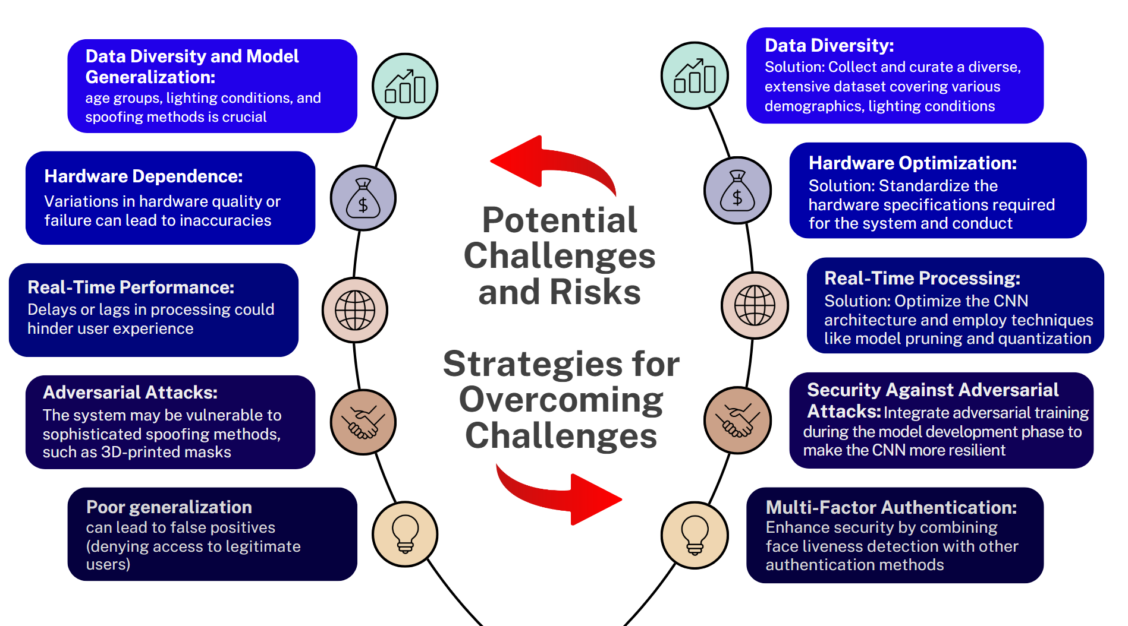
FEASIBILITY AND VIABILITY

Slide 5
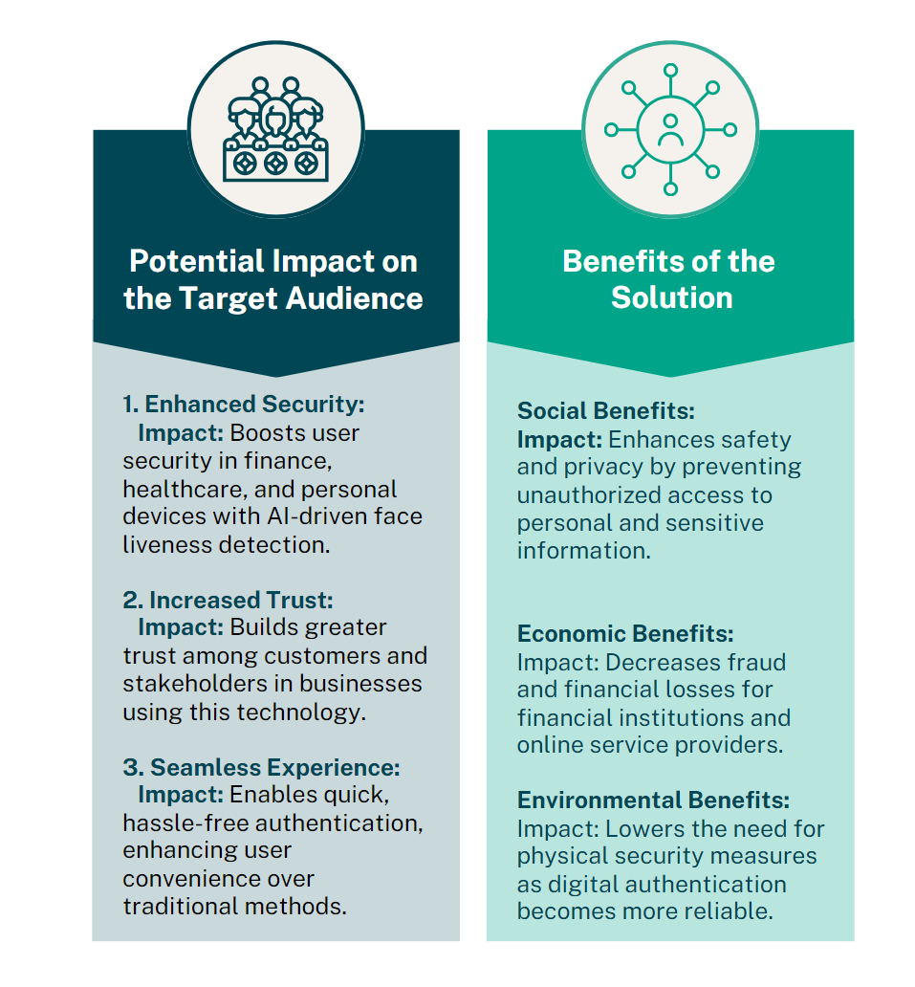
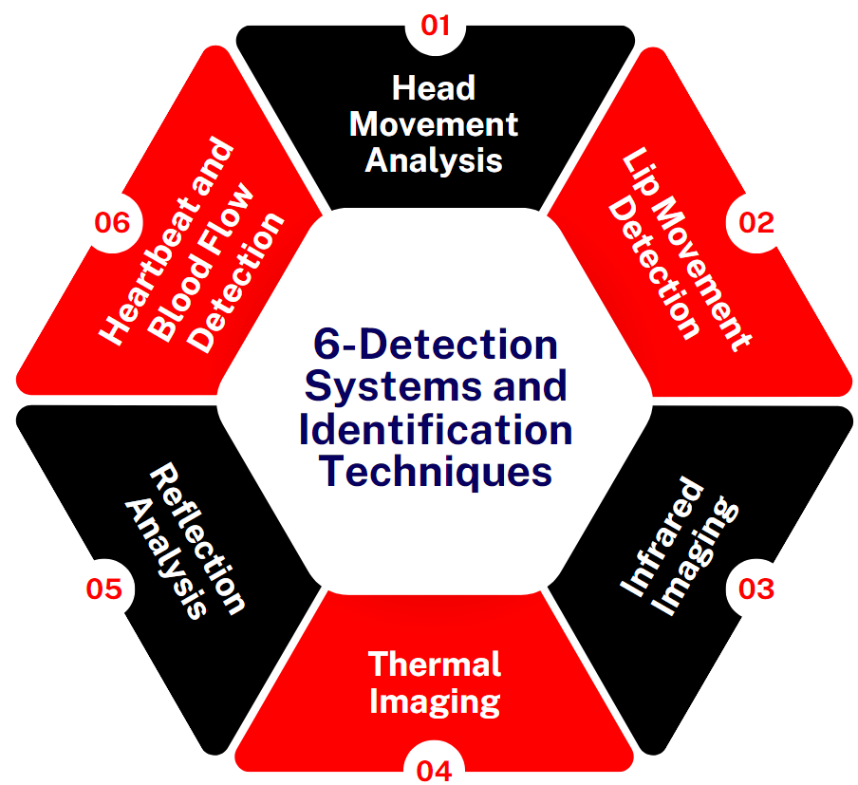
IMPACT AND BENEFITS

Slide 6
RESEARCH AND REFERENCES
Reference of Research Papers on IEEE Explore :
  https://ieeexplore.ieee.org/document/8090202/figures#figures
  2. Deep Feature Extraction for Face Liveness Detection
  https://ieeexplore.ieee.org/document/8620804
3. Reference of Face Liveness Detection using Depth Map Prediction
https://github.com/anand498/Face-Liveness-Detection
  4. Reference GitHub Repository of Face Liveness Detection (CRMNet)
https://github.com/sakethbachu/Face-Liveness-Detection
  5. Reference of Face Liveliness Image From :
  https://medium.com/@abdul_qadir_/enhancing-face-liveness- detection-in-image-based-authentication-systems-6083271f8065

