Slide 1
- S Tharun Kumar
KYC/ AML REPORTING AUTOMATION
AUTOMATING COMPLIANCE MONITORING WITH SQL, PYTHON & BI DASHBOARDS

Slide 2
PROBLEM AND OBJECTIVES
PROBLEMS
OBJECTIVES
Manual KYC checks are slow & error-prone
AML alerts generated reactively → risk of non-compliance
Teams waste time on repetitive monitoring
Automate KYC completeness & expiry tracking
Detect AML patterns in real-time
Provide compliance dashboards for faster decisions

Slide 3
SOLUTION ARCHITECTURE
SQL (Data Layer)
Customer
Transactions
KYC DOCS
Watchlist
Python (Processing Layer)
ETL
AML Rule Logic
Reporting Automation
BI Dashboards (Visualization Layer)
Tableau
Power BI

Slide 4
Key Features
🔍 KYC Monitoring → Complete / Partial / Missing, Expiry Alerts
🚨 AML Rules → Structuring, Velocity, High-Risk Geography, PEP, Rapid In–Out Flow
📊 Dashboards → Interactive risk reports
⏱️ Automation → Scheduled scripts, reduced manual effort

Slide 5
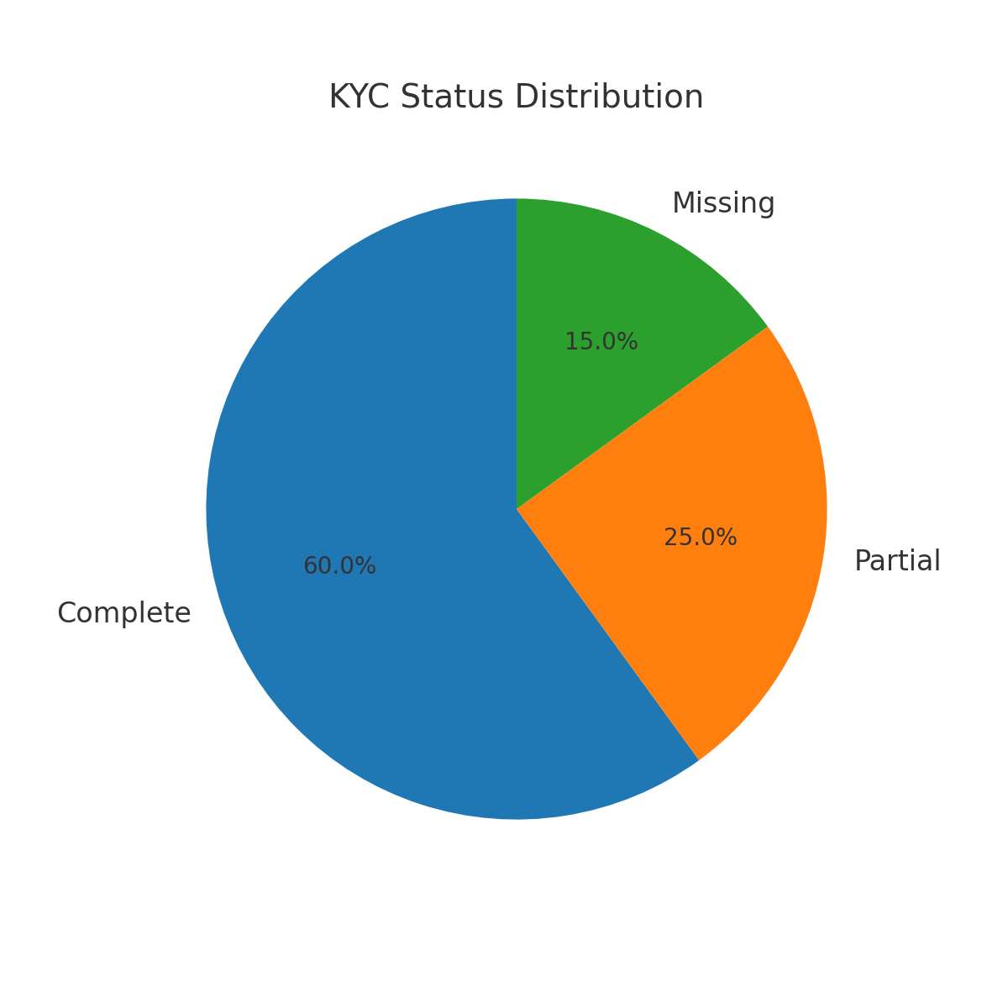
Dashboards Showcase
KYC STATUS DISTRIBUTION

Slide 6
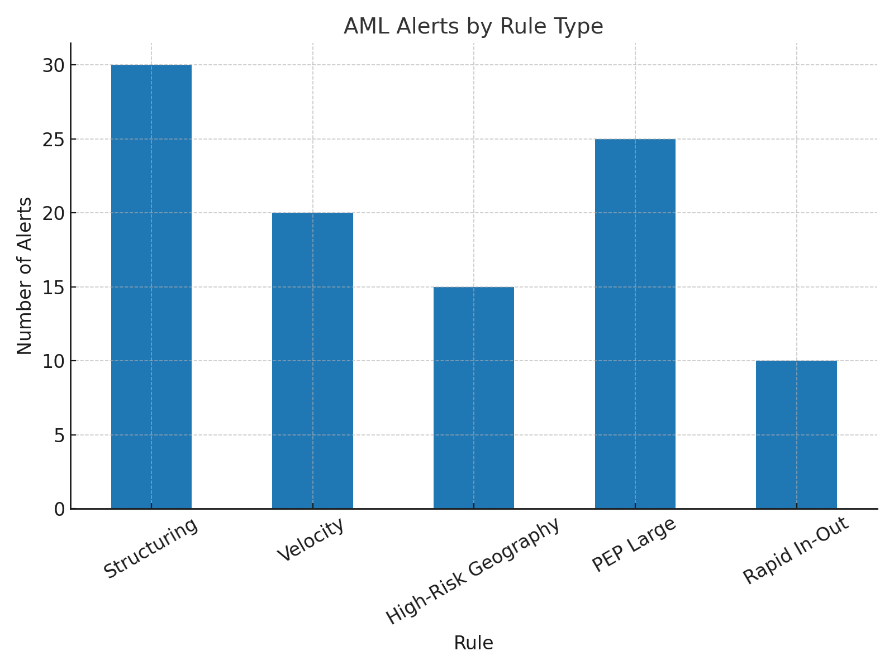
AML Alerts by Rule Type

Slide 7
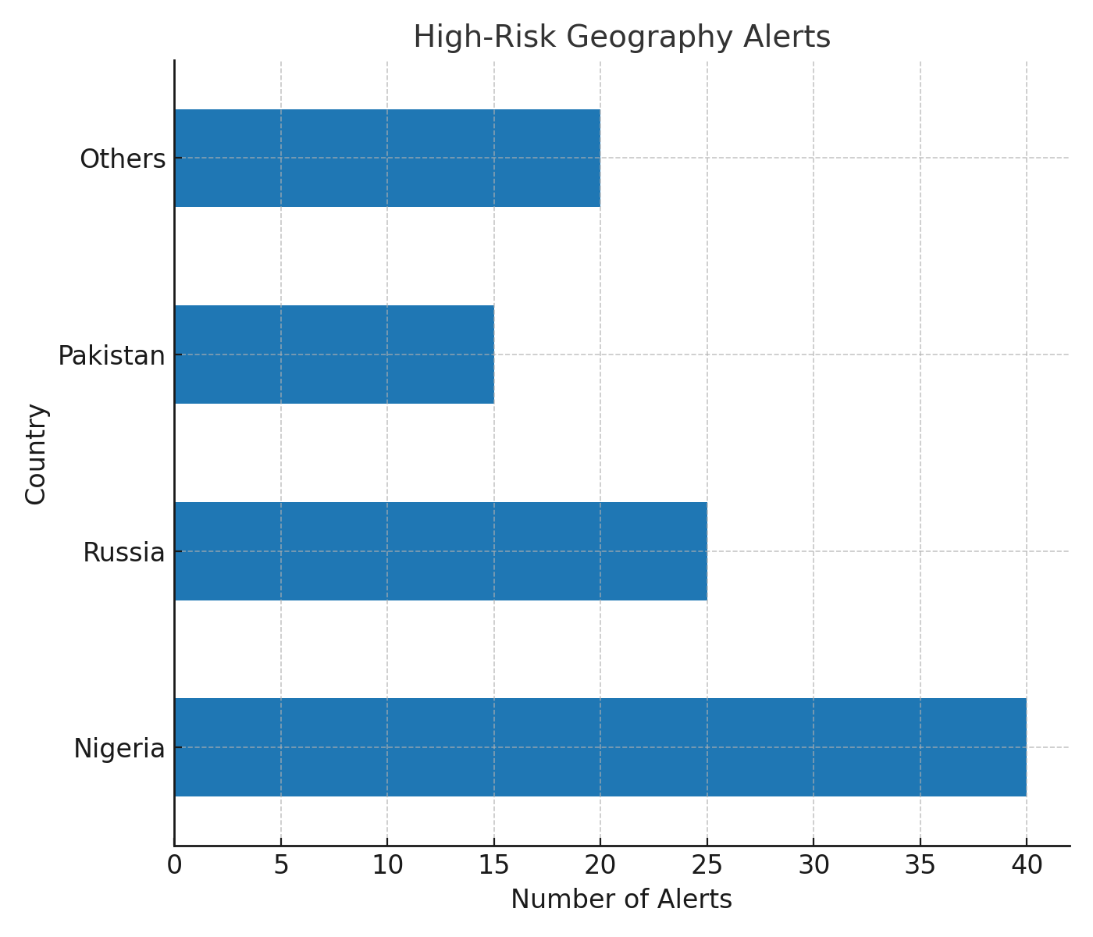
High-Risk Geography Alerts

Slide 8
Impact & Learnings
IMPACT
90% less manual monitoring
Faster detection of suspicious activity
Better decision support
LEARNINGS
SQL query design for compliance
Python for ETL & automation
BI dashboards for monitoring
Translating compliance needs → insights

