Slide 1
Operational SLA Monitoring
Automating SLA Compliance for Operational Excellence
Tharun Kumar

Slide 2
Project Objective
Automate SLA monitoring for operations tasks.
Ensure compliance and identify bottlenecks.

Slide 3
Workflow
Tasks → Duration → SLA Status → Dashboard → Insights

Slide 4
Tools & Technology
Python (Pandas)
SQL (PostgreSQL/MySQL)
Tableau / Power BI / Excel

Slide 5
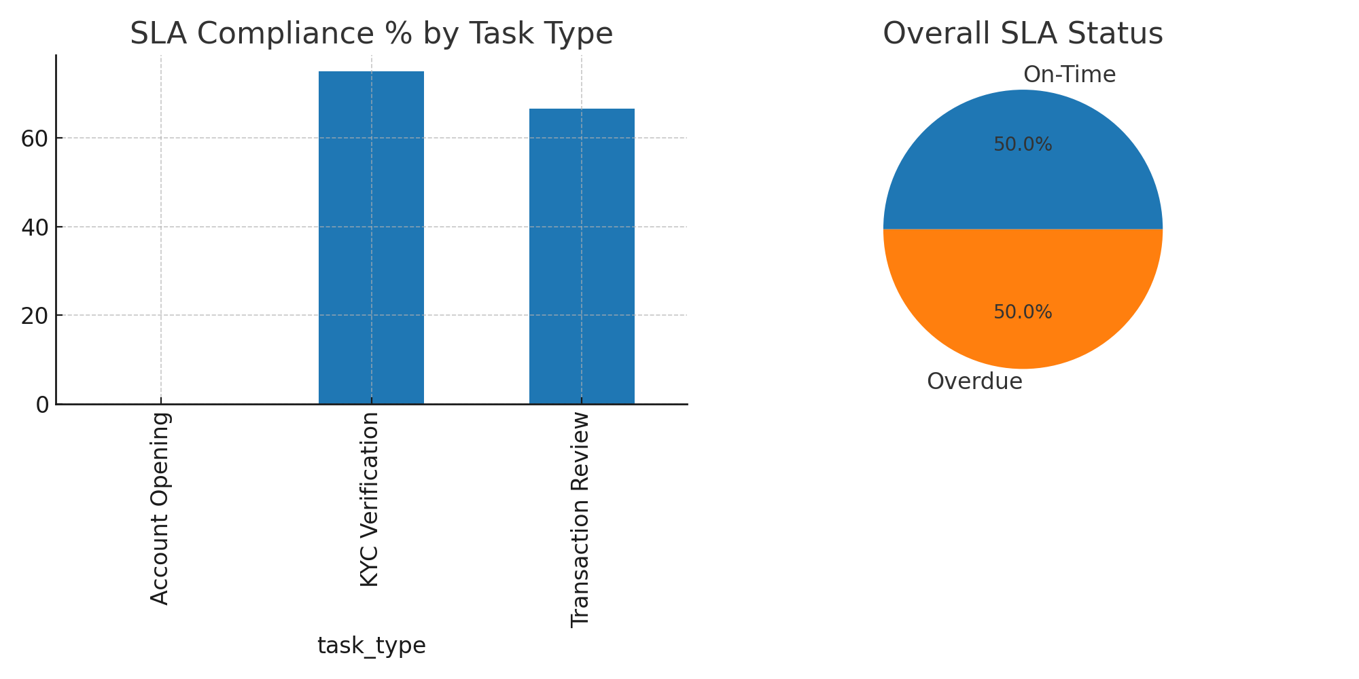
SLA Dashboard

Slide 6
Impact & Insights
• SLA compliance adherence
• Bottleneck identification
• Data-driven operational decisions

