Slide 1
Application Architecture Assignment – Travels

Slide 2
Business Case Articulation
Springline Travels is a fictitious inter-state bus service which sells their tickets through their physical stores and internet stores.
Springline Travels intends to make booking of tickets available on social-network applications, multiple devices and also, through their affiliate partner sites.
Travels application allow users to:
Search Bus See detailed Bus Schedule Online Purchase of tickets Notification of confirmation Reminder of bus schedule Display current location of bus on map

Slide 3
4 + 1 views
| 3
4+1 is a view model used for "describing the architecture of software-intensive systems, based on the use of multiple, concurrent views“.
The views are used to describe the system from the viewpoint of different stakeholders, such as end-users, developers, system engineers, and project managers.
The four views are:
Logical View
Process View
Development View
Physical View
Scenarios
Infosys

Slide 4
Logical View:
The logical view of the Springline Travels application will be based on the Model-View-Controller (MVC) architectural pattern.
The model layer will handle business logic, the view layer will handle user interfaces, and the controller layer will handle user interactions. The logical architecture will be divided into four layers:
Presentation Layer: This layer will handle user interfaces and user interactions.
Business Layer: This layer will handle business logic and rules.
Data Access Layer: This layer will handle data persistence and retrieval.
Integration Layer: This layer will handle integration with external systems and APIs.
| 4

Slide 5
Technologies:
| 5
The technology view of the Springline Travels application will be based on the following technologies:
Web Server: Apache Tomcat
Frameworks: Spring Framework for MVC and Hibernate for Object-Relational Mapping (ORM)
Deployment: Amazon Web Services (AWS)
Database: MySQL

Slide 6
Services:
The service view of the Springline Travels application will be based on the following services:
Search Bus Service: This service will allow users to search for buses based on different criteria.
Booking Service: This service will allow authenticated users to book tickets online.
Notification Service: This service will send SMS or email notifications to users confirming
their booking and reminders of bus schedules.
Tracking Service: This service will track the current location of the bus and display it on the map.
| 6

Slide 7
Deployment View:
| 7
The deployment view of the Springline Travels application will be based on a three-tier architecture
Presentation Tier:
This tier will host the user interfaces and handle user interactions.
Application Tier:
This tier will handle business logic and rules, data persistence and retrieval, and integration with external systems and APIs.
Database Tier:
This tier will host the database and handle data storage and retrieval.

Slide 8
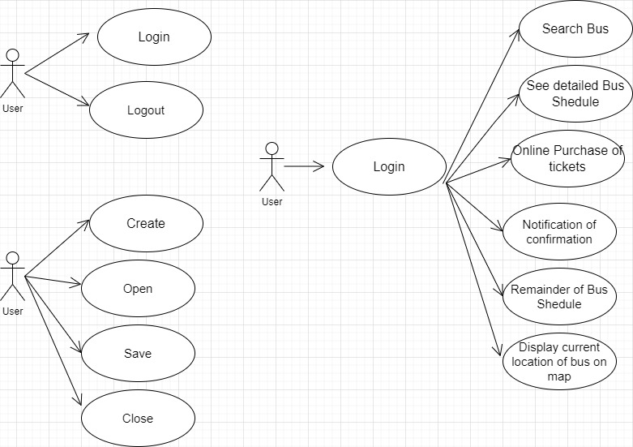
Architecture-Use Case View
| 8

Slide 9
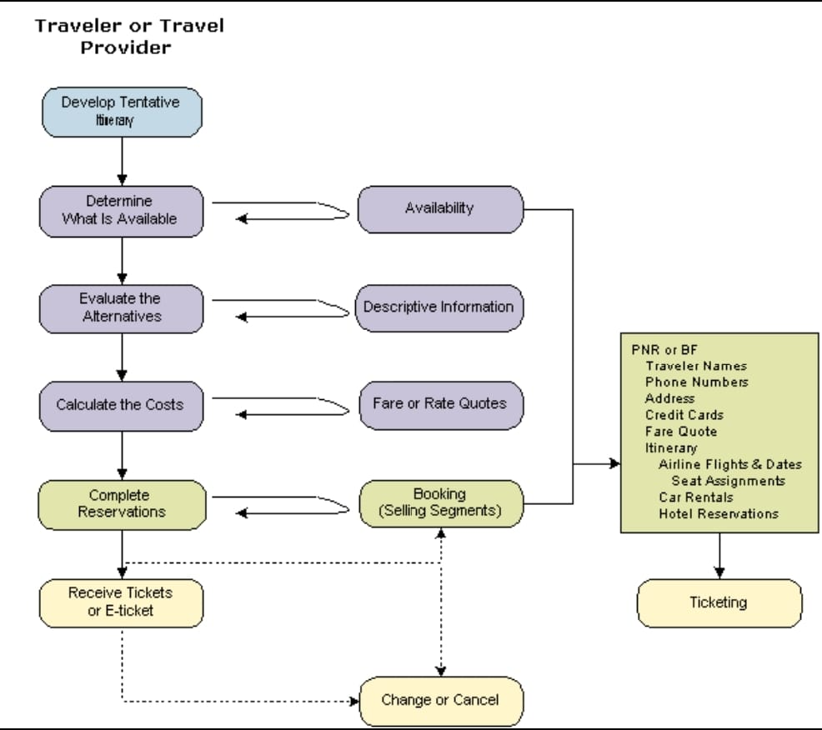
Architecture- Process View
| 9

Slide 10
Non-Functional Requirements
The Springline Travels application must meet the following non-functional requirements:
Performance: The application must be responsive and handle a high volume of user traffic.
Security: The application must be secure and protect user data and transactions.
Availability: The application must be available 24/7 and handle system failures and downtime.
Scalability: The application must be scalable and handle growth in user traffic and data volume.
Maintainability: The application must be maintainable and allow for easy updates and enhancements.
| 10

Slide 11
Architecture Decisions
The following are the key architecture decisions for the Springline Travels application:
Choice of Technology Stack and Layers:
The application will be built using the following technology stack and layers:
Presentation Layer: ReactJS
Business Layer: Java
Data Access Layer: Spring Data JPA
Database: MySQL
Communication Layer: REST APIs
Choice of Web Server: The application will be deployed on an Apache Tomcat web server.
| 11

Slide 12
Choice of Frameworks:
The following frameworks will be used for building the application:
Spring Boot: for building the Java-based web application
ReactJS: for building the user interface
Spring Data JPA: for data access
Choice of Deployment: AWS, Azure or GCP
Choice of Database: MySQL
| 12

Slide 13
Architecture Definition
Logical Architecture: The logical architecture of the Springline Travels application comprises four main layers: Presentation Layer, Business Layer, Data Access Layer and Database Layer. The Presentation Layer is responsible for presenting the user interface to the users, the Business Layer processes the user requests, the Data Access Layer retrieves and stores data in the database, and the Database Layer stores the data.
Technology Architecture: The technology architecture of the Springline Travels application includes the use of a web server, application server, database server, and container orchestration platform for deployment. The application will use REST APIs for communication between different layers.
| 13

Slide 14
Solution Architecture: The solution architecture of the Springline Travels application includes the use of ReactJS for building the user interface, Spring Boot for building the Java-based web application, Spring Data JPA for data access, and MySQL for storing data. The application will be containerized using Docker and deployed on a cloud platform like AWS using Kubernetes.
Service Architecture: The service architecture of the Springline Travels application includes the use of REST APIs for communication between different layers. The application will use RESTful web services for inter-process communication.
| 14

Slide 15
Risks and Mitigations
Risk: Security threats such as hacking and data breaches.
Mitigation: Implement strong security measures such as encryption, access controls, and regular security audits.
Risk: Performance issues such as slow response times and system overload.
Mitigation: Optimize system performance by implementing caching, load balancing, and other performance tuning techniques.
Risk: Integration issues with external systems and APIs.
Mitigation: Perform thorough testing and implement error handling and exception handling mechanisms to handle integration issues.
| 15

Slide 16
Thank you

