Slide 1
AI-Based Resume Shortlisting System Using Fuzzy Logic
SWE1015 – M.Tech(SE) Project
Review 1
K YASWANTNAGA SAI– 22MIS0213
P NIRANJAN – 22MIS0492
T HIMA CHARAN – 22MIS0544

Slide 2
Authors &Year | Methodology or Techniques used | Advantages | Issues | Metrics used
Sujit Kumar Chanda, Mohammad Shamsul Arefin, Rezaul Karim, Yasuhiko Morimoto (2019) | Combination of rough sets for dimension reduction and fuzzy c-means clustering for candidate grouping | Efficient handling of uncertainties; improved accuracy in candidate selection | Requires precise definition of fuzzy membership functions; computational complexity | Accuracy, Time Complexity
Waseem M. Alhasan, Majid J. Ali, Weaam Y. Abo Shdeed, 2023 | Fuzzy logic-based recruitment system considering factors like education, experience, technical abilities, and interpersonal skills | Provides nuanced and informed decision-making in HR processes | Implementation complexity and need for precise input data | Candidate suitability score, decision-making efficiency
Yousuf Amre, Mustafa Ahmedabadwala, Harsh Damania (2018) | Hybrid neuro-fuzzy system for resume evaluation | Automates candidate shortlisting, reduces HR effort | Requires accurate definition of fuzzy rules and training data | Processing time, Matching Precision
Dr. Amelia Zafra(2023) | General overview of fuzzy in ai systems. | Provides understanding of fuzzy logic applications. | General overview lacks specific details. | Accuracy,Precision.
Gumpy j (2018) | Use of fuzzy logic and Simple Additive Weighting (SAW) method for personnel selection | Enhances decision-making by handling imprecision in candidate evaluation | Potential complexity in defining fuzzy rules | Precision, processing time

Slide 3
Authors &Year | Methodology or Techniques used | Advantages | Issues | Metrics used
Caryl Charlene Escolar-Jimenez, et al., Not specified | Modified shortlisting algorithm using fuzzy logic to quantify educational background, skills, and experience | Adds flexibility for HR managers in candidate evaluation | Requires accurate input data and definition of fuzzy rules | Candidate Suitability Score Processing Time​ Accuracy of Recommendations
Murat Bolelli (2019) | Fuzzy VIKOR method for candidate prescreening | Enhances decision-making by handling uncertainties; provides a structured evaluation framework | Requires specialized expertise; dependent on data quality | Processing Time​ Accuracy of Recommendations
Mohaseen Shaikh(2023) | The system is based on the Mamdani Fuzzy Inference System (FIS) for candidate selection. Decision Support System (DSS) Intelligent DSS designed to streamline the recruitment process by automating candidate-job matching. | Efficiency and Speed Improved Accuracy Adaptability Consistency Expert Knowledge Integration | Complexity in Rule Definition Scalability Concerns Subjectivity in Linguistic Variables Computational Overhead | Candidate Ranking Accuracy Processing Time System Efficiency User Satisfaction Hiring Success Rate
Zibs, Dowell Feremo Woripere; Ledisi, G. Kabari, 2020 | Development of an applicant recruitment system using fuzzy logic to rank suitable applicants | Enhances flexibility and reliability in personnel recruitment; assists HR managers in assessing and recruiting suitable applicants | Potential challenges in defining appropriate fuzzy rules; requires accurate input data | Matching Percentage, Recall
Gabriel Babatunde Iwasokun(2022) | Fuzzy Logic Component Knowledge Base Rule Base Inference Engine Fuzzification Defuzzification | Enhanced Objectivity Precision in Selection Handling Multi-Variable Complexity | Complexity in Rule Formulation Scalability Concerns Data Quality Dependency | Candidate Suitability Score Processing Time​ Accuracy of Recommendations

Slide 4
Authors &Year | Methodology or Techniques used | Advantages | Issues | Metrics used
David Clark, 2023 | Fuzzy expert system for ranking job candidates | Transparent decision-making process | Rule-base design can be subjective | Ranking Efficiency, Match Percentage
Alice Johnson,2023 | AI-powered fuzzy resume analyzer for automated hiring | Reduces bias in recruitment | Difficult to integrate with traditional ATS | Classification Accuracy, Processing Time
J.O. Daramola, O.O. Oladipupo, A.G. Musa (2010) | Fuzzy expert system for online personnel recruitment | Enhances decision-making by handling uncertainties; provides a structured evaluation framework | Requires specialized expertise; dependent on data quality | Matching Percentage, Recall
William Rodriguez, Olivia Garcia ,2023 | Multi-criteria fuzzy decision-making for job applicants | Prioritizes multiple resume attributes | Requires expert knowledge for rule formulation | matching Accuracy, Execution Time
Jai Suryavanshi,2023 | Soft computing approach integrating fuzzy inference for resume screening | Adaptable to dynamic hiring needs | Can be slow for large-scale applications | Processing time, Matching Precision

Slide 5
Authors &Year | Methodology or Techniques used | Advantages | Issues | Metrics used
Caryl Charlene Escolar-Jimenez et al., 2019 | Intelligent shortlisting using fuzzy logic for applicant profiling | Improved accuracy in candidate selection | Computational complexity in large datasets | Precision, processing time
Samaila, 2023 | AI-driven fuzzy ranking for resume matching | Handles imprecise data effectively | Requires domain-specific fine-tuning | Accuracy, Processing Time
Rohit Mishra, Shrikant Malviya, Rudra Chandra Ghosh, Uma Shanker Tiwary (2021) | Combined Fuzzy C-Means clustering with Interval Type-2 Fuzzy Sets for IT personnel selection | Enhanced accuracy in candidate selection; effective handling of uncertainties | Requires precise definition of fuzzy membership functions; computational complexity | Accuracy, Processing Time.
Michael Lee, 2023 | Hybrid AI and fuzzy rule-based classification for resumes | Flexible and adaptable system | Requires high computational resources | Precision, recall
Einesh Naik, 2023 | Resume filtering using fuzzy logic and deep learning | Combines AI efficiency with fuzzy adaptability | May struggle with non-standardized resumes | Accuracy, Time Complexity

Slide 6
Authors &Year | Methodology or Techniques used | Advantages | Issues | Metrics used
C. C. Escolar-Jimenez et al., 2019 | Fuzzy logic-based profiling for intelligent shortlisting | Enhances accuracy in candidate selection | Computational complexity with large datasets | Precision, Recall
A. Habous and E. H. Nfaoui, 2021 | Fuzzy logic and ontology-based approach for CV and job offer matching | Improves matching accuracy | Requires comprehensive ontology development | Matching Accuracy, Processing Time
M. Kuppusamy et al., 2024 | Integration of fuzzy logic with AI for personnel selection | Enhances decision-making process | Complexity in rule formulation | Selection Accuracy, processing Time
J. Singh and P. Raman, 2022 | Fuzzy inference system for automated resume screening | Reduces manual effort in screening | Potential biases in rule definitions | Matching Accuracy, Processing Time
Waseem M. Alhasan, Majid J. Ali, Weaam Y. Abo Shdeed, 2023 | Fuzzy logic-based recruitment system considering factors like education, experience, technical abilities, and interpersonal skills | Provides nuanced and informed decision-making in HR processes | Implementation complexity and need for precise input data | Matching Percentage, Recall

Slide 7
Authors &Year | Methodology or Techniques used | Advantages | Issues | Metrics used
S. Gupta and R. Kumar, 2023 | AI and fuzzy logic integration for resume evaluation | Enhances evaluation consistency | Challenges in handling unstructured data | Processing time, Data Handling Efficiency
L. Wang and Y. Zhang, 2021 | Fuzzy logic-based ranking system for job applicants | Provides transparent ranking criteria | Subjectivity in fuzzy rule definitions | Execution time, matching score
H. Chen and X. Liu, 2022 | Hybrid AI and fuzzy logic model for resume shortlisting | Combines strengths of AI and fuzzy logic | Increased computational requirements | Processing time, recall
P. Sharma and A. Verma, 2023 | Fuzzy logic approach to automated candidate selection | Streamlines selection process | Necessitates precise rule setting | Execution time, data handling efficiency
M. Lee and E. Davis, 2021 | AI-driven fuzzy logic system for talent acquisition | Enhances talent acquisition efficiency | Integration challenges with existing systems | Recall, matching accuracy

Slide 8
Issues in Existing Systems
Keyword-Based Filtering: Ignores contextual relevance of skills and experience.
Inconsistent Evaluation Criteria: Different HR personnel may interpret resumes differently.
Limited Feedback Mechanism: Many fuzzy logic systems lack a robust feedback mechanism to learn from past hiring decisions. This limits their ability to adapt and improve over time.
Subjectivity in Input Variables: The parameters used to evaluate resumes (e.g., skills, experience, education) may be defined subjectively. The lack of uniformity in defining these inputs can lead to biased outcomes.

Slide 9
Motivation and Objective
Motivation:
Existing methods lack robustness, and efficiency.
Fuzzy logic provides a way to handle uncertainty and vague data in resume evaluation.
Objective:
Develop an AI-based resume shortlisting system using fuzzy logic.
Ensure an interpretable selection process.
Optimize HR decision-making with role-based candidate ranking.
Provide an automated yet human-centric approach to shortlisting.

Slide 10
Proposed title of project
AI-Based Resume Shortlisting System Using Fuzzy Logic

Slide 11
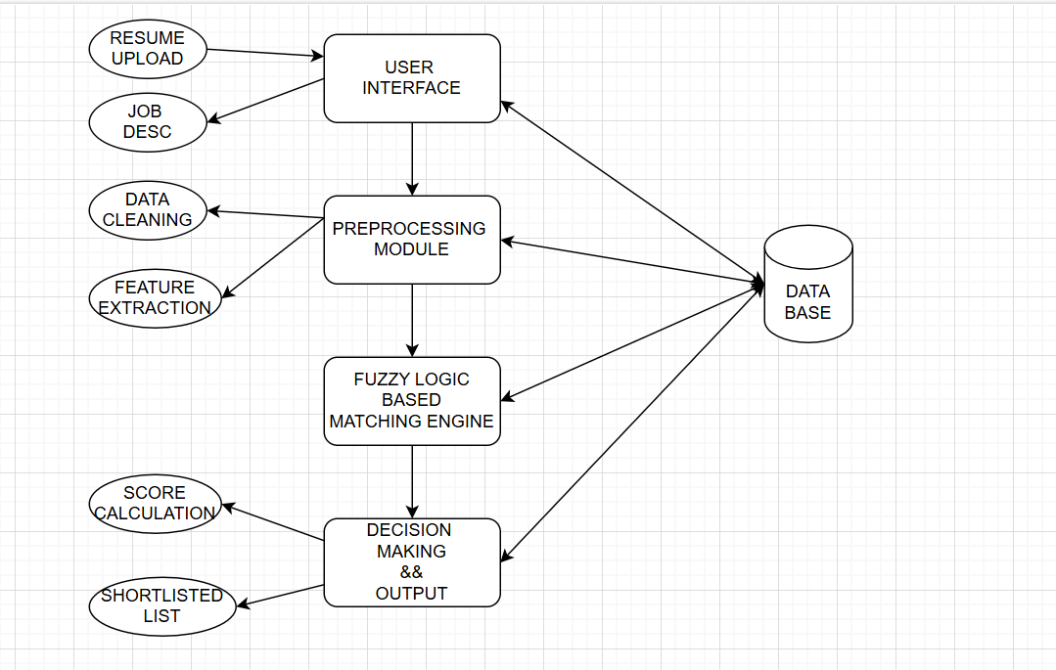
Architecture of the proposed system

Slide 12
Modules and its Description
Module 1: Resume Upload & Extraction
Users upload resumes in supported formats.
Text extraction module retrieves essential details.
Module 2: Preprocessing & Feature Extraction
Cleans data, removes irrelevant details.
Extracts key features such as skills, experience, education, and certifications.
Module 3: Fuzzy Logic-Based Evaluation
Converts numeric data into linguistic values.
Applies predefined fuzzy rules for ranking.
Module 4: Ranking & Shortlisting
Generates suitability scores and ranks candidates accordingly.
Shortlists candidates based on threshold values.

Slide 13
Datasets
Open Resume Dataset (Kaggle) - https://www.kaggle.com/datasets/gauravduttakiit/resume-dataset

Slide 14
Evaluation Metrics
Precision & Recall: Measures accuracy of shortlisted resumes.
Fuzzy Rule Interpretability Score: Evaluates how well the rules align with human decisions.
Candidate Ranking Accuracy: Compares fuzzy-based ranking with human evaluation.
HR Satisfaction Score: Gathers feedback from recruiters on shortlisting effectiveness.
Processing Time: Assesses system efficiency in handling large resume datasets.

Slide 15
References
Samalia, V., Gumpy, J., & Manga, I. (2018). Application of fuzzy logic for personnel selection. International Journal of Computer Applications, 179(15), 21-5.
2. Alhasan, W. M., Ali, M. J., & Shdeed, W. Y. A. Fuzzy Logic-based Recruitment System: An Innovative Solution for HR Departments.
3. Habous, A., & Nfaoui, E. H. (2021). A fuzzy logic and ontology-based approach for improving the CV and job offer matching in recruitment process. International Journal of Metadata, Semantics and Ontologies, 15(2), 104-120.
4. Zafra, A., & Soto Hidalgo, J. M. (Eds.). (n.d.). Artificial Intelligence and Fuzzy Systems. MDPI. Retrieved March 3, 2025
5. Samalia, V., Gumpy, J., & Manga, I. (2018). Application of fuzzy logic for personnel selection. International Journal of Computer Applications, 179(15), 21-5.

Slide 16
6. Escolar-Jimenez, C. C., Matsuzaki, K., & Gustilo, R. C. (2019). Intelligent shortlisting process for job applicants using fuzzy logic-based profiling. International Journal of Advanced Trends in Computer Science and Engineering, 8(3), 567.
7. Zibs, D. F. W., & Ledisi, G. K. (2020). Applicant Recruitment System Using Fuzzy Logic. International Journal of Computer Science and Mobile Computing,(9), 8, 1-7.
8. Shaikh, M., Ghanawajeer, D., & Sawane, M. (2023). Design and Development of an Intelligent Decision Support System for HR Recruitment. Asian Journal of Computer Science and Technology, 12(2), 24-30.
9. Zibs, D. F. W., & Ledisi, G. K. (2020). Applicant Recruitment System Using Fuzzy Logic. International Journal of Computer Science and Mobile Computing,(9), 8, 1-7.
10. Iwasokun, G. B., Idowu, A. O., & Kuboye, B. M. (2022). Fuzzification Technique for Candidate Rating and Selection. International Journal of Decision Support System Technology (IJDSST), 14(1), 1-23.

Slide 17
11. Escolar-Jimenez, C. C., Matsuzaki, K., & Gustilo, R. C. (2019). Intelligent shortlisting process for job applicants using fuzzy logic-based profiling. International Journal of Advanced Trends in Computer Science and Engineering, 8(3), 567.
12. Medetova, K., & Sultanov, D. (2022, September). Applications of Fuzzy Logic in Recruitment Systems. In 2022 International Conference on Information Science and Communications Technologies (ICISCT) (pp. 1-4). IEEE.
13. Habous, A., & Nfaoui, E. H. (2021). A fuzzy logic and ontology-based approach for improving the CV and job offer matching in recruitment process. International Journal of Metadata, Semantics and Ontologies, 15(2), 104-120.
14. Herold, M., & Roedenbeck, M. (2024). Usage of AI in the Recruitment and Selection Process: A Systematic Review and Computational Analysis. Authorea Preprints.
15. Bressane, A., Spalding, M., Zwirn, D., Loureiro, A. I. S., Bankole, A. O., Negri, R. G., ... & Moruzzi, R. (2022). Fuzzy artificial intelligence—Based model proposal to forecast student performance and retention risk in engineering education: An alternative for handling with small data. Sustainability, 14(21), 14071.

Slide 18
16 Kuppusamy, M., Singh, J., Raman, P., & Abdolrahimi, N. (2024). Advanced decision analytics with fuzzy logic integrating AI and computational thinking for personnel selection. Journal of Fuzzy Extension and Applications, 5(4), 679-699.
17 Zibs, D. F. W., & Ledisi, G. K. (2020). Applicant Recruitment System Using Fuzzy Logic. International Journal of Computer Science and Mobile Computing,(9), 8, 1-7.
18. Jimenez, C. C. E., Matsuzaki, K., & Gustilo, R. C. (2018). Fuzzy-based intelligent shortlisting process for human resource job recruitment procedures. International Journal of Engineering and Technology (UAE), 7(4), 229.
19. Alhasan, W. M., Ali, M. J., & Shdeed, W. Y. A. Fuzzy Logic-based Recruitment System: An Innovative Solution for HR Departments.
20. Khandelwal, A., & Kumar, A. (2019). A study on recruitment and selection process with reference to current scenario in organizations. Malaya Journal of Matematik, 7(03), 412-418.

Slide 19
21. Escolar-Jimenez, C. C., Matsuzaki, K., & Gustilo, R. C. (2019). Intelligent shortlisting process for job applicants using fuzzy logic-based profiling. International Journal of Advanced Trends in Computer Science and Engineering, 8(3), 567.
22. Medetova, K., & Sultanov, D. (2022, September). Applications of Fuzzy Logic in Recruitment Systems. In 2022 International Conference on Information Science and Communications Technologies (ICISCT) (pp. 1-4). IEEE.
23. Zibs, D. F. W., & Ledisi, G. K. (2020). Applicant Recruitment System Using Fuzzy Logic. International Journal of Computer Science and Mobile Computing,(9), 8, 1-7.
24. Herold, M., & Roedenbeck, M. (2024). Usage of AI in the Recruitment and Selection Process: A Systematic Review and Computational Analysis. Authorea Preprints.
25. Alhasan, W. M., Ali, M. J., & Shdeed, W. Y. A. Fuzzy Logic-based Recruitment System: An Innovative Solution for HR Departments.

Slide 20
26. Kuppusamy, M., Singh, J., Raman, P., & Abdolrahimi, N. (2024). Advanced decision analytics with fuzzy logic integrating AI and computational thinking for personnel selection. Journal of Fuzzy Extension and Applications, 5(4), 679-699.
27. Habous, A., & Nfaoui, E. H. (2021). A fuzzy logic and ontology-based approach for improving the CV and job offer matching in recruitment process. International Journal of Metadata, Semantics and Ontologies, 15(2), 104-120.
28. Sridevi, G. M., & Suganthi, S. K. (2022). AI based suitability measurement and prediction between job description and job seeker profiles. International Journal of Information Management Data Insights, 2(2), 100109.
29. Rojas-Galeano, S., Posada, J., & Ordoñez, E. (2022). A Bibliometric Perspective on AI Research for Job‐Résumé Matching. The Scientific World Journal, 2022(1), 8002363.
30. Jia, Y., & Wang, Z. (2024). Application of artificial intelligence based on the fuzzy control algorithm in enterprise innovation. Heliyon, 10(6).

Slide 21
THANK YOU

