Slide 1

J mun

Slide 2
Proof!

Slide 3
S

Slide 4
Search

Slide 5
Register

Slide 6
Talk

Slide 7
T

Slide 8
Crawl

Slide 9
PriorM!

Slide 10
Prior!

Slide 11
Good Man From Earth

Slide 12
GM
F E

Slide 13
Stack! @MIT

Slide 14
UrL-iT

Slide 15
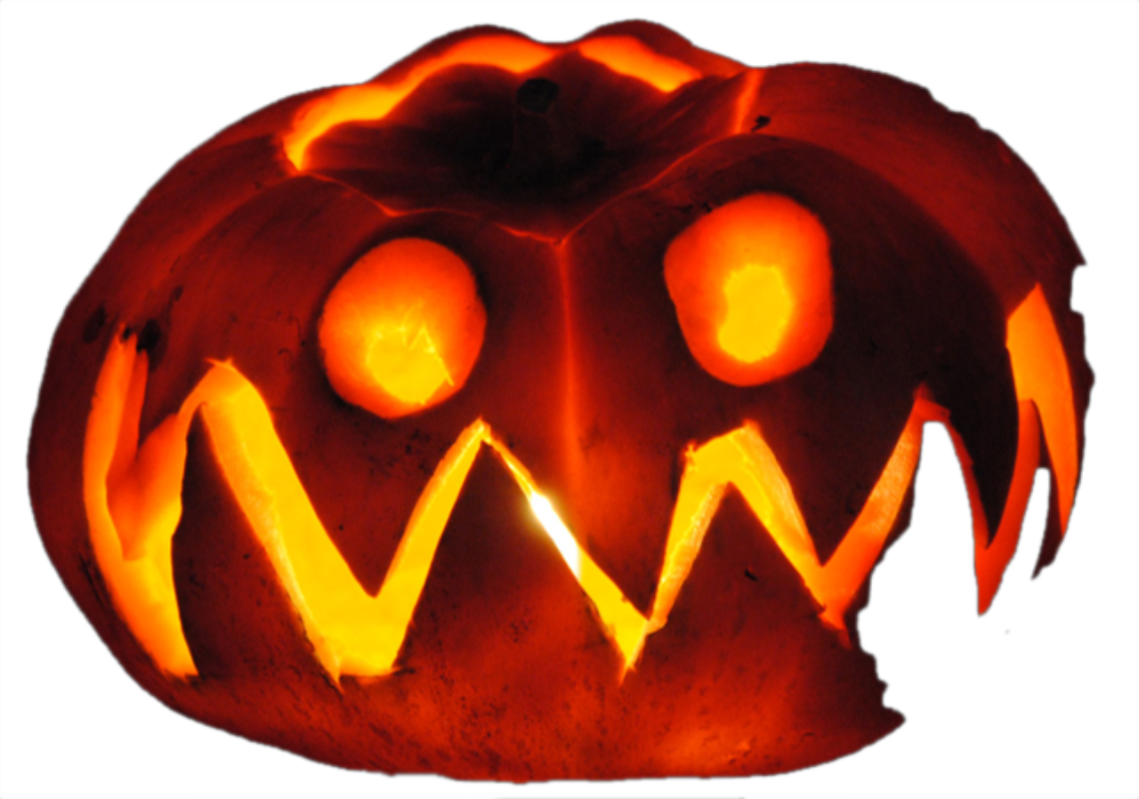
Pri r!

Slide 16

henium Live

Slide 17
2020
Re-Wind

Slide 18
Re-wind
2020

Slide 19
History
2020

Slide 21
P
U

Slide 22
D

Slide 23
Poll

Slide 24
Oops

Slide 25
P

