Slide 1
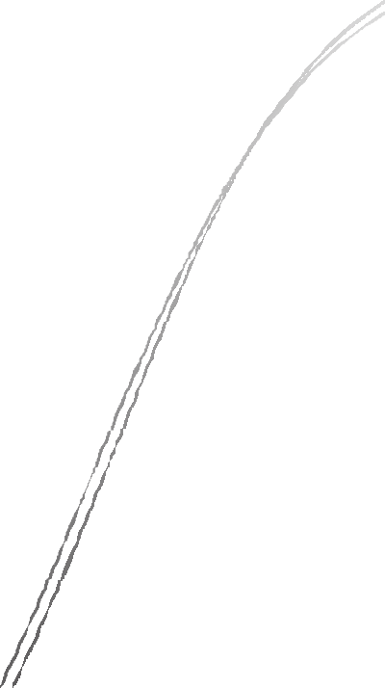
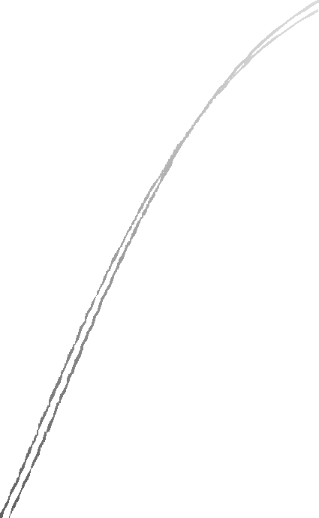
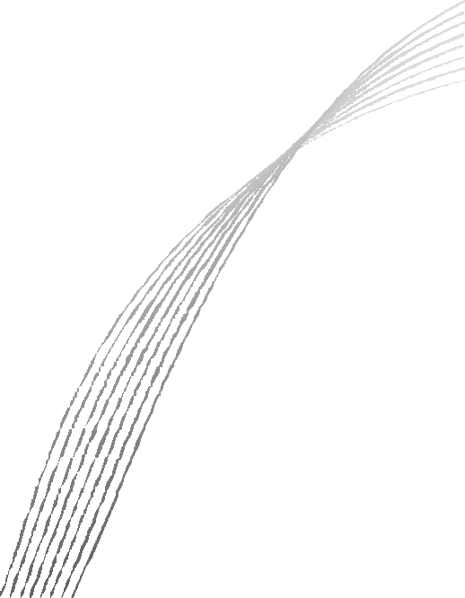
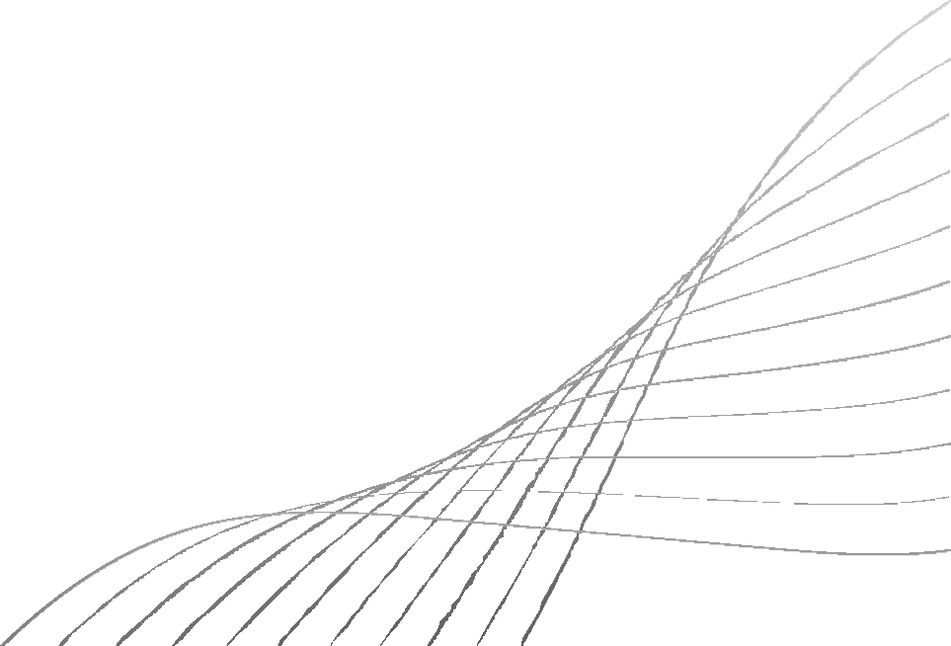
KNN ALGORITHM

Slide 2

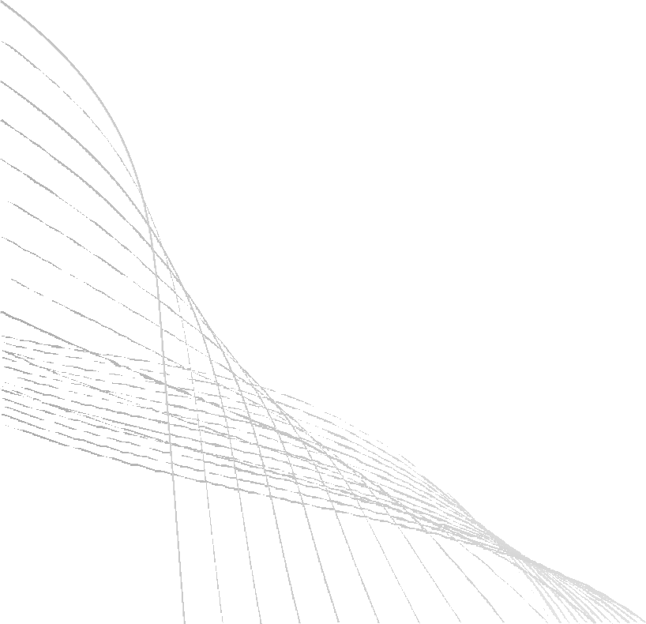
K-NEAREST NEIGHBORS
KNN is a supervised machine learning algorithm used Classification (most common)
Regression (less common)
It’s called “lazy learner” because it doesn’t learn a model during training.
It stores the training data and only works when you give it new data to predict.

Slide 3
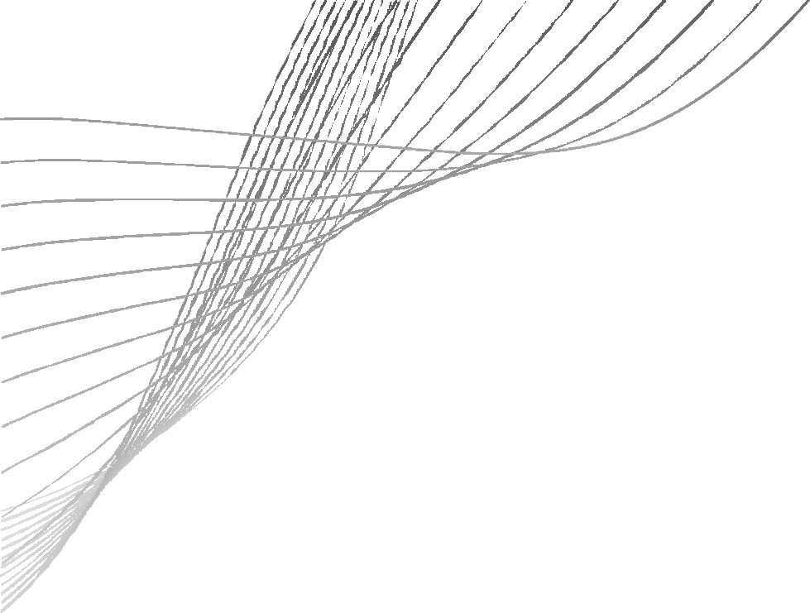
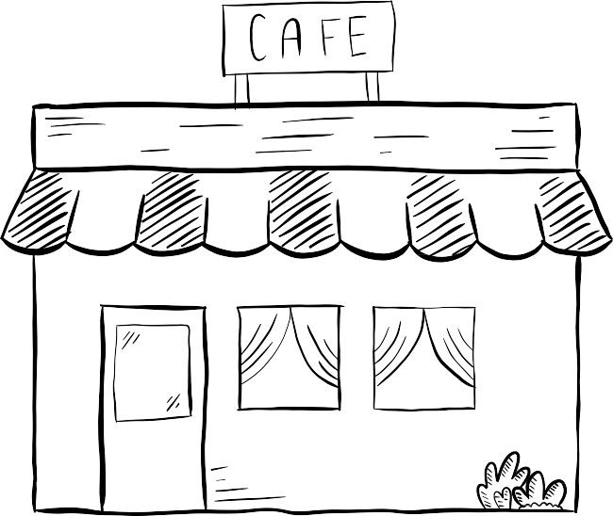
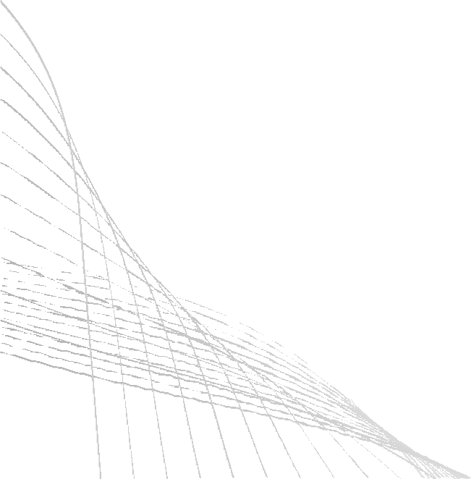
EXAMPLE
You
Yes
No
Yes
That’s KNN!
It checks the "K nearest neighbors" and predicts based on the majority.

Slide 4
DISCUSSION

Slide 5
