Slide 1
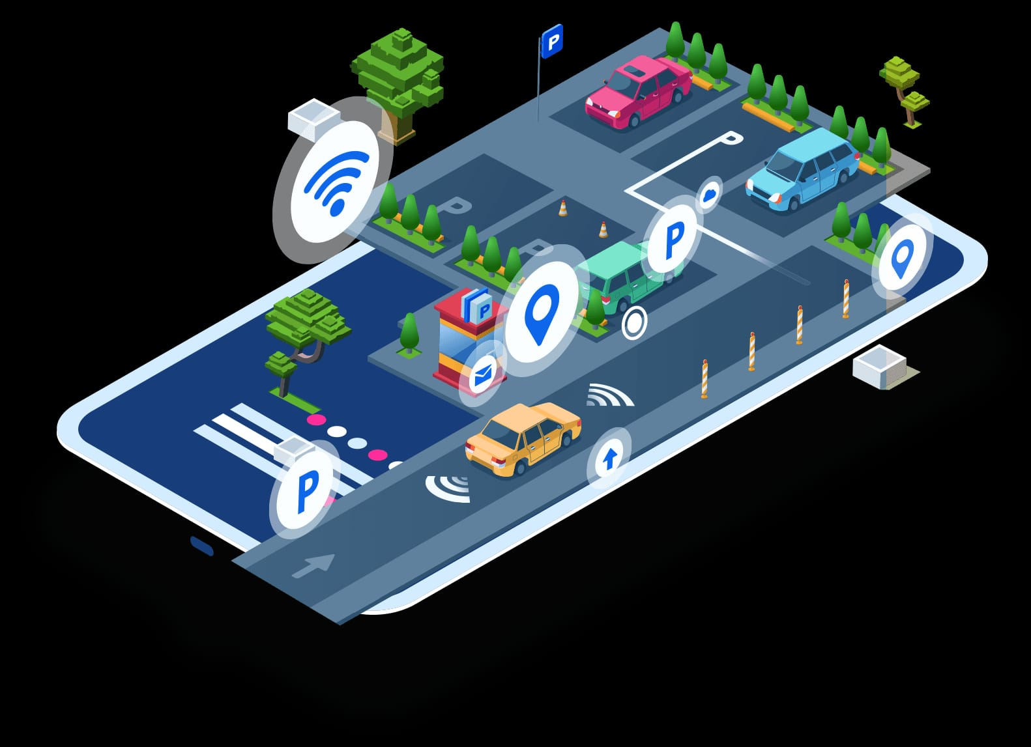
SMART PARKING system
INTERNET OF THINGS

Slide 2
BASIC DETAILS OF TEAM
Team Name : proj_224089_Team1
Team Based : Smart parking
Team Leader Name : Manivannan.J
Institution Name : chendu college of engineering and technology
Theme : Real Time Availability and Fire Detection Smart Parking System

Slide 3
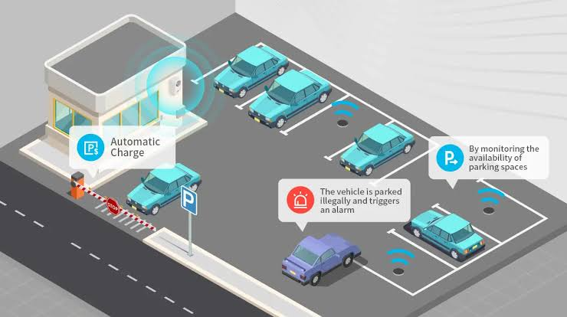
Smart parking system
In this project we are discuss about smart parking.Nowadays, we use automobiles to save time, but often struggle to find parking spaces.Some parking places are manually operated,causing issues such as slow gate opening and high fees.
Smart parking system can be implemented in places like hospitals ,shopping malls,theaters,tourist places and more.

Slide 4
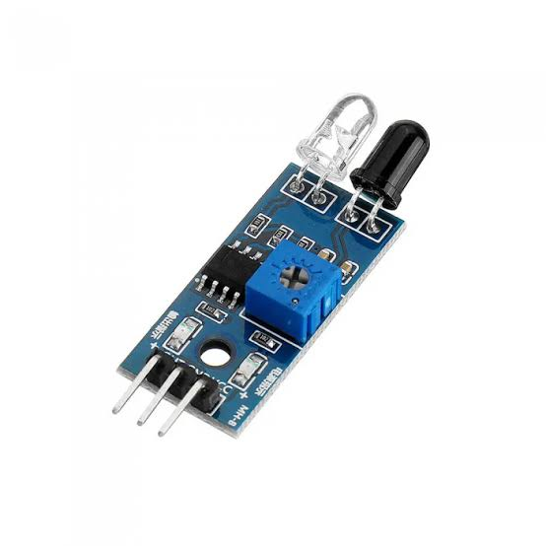
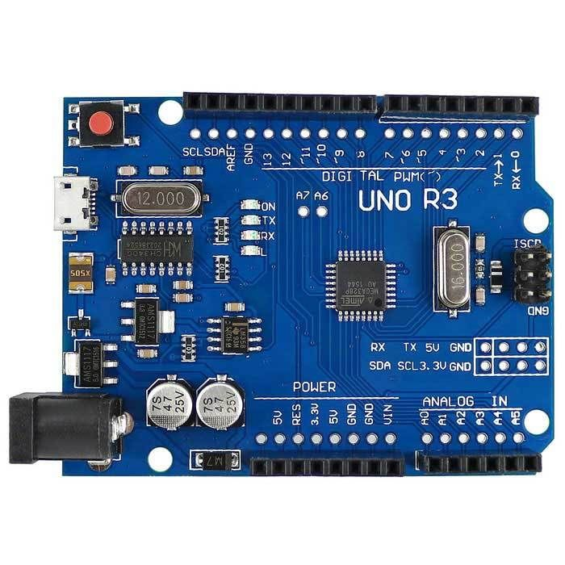
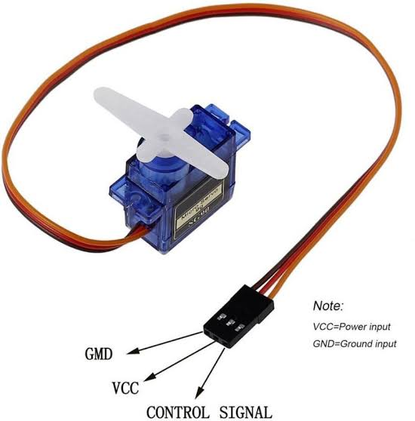
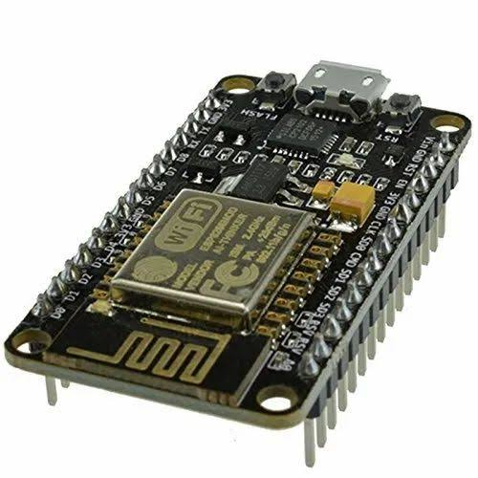
Components Required :
Arduino UNO
IR proximity sensors
Jumper cables
LCD display
LED lights
Node MCU
Servo motors
Arduino IDE

Slide 5
WORKING DESCRIPTION :
As a car approaches the entrance gate,a infrared motion sensor detects its presence and transmits this information to an Arduino board
The Arduino board is pre-programmed with the knowledge of the available parking sites.If a parking slot is vacant,it acticates the gate to open.if no slots are available,it displays a message to the car owner indicating that all parking slots are occupied.
once the car is parked in a slot,an occupancy sensor detects the presence of the car and uses a counter to keep track of the parking duration.
In the event of a fire,a flame-detecting sensor on the premises detects the fire and sends a signal to the Arduino board.
The Arduino board,upon receiving the fire signal,activates an alarm system to alert relevant personal pr occupants about the fire emergency.

Slide 6
BENEFITS OF SMART PARKING SYSTEM :
Improved Efficiency: Real-time monitoring helps drivers find available parking spaces quickly.
Reduced Traffic Congestion: Efficient parking reduces circling, easing traffic congestion.
Cost Savings: Drivers save on fuel and parking fees, while parking lot owners optimize revenue.
Environmentally Friendly: Fewer cars circling mean reduced emissions and improved air quality.
Reduced Vehicle Theft :Real time monitoring deters theft and vandalism.
Remote Management :operators can manage facilities remotely,reducing maintenance costs.
Scalability:easily expand the system to accommodate growing parking demands.

Slide 7
Team members details
ROLE IN TEAM | NAME | BRANCH NAME | YEAR
TEAM LEADER | MANIVANNAN.J | CSE | 3rd year
TEAM MEMBER 1 | TAMIL SELVAN.S.S | CSE | 3rd year
TEAM MEMBER 2 | THARUN.J.S | CSE | 3rd year
TEAM MEMBER 3 | SIVA ABINESHWARAN.K | CSE | 3rd year

