Slide 1
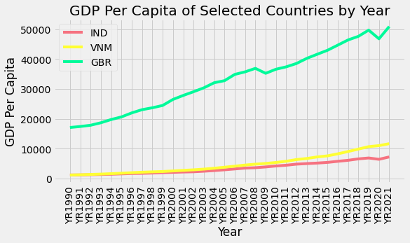
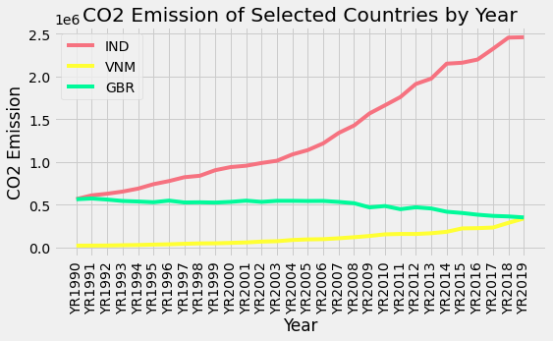
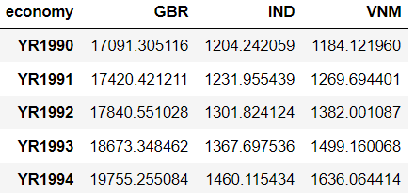
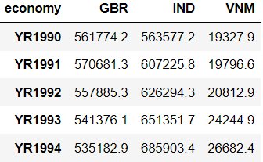
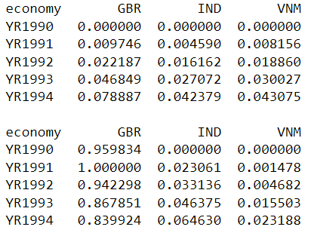
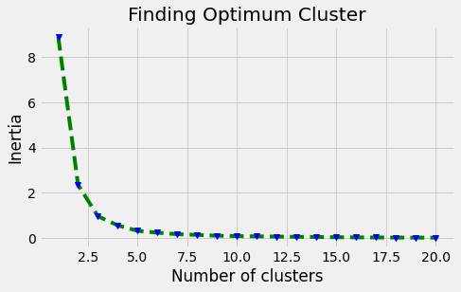
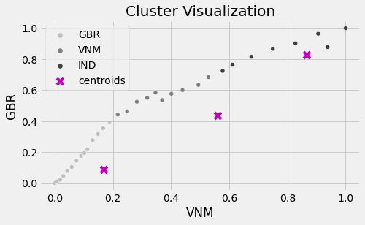
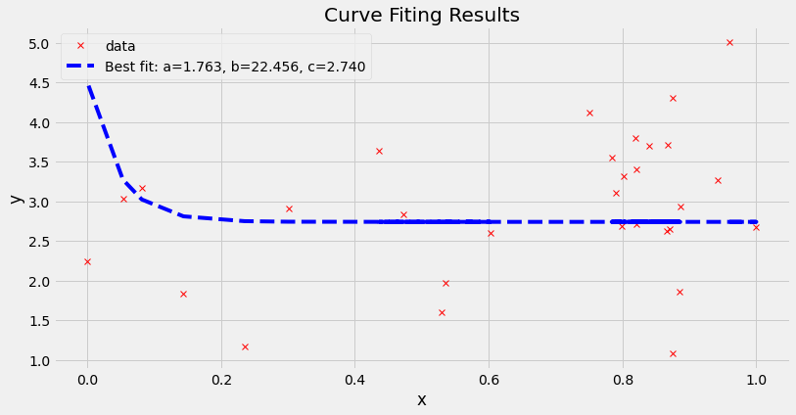
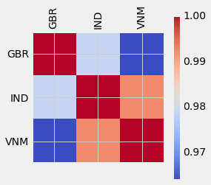
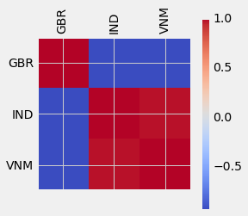
CO2 Emission and GDP Per Capita
Introduction and Aim
The emission of CO2 is the result of the usability of the fuels for industry and household purposes. The GPP per capita is the measure of the output of a country per person. It means the total revenue of the country is divided by the number of people living there to calculate GDP Per capita. As the major part of a country’s income come from industries, so a large number of fuels are consumed there to produce power. So, if the number of people in a country will be higher, certainly, the emission of CO2 will be higher. In this project, the relationship of the emission of CO2 with the GDP per capita to understand the growth of a country and the pollution factors.
Technology and Background
The collected data has been analyzed and the analytics have been applied there to get insights of the indicators which have been selected. In this context, the below-mentioned technologies have been applied:
Correlation
Normalization
Clustering
Curve Fitting
Data Analysis
The analyses have been done on both data to understand the progress of CO2 Emissions and GDP Per Capita for the selected countries. It has been seen that the highest CO2 emission has been seen for India whereas the highest growth of GDP Per Capital has been seen for Great Britain.
Data Collection
The data has been collected from World Back concerning the GPP per capita and CO2 Emissions for three countries namely India, Vietnam and Great Britain. To collect the data, two docstrings have been used which are as follows:
NY.GDP.PCAP.PP.CD for GDP Per Capita
EN.ATM.CO2E.KT for CO2 Emission
The respective data are shown below:
GDP Per Capita Data CO2 Emission Data
Result of Clustering
Clustering has been to visualize the statistics of countries for GDP Per Capita. The clustering has been done using K-Means algorithms after normalizing the data. The pipeline is shown below:
Normalization
K-Value Selection
Clustering
Relationship of GDP Per Capita with CO2 Emission
To understand the relationship of GDP Per Capita with CO2 Emission for three selected countries, Correlation has been applied and the heatmaps have been produced which are shown below:
GDP Per Capita Data CO2 Emission Data
Curve Fitting
The error range has been used between 1 to 5 on the CO2 Emission data and the curve fitting has been used. It is widely used to determine the relationship of the predictors in a data. Hence, this has been applied here to determine the country’s relationship for CO2 emission. The result of curve fitting is shown below:
References
Ren, H., Guo, J. & Sun, L., 2018. Prediction Algorithm Based on Weather Forecast for Energy-Harvesting Wireless Sensor Networks. 17th IEEE International Conference On Trust, Security And Privacy In Computing And Communications, pp. 1785-1790.
Rivero, C. R., Tupac, Y. & Pucheta, J., 2017. Time-series prediction with BEMCA approach: Application to short rainfall series. IEEE Latin American Conference on Computational Intelligence (LA-CCI), pp. 1-6.
Singh, B. K., Bisen, T. & Kharayat, S., 2018. Disease Manifestation Prediction from Weather Data Using Extreme Learning Machine. 3rd International Conference On Internet of Things: Smart Innovation and Usages (IoT-SIU), pp. 1-6.

