Slide 1







ENERVISION
Empowering Smart Energy Insights

Slide 2


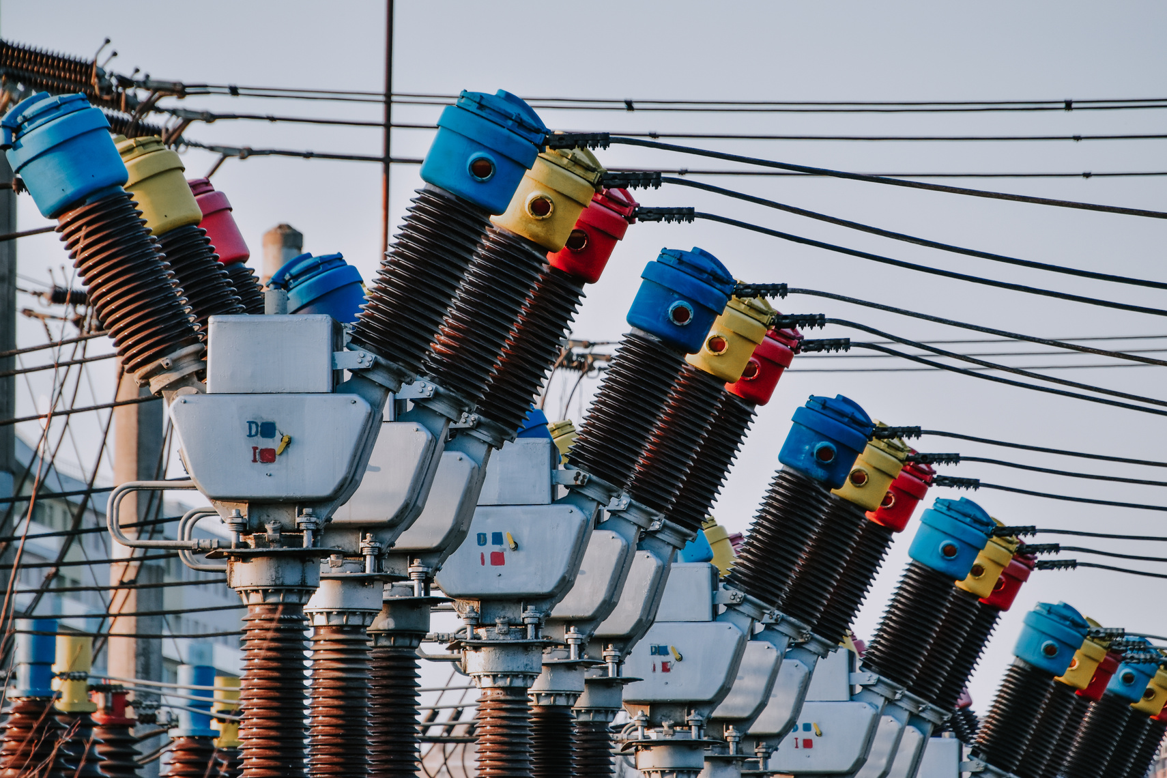
ABOUT
ENERVISION
EnerVision blends IoT sensors and 95%-accurate AI to transform energy monitoring and optimization. With energy costs rising and India’s demand growing 4.2% annually, we deliver continuous insights far beyond traditional audits.
Organizations achieve 20–25% Energy savings and up to 25% carbon reduction. Our proven prototype and strong multi-sector validation position us to lead India’s ₹10,000 crore market.
Backed by deep expertise in IoT, AI, and energy engineering, EnerVision turns energy use into strategic advantage.

Slide 3





WHAT WE OFFER
EnerVision goes beyond monitoring by using IoT sensors and AI to analyze real-time data every 6 seconds and deliver prescriptive, context-aware recommendations.
ALWAYS
1
Our system identifies issues like HVAC zones consuming 22% extra power, traces root causes using weather, occupancy, and equipment history, and suggests the most cost-effective fix.
2
We also integrate sustainability metrics—carbon reduction, ESG reporting, and renewable planning—bringing operational efficiency and environmental impact into one platform.
3

Slide 4

Features
REAL-TIME ENERGY MONITORING
"See your energy, save your costs—live, anytime, anywhere."
AI-DRIVEN PREDICTIVE ANALYTICS
SUSTAINABILITY AND CARBON FOOTPRINT REPORTING
"Smart insights today for a sustainable, cost- efficient tomorrow."
CUSTOMIZED ENERGY EFFICIENCY SOLUTIONS
"Track, reduce, and thrive with eco-friendly energy practices."
“Tailored strategies to power efficiency and cut waste."

Slide 5
ENERVISON
CORE EFFICIENCY SERVICES
1
REAL TIME ENERGY MONITORING
Provides deep real-time visibility into power patterns, peak loads, and appliance behavior, enabling quick detection of abnormalities.
Uses AI-driven forecasting to predict consumption trends, optimize usage, and reduce operational energy costs.
2
AI POWERED PREDICTIVE ANALYSIS
APPLIANCE LEVEL CONSUMPTION ANALYSIS
3

Slide 6
ENERVISION
ENERGY DRIVEN SERVICES
ENERGY EFFICIENCY RECOMMENDATION
1
Provides precise energy-efficiency recommendations, identifies major loss points, and calculates real-time carbon footprint with carbon-credit readiness for sustainability reporting.
Integrates architectural design analysis to optimize building layout, airflow, equipment positioning, and sensor placement—reducing power losses and improving long-term energy performance.
CARBON FOOTPRINT AND CARBON CREDIT REPORTING
2
ARCHITECTURAL DESIGN ANALYSIS FOR ENERGY OPTIMIZATIO
3

Slide 7

WE PROVIDE TO
MARKETPLACE
CUSTOMER SEGEMENT
2M
600M
43%
Sq.ft
India’s 1.5M schools and 39k colleges spend ₹50L–₹2Cr annually on energy, making them a high-impact segment for savings.
Commercial office spaces consume massive power for 24/7 operations, representing a fast-growing ₹5,000 crore market.
Industries like textiles, pharma, and automotive consume 40% of India’s industrial energy—where even 2–3% savings shift profitability.

Slide 8

MARKET SIZE
Total Addressable Market (TAM):
$5 billion (~₹40,000 crores) by 2030.
Represents the entire global market for energy auditing systems across industries like manufacturing, healthcare, education, retail, and commercial offices.
TAM
5 Billion USD
by 2030
SAM
5% of TAM 1.5
Billion USD
Serviceable Available Market (SAM):
$1.2 billion (~₹10,000 crores) by 2030.
Focuses on the Indian energy management .
SOM
10% Share of SAM 200Million USD
Serviceable Obtainable Market (SOM):
$60 million (~₹500 crores).
Represents 5% of the SAM, achievable by Enervision within 2–3 years, accounting for competition, scalability, and operational capabilities.

Slide 9

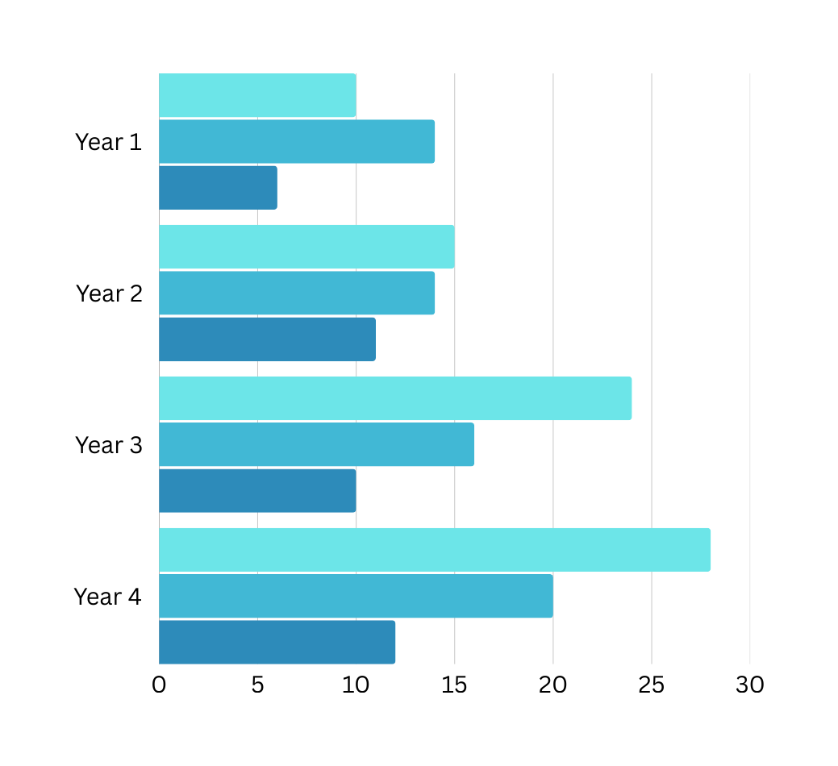
IMPACT
FLOW CHART
Every 1% reduction in annual energy usage results in 2–3% reduction in long-term operational cost, due to compounding savings, reduced maintenance, and lower peak-time penalties.
Buildings that adopt smart energy monitoring report 15–25% reduction in electricity consumption within the first year, based on global facility-management benchmarks.
Predictive maintenance driven by energy analytics reduces equipment failure by 30–40%, increasing lifespan of HVAC systems and industrial machinery by up to 5–7 years.
Improved power factor and optimized load balancing can save 8–12% in monthly bills—especially in commercial and industrial environments.
Carbon footprint reduction typically scales as 0.82 kg of CO₂ per kWh saved, meaning a building saving just 50,000 kWh/year avoids ~41 tons of CO₂, making it eligible for multiple carbon-credit schemes.
Over 5 years, cumulative savings can reach 60–70% of a building’s annual electricity budget, once compounding, efficiency upgrades, and reduced downtime are factored in.

Slide 10

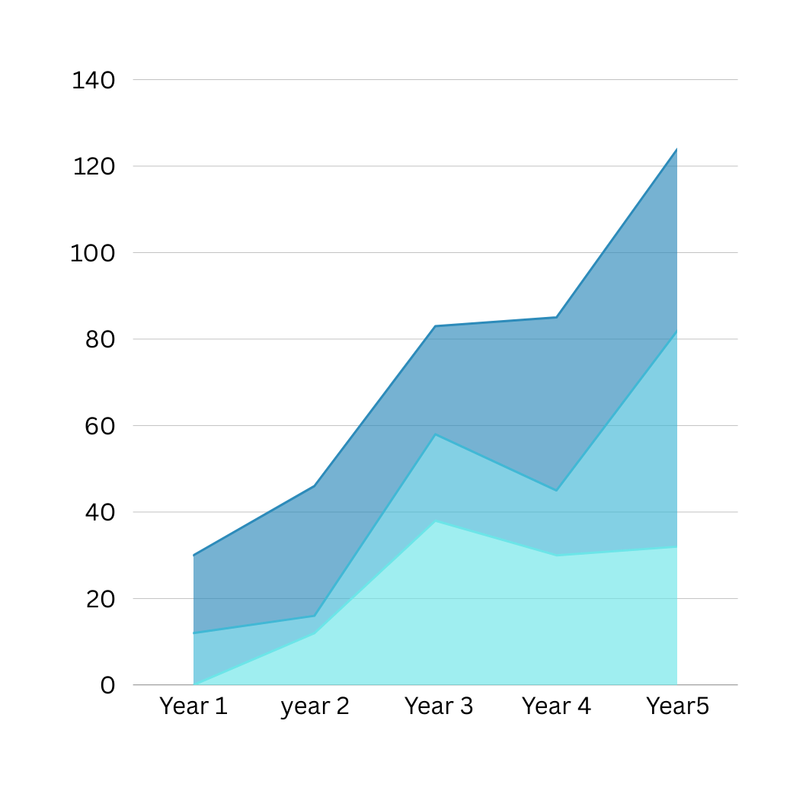
ENERGY SAVING
Immediate reduction as the system identifies and fixes wastage in lighting, HVAC, and machinery within weeks.
AI-driven optimization improves monthly, learning usage patterns to steadily increase savings.
Predictive maintenance prevents energy-heavy equipment failures, reducing overconsumption long-term.
Architectural & operational improvements refine sensor placement and building flow for deeper efficiency gains.
Compounding savings accumulate year after year, cutting total energy costs by 50–70% over 5–10 years.

Slide 11

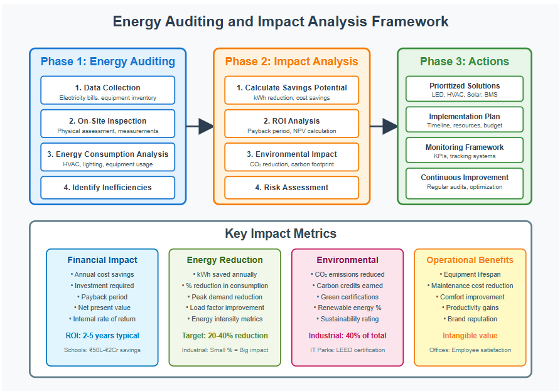

Slide 12

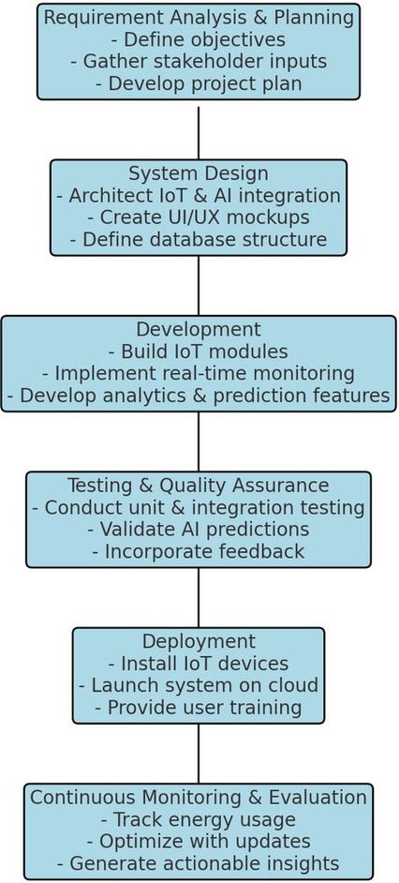
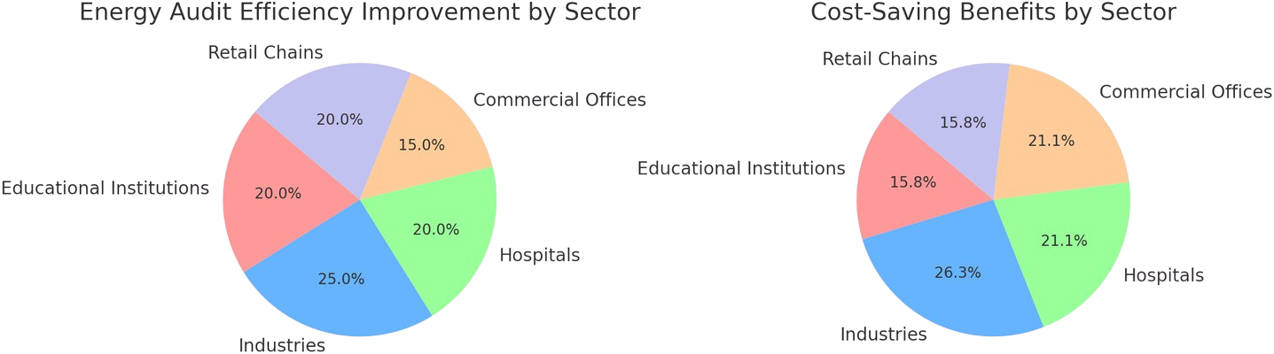
ENERVISION
UNIQUNESS
Full-Stack Energy Intelligence + Architectural Design Analysis: EnerVision goes beyond monitoring by combining real-time IoT sensing, predictive AI, and architectural design analysis to identify structural inefficiencies (lighting layout issues, HVAC zoning flaws, load distribution errors) and provide actionable redesign recommendations that boost building-level efficiency.
Maximum Savings With Predictive Optimization: Our platform delivers 20–25% energy reduction using continuous monitoring, instant anomaly detection, equipment-health prediction, and sector-specific optimization—doubling the impact of traditional audits while remaining easier and more customizable than global solutions like Google EMS.
Integrated Sustainability + Carbon Credit Generation: EnerVision automatically tracks carbon footprint, measures emission reductions, and converts verified savings into tradable carbon credits, unlocking new revenue streams while ensuring ESG compliance, sustainability reporting, and alignment with global climate frameworks.

Slide 13
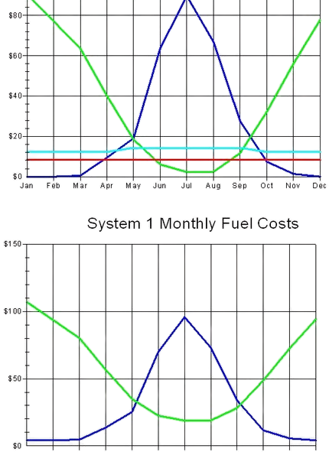
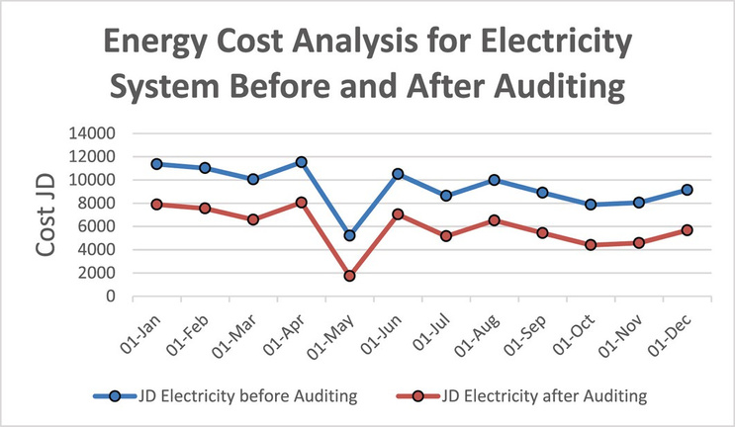
ENERVISION
TECHNICAL STACK
Leverages sensors to track energy consumption in lighting, HVAC systems, and machinery, allowing for the prompt detection and rectification of inefficiencies.
Utilizes sophisticated machine learning algorithms to identify usage patterns, flag irregularities, and forecast energy requirements with a high degree of precision (95% accuracy).
Ensures seamless data storage and processing on a centralized platform, offering scalable and real-time access to energy analytics,protecting through encryptions.
User-friendly interface provides live updates, alerts, and actionable insights for efficient resource management.

Slide 14
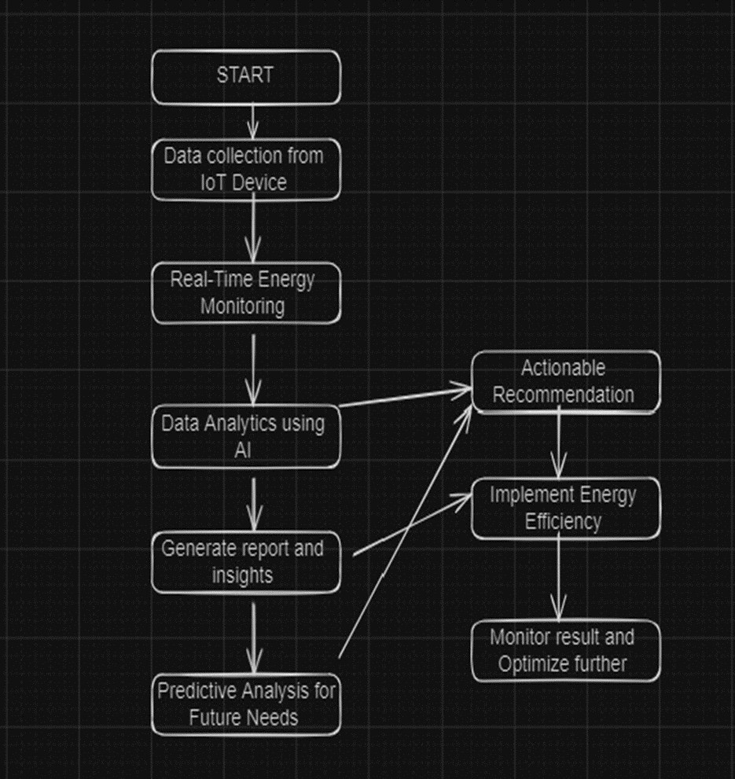
ENERVISION
WORK FLOW
TECHNOLOGY
IoT sensors track real-time energy usage across all systems with encrypted data flow.
AI detects inefficiencies, predicts demand with high accuracy, and flags anomalies instantly.
Automated reports deliver insights, appliance-level breakdowns, and carbon credit generation data.
Actionable recommendations optimize usage, reduce costs, and continuously improve performance.

Slide 15
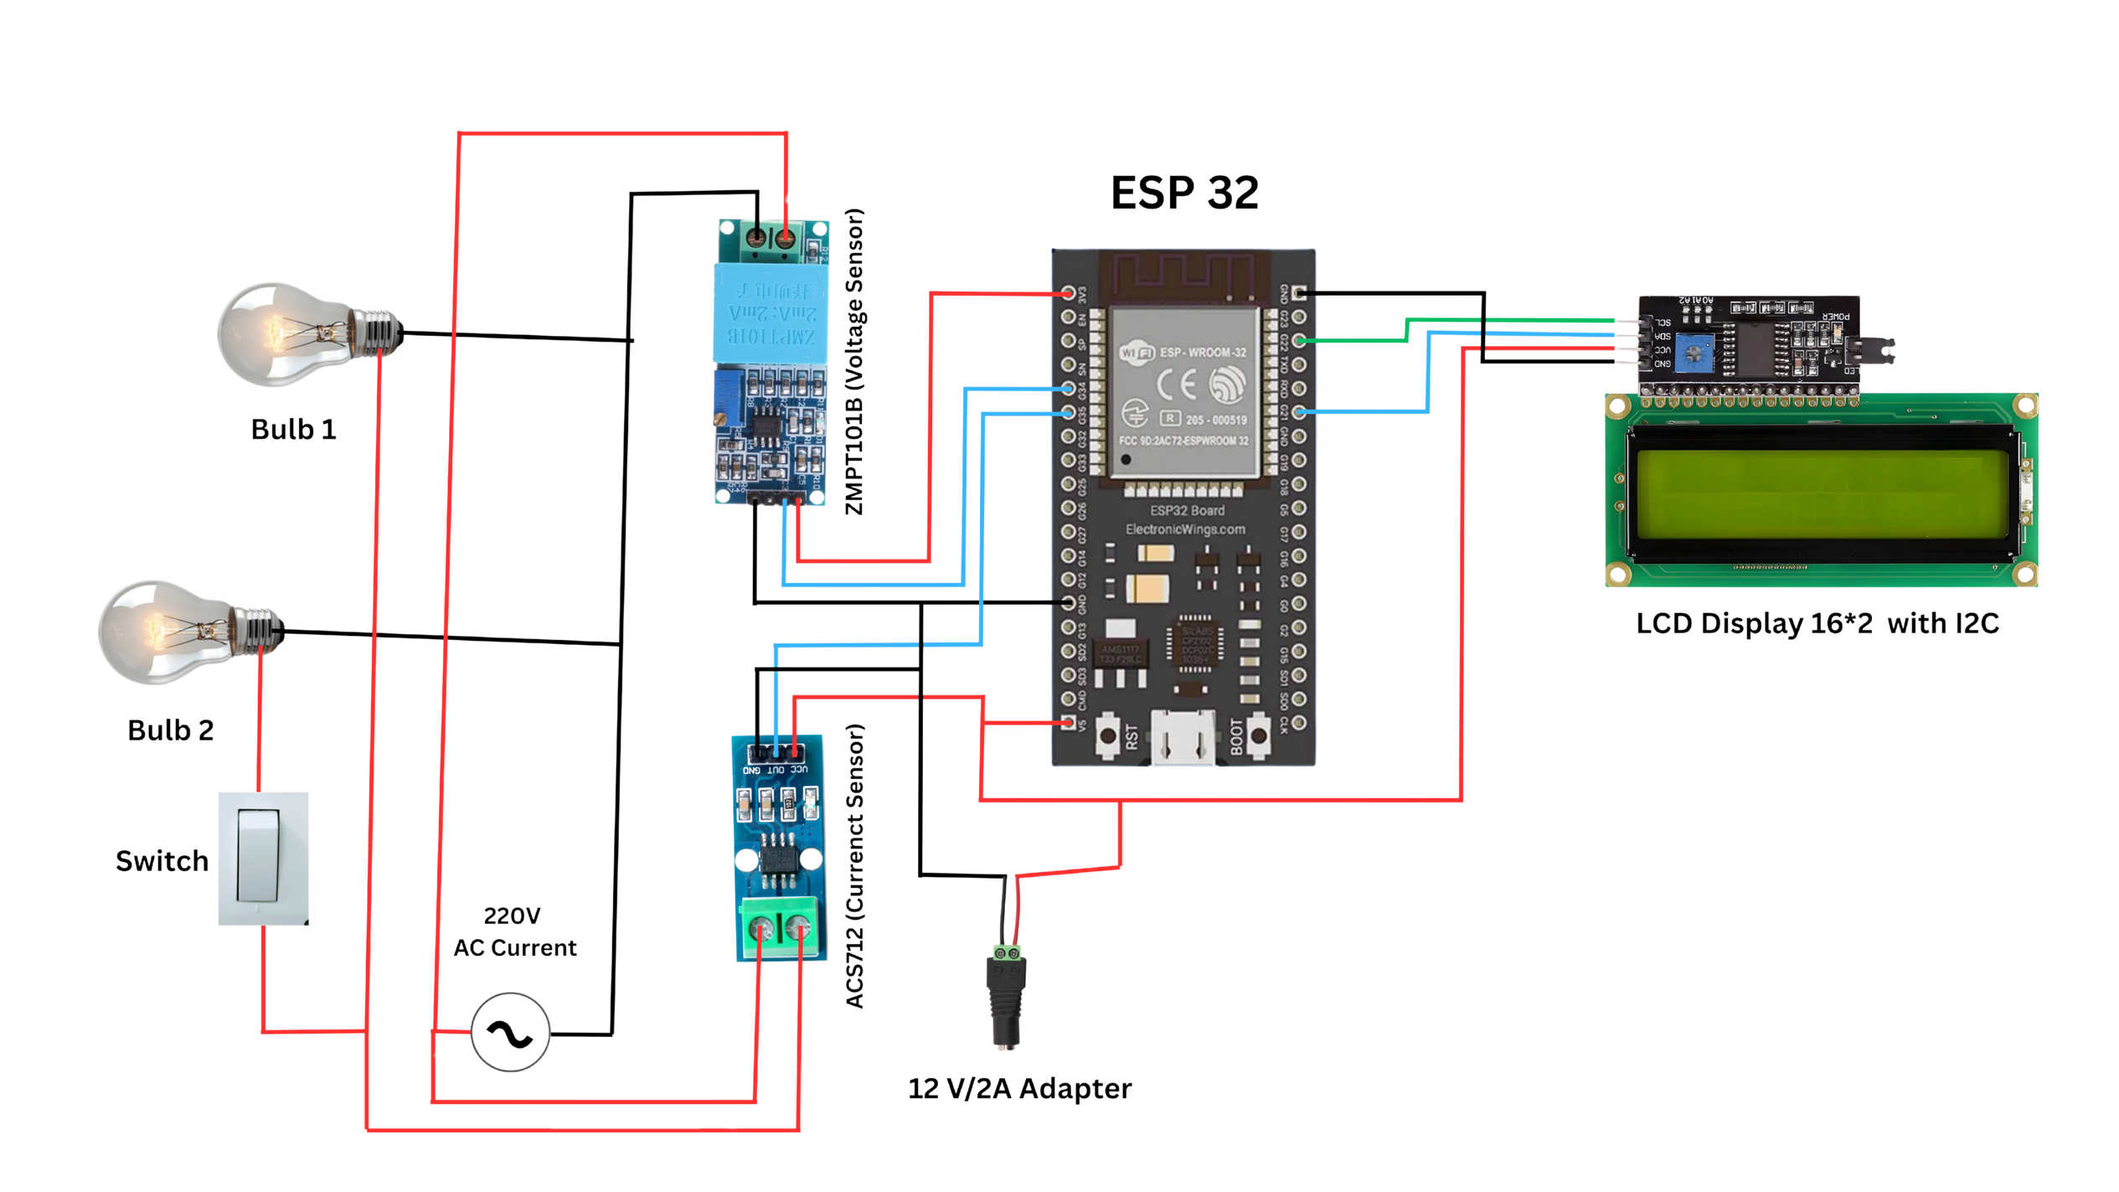
ENERVISION IOT - CIRCUIT DIAGRAM

Slide 16
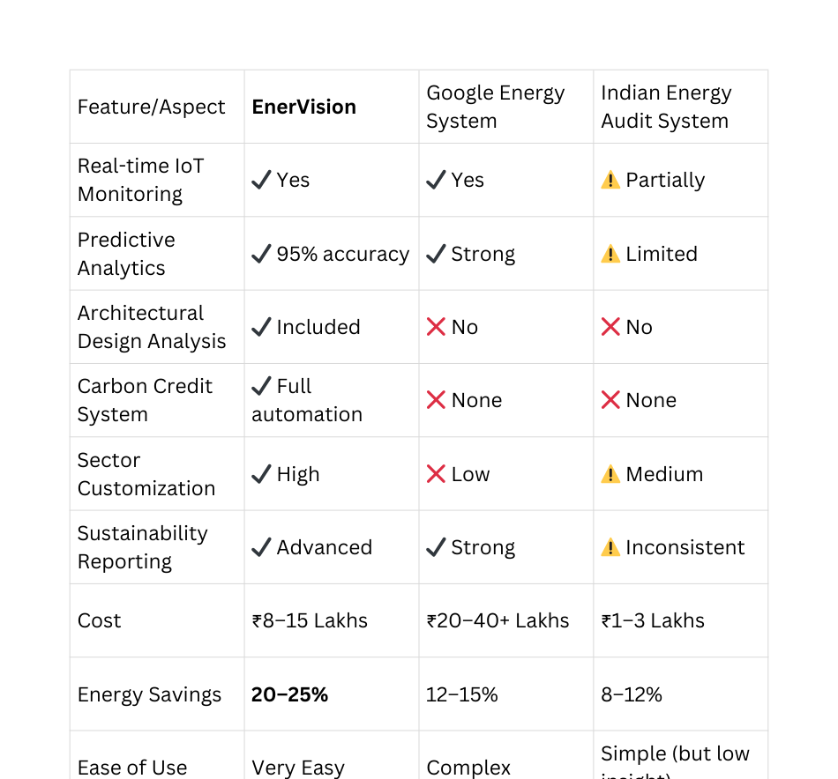
ENERVISION
COMPETITION
Global tools like Schneider EcoStruxure & Siemens Desigo focus on large enterprises, while EnerVision targets mid-size to enterprise with faster deployment and lower setup cost.
Most competitors offer only monitoring dashboards, whereas EnerVision integrates AI prediction, peak-hour intelligence, and appliance-level analytics in one unified platform.
Traditional energy audit firms perform manual, periodic audits; EnerVision provides real-time, automated, continuous auditing with AI-driven insights.
Competitors lack architectural design analysis, while EnerVision identifies building-level structural inefficiencies (HVAC layout issues, load design, lighting zoning).
Very few platforms support carbon credit tracking & generation, making EnerVision one of the only systems offering energy optimization + new revenue stream creation.

Slide 17
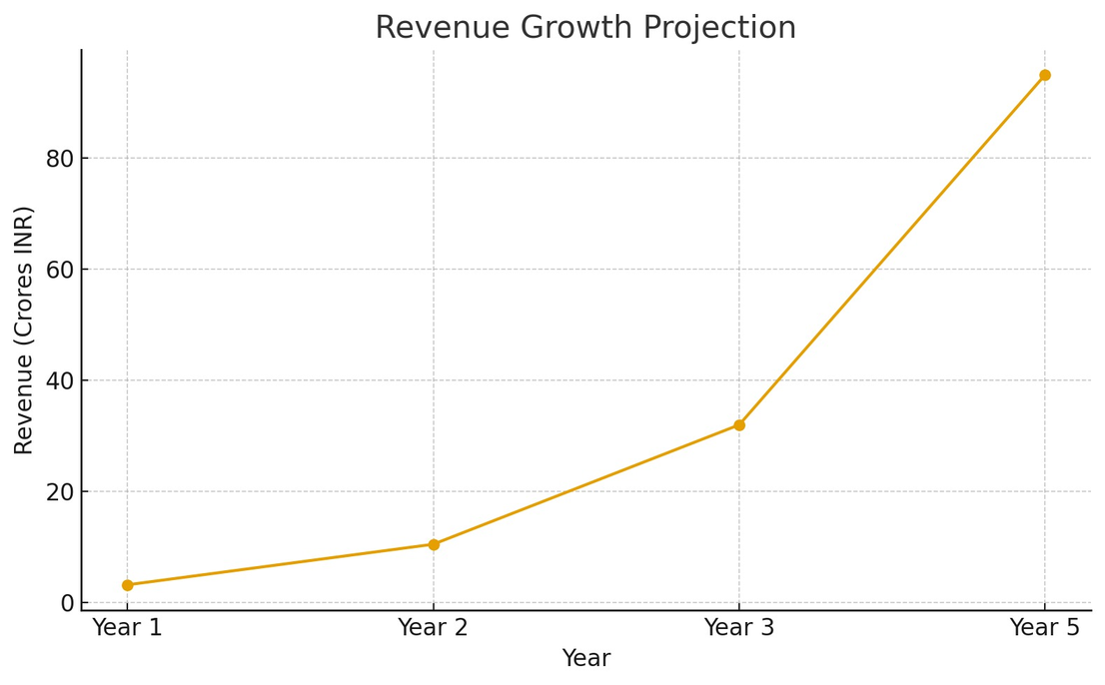
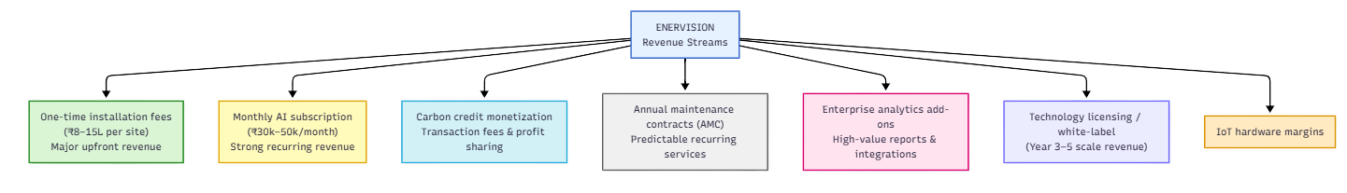
ENERVISION
REVENUE STREAM
Year 1: 25 installations generating ₹3.2 crores revenue; EBITDA ₹40 lakhs (12.5%), proving business model viability and achieving cash-flow break-even by Q4.
Year 2: Scale to 75 installations and ₹10.5 crores revenue; EBITDA jumps to ₹3.3 crores (31%), demonstrating strong operating leverage and predictable subscription growth.
Year 3: 200+ installations delivering ₹32 crores revenue and ₹14 crores EBITDA (44%), supported by multi-city expansion and recurring subscription compounding.
Year 5: Over 600 installations with ₹95 crores revenue, recurring revenue reaching 40% (₹38 crores), and EBITDA stabilizing at 48–50%, indicating a highly scalable and profitable model.
Projections assume 60% retention, but actual expected 85%+ retention would accelerate growth further due to high switching costs and ongoing value delivery.

Slide 18
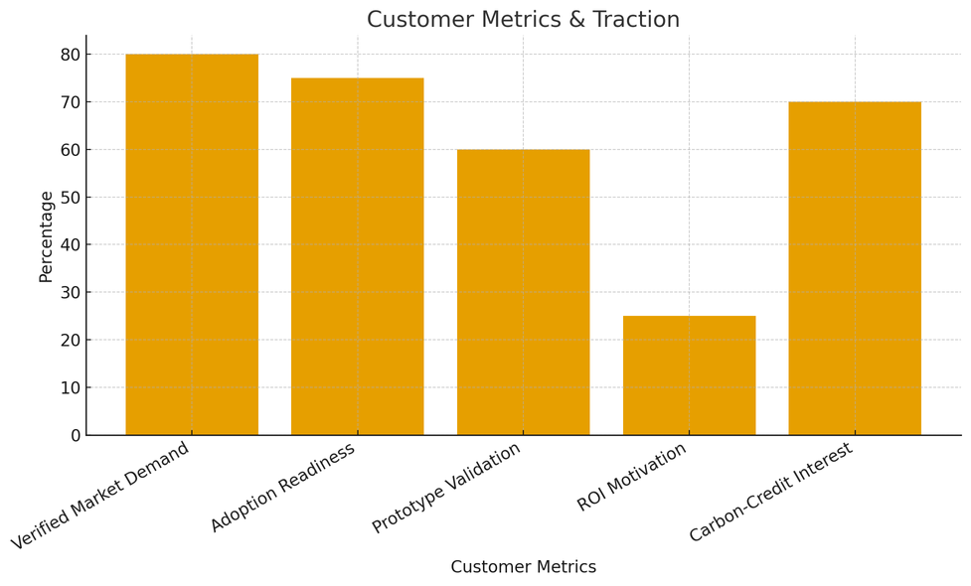
ENERVISION
TRACTION
Verified Market Demand (Survey-Based): Over 80% of surveyed institutions and industries reported significant energy wastage, lack of real-time visibility, and high interest in continuous auditing solutions like EnerVision.
High Adoption Readiness: 3 out of 4 decision-makers (principals, facility managers, industrial supervisors) expressed willingness to implement EnerVision once full deployment is available—showing strong pre-market pull.
Prototype Validation: Initial prototype testing confirmed EnerVision’s ability to capture live energy data, flag anomalies, and generate actionable insights, validating technical feasibility and system reliability.
ROI-Driven Customer Motivation: Survey responses show customers are ready to adopt if they can achieve 15–25% yearly savings, with most expecting 6–12 months ROI, confirming strong economic motivation.
Carbon-Credit Advantage as a Differentiator : 70% of surveyed customers showed high interest in EnerVision’s carbon tracking and future carbon-credit generation, identifying it as a key value-add over traditional audits.

Slide 19
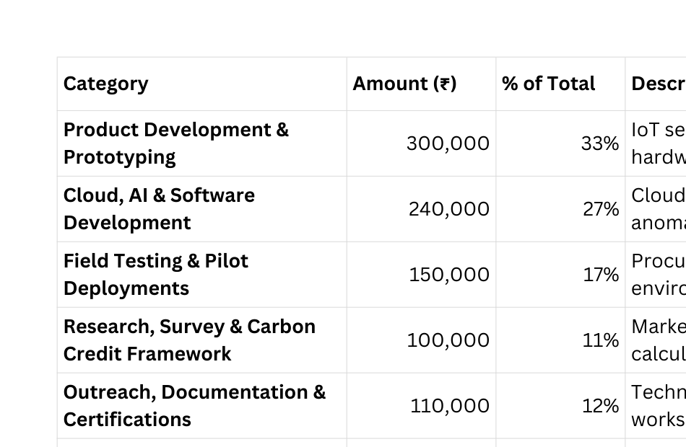
ENERVISION
RESOURCE MOBILIZATION

Slide 20
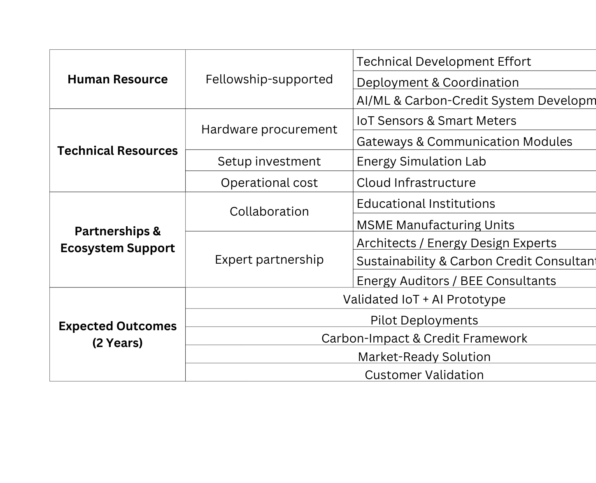
ENERVISION
RESOURCE MOBILIZATION

Slide 21
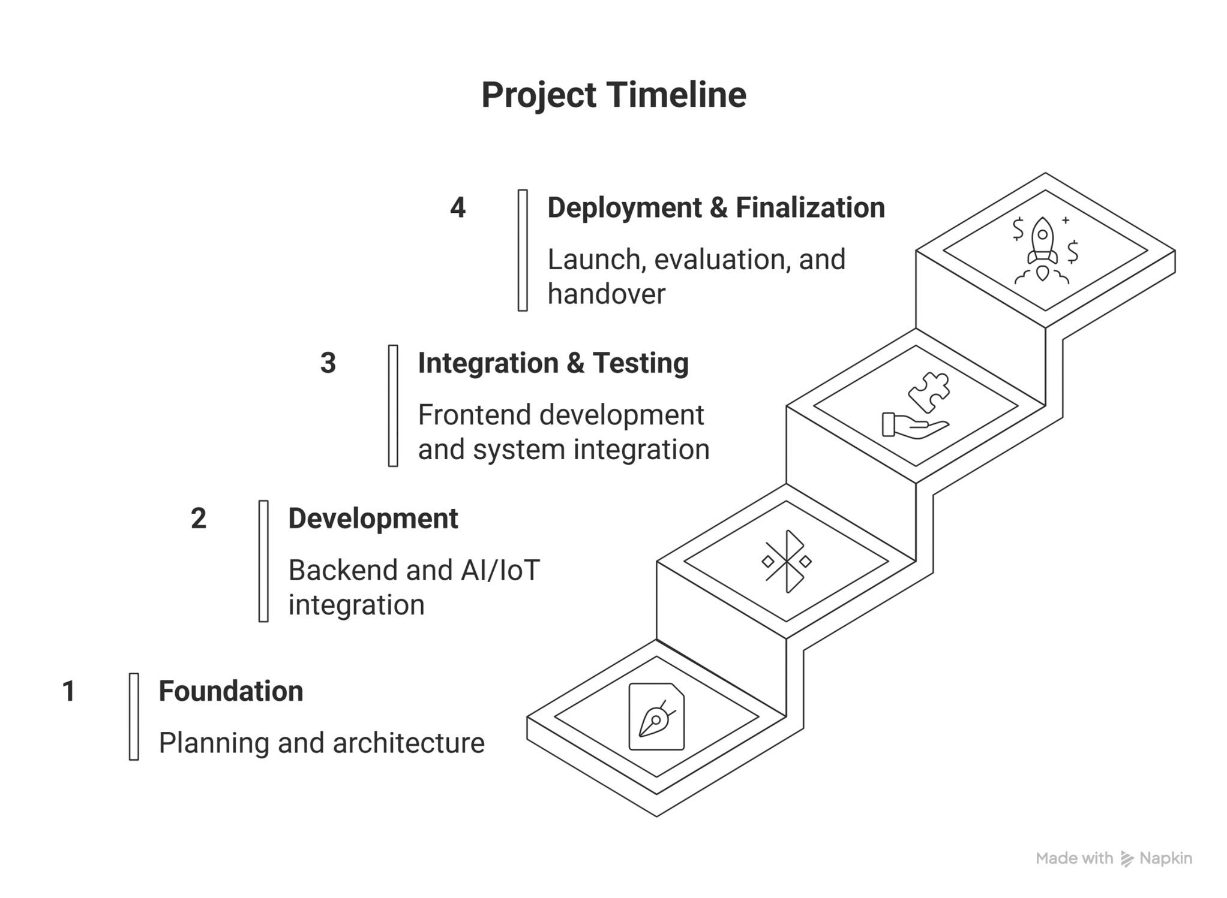
ENERVISION
WAY FORWARD STRATEGY

Slide 22




MEET OUR
TEAM MEMBERS
Bhuvanesh Ganapathi
Master of Computer Application
PSGCAS
Tharun Vaibhav S S
Master of Computer Application
PSGCAS
Prateepan MS
Bachelor of Computer Application
PSGCAS

Slide 23

THANK YOU

