Slide 1
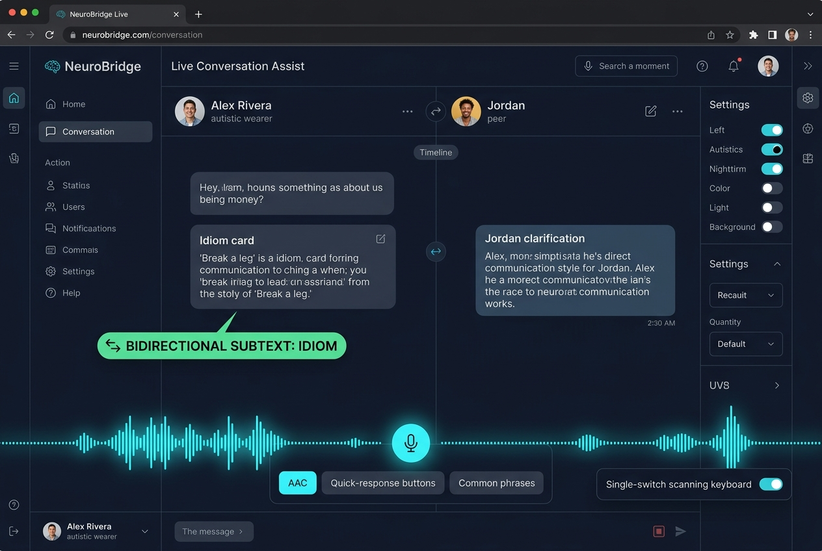
Team NeuroBridge
HACK2HEAL
2.0 • 2026
Hack2Heal 2.0 • Global Healthcare Hackathon
NEUROBRIDGE: LifeConnect & SocialOrbit
Wearer-Controlled Multimodal Communication Bridge & Sovereign Safety Net Grounded in Double Empathy
TEAM DETAILS & TRACK
• Track: Digital Health • Assistive Medical Technology • AI
• Team Name – Team NeuroBridge
• Team Lead – [Your Name]
• Member 2 – [Team Member 2]
• Member 3 – [Team Member 3]
• Member 4 – [Team Member 4]
• Live Deployed URL: https://hack2health.vercel.app
@H2H Idea submission- Template 1

