Slide 1
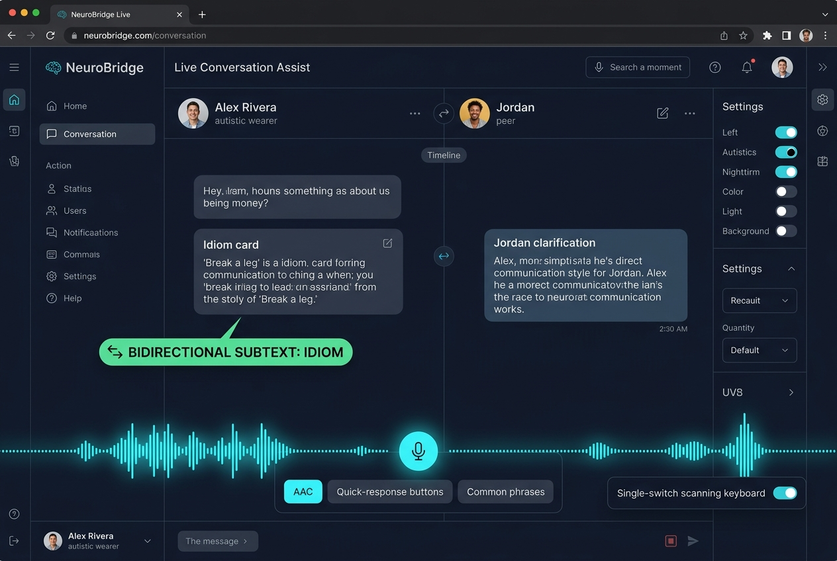
Hack2Heal 2.0 • Global Healthcare Hackathon
NEUROBRIDGE: LifeConnect & SocialOrbit
Wearer-Controlled Multimodal Communication Bridge & Sovereign Safety Net Grounded in Double Empathy
• Track: Digital Health & Assistive Medical Technology
• Team Name – Team NeuroBridge
• Team Lead – [Your Name]
• Member 2 – [Team Member 2]
• Member 3 – [Team Member 3]
• Member 4 – [Team Member 4]
• Live Prototype – https://hack2health.vercel.app

Slide 2
Team NeuroBridge
❖ Proposed Solution (Describe your Idea/Solution/Prototype)
H2H 2.0
1. Detailed Explanation of Proposed Solution
• Operationalizes Dr. Damian Milton's Double Empathy Problem into software.
• Bidirectional Subtext Translation: Translates neurotypical idioms/sarcasm for autistic wearers, while explaining autistic directness for peers.
• Multimodal Timeline Unification: Synthesizes Speech, Single-Switch Scanning, Quick-Chip AAC, and 3D Kinematic Stims into one real-time timeline.
• Sovereign Safety Net: On-demand GPS & Communication Passport dispatch.
2. How It Addresses the Healthcare Challenge
• Bridges 'The Social Cliff': Over 40% of autistic students transition from segregated K-12 settings to college/jobs with zero aides (NCES data).
• Overcomes Situational Mutism: In acute sensory overload, verbal speech shuts down; users communicate via switch scan or 3D stim gestures.
• Prevents Masking Burnout: Tactful Exit Cards normalize boundaries.
• Democratizes Access: Eliminates reliance on $7,000 proprietary AAC hardware.
3. Innovation and Uniqueness of the Solution
• Bidirectional vs. One-Way: Unlike Social Express (which forces masking), NeuroBridge educates both communication partners equally.
• Anti-Gaslighting Hostility Shield: Detects malicious insults and refuses to whitewash bullying as idioms, protecting against Rejection Dysphoria (RSD).
• Biomechanical Jitter Buffer: 800ms rolling filter eliminates resting false alarms.
LIVE SYSTEM CAPABILITY: Double Empathy Translation
• Tested utterance: 'Break a leg today!' -> Gemini 2.5 Flash clarifies benign idiom.
• Tested hostile utterance: 'Go break your leg, nobody likes you' -> System warns of hostile intent and offers Tactful Exit boundary.
Hack2Heal 2.0 Idea Template 2

Slide 3
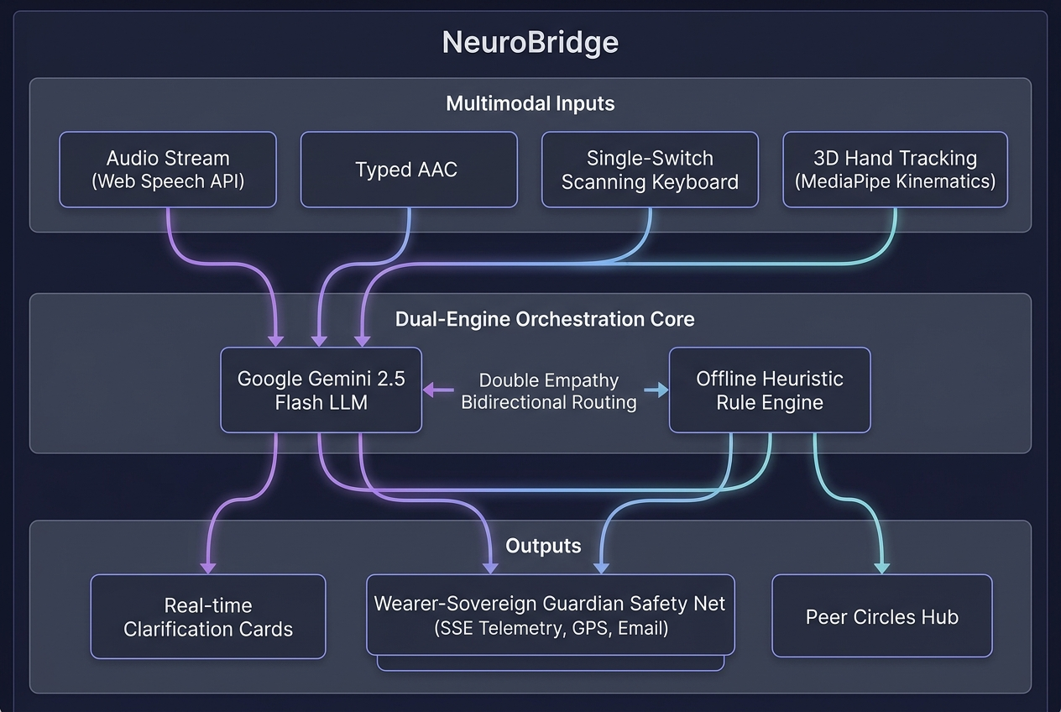
Team NeuroBridge
TECHNICAL APPROACH
H2H 2.0
• Technologies Used (Languages, Frameworks, Architecture)
• Frontend: React 19, Vite 8.3, Accessible Glassmorphism Design System.
• Backend: Node.js, Express.js REST API, Server-Sent Events (SSE) telemetry.
• AI/LLM Orchestration: Google Gemini 2.5 Flash with offline regex heuristics.
• Computer Vision: Google MediaPipe HandLandmarker (21 3D hand joints).
• Accessibility & Hardware APIs: Web Speech API, HTML5 Geolocation, DeviceMotion API (accelerometer G-force monitoring).
• Cloud Deployment: Vercel serverless edge deployment (https://hack2health.vercel.app).
• Methodology and Implementation Process
1. Multimodal Ingestion Layer: Unifies audio stream, single-switch scanning keyboard keystrokes, and MediaPipe landmark vectors into /api/analyze.
2. Biomechanical Jitter Buffer: 12-frame (~800ms) rolling window analyzes velocity & reversals; checks fingertip-wrist curl to eliminate resting hand false alarms.
3. Dual-Engine Core: Gemini 2.5 Flash analyzes pragmatic subtext; offline engine acts as high-speed zero-latency fallback during connectivity drops.
4. Sovereign Telemetry Pipeline: SSE stream dispatches GPS beacon & Communication ID only upon explicit wearer trigger (no 24/7 surveillance).
5. Verification Suite: 18 automated tests in test-suite.js validate live API contracts.
VERIFIED SYSTEM ARCHITECTURE
• Ingestion: 4 modalities -> Dual-Engine Core (Cloud Gemini + Local Heuristic) -> Output: Real-time Clarification Cards + Sovereign Guardian Dispatch.
• Self-Test Suite: 16 passing tests verified against live production.
Hack2Heal 2.0 Idea Template 3

Slide 4
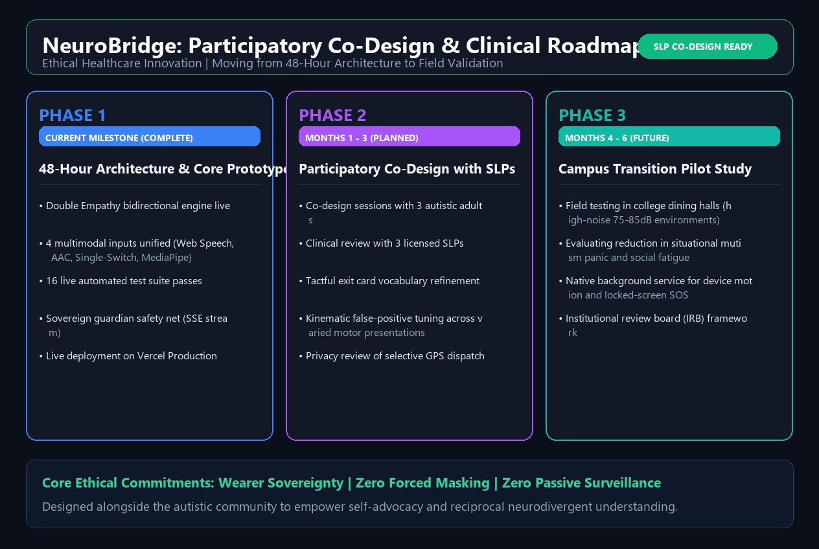
Team NeuroBridge
FEASIBILITY AND VIABILITY
H2H 2.0
• Analysis of the Feasibility of the Idea
• Zero Hardware Barrier: Operates in standard Chrome, Edge, and Safari browsers on existing student laptops and smartphones.
• Production Proven Today: Full-stack application is live and operational on Vercel at https://hack2health.vercel.app with Gemini LLM integration.
• Cost-Effective Infrastructure: Serverless execution scales dynamically with zero idle server overhead, costing <$0.01 per conversation.
• Potential Challenges and Technical Risks
• Acoustic Noise Challenge: High-decibel cafeteria background noise (75-85dB) can degrade browser speech recognition accuracy.
• Mobile OS Sensor Throttling: Android and iOS throttle background browser accelerometer APIs when the phone screen is locked.
• AAC Lexical Typos: Speech-language disfluency or fragmented typing ('neeeed a brek') bypasses simple regex rules.
3-PHASE CLINICAL SCALING ROADMAP
• Phase 1 (Complete): 48-hr Multimodal Architecture & Live Deployment.
• Phase 2 (Months 1-3): Participatory Co-Design with 3 autistic self-advocates & 3 licensed Speech-Language Pathologists (SLPs).
• Phase 3 (Months 4-6): Campus dining hall pilot study (IRB approved).
• Strategies for Overcoming These Challenges
• Multimodal Redundancy: When acoustic noise spikes on the Sensory Radar, wearers seamlessly switch to single-switch scanning or one-tap AAC chips.
• Native Packaging Roadmap: Packaging via Capacitor/React Native with an Android Foreground Service to maintain locked-screen fall monitoring.
• LLM Semantic Normalization: Gemini 2.5 Flash reconstructs fragmented words into clear, dignified intent without judging grammar.
Hack2Heal 2.0 Idea Template 4

Slide 5
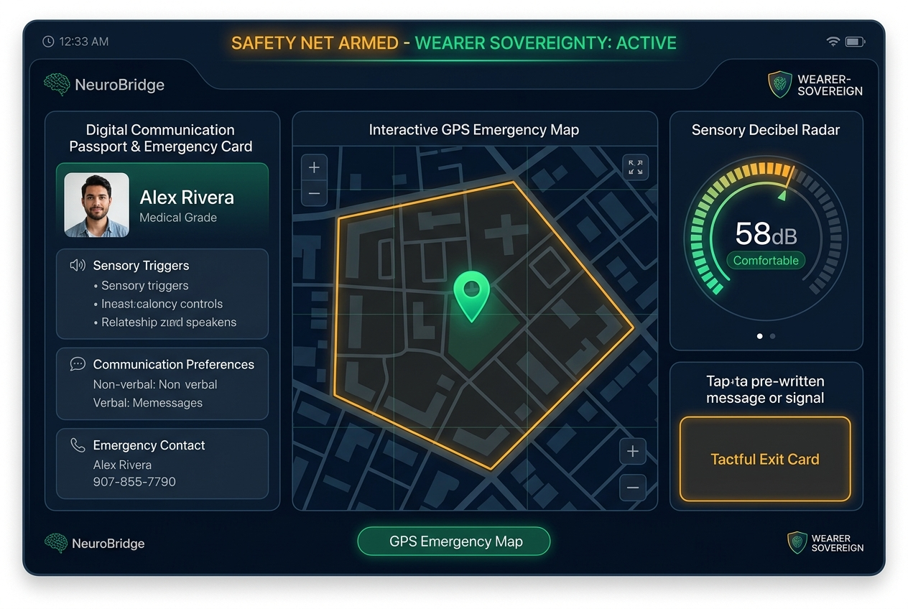
Team NeuroBridge
IMPACT AND BENEFITS
H2H 2.0
• Potential Impact on the Target Audience
• Focused Persona: Transitioning autistic youth and young adults (ages 14-24) entering higher education or early career employment.
• Eliminates The Social Cliff: Replaces the abrupt loss of 1:1 K-12 special education aides with an autonomous, dignified digital assistant.
• Mitigates Acute Situational Mutism: Gives wearers an instant voice during sensory shutdowns without relying on vocal speech.
• Reduces Mental Health Crises: Lowers rates of social exhaustion and chronic autistic burnout caused by continuous camouflage/masking.
• Quantified Benefits (Social, Economic, Clinical)
• Economic Benefit: Saves families & colleges $4,000 to $8,000 per user by eliminating proprietary dedicated AAC hardware in favor of browser software.
• Social Benefit: Promotes authentic peer inclusion through Parallel-Play virtual study rooms and Social Wingman passion matching with zero small-talk demands.
• Clinical Safety Benefit: Equips first responders and campus staff with instant medical sensory profiles via the Digital Communication Passport.
• Ethical Sovereignty: Zero 24/7 invasive surveillance; data dispatched only with wearer consent.
WEARER-SOVEREIGN SAFETY NET
• Real-Time Guardian Dashboard: Live GPS safe-perimeter map, 58dB acoustic decibel radar, and Digital Medical Passport.
• Instant Tactful Exit Card: Allows wearers to step away from high-stimulus sensory environments with dignity.
Hack2Heal 2.0 Idea Template 5

Slide 6
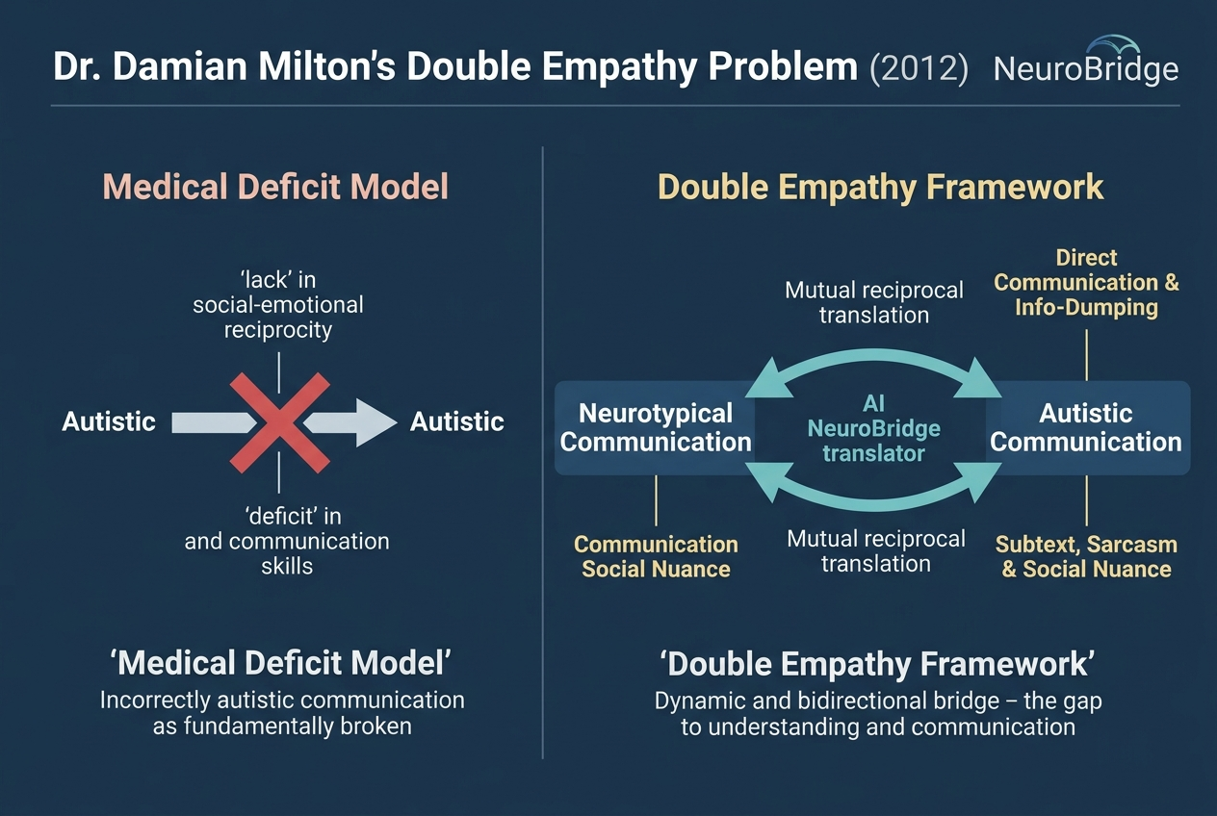
Team NeuroBridge
RESEARCH AND REFERENCES
H2H 2.0
• Peer-Reviewed Clinical & Scientific Literature
1. Milton, D. E. (2012). 'On the ontological status of autism: the double empathy problem.' Disability & Society, 27(6), 883-887. (Grounds our bidirectional translation engine).
2. U.S. Department of Education & NCES (2023-24). Digest of Education Statistics, Table 204.60 & IDEA Part B Section 618. (>40% of autistic students segregated in K-12).
3. Raymaker, D. M., et al. (2020). 'Defining Autistic Burnout: Having All of Your Internal Resources Exhausted.' Autism in Adulthood, 2(2), 132-143. (Informs Tactful Exit Cards).
4. Beardon, L. (2017). Autism and Normalcy. (Supports low-demand parallel play spaces).
• Technical Documentation & Verified Prototype Links
• Live Deployed Web Application: https://hack2health.vercel.app
• Mobile Guardian Telemetry Companion: https://hack2health.vercel.app/?view=guardian
• GitHub Codebase & Test Suite: https://github.com/tharunya0105-afk/hack2health
• Automated Test Suite: backend/test-suite.js (16 passed on live production)
• Video Demonstration Walkthrough: gallery/neurobridge_demo_video.mp4
• Computer Vision Framework: Google MediaPipe Vision HandLandmarker (Float16 Wasm).
THEORETICAL FOUNDATION: DOUBLE EMPATHY
• Paradigm Shift: Replaces the medical deficit model with a reciprocal two-way bridge.
• Ethics: NeuroBridge empowers autistic self-advocacy without demanding performative neurotypical masking.
Hack2Heal 2.0 Idea Template 6

