Slide 1


Inno-Vengers

Slide 2

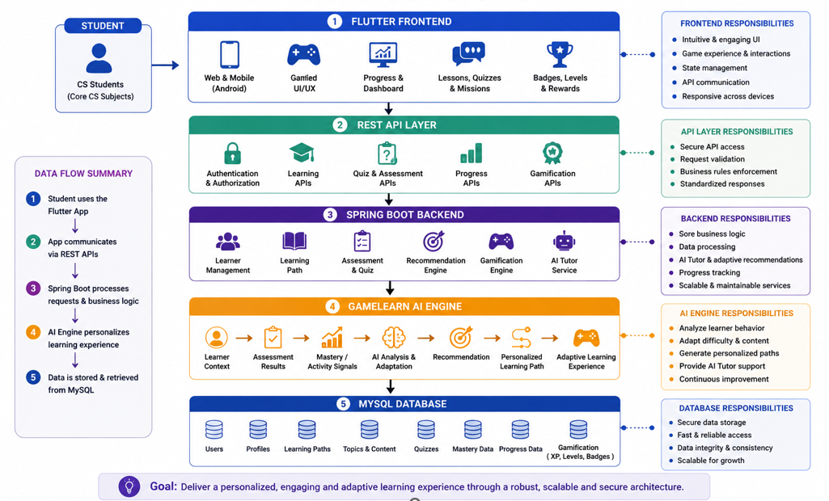
Inno-Vengers

Slide 3

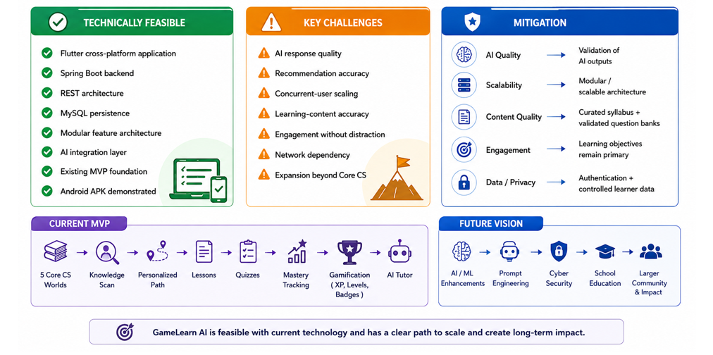
Inno-Vengers

Slide 4

Inno-Vengers

Slide 5
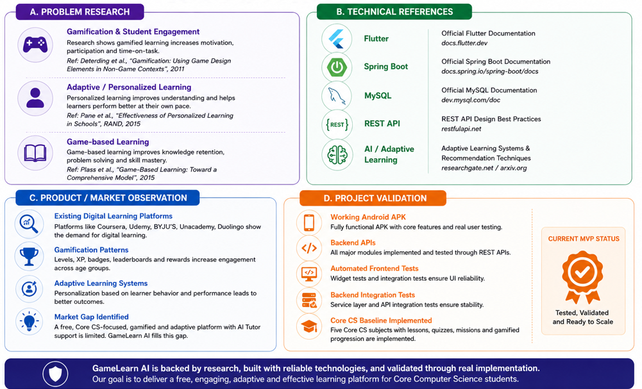
Inno-Vengers

