Slide 1
E-Commerce Customer Behavior Analysis
Data Science & Analytics Internship – Task 2
Dataset: E-commerce Customer Behavior
Focus: Revenue Drivers, Customer Segmentation & Business Insights

Slide 2
Business Objective
• Analyze customer purchase behavior
• Identify revenue drivers
• Perform feature engineering
• Generate actionable insights
• Support data-driven decisions

Slide 3
Dataset Overview
• 5000+ customer records
• Demographics: Age, Gender, City
• Behavioral metrics: Items Purchased, Rating
• Revenue variable: Total Spend
• Customer engagement indicators

Slide 4
Data Cleaning Process
• Removed duplicate records
• Checked missing values
• Outlier removal using IQR
• Standardized column naming

Slide 5
Feature Engineering
• Age Group segmentation
• High Value Customer flag
• Spend per Item calculation
• Rating Category classification

Slide 6
Correlation Analysis
• Examined numerical relationships
• Items Purchased strongly impacts revenue
• Rating moderately correlates with spending
• Identified key revenue drivers

Slide 7
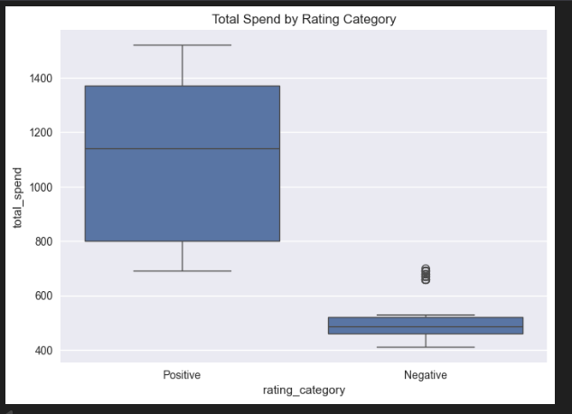
Total spend by rating category

Slide 8
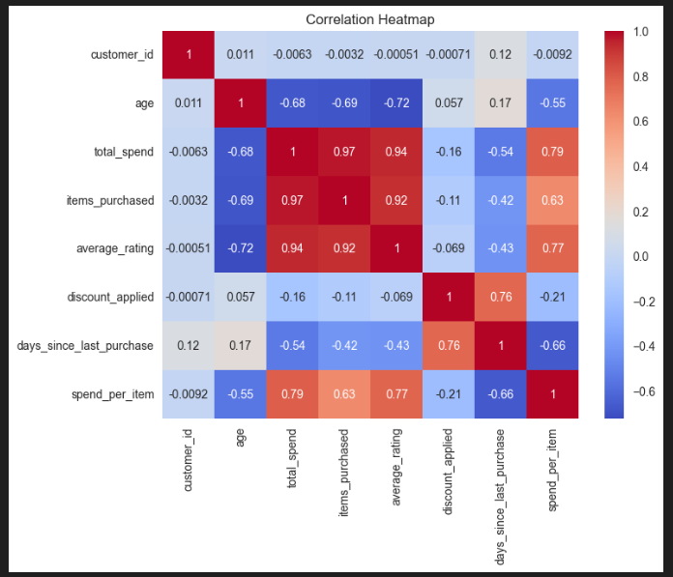
Correlation heatmap

Slide 9
Customer Segmentation Insights
• Premium members generate higher revenue
• Adult age group contributes most
• High-value customers dominate revenue share
• Spending varies across demographics

Slide 10
Revenue Analysis
• Revenue slightly right-skewed
• Certain cities generate more revenue
• Positive ratings linked to higher spend
• Recency affects spending behavior

Slide 11
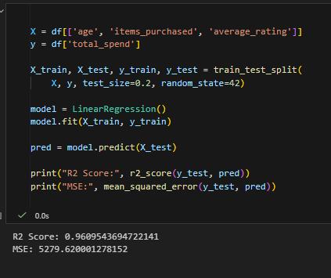
Predictive Modeling (Optional)
• Linear Regression applied
• Features: Age, Items Purchased, Rating
• Evaluated using R² and MSE
• Supports revenue forecasting

Slide 12
Key Business Insights
• Membership type impacts spending
• High-value customers should be prioritized
• Customer satisfaction affects revenue
• Age segmentation improves targeting

Slide 13
Business Recommendations
• Launch loyalty programs
• Improve low-rated services
• Target adult demographic
• Focus on customer retention
• Use predictive analytics for planning

Slide 14
Conclusion
Analysis uncovered key revenue drivers.
Data-driven strategies improve retention,
increase revenue, and optimize performance.

