Slide 1
Customer Segmentation & Business Performance Analysis
Data Science & Analytics Internship – Task 3
Submitted By: Sagar Tharu
Tools Used: Python, Pandas, Matplotlib, Seaborn, Scikit‑Learn

Slide 2
Introduction
Businesses collect large volumes of customer data from digital platforms.
Analyzing this data helps companies understand customer behavior, spending patterns, and churn risk.
Customer segmentation allows businesses to group customers with similar characteristics.
This project analyzes customer subscription and usage data using data science techniques.

Slide 3
Project Objective
Analyze customer usage and subscription data
Perform data cleaning and preprocessing
Apply clustering techniques for customer segmentation
Visualize customer behavior and business performance
Generate actionable business insights

Slide 4
Dataset Description
Dataset Name: Customer Subscription Churn Usage Patterns
Dataset Type: Customer Behavior & Subscription Data
File Used: customer_subscription_churn_usage_patterns.csv
Contains customer engagement, usage patterns, spending behavior and churn information.

Slide 5
Data Understanding
Checked dataset structure using df.info()
Analyzed dataset shape and number of records
Reviewed column data types
Identified missing values in dataset
Observed distribution of customer attributes.

Slide 6
Data Cleaning – Steps Performed
Handled missing values
Removed duplicate records
Converted data types where required
Standardized data format
Prepared dataset for analysis and clustering.

Slide 7
Exploratory Data Analysis (EDA)
EDA performed to understand:
Customer usage patterns
Spending behavior
Customer engagement levels
Relationship between usage and churn
Patterns useful for customer segmentation.

Slide 8
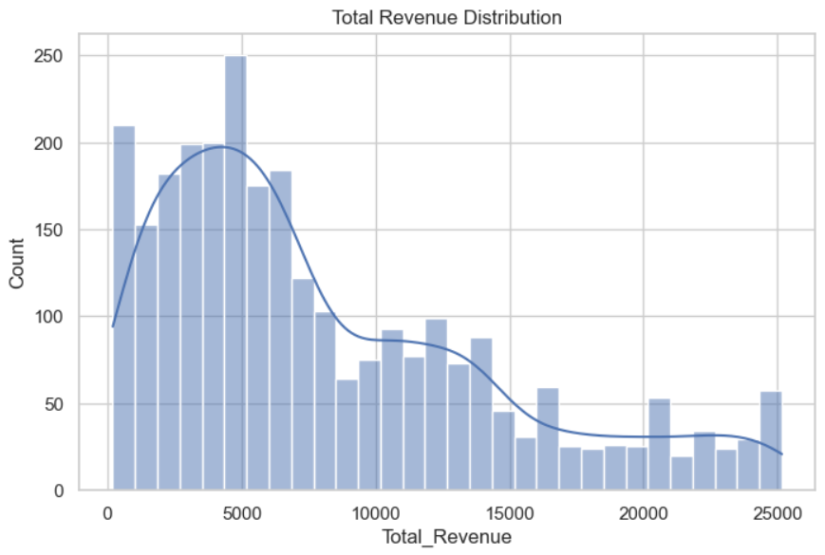
Total Revenue

Slide 9
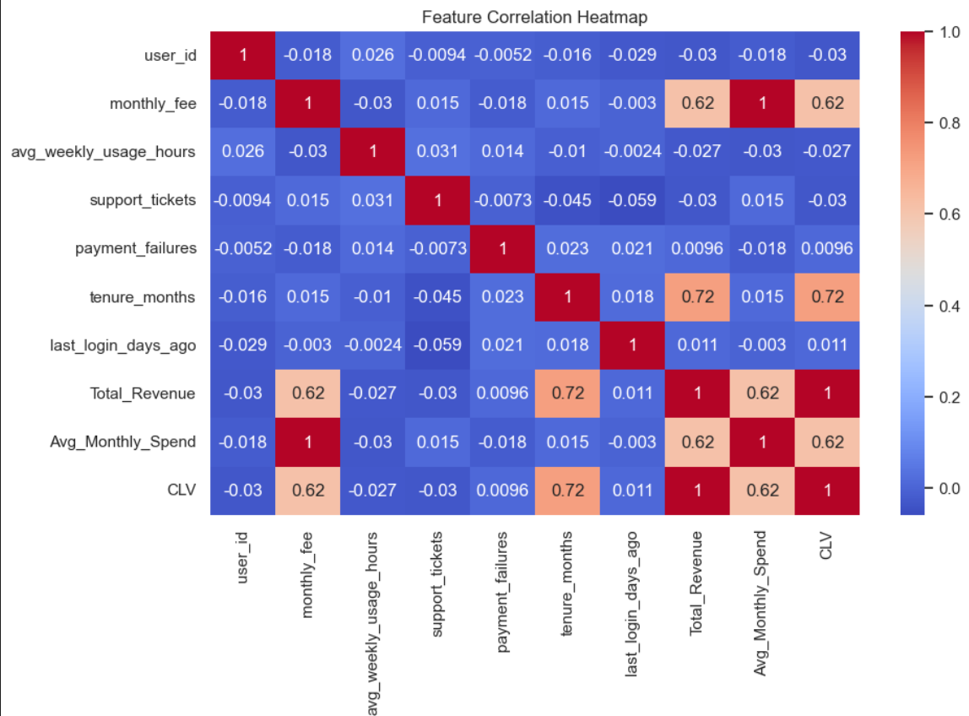
Feature Correlation Heatmap

Slide 10
Customer Segmentation (K-Means Clustering)
Applied StandardScaler for feature scaling
Used K-Means clustering algorithm
Grouped customers into different segments
Identified behavioral differences between clusters.

Slide 11
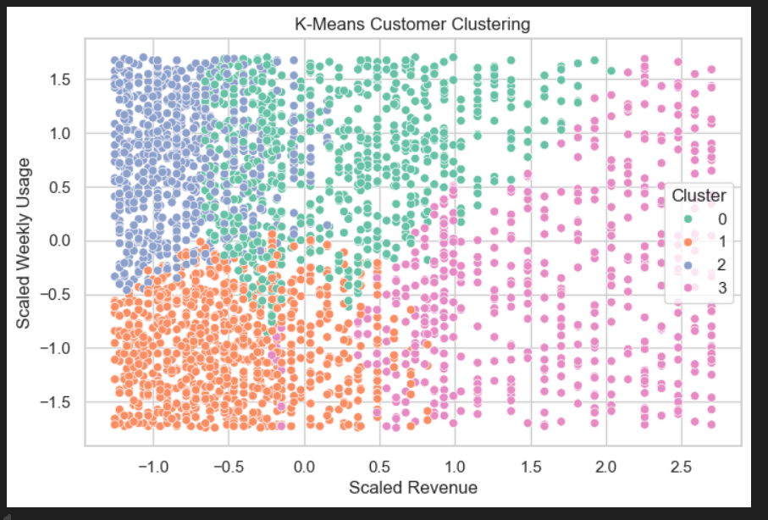
K-means customer clustering

Slide 12
Key Insights
Customers show different engagement and usage patterns
High usage customers tend to generate higher revenue
Low engagement customers show higher churn risk
Segmentation helps identify high-value customers.

Slide 13
Business Recommendations
Target high-value customers with loyalty programs
Improve engagement strategies for low-usage users
Reduce churn through personalized offers
Use segmentation for targeted marketing campaigns.

Slide 14
Conclusion & Tools Used
Tools Used:
Python
Pandas
Matplotlib
Seaborn
Scikit-learn
Jupyter Notebook
Conclusion:
Customer segmentation helps businesses understand user behavior and improve decision making.

