Slide 1
Candidate Key
Candidate keys are defined as the set of fields from which primary key can be selected. It is an attribute or set of attribute that can act as a primary key for a table to uniquely identify each record in that table.
ISBN
Title
AuName
AuPhone
PubName
PubPhone
Price
0-321-32132-1
Balloon
Sleepy, Snoopy, Grumpy
321-321-1111, 232-234-1234, 665-235-6532
Small House
714-000-0000
$34.00
0-55-123456-9
Main Street
Jones, Smith
123-333-3333, 654-223-3455
Small House
714-000-0000
$22.95
0-123-45678-0
Ulysses
Joyce
666-666-6666
Alpha Press
999-999-9999
$34.00
1-22-233700-0
Visual Basic
Roman
444-444-4444
Big House
123-456-7890
$25.00

Slide 2
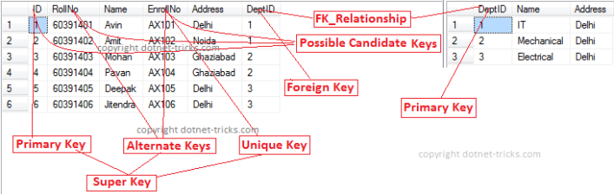
Super Key
Super Key is defined as a set of attributes within a table that uniquely identifies each record within a table. Super Key is a superset of Candidate key.

Slide 3
Primary Key
Primary key is a candidate key that is most appropriate to become main key of the table. It is a key that uniquely identify each record in a table.

Slide 4
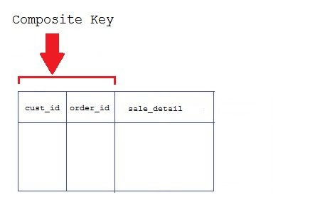
Composite Key
Key that consist of two or more attributes that uniquely identify an entity occurance is called Composite key. But any attribute that makes up the Composite key is not a simple key in its own.

Slide 5
Secondary or Alternative key
The candidate key which are not selected for primary key are known as secondary keys or alternative keys

Slide 6
Non-key Attribute
  Non-key attributes are attributes other than candidate key attributes in a table.
Non-prime Attribute
  Non-prime Attributes are attributes other than Primary attribute

Slide 7
Database Normalization

Slide 8
Definition
Normalization is the process of reorganizing data in a database so that it meets two basic requirements:
  (1) There is no redundancy of data
    (all data is stored in only one place), and
  (2) data dependencies are logical
    (all related data items are stored together).

Slide 9
Levels of Normalization
Levels of normalization based on the amount of redundancy in the database.
Various levels of normalization are:
  First Normal Form (1NF)
  Second Normal Form (2NF)
  Third Normal Form (3NF)
  Boyce-Codd Normal Form (BCNF)
  Fourth Normal Form (4NF)
  Fifth Normal Form (5NF)
  Domain Key Normal Form (DKNF)
Redundancy
Number of Tables
Complexity
Most databases should be 3NF or BCNF in order to avoid the database anomalies.

Slide 10
Levels of Normalization
1NF
2NF
3NF
4NF
5NF
DKNF
Each higher level is a subset of the lower level

Slide 11
First Normal Form (1NF)
A table is considered to be in 1NF if all the fields contain
only atomic values (as opposed to list of values).
Example (Not 1NF)
ISBN
Title
AuName
AuPhone
PubName
PubPhone
Price
0-321-32132-1
Balloon
Sleepy, Snoopy, Grumpy
321-321-1111, 232-234-1234, 665-235-6532
Small House
714-000-0000
$34.00
0-55-123456-9
Main Street
Jones, Smith
123-333-3333, 654-223-3455
Small House
714-000-0000
$22.95
0-123-45678-0
Ulysses
Joyce
666-666-6666
Alpha Press
999-999-9999
$34.00
1-22-233700-0
Visual Basic
Roman
444-444-4444
Big House
123-456-7890
$25.00
Author and AuPhone columns are not atomic(scalar)
Notes:
Having scalar values also means that all instances of a record type must contain the same number of fields.
A table not in first normal form is called un normalized

Slide 12
1NF - Decomposition
Place all items that appear in the repeating group in a new table
Designate a primary key for each new table produced.
Duplicate in the new table the primary key of the table from which the repeating group was extracted or vice versa.
Example (1NF)
ISBN
AuName
AuPhone
0-321-32132-1
Sleepy
321-321-1111
ISBN
Title
PubName
PubPhone
Price
0-321-32132-1
Snoopy
232-234-1234
0-321-32132-1
Balloon
Small House
714-000-0000
$34.00
0-321-32132-1
Grumpy
665-235-6532
0-55-123456-9
Main Street
Small House
714-000-0000
$22.95
0-55-123456-9
Jones
123-333-3333
0-123-45678-0
Ulysses
Alpha Press
999-999-9999
$34.00
0-55-123456-9
Smith
654-223-3455
1-22-233700-0
Visual Basic
Big House
123-456-7890
$25.00
0-123-45678-0
Joyce
666-666-6666
1-22-233700-0
Roman
444-444-4444
Notes:
1. The designated key will be the primary key of the original table concatenated with one or more data items from the new table.
For the first table the primary key is ISBN
For the second table the primary key is ISBN + Author Name

Slide 13
Functional Dependencies
If one set of attributes in a table determines another set of attributes in the table, then the second set of attributes is said to be functionally dependent on the first set of attributes.
Example 1
ISBN
Title
Price
Table Scheme: {ISBN, Title, Price}
Functional Dependencies: {ISBN} → {Title}
{ISBN} → {Price}
0-321-32132-1
Balloon
$34.00
0-55-123456-9
Main Street
$22.95
0-123-45678-0
Ulysses
$34.00
1-22-233700-0
Visual Basic
$25.00
Notes:
Notes to Instructor: Need more rigor in the functional dependencies. With a few examples. May be create a class assignment for functional dependencies.

Slide 14
Functional Dependencies
Example 2
PubID
PubName
PubPhone
1
Big House
999-999-9999
2
Small House
123-456-7890
3
Alpha Press
111-111-1111
Example 3
AuID
AuName
AuPhone
1
Sleepy
321-321-1111
2
Snoopy
232-234-1234
3
Grumpy
665-235-6532
4
Jones
123-333-3333
5
Smith
654-223-3455
6
Joyce
666-666-6666
7
Roman
444-444-4444

Slide 15
