Slide 1
SELECT Statement Syntax
SELECT [DISTINCT] column_list
FROM table_list
[WHERE conditional expression]
[GROUP BY column_list]
[HAVING conditional expression]
[ORDER BY column_list] ;
Slide <number> of 35

Slide 2
The SELECT Statement
SELECT - List the columns (and expressions) that should be returned from the query
FROM - Indicate the table(s) or view(s) from which data will be obtained
WHERE - Indicate the conditions under which a row will be included in the result
GROUP BY - Indicate categorization of results
HAVING - Indicate the conditions under which a category (group) will be included
ORDER BY - Sorts the result according to specified criteria
Slide <number> of 35

Slide 3
The Basic SELECT Statement
SELECT column1, column2, column3,...
FROM table;
SELECT identifies what columns
FROM identifies which table
Slide <number> of 35

Slide 4
Example SELECT Statement
SQL> SELECT deptno, loc
2 FROM dept;
DEPTNO LOC
--------- -------------
10 NEW YORK
20 DALLAS
30 CHICAGO
40 BOSTON
Slide <number> of 35

Slide 5
Selecting All Columns
SQL> SELECT *
2 FROM dept;
DEPTNO DNAME LOC
--------- -------------- ––––––––––––-
10 ACCOUNTING NEW YORK
20 RESEARCH DALLAS
30 SALES CHICAGO
40 OPERATIONS BOSTON
Slide <number> of 35

Slide 6
Specifying Output Headings
SQL> SELECT loc AS location
2 FROM dept;
LOCATION
-------------
NEW YORK
DALLAS
CHICAGO
BOSTON
Note Upper-Case Heading
Slide <number> of 35

Slide 7
Specifying Output Headings
Double quotes
SQL> SELECT loc AS “Location”
2 FROM dept;
Location
-------------
NEW YORK
DALLAS
CHICAGO
BOSTON
Note Mixed-Case Heading
Slide <number> of 35

Slide 8
Duplicate Output
SQL> SELECT job
2 FROM emp;
JOB
---------
PRESIDENT
MANAGER
MANAGER
MANAGER
SALESMAN
SALESMAN
...
A total of 14 records display
Slide <number> of 35

Slide 9
Suppressing Duplicate Output
SQL> SELECT DISTINCT job
2 FROM emp;
DISTINCT precedes the list of fields
JOB
---------
ANALYST
CLERK
MANAGER
PRESIDENT
SALESMAN
Each unique job is listed only once
Slide <number> of 35

Slide 10
Limiting Rows with WHERE
SQL> SELECT ename, job, sal
2 FROM emp
3 WHERE job = ‘CLERK’;
Case sensitive;
single quotes
ENAME JOB SAL
---------- --------- ---------
JAMES CLERK 950
SMITH CLERK 800
ADAMS CLERK 1100
MILLER CLERK 1300
Slide <number> of 35

Slide 11
WHERE Clause Criteria
Text and dates are enclosed in single quotes
Numbers are not enclosed in quotes
Text values are case sensitive
Date values are format sensitive
(Our Oracle default date format is DD-MON-YYYY)
SQL> SELECT ename, hiredate
2 FROM emp
3 WHERE hiredate >= ’01-JAN-1982';
Slide <number> of 35

Slide 12
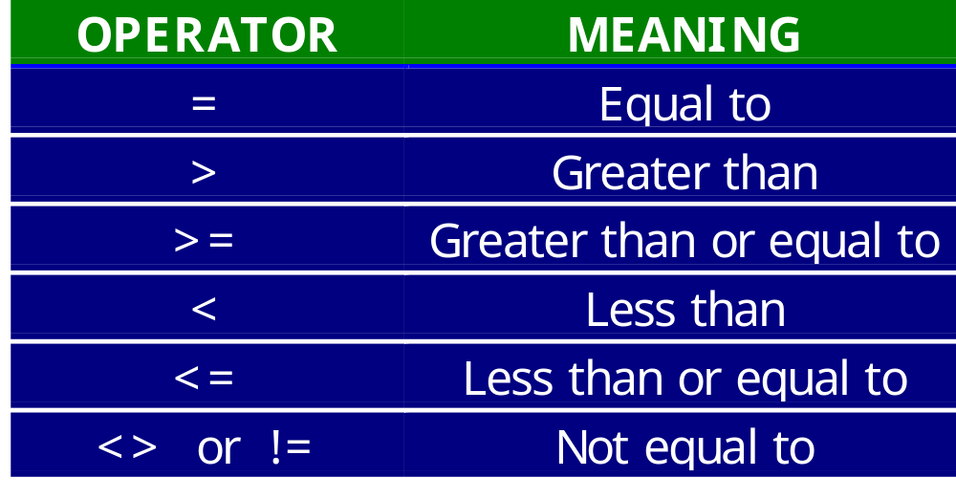
SQL Comparison Operators
Slide <number> of 35

Slide 13
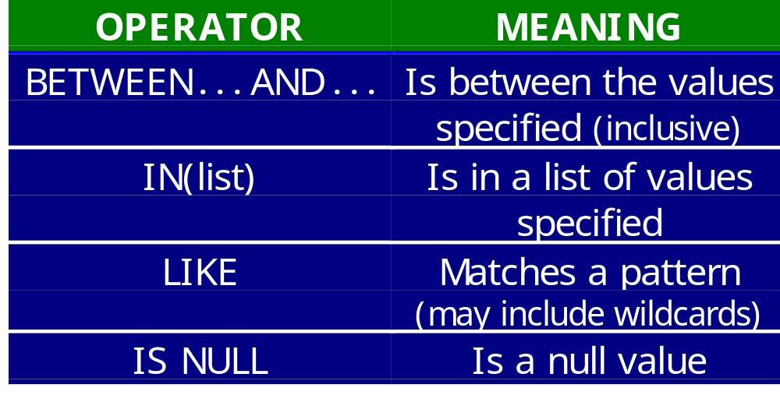
SQL Comparison Operators
Slide <number> of 35

Slide 14
BETWEEN Operator Example
SQL> SELECT ename, sal
2 FROM emp
3 WHERE sal BETWEEN 1000 AND 1500;
ENAME SAL
---------- ---------
MARTIN 1250
TURNER 1500
WARD 1250
ADAMS 1100
MILLER 1300
Slide <number> of 35

Slide 15
IN Operator Example
SQL> SELECT ename, job
2 FROM emp
3 WHERE job IN(‘PRESIDENT’,’MANAGER’);
ENAME JOB
---------- ---------
KING PRESIDENT
BLAKE MANAGER
CLARK MANAGER
JONES MANAGER
Slide <number> of 35

Slide 16
LIKE Operator Example
SQL> SELECT ename
2 FROM emp
3 WHERE ename LIKE ‘J%’;
ENAME
----------
JONES
JAMES
The % is a wildcard character
that stands for zero to many
characters. The underscore
character (_) can be used to
stand for exactly one character.
The LIKE comparison operator is used when using wildcards.
( LIKE is not the same as = )
Slide <number> of 35

Slide 17
IS NULL Operator Example
SQL> SELECT ename, mgr
2 FROM emp
3 WHERE mgr IS NULL;
ENAME MGR
---------- ---------
KING
Slide <number> of 35

Slide 18
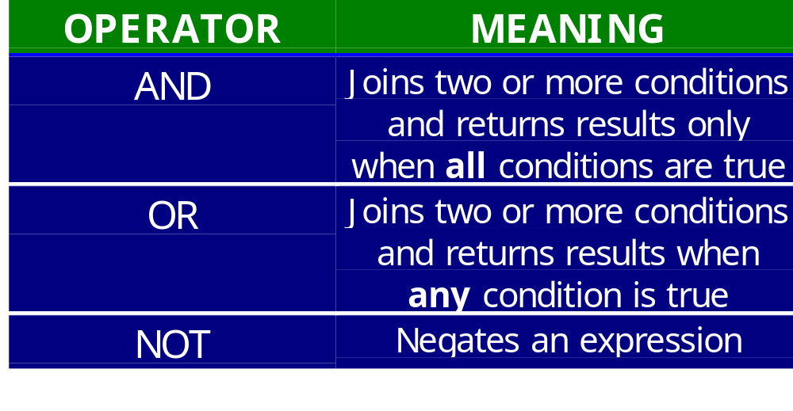
Boolean (Logical) Operators
Slide <number> of 35

Slide 19
AND Operator Example
SQL> SELECT ename, job, sal
2 FROM emp
3 WHERE job = ‘CLERK’
4 AND sal > 1000;
Both conditions
must be true
ENAME JOB SAL
---------- --------- ---------
ADAMS CLERK 1100
MILLER CLERK 1300
Slide <number> of 35

Slide 20
OR Operator Example
SQL> SELECT ename
2 FROM emp
3 WHERE ename LIKE ‘J%’
4 OR ename LIKE ‘M%’;
At least one condition
must be true
ENAME
----------
JONES
MARTIN
JAMES
MILLER
Slide <number> of 35

Slide 21
NOT Operator Example
SQL> SELECT DISTINCT job
2 FROM emp
3 WHERE job NOT LIKE ‘C%’;
JOB
---------
ANALYST
MANAGER
PRESIDENT
SALESMAN
Slide <number> of 35

Slide 22
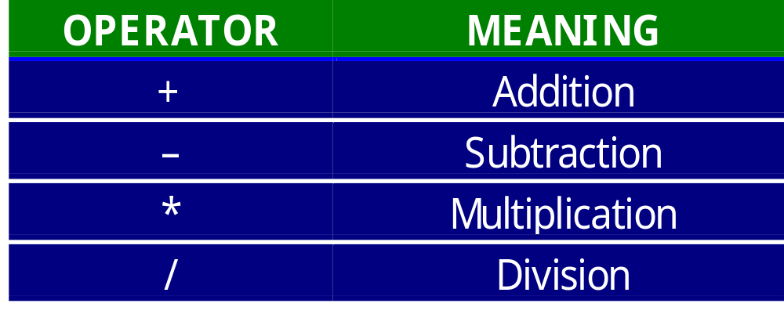
Arithmetic Operators
Slide <number> of 35

Slide 23
Arithmetic Expression Example
SQL> SELECT ename, sal, sal*12 AS annual
2 FROM emp
3 WHERE job = ‘CLERK’;
ENAME SAL ANNUAL
---------- --------- ---------
JAMES 950 11400
SMITH 800 9600
ADAMS 1100 13200
MILLER 1300 15600
Slide <number> of 35

Slide 24
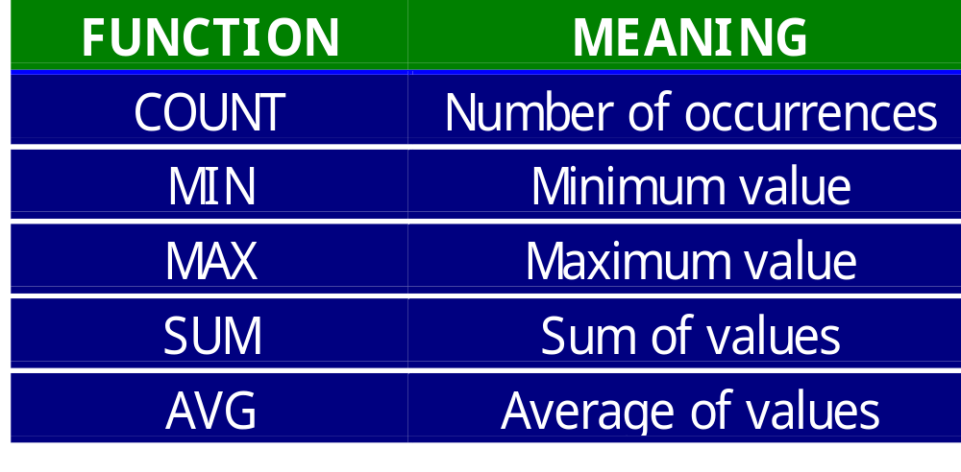
Aggregate Functions
Slide <number> of 35

Slide 25
Aggregate Function Example
SQL> SELECT AVG(sal) AS “SALARY AVG”
2 FROM emp
3 WHERE job = ‘SALESMAN’;
SALARY AVG
----------
1400
Slide <number> of 35

Slide 26
Aggregate Function Example
SQL> SELECT COUNT(*)
2 FROM emp;
COUNT(*)
---------
14
Note: COUNT(*) returns the number of rows in a table
while COUNT(field)
returns the number
of rows that are
nonnull for the
field counted
Slide <number> of 35

Slide 27
Sorting Rows with ORDER BY
SQL> SELECT ename, job, sal
2 FROM emp
3 ORDER BY ename;
ENAME JOB SAL
---------- --------- ---------
ADAMS CLERK 1100
ALLEN SALESMAN 1600
BLAKE MANAGER 2850
CLARK MANAGER 2450
FORD ANALYST 3000
... ... ...
Slide <number> of 35

Slide 28
Sorting by Multiple Fields
SQL> SELECT ename, job, sal
2 FROM emp
3 ORDER BY job, ename;
The order of the
list determines
the precedence
of the sort order
ENAME JOB SAL
---------- --------- ---------
FORD ANALYST 3000
SCOTT ANALYST 3000
ADAMS CLERK 1100
JAMES CLERK 950
MILLER CLERK 1300
... ... ...
Slide <number> of 35

