Slide 1
DBMS

Slide 2
DATABASE EXAMPLES
Database is involved like everywhere in our world
For example:
If we go to bank to deposit or withdraw
Make hotel and airline reservation
Purchase something on line
Buy groceries in supermarkets

Slide 3
DATABASE APPLICATIONS
These examples are what we called traditional database applications
More Recent Applications:
  Youtube
  iTunes
  Geographic Information Systems (GIS)
  Data Warehouses
  Many other applications

Slide 4
DATABASE CAN BE ANY SIZE AND COMPLEXITY
For example:
A list of names and address
IRS – Internal Revenue Service
(assume it has 100 million taxpayers and each taxpayer file 5 forms with 400 characters of information per form=800Gbyte)
Amazon.com
(15 million people visit per day; about 100 people are responsible for database update)
Facebook.com

Slide 5
DATABASE SYSTEM
Database:
  A collection of related data.
Data:
  Known facts that can be recorded and have an
  implicit meaning.
Database Management System (DBMS):
  A software package/system to facilitate the
  Define, Construct, Manipulate and Share functions of a computerized database.

Slide 6
TYPICAL DBMS FUNCTIONALITY
Define a particular database in terms of its data types, structures, and constraints
Construct or Load the initial database contents on a secondary storage medium
Manipulate the database:
  Retrieval: Querying, generating reports
  Modification: Insertions, deletions and updates to its content
  Accessing the database through Web applications
Share a database allows multiple users and programs to access the database simultaneously

Slide 7
DATABASES…
Information Systems process and manage data.
Data Management involves “Capturing”, “Retrieval,” and “Storage” of data.
Database Management Systems (DBMSs) are Computer systems that manage data in databases.
Today’s DBMSs are based on sophisticated software and powerful computer hardware.
Well known DBMS software includes ORACLE, Microsoft SQL Server, Sybase and MySQL(free download) among others.

Slide 8
FILE ORGANISATION
Sequential Files
records are stored in a fixed sequence
records can only be read in that sequence, starting from the first record
records can only be added at the end of the file (append)
sequential files are not efficient
Indexed Files
Use an index to access records in a random fashion.
Records can be sorted according to an attribute or preference. (e.g Alphabetically, Ascending, Descending, etc.)
Indexed files are efficient, and faster to access.

Slide 9
THE FILE SYSTEMS APPROACH
General
Ledger
Personnel
Redundant Data Storage.
One file is used in each application.
No data sharing.
Cross-application transfers are difficult to manage and achieve.
File Systems are rarely used for data processing anymore.
File
File
Production
Planning
Payroll
File
File
Invoicing
Inventory
File
File
Despatch
Order
Entry
File
File

Slide 10
THE DATABASE APPROACH
General
Ledger
Personnel
Compactness. Data is stored in a single logical “place.”
Data can be shared and related between applications
Data transfer between applications is easier
Used for a wide range of applications.
Production
Planning
Payroll
Database
Invoicing
Inventory
Despatch
Order
Entry

Slide 11
AN UNIVERSITY EXAMPLE
A UNIVERSITY database for maintaining information concerning students, courses, and grades in a university environment
We have:
STUDENT file stores data on each student
COURSE file stores data on each course
SECTION file stores data on each section of each course
GRADE_REPORT file stores the grades that students receive
PREREQUISITE file stores the prerequisites

Slide 12
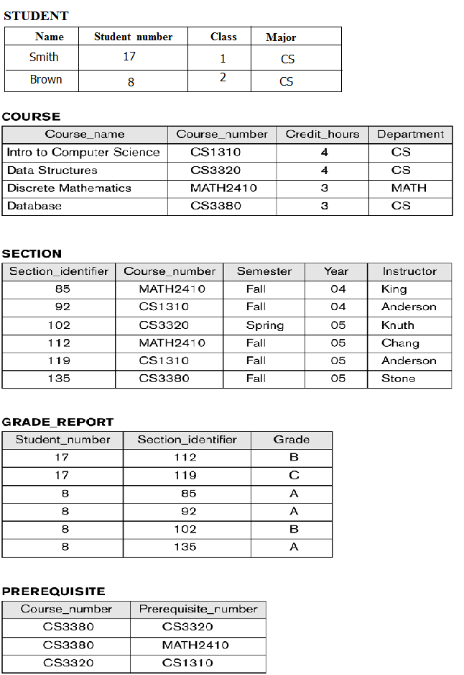
EXAMPLE OF A SIMPLE DATABASE

Slide 13
DATABASE MANIPULATION
Database manipulation involves querying and updating
Examples of querying are:
Retrieve a transcript
List the prerequisites of the “Database” course
Examples of updating are:
Enter a grade of “A” for “Smith” in “Database” course

Slide 14
ADVANTAGES OF USING A DATABASE APPROACH
Flexible Data Access.
DBMSs have various tools to manipulate, query, or report data, such as Structured Query Language (SQL), and Report Generators. Hence:
  Selected data is easily retrieved
  A DBMS can accommodate different data views for different users
Improved Data Integrity. Modern DBMSs consist of various tools and methods to:
  ensure that data is correct, consistent, and current
  verify data input and check whether data is ‘reasonable’.

Slide 15
ADVANTAGES OF DBS (CONTINUED)
Improved Data Security. Tools such as password access, and encryption, ensure that data is not:
  deliberately or accidentally damaged or changed
  accessed without proper authorisation
Reduced Data Redundancy.
  Single version of the truth.
  Efficient data storage.
  Efficient time management of Hardware (CPU), programmer(s), analyst(s) and user(s).
  Relational DBs use Normalisation to reduce data redundancy.

Slide 16
ADVANTAGES OF DBS (CONTINUED)
Ability to Share and Relate Data.
  Different user groups can use the same data.
  Data in different (physical or logical) parts of the system can be related for a certain application.
Standardisation of Data.
  In general data items have common names and storage format.
Increased Productivity.
  The various tools reduce the complexity that is otherwise associated with DB maintenance when changes are required to the system. For example Law changes, Economy Changes, User Changes.

Slide 17
COSTS OF DATABASE APPROACH
The implementation and use of DBMSs is normally associated with various costs. Such as:
  Initial expenses involve planning costs, and consultancy fees.
  Computer hardware costs.
  Software costs.
  Database Administrator costs, and staff training costs.
  Conversion costs of an existing system.
  Various operational costs.

Slide 18
DATABASE V.S. FILE
In the database approach, a single repository of data is maintained that is defined once then accessed by various users
The major differences between DB and File are:
Self-describing of a DB
Insulation between programs and data
Support of multiple views of the data
Sharing of data and multiuser transaction processing

Slide 19
THE FILE SYSTEMS APPROACH
General
Ledger
Personnel
File
File
Production
Planning
Payroll
File
File
Invoicing
Inventory
File
File
Despatch
Order
Entry
File
File

Slide 20
SELF-DESCRIBING NATURE OF A DATABASE SYSTEM
Database system contains not only the database itself but also a complete definition of the database structure and constrains
The information stored in the catalog is called Meta-data (data about data), and it describes the structure of the primary database.

Slide 21

EXAMPLE OF A SIMPLIFIED META-DATA

Slide 22
INSULATION BETWEEN PROGRAMS AND DATA
In file processing, if any changes to the structure of a file may require changing all programs that access the file
In database system, the structure of data files is stored in the DBMS catalog separately from the access program
This is called program-data independence

Slide 23
SUPPORT OF MULTIPLE VIEWS OF THE DATA
Each user may see a different view of the database, which describes only the data of interest to that user
It may also contain some virtual data that is derived from the database files but its not explicitly stored

Slide 24
SHARING OF DATA AND MULTI-USER TRANSACTION PROCESSING
Allowing a set of concurrent users to retrieve from and to update the database.
Concurrency control within the DBMS guarantees that each transaction is correctly executed or aborted
  For example, when several reservation clerks try to assign a seat on an airplane flight
  (these types of applications are generally called online transaction processing (OLTP))

Slide 25
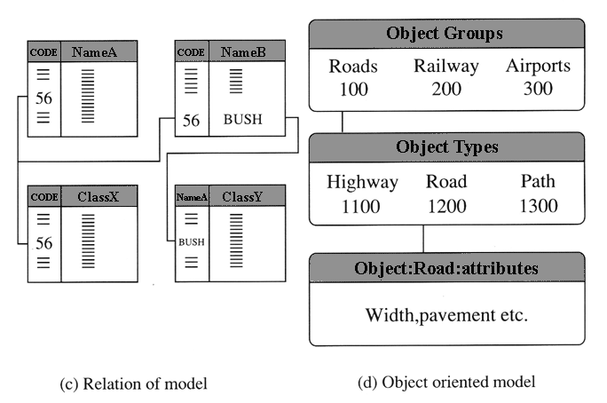
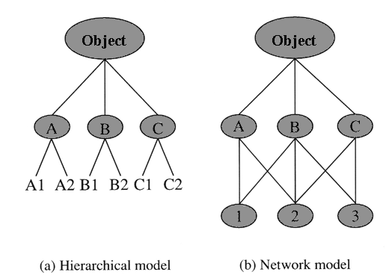
DATA MODELS
Relational
Object
Hierarchical
Network

Slide 26
1. HIERARCHICAL MODEL
Stores data as hierarchically related to each other. Record shape are tree structure.
NSBM
Faculty of
Engineering
Faculty of
IT
CE
EE
PLY
UCD

Slide 27
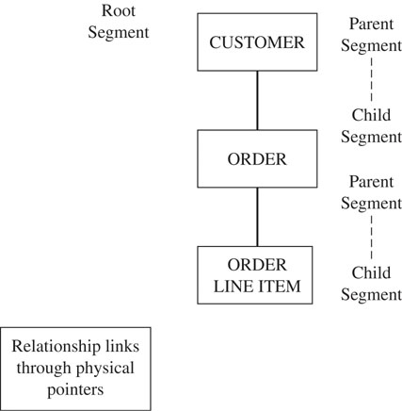
HIERARCHICAL DATABASE MODEL

Slide 28
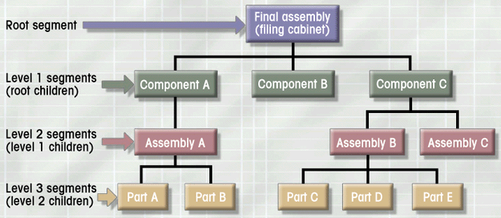
HIERARCHICAL DATABASE MODEL
Logically represented by an upside down tree
  Each parent can have many children
  Each child has only one parent

Slide 29
HIERARCHICAL MODEL
Several records or files are hierarchically related with each other. For example, an organization has several departments, each of which has attributes such as name of director, number of staffs, annual products etc.
Each department has several divisions with attributes of name of manager, number of staffs, annual products etc.
Then each division has several sections with attributes such as name of head, number of staff, number of PCs etc.

Slide 30
ADVANTAGE AND DISADVANTAGES OF HIERARCHICAL MODEL
Advantages
  High speed access to large databases
  Easy to update- (to add or delete new nodes)
Disadvantages
  Links are only possible in Vertical Direction (from top to bottom) but not for horizontal or diagonal unless they have same parents.
  For example, it is hard to find what is the relation between URP and DCE from this data model.

Slide 31
2. NETWORK DATABASE MODEL
Doesn’t force data into hierarchical levels
Owner/Member relationships:
  Owner record type
  Member record type
Each owner may have one or more member types
Each member type and corresponding owner record type form set, which represents relationship

Slide 32
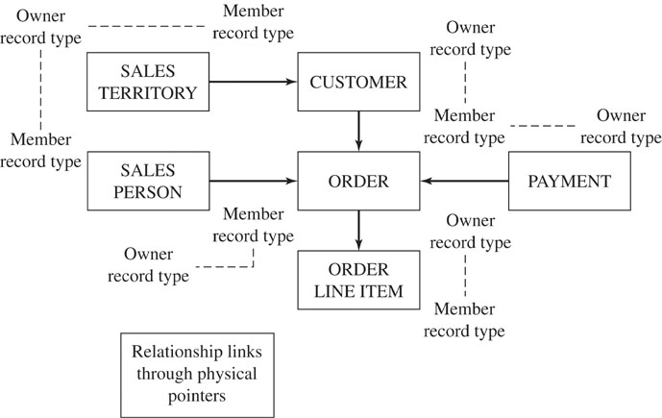
NETWORK DATABASE MODEL

Slide 33
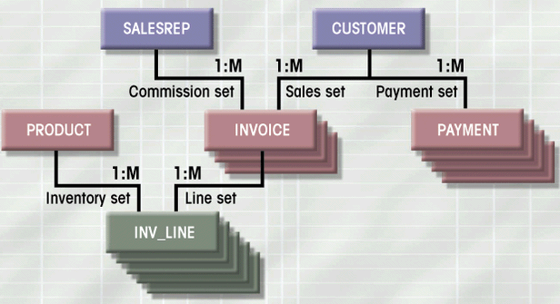
NETWORK DATABASE MODEL
Each record can have multiple parents
  Composed of sets - relationships
  Each set has owner record and member record
  Member may have several owners
  A set represents a 1:M relationship between the owner and the member
Figure 1.10

Slide 34
3. RELATIONAL MODEL
Student Table
Student ID | Name | CourseID
1 | Mr. X | 001
2 | Mr. X | 002
3 | Mr. Y | 003
Based on two important concepts:
  Key of relation - one to one, one to many, many to many
  Primary attribute – which can’t be duplicate
Course table
CourseID | Title | Credit
001 | RS & GIS in WM | 3
002 | Watershed Hydrology | 3
003 | Risk Management | 3
*
*
Course Table
Student Table
Many to many relationship

Slide 35
RELATIONAL DATABASE
Relational database is the most popular model. For example, the following relational database softwares are widely used.
In a relational model, the following two important concepts should be defined.
Key of relation ; a subset of attributes
Unique identification ; e.g. the key attributes is a phone directory in a set of last name, first name and address.
non redundancy ; any key attribute selected and tabulated should keep the key's uniqueness. e.g. address can not be dropped from telephone address, because there may be many with the same names.
Prime attribute : an attribute listed in at least one key.
The most important point of the relational database design is to build a set of key attributes with a prime attribute, so as to allow dependence between attributes as well as to avoid loss of general information when records are inserted or deleted.

Slide 36
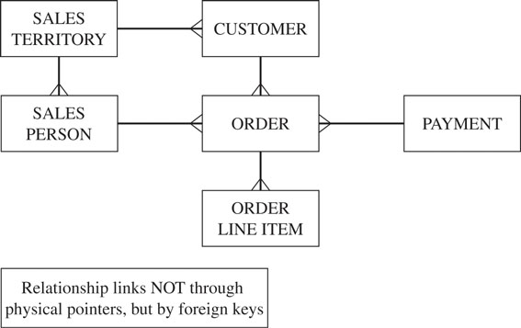
RELATIONAL DATABASE MODEL

Slide 37
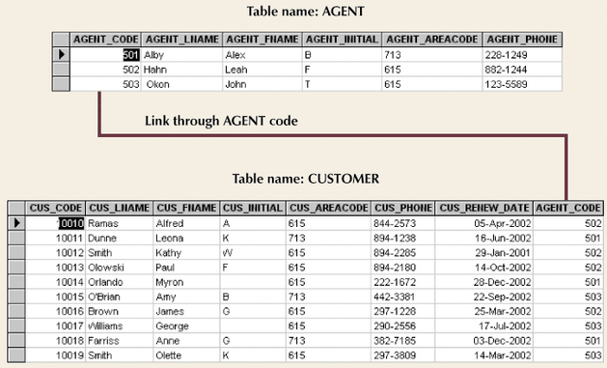
RELATIONAL DATABASE MODEL
Figure 1.11

Slide 38
4. OBJECT DATABASES
Current generation systems have a need to handle complex data for complex applications such as
  computer aided design
  computer aided software engineering
  geographic information systems
  interactive web sites

Slide 39
OBJECT DATABASE TYPES
Object-oriented
  extend a programming language such as Java with persistency and a query language
Object-relational
  extend a current RDBMS (e.g. Oracle) with object-oriented extensions

Slide 40
OBJECT ORIENTED MODEL
NSBM
Part of
Part of
Departments
Faculties
Is a
Is a
Is a
Finance
HR
Eng
IT
Business
sales
Is a = Inheritance
Part of = association
Attributes:
Faculty, Staff, Students

Slide 41
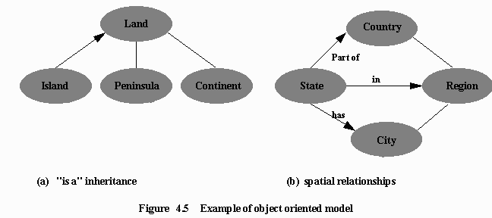
EXAMPLE OF OBJECT ORIENTED MODEL

Slide 42
5. OBJECT-RELATIONAL DATABASE MODEL
Object-relational database management systems (ORDBMS):
  Combine:
    Ability of object technology to handle advanced relationship types
    Data integrity, reliability, and recovery features of relational models
  Most popular and powerful of modern database system applications
    Oracle, Microsoft SQL Server

Slide 43
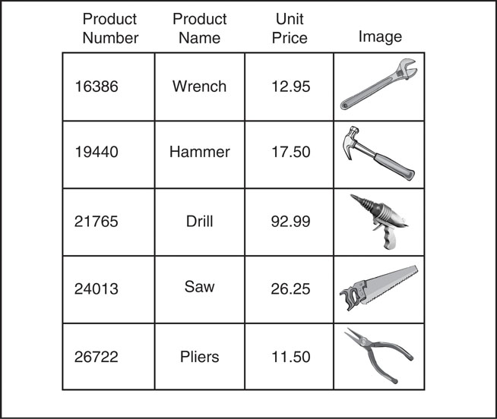
OBJECT-RELATIONAL DATABASE TABLE

