Slide 1
Epistemic Modal Logic MTH 701
Ayush Tharwani
170201

Slide 2
Contents
Introduction
Examples
Syntax
Semantics
Group Knowledge
Bisimulation
Decidability

Slide 3
Introduction

Slide 4
Epistemic modal logic is a subfield of modal logic that is concerned with reasoning about knowledge.
In this, we try to represent the knowledge generally expressed in natural language in a logical form.

Slide 5
Examples

Slide 6
Bob is invited for a job interview with Alice. They have agreed that it will take place in a coffeehouse downtown at noon, but the traffic is quite unpredictable, so it is not guaranteed that either Alice or Bob will arrive on time. However, the coffeehouse is only a 15-minute walk from the bus stop where Alice plans to go, and a 10-minute walk from the metro station where Bob plans to go. So, 10 minutes before the interview, both Alice and Bob will know whether they themselves will arrive on time. Alice and Bob have never met before.

Slide 7
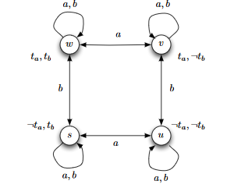
Kripke model describing the situation looks this .

Slide 8
Suppose that at 11:50, both Alice and Bob have just arrived at their respective stations. Taking ta and tb to represent that Alice (resp., Bob)arrive on time, this is a situation (denoted w in Figure) where both ta and tba re true. Alice knows that ta is true (so in w we have Ka_ta), but she does not know whether tb is true; in particular, Alice considers possible the situation denoted v in Figure 1.2, where ta and ¬tb holds. Similarly, in w, Bob considers it possible that the actual situation is s, where Alice is running late but Bob will make it on time, so that ¬ta and tb holds. Of course, in s, Alice knows that she is late; that is, Ka_¬ta holds. Since the that Bob considers possible at world w are w and s, he knows that he will be on time (Kb_tb), and knows that Alice knows whether or not she is on time (Kb_(Ka_ta or Ka_¬ta)). Note that the latter fact follows since Ka_ta holds in world w and Ka_¬ta holds in world s, so Ka_ta or Ka_¬ta holds in both worlds that Bob considers possible situations.

Slide 9
Syntax

Slide 10
Modal Operators
Knowledge Operator (Ka X) : Defined as an agent a knows X.
Belief Operator (Ba X) : Defined as an agent a knows X.

Slide 11
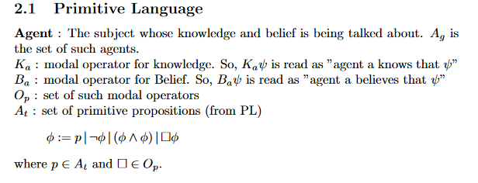
Primitive Language

Slide 12
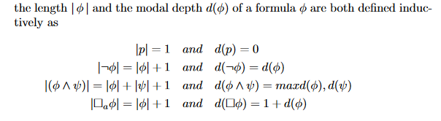
Length and Modal Depth of formulae

Slide 13
Semantics

Slide 14
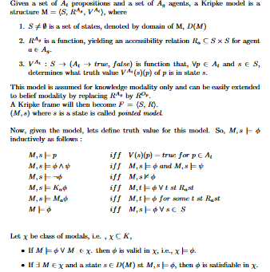
Kripke Model

Slide 15
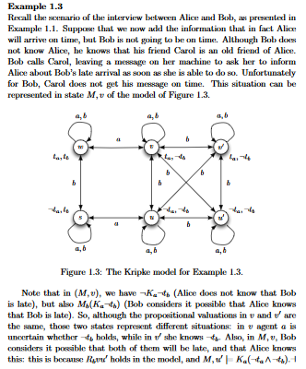
Example

Slide 16
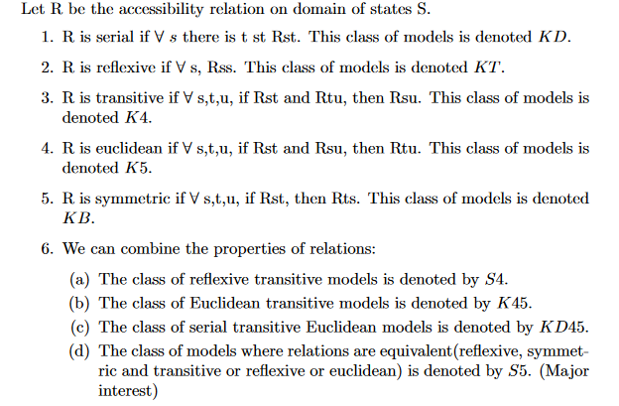
Frame Properties

Slide 17
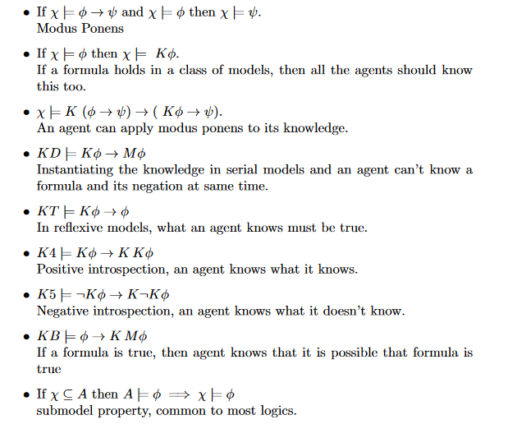
Examples of Some Valid Formulae

Slide 18
Notions of Group Knowledge

Slide 19
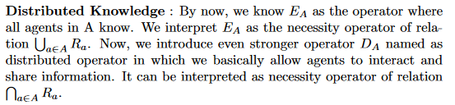
Distributed Knowledge
Knowledge that emerges when agents are allowed to communicate.

Slide 20
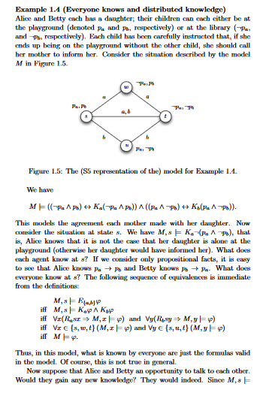
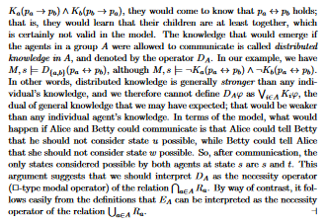
Example

Slide 21

Common Knowledge

Slide 22
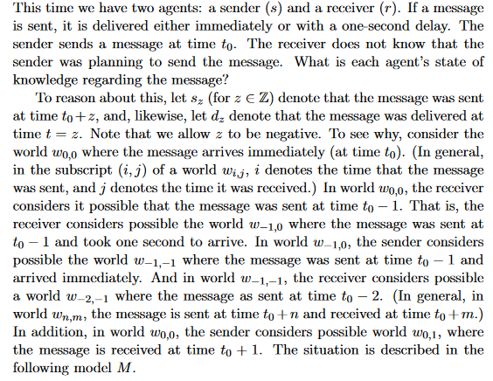
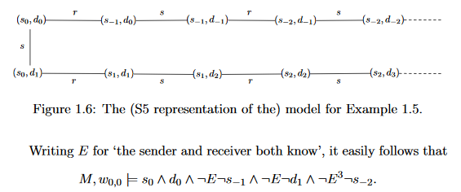
Example

Slide 23
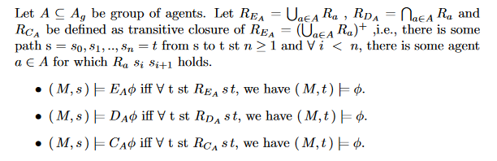
Formal Semantics of Group Knowledge

Slide 24
Bisimulations

Slide 25
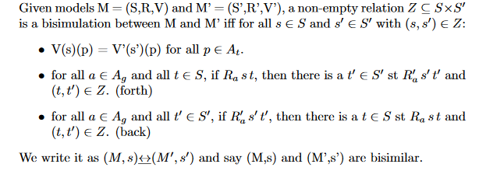
Definition

Slide 26
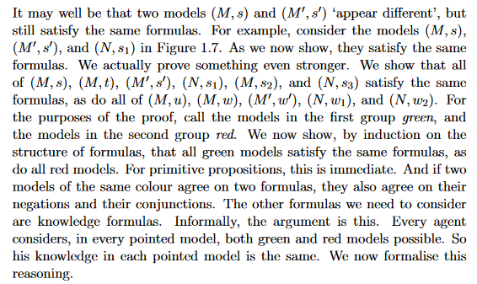
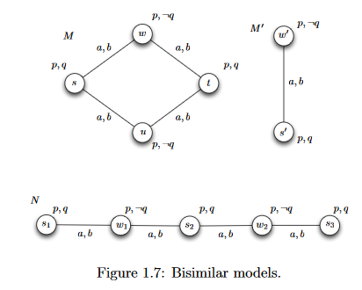
Example

Slide 27

Preservation Under Bisimulation
The Proof is there in write-up.

Slide 28
Decidabililty

Slide 29
Defintion
A decidability problem checks some input for some property, and returns ‘yes’ or ‘no’

Slide 30
Three Major Problems in Decidability
Model Checking
Satisfiability
Validity

Slide 31
Model Checking

Slide 32
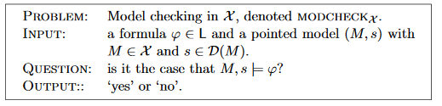
Problem Statement

Slide 33
Complexity
The Proof is in the write-up.

Slide 34
Satisfiability

Slide 35
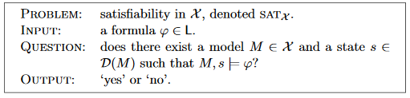
Problem Statement

Slide 36
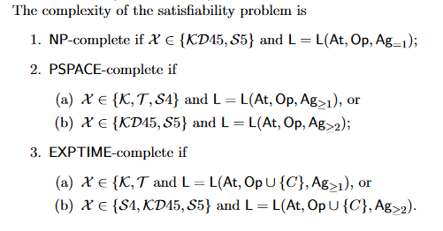
Complexity

Slide 37
Validity

Slide 38
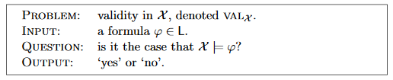
Problem Statement and Complexity
The Complexity of the problem of Validity is same as that of satisfiability because a formula is valid iff its negation is not satisfiable.

Slide 39
Thank You

